Slide 1
Enron Energy Services All Employee Meeting
March 27, 2001

Slide 2
Agenda
Introduction
Vision
Expectations
2000 Review
Customer Video
2001 Targets
Retail Market Overview
Strategy/Themes
Organization
Awards
Q & A
Close

Slide 3
Introduction
Perceptions:
Market is “ripe” for EES value proposition
Basic retail value proposition is on solid footing
Earnings power of the organization is high despite recent market and organization turmoil
Deregulation and access is important
High-quality people
Not without our challenges that need to be addressed now if we are to reach our goals in the future
These challenges are consistent with the lifecycle growing pains of other successful Enron businesses
It is time to make the move from “concept stock” or start-up to a consistent and growing earnings performer in the Enron family

Slide 4
Agenda
Introduction
Vision
Expectations
2000 Review
Customer Video
2001 Targets
Retail Market Overview
Strategy/Themes
Organization
Awards
Q & A
Close

Slide 5
Vision
Enron’s New Vision:
From “The World’s Leading Energy Company” to…“The World’s Leading Company”
EES’s Vision:
“The World’s Leading Energy Retailer and Enron’s Leading Division”
As Defined By:
The Talent of Our Employees
Our Work Ethic
Our Innovation
Our Growth and Profitability
Our Customer Relationships
Our Integrity
In How We Work With Each Other
Our Culture of Success, Hard Work and Fun
This is the place to be in Enron!

Slide 6
Agenda
Introduction
Vision
Expectations
2000 Review
Customer Video
2001 Targets
Retail Market Overview
Strategy/Themes
Organization
Awards
Q & A
Close

Slide 7
Expectations
Meet Our Financial and Non-Financial Targets
Build for the Future
Focused and Accountable
High Performance Culture
Nimble/Continual Reinvention
Open Communication, Respect and Integrity: “No separate agendas or games”
Work Hard/Play Hard
Tight Business Plans and Crisp Execution
Earnings Machine
Continual Personal and Corporate Growth: “Raising the Bar”
Understanding of Value and Continual Innovation
Individual and Corporate Integrity

Slide 8
Agenda
Introduction
Vision
Expectations
2000 Review
Customer Video
2001 Targets
Retail Market Overview
Strategy/Themes
Organization
Awards
Q & A
Close

Slide 9
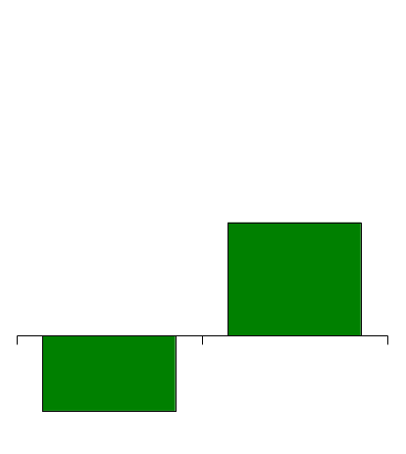
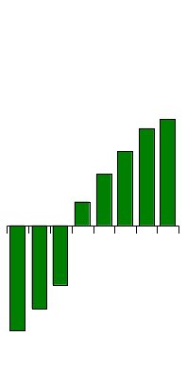
Enron Energy Services EBIT
Quarterly
(Millions)
Annual (Millions)
$30
$33
$103
$24
$16
$50*
$7
Q199
Q299
Q399
1999
Q499
Q100
Q200
Q300
Q400
2000
($18)
($68)
($26)
*Original Target
($31)

Slide 10
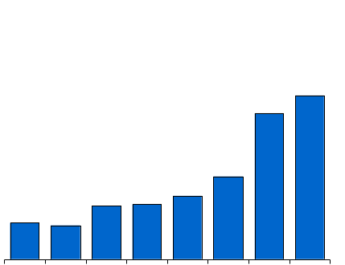
Enron Energy Services Revenues
Quarterly
(Millions)
Annual (Billions)
$1,657
$1,476
$840
$4.6
$642
$542
$556
-8.1%
$370
$340
$1.8
Q199 Q299 Q399 Q499 Q100 Q200 Q300 Q400
1999
2000

Slide 11
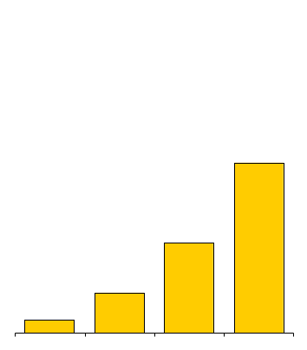
Enron Energy Services TCV Growth (Billions)
$16.1
$8.5
$3.8
$1.7
1997 1998 1999 2000
TCV = Total Contract Value

Slide 12
2000 Achievements
Customer Satisfaction
Achieved 4.0 on overall account management satisfaction which meets the referral threshold
Did not meet 4.2 goal on overall satisfaction due to average scores in billing. 4th quarter trend improving in billing
Achieved 4.1 on likelihood to recommend Enron
Employee Satisfaction and Development:
Significantly improved ETC response rates on 5 key communication questions
E-commerce
Piloted San Diego microsite for customer acquisition
Diversity
Achieved 10% MWBE procurement, meeting corporate goal
Achieved EES Chairman Top 30 diversity hiring goals

Slide 13





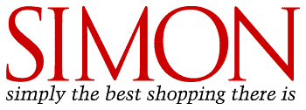






















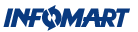



































2000 Achievements Our Customers
Structure

Slide 14

2000 Achievements Europe
Gross Margin (Millions)
EBIT (Millions)
94
52
21
14
1999
2000
1999
2000

Slide 15
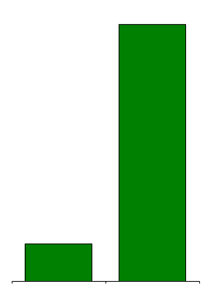
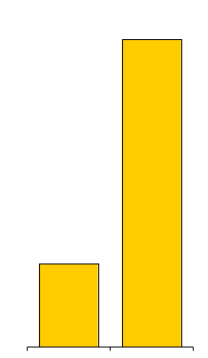
2000 Achievements: Europe/Enron Direct
Customer Sites
Electricity Volumes
(Twh)
Headcount
134,000
11.7
188
51
27,000
1.7
1999
2000
1999
2000
1999
2000

Slide 16
Agenda
Introduction
Vision
Expectations
2000 Review
Customer Video
2001 Targets
Retail Market Overview
Strategy/Themes
Organization
Awards
Q & A
Close

Slide 17
Agenda
Introduction
Vision
Expectations
2000 Review
Customer Video
2001 Targets
Retail Market Overview
Strategy/Themes
Organization
Awards
Q & A
Close

Slide 18


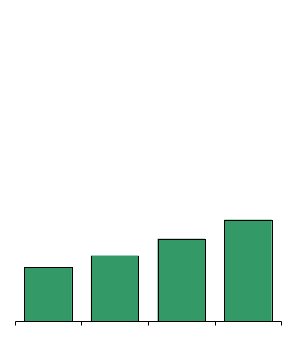
2001 Financial Targets EBIT
2000 Actual
(Millions)
2001 Targets
(Millions)
$225
$103
$75
$61
$49
$40
2000
Q1 Q2 Q3 Q4
2001E

Slide 19
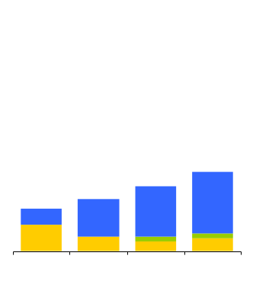

2001 Financial Targets EBIT By Geography
2001 Targets
(Millions)
$225
USA
Canada
Europe
155
$75
$61
10
$49
$40
15
35
47
58
25
14
5
12
5
60
9
Q1 Q2 Q3 Q4
2001E

Slide 20


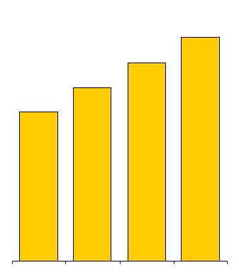
2001 Financial Targets TCV
2000 Actual
(Billions)
2001 Targets
(Billions)
$30
$16
$9
$7
$8
$6
2000
Q1 Q2 Q3 Q4
2001E

Slide 21
2001 Non-Financial Goals
Customer Satisfaction
Increase number of customers above 4.0 referral target by 20%.
Enhance the Customer Satisfaction program to accommodate growing customer base.
Employee Satisfaction & Management Development
Drive continued improvement on “Pulse” survey’s 5 core communication questions
Substantially upgrade training and development across all EES
Diversity
Increase MWBE procurement - Goal: 12%
Implement integrated diversity program to improve AAP underutilized job groupings: within 80% of AAP goal in all classifications

Slide 22
Agenda
Introduction
Vision
Expectations
2000 Review
Customer Video
2001 Targets
Retail Market Overview
Strategy/Themes
Organization
Awards
Q & A
Close

Slide 23
Fundamental Improvement In Market Environment
Despite turmoil in California, re-regulation for “our” target customers unlikely
Increasing backwardation and upward shift in energy prices plus increasing volatility has significantly increased demand for Enron products and improved Enron value proposition in regulated and deregulated jurisdictions
Utilities will abandon regulated merchant services, expanding retail opportunities
Legislative deregulation most likely to slow…Need to find innovative new channels to achieve “access” in short run
Private branding/ white labeling of our products
Muni “opt out”
Merchant acquisition of customers in large blocks
In the medium- and long-run continue to press for deregulation and choice

Slide 24
California
Continue to honor our customer commitments
“Re-sourced” power to utilities given PG&E and SoCal Edison’s failure to pay the negative CTC
Bail out of utilities through state acquisition of transmission increasingly likely
Probability of collection of negative CTC receivable very high
Neither EES nor Enron will be negatively financially affected by California
Fundamental problems in California are:
Short supply given high demand growth
No new construction in years and difficult permitting and construction environment
Dry Pacific Northwest
Fixed tariff eliminated price signals to consumers
California authorities are not fixing the fundamental problems: This summer could be very difficult
Choice for California’s larger customers (C&I) is increasingly likely

Slide 25
Why Re-Regulation Won’t Happen
Stranded Cost Recovery (Since 1998)
38 Utilities Recovering Stranded Costs
$50 Billion Collected
Utility Unbundling (Since 1998)
Mergers / Acquisitions
(Since 1996)
54 Utilities Unbundling
$40 Billion in Generation Sold
69 Mergers Involving Utilities
26 Mergers Where Electric Utility Assets Changed Hands
18 Mergers Pending

Slide 26
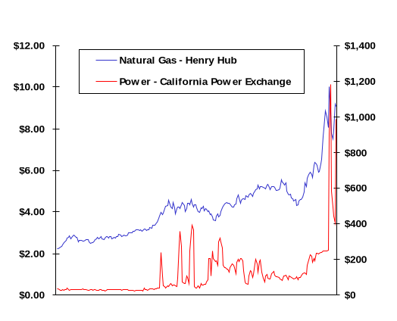
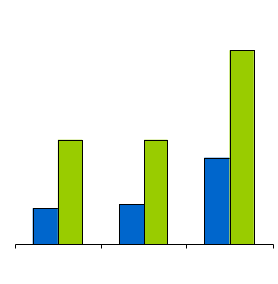
Energy Price Impact On Companies’ Operating Expenses
2000 Commodity Prices
Energy Cost as % of Total Operating Expenses
Nat. Gas
($/mmbtu)
Power
($/MWh)
Jan.-00
Dec.-00
54%
29%
29%
24%
10%
11%
Jan. 00
Dec. 00
Fast Food
Restaurant
Hotel
Mall
With or Without Deregulation, Impact of Rising Energy Costs Will Increase Demand For Enron Products

Slide 27
Agenda
Introduction
Vision
Expectations
2000 Review
Customer Video
2001 Targets
Retail Market Overview
Strategy/Themes
Organization
Awards
Q & A
Close

Slide 28
Strategy/Themes
Increased focus on value
Significant increase in accountability
Build a scalable business model: process, components and standardization
Employ the “right” business model for the chosen market
Greater understanding of risk and a more complete accounting for risk and costs in our contract pricing
Respect for process, controls and approvals: the basics of business
Better alignment & coordination: one strategy, one agenda and one company
Knowledge-based organization: “packaging” not “heavylifting”
Crisper execution
Need to start considering our balance sheet and funds flow (cash) in our business
Need to enforce and protect our agreements: protect value and trade up
Demand excellence: cultivate high performers - quickly manage performance issues

Slide 29
Strategy/Themes
Technology is core and strategic
More market signals moving quicker from the back to the front
Greater velocity and number of new products: must accelerate the innovation in our DSM product - focus on commodization and curtailment
Eliminate distractions and none-core business
Shorten deal closure cycles and increase deal velocity
Restructure our pricing, delivery and execution infrastructure
Low cost provider: best-in-class customer acquisition and maintenance costs
Explore new templates appropriate for our markets that make us more responsive: legal, credit, finance, regulatory and risk
Manage, price and compartmentalize risk more comprehensively
Eliminate hierarchies, flatten the organization - promote a partnership
Laser focus on growth, innovation and earnings

Slide 30
Agenda
Introduction
Vision
Expectations
2000 Review
Customer Video
2001 Targets
Retail Market Overview
Strategy/Themes
Organization
Awards
Q & A
Close

Slide 31
Organization
General:
Need to address these plus other issues - NOW!
Re-organization promotes and solves many of our issues
May take a quarter or two to fully reach the benefits
In the meantime, stay focused - particularly Q2
Change is positive and healthy

Slide 32
Organization
Partnership Model:
In the interest of reducing hierarchies, flattening the organization and enfranchising our leaders, we are creating the EES Executive Committee and EES Operating Committee
Groups will meet periodically to discuss and implement broad strategy, tactical objectives and organizational issues

Slide 33
Organization
EES Office of the Chairman
Energy Outsourcing Mann
Energy Portfolio Mgmt Blachman
Enron Direct USA Gahn
Structuring Holmes
Risk Mgmt & Sourcing Black
New Business Ventures Muller
Europe Scrimshaw
Product Management Zdunkewicz/ Wood
Process & Resource Re-Engineering Messina/Spruiell
Canada Milnthorp
EFS Earle/Whaley

Slide 34
Support Services
EES Office of the Chairman
Legal Sharp
Human Resources Pieper
Finance/CFO Lipshutz
MarCom/ Customer Loyalty/PR Tilney
Regulatory Steffes
IT Dayao/ Harris
Financial Ops K. Hughes
Risk Control & Ops Curry

Slide 35
Segments
EES Office of the Chairman
Energy Outsourcing
Mann
Energy Portfolio Mgmt Blachman
Enron Direct USA Gahn
Client Management Muench
Product Management Zdunkewicz/Wood

Slide 36
Segments
General:
Separate marketing strategy and products from target market and business model
May be very different business models, cultures, cost structures, etc. employed across these segments but share common scale services
Bright line customer ownership across these segments: in progress
Each business team responsible for:
Marketing strategy: “outsourcing, “regional commodity”, “Enron Direct”, “certified energy planner”, etc. (may be more than one)
Further segmentation/channels
Product definition and sales
Acquisition and maintenance model
EBIT targets
Value focus
Agreement on customer split between wholesale and retail in progress - memo to follow

Slide 37
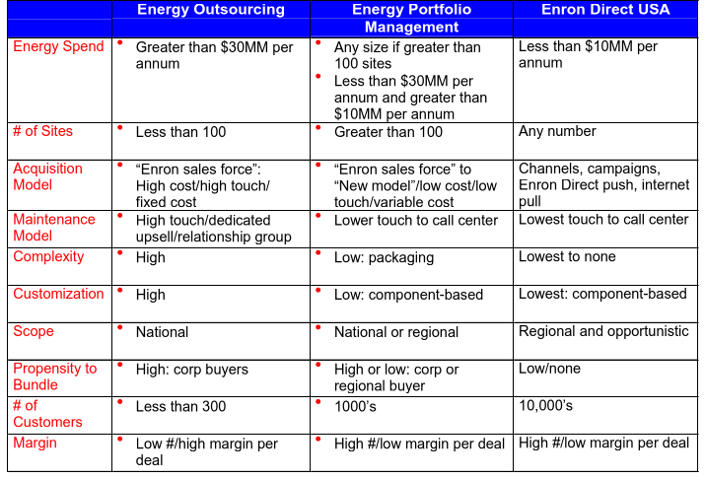
Segments

Slide 38
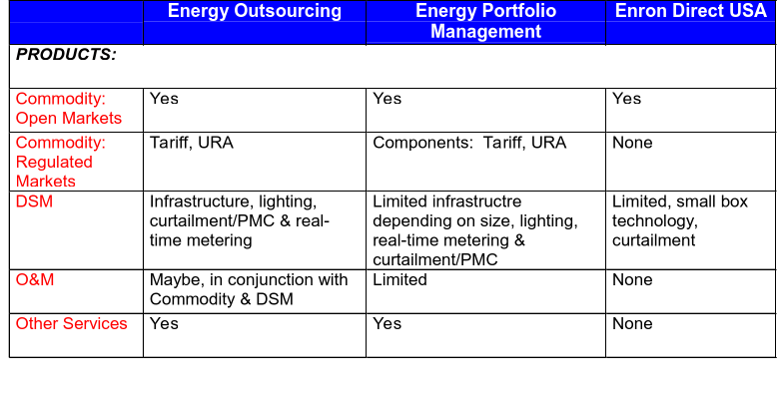
Segments (cont’d)

Slide 39
Client Management
Need to “commercialize” and align with the Energy Outsourcing business: current account management and VEG functions
Vision:
Sized/designed to match segment and maintenance model
Reduce redundancy, client confusion and increased commercial focus
Align with the segment or channel
Manage customer satisfaction plus protect and enhance the value of the portfolio
Broaden objective:
Subject matter specialists
Client satisfaction
Non-structured up sell
Will manage client satisfaction for both the Energy Outsourcing and Energy Portfolio Management Groups until the EPMG group determines its best course of action
Structured and strategic upsell
Restructurings - entire portfolio
URS/Soft option execution

Slide 40
Product Management Group
“Nests”: product development and management groups inside all three segments accountable to the segment leaders
Maintains a number of centralized responsibilities, as a result reports to the OOC as well
Vision:
“Nests”
Broadly increases our products available to the channels
Dramatically increases the velocity of new innovative product development
Taps into other new product components like “weather”, etc.
Provides deal support and pricing matrices
Central
Rapidly shares new innovations and technologies across all the segments

Slide 41
Product Management Group
Vision (cont’d):
Central
Promotes greater communication across the organization to the sales forces and the channels
Products
Market signals
Prices
Develop technology tools - Intranet or internet communication
Provides comprehensive economics for deals, campaigns and new business initiatives
Develops standard product components (assuming demand, basic product terms and conditions, pricing parameters and profitability)
Defines and implements appropriate procedures and processes
Works closely with the Structuring group to manage deal flow
Manages the deal pipeline

Slide 42
Segments
EES Office of the Chairman
Energy Outsourcing
Mann
Energy Portfolio Mgmt Blachman
Enron Direct USA Gahn
Industrial GNO
Commercial GNO Schwarz
Regional Commodity Sharp
Client Management Muench
Fast Track Sutter
Mass Market Initiative
Regional Commodity Sharp
EEIS Kettyle
Account Mgmt
VEG
Utility Representation
Product Management Zdunkewicz/Wood
Product Management in Fast Track
Market Devlopment in Regional Commodity
Product Development

Slide 43
Structuring
Structuring
Holmes

Slide 44
Structuring Group
Centralized reporting to OOC
Vision:
Disciplined implementation of “Gutenberg” processes
Disciplined implementation of standardization and components necessary to scale and manage risk
Proper booking and pricing of transactions/deals
Independent look and verification: Arbiter of value
Manage the DASH process
Responsible for the development, management and “sole” owner of appropriate business or deal models
“Protects” the back-office and risk from poorly structured or processed deal flow

Slide 45
Structuring
Structuring
Holmes
Gutenberg
Underwriting
AIP Hurt
Structuring (From Origination)
Knowledge Management

Slide 46
Enron Energy Services: Risk Management & Sourcing
Risk Management & Sourcing Black
Options Jackson
Power Desk Bresnan
Gas Desk Hewitt
Tariff Lewis
DSM Book Black
Research Krishna
Price
Execution
IAM Dobler/Weiss
Matrix Products/ Secondary Commodities
Black
Billing/Services E. Hughes
Site Profiles Avs
Planning
Development
Measurement
Price
Execution
Volume/ Consumption
Inventories

Slide 47
Risk Management & Sourcing
Reports to OOC; note change in name
EOL to provide wholesale liquidity; wholesale book transfer to ENA
Develop world-class ability to manage “retail” risks
Facilitate deal flow, product development and information transfer
New risk policy being defined - memo to follow
Better identify, manage and compartmentalize risk components
Research
Centrally controlled by risk; manages and prioritizes projects
Power Desk
Manages ancillaries, wholesale aggregation and retail load following - price only
Split into East and West
Gas Desk
Manage gas risk

Slide 48
Risk Management & Sourcing
Options Desk
New options book formed recognizing the importance of the ability to price, manage and monetize optionality in our deals and the portfolio
Site Profile Desk
Manages volume and consumption risk including load profiles by portfolio, customer, site and geography
Manages customer site and customer energy infrastructure inventories
Tariff Desk
Increasing focus on identifying and managing risk appropriately
Need to find more innovative ways to manage risk
Greater alignment of the Corporate Regulatory Affairs group
Billing/Services Desk
Provide a template of services and prices
Manages and executes on these requirements
Controls the execution capability to provide greater alignment

Slide 49
Risk Management & Sourcing
Matrix Products/Secondary Commodities
Provides daily matrices for pricing to sales organization
Manages secondary commodities
DSM Book
Vision:
Limit infrastructure products to those activities that can be commoditized and managed in a vendor management/ packaging approach
Need to transfer from the “heavy lifting” model to a “knowledge-based” model
Emphasis on “hard value” optionality
Emphasis on technology that can allow us to extract the value of the option plus manage vendors more appropriately
Will require national supply chain
Mark activity to Best-in-Class curves
Significant measurement and verification process
Syndicatable risk/contracts

Slide 50
Risk Management & Sourcing
DSM Book
Vision (cont’d):
Create bid/offers based upon what can be purchased and sold
Manage due diligence more completely through geographic, industry and climate profile versus labor-intensive models if possible
Align execution capability inside the book to increase accountability and focus

Slide 51
Enron Energy Services: Risk Management & Sourcing
Risk Management & Sourcing Black
Options Jackson
Power Desk Bresnan
Gas Desk Hewitt
Tariff Lewis
DSM Book Black
Research Krishna
East Decker
Price
Execution
Pricing Books
IAM Dobler/Weiss
Matrix Products/ Secondary Commodities
Black
Ancillaries
Wholesale Aggregation
Retail
Billing/Services E. Hughes
Site Profiles Avs
West Bresnan
Planning
Development
Measurement
Price
Execution
Field Execution
Volume/ Consumption
Inventories
Ancillaries
Wholesale Aggregation
Retail
PMC

Slide 52
Process & Resource Re-Engineering
Process & Resource Re-Engineering
Messina/Spruiell

Slide 53
Process & Resource Re-Engineering
Reports to OOC
Vision
Staff function and incubator that “re-thinks” and helps restructure and implement changes in the client management, DSM and IAM/EAM organizations
Manage transition and restructuring
Singular call center strategy/implementation
Singular billing (“CSC”) services strategy/implementation
Re-think DSM product: take to “new” level
Valuation
Execution
Monetization
Product definition including standardization
Legal and accounting

Slide 54
Process & Resource Re-Engineering
Process & Resource Re-Engineering
Messina/Spruell
CSC
Call Centers
Operations
DSM Products

Slide 55
New Business Ventures
New Business Ventures
Muller
Merchant Acquisitions Ader
Power Quality Melvin
Distributed Gen & Sourcing Bernstein
TNPC Williams
Corp. Development Golden/Williams

Slide 56
New Business Ventures
Merchant Acquisitions
Identifies innovative ways to acquire large blocks of customers in deregulated and regulated markets
Facilitates “virtual access” to customers behind munis and IOU’s in regulated markets
Power Quality
Defines power quality and reliability product: take to commercial level quickly
Aggregation strategy as a principal: Technology agnostic

Slide 57
New Business Ventures
Distributed Generation and Sourcing
Shore up EES “supply curve”
Actively identifying and implementing distributed generation opportunities that manage risk or promote profit opportunity
Develops vendor relationships with the generators to augment our ability to manage our risk; particularly congestion, capacity, load following and ancillaries
TNPC
Manage our relationship with TNPC

Slide 58
Europe
Europe
Scrimshaw
Enron Direct Crossley-Cooke
Energy Portfolio Mgmt Rexrode

Slide 59
Canada
Canada
Milnthorp
Enron Direct Canada

Slide 60
EFS
EFS
Earle/Whaley

Slide 61
Support Services
EES Office of the Chairman
Regulatory
Steffes
Legal
Sharp
Risk Control & Ops Curry
Advocacy
Financial Ops K. Hughes
Finance/CFO Lipshutz
Tariff Book
Accounting
Marcom/Customer Loyalty/PR Tilney
IT Dayao/Harris
Tax
Applications
HR Pieper
Infrastructure
SMP
Vendor Mgmt
Training

Slide 62
Agenda
Introduction
Vision
Expectations
2000 Review
Customer Video
2001 Targets
Retail Market Overview
Strategy/Themes
Organization
Awards
Q & A
Close

Slide 63
Awards: Power Players
Heather Mitchell
Elizabeth Howley
Tom Munoz
Ed Jerome
Stacie Harrison
Bibiana Norton
Rob Davis
Chuck Allured
Andy Wu
Karen Harrison
Micah Hatten
Debra Blake
Jeanette Reese
Humberto Cubillos
Ursula Brenner
Steve Nguyen
Jeff Parker
Judy Smith
Jennifer Rudolph
Nicole Schwartz
Richard Miller
Maurice Winter

Slide 64
Awards: Chairman’s Award
Deb Merril Q42000 Chairman’s Award
Because of Deb Merril’s truly exceptional contributions as Director of Commodity Structuring, she has been selected by her colleagues to receive the EES Chairman’s Award of Excellence for the fourth quarter 2000. Deb has been and continues to be highly instrumental in the success of many of our deals, most recently Pilkington and Owens Corning, working tirelessly to keep team members current on the status of the ever-evolving dynamics of the marketplace and the subsequent issues facing our deals.
In addition, Deb has consistently gone above and beyond the call of duty to balance multiple client meetings from the road and leaving her MBA classes to address emerging deal issues. She has also worked with the deal teams on the weekends and late into the night to ensure that our clients had solutions that could confidently be presented and approved by their boards.
Driving our innovative environment is a diverse population of professional backgrounds and experiences. Deb always takes the time to appreciate the alternative opinions and consistently works towards the common goals of the team. Most impressive, however, in the urgent environment we know as Enron, she never compromises the notion of treating each team member with the utmost respect.
Deb’s attitude, creativity and drive have truly made a difference to EES. Her work ethic and dedication to finding the best deal structuring solutions for our customers distinguish her as an individual committed to excellence.
Thank you, Deb, for your many contributions to EES!

Slide 65
Agenda
Introduction
Vision
Expectations
2000 Review
Customer Video
2001 Targets
Retail Market Overview
Strategy/Themes
Organization
Awards
Q & A
Close

Slide 66
Agenda
Introduction
Vision
Expectations
2000 Review
Customer Video
2001 Targets
Retail Market Overview
Strategy/Themes
Organization
Awards
Q & A
Close

