Slide 1


QSE Program Managers’ Meeting - Nov 15th, 2000

Slide 2
Topics
  Context
  Schedule Review
  Package status
  Program Team
  Statistics

Slide 3
Context
Apr 30: Business Architecture Developed
Jul 1:
Early Delivery of Frequency Control
Nov 30: Package 1 and 2 Build Competed
Mar 28: Business Test Completed
Feb 1: Full Volume Test Completed
Mar 1: Package 1, 2, 3 Integration Testing Completed
Aug 1: Package 1 and 2 Design Competed
May 15: Package 2 Requirements Completed
Oct 15: Package 3 Design Competed
Jan 1: Package 3 Build Competed
May 25: Mock Market Test Completed
7/00
10/00
1/01
4/01
7/01
2002
Jun 1: Package 3 Requirements Completed
Apr 1: Mock Market Initiated
Jun 1: Pilot Cutover Completed
Sep 1: Full Acceptance Test Completed
We Are Here
May 1:
PMO Established
Sep 1:
TCH Data Validation Tool Completed
Mar 15: Cross Package Integration Test Completed
Jun1:
Warranty Period Ended
Apr 7:
SoW / Contract Completed

Slide 4
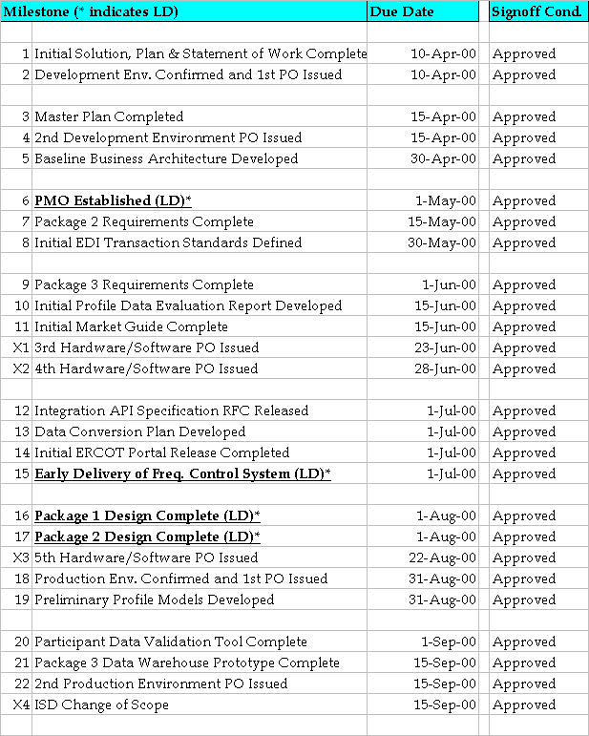
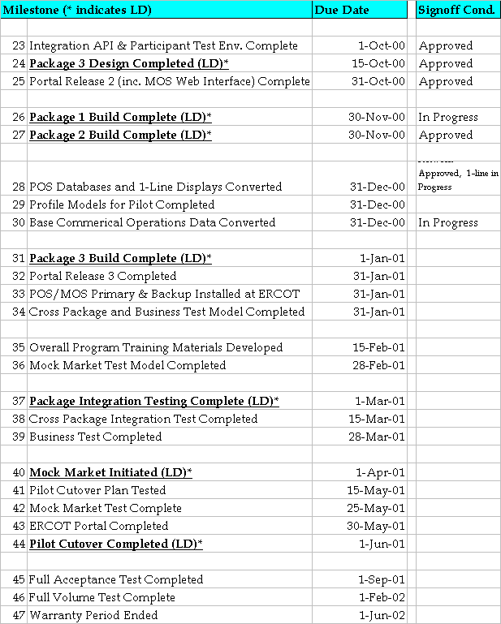
Schedule Review - Milestones
- Today’s Date
- Complete
- Complete and Signed-Off
- In Progress (Late)
- In Progress (Potentially Delayed)
- In Progress (on target)

Slide 5
Schedule Review - Activities
Completing protocol/design reconciliation.
Market Participant Interfaces:
Security architecture developed and published
Programmatic Interface: specification and test environment developed, Package 1,2,3 XML specification complete and published.
Transaction Clearinghouse: EDI standards defined and published. XML Implementation Guides drafted and available on request.
Portal: Release 1 and Release 2 (Oct 31) developed. Release 2 currently available for viewing. Public component of the portal will be delivered in the Portal Release 3 (1/31).
Market Participant Training
Market Participant curriculum drafted. Will be available for publication after ERCOT final review.
Market Participant Testing
Continuing test of EDI conversion files from the 6 IOU utilities (Reliant, TXU, AEP, TNMP, Xcel, Entergy)
Test environment for Programmatic interface available since 10/2 (minimal use to date)
Drafted EDI/XML certification test approach (not yet published; discussed with Test Planning Group)
Drafted Mock Market approach and discussed with QSEs - ongoing refinement
Prime / Integration

Slide 6
Schedule Review - Activities
Completing Build for Package 1 (POS/MOS systems) - targeted for 11/30.
Completing System Validation and Testing Plan (SVPP) - targeted for 11/30.
Network database conversion essentially complete - ESCA continuing upload to Package 1 solution - targeting 11/24. Running power flow solution to confirm accuracy of converted data
1-Line Conversion underway - targeting 12/31/00 completion date for initial conversion.
Supported successful EFC test on Oct 24 – EFC testing support complete.
Package 1 - Operations Systems

Slide 7
Schedule Review - Activities
Completing Build (Transaction Clearinghouse, Siebel, LODESTAR, STC (Application Integration, ND Auto (Load Profiling), MV-90 (Meter Data Acquisition), Portal) targeted for 11/30
TCH Data Validation tool completed and signed-off. Utilizing environment to support EDI technical connectivity testing.
Profile data evaluation report completed and preliminary profile models delivered (Aug 31). Final Weather Zone and Segment Definitions delivered to ERCOT (Oct 31). Final profile models to be delivered 12/31.
Conducting product test (136 test scripts); developing integration test model (56 test scripts).
Package 2 - Commercial Operations
Completed Package 3 Design - 35 OLAP reports, 28 dynamic extracts, 8 scheduled extracts.
Building package 3 solution - targeted completion 12/31.
Working on Package 3 test model development (product, package)
Preparing to publish extract descriptions.
Package 3 - Data Archive / Data Warehouse

Slide 8
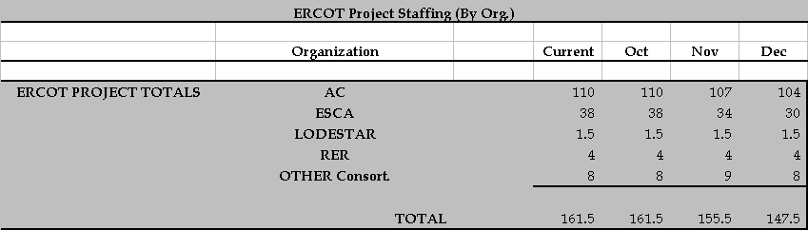
Project Staffing - Organization

Slide 9
www.texaschoiceprogram.com
Statistics for the Week of 11/4/2000 to 11/11/2000
Participants Requesting NDA for Market Design Documents
AEP/CSW
AES New Energy
Austin Energy
Automated Power Exchange
Brazos Electric
Bryan Utilities
Calpine
CPS – San Antonio
Dynegy
Enron
Garland
LCRA
LODESTAR
Rayburn
Reliant
Southern Company
STEC
Structure Consulting
Tenaska
TXU
Winfield Tech.
Xi Technologies Corporation

Slide 10
www.texaschoiceprogram.com
Historical Statistics - 10/02/2000 to 11/11/2000

Slide 11
EDI Technical Connectivity Statistics

