Slide 1

®
Natural Gas Outlook & Issues AB 1890 Implementation Group Annual Meeting November 14, 2000

Slide 2
U.S. Average Gas Prices by Sector 1985 vs. 1999 (In constant 1999$)
-30%
-37%
-48%
$/MMBtu
-48%
The average real price to all end users has fallen 42% under open access. In the prior decade, real prices increased 71%.

Slide 3

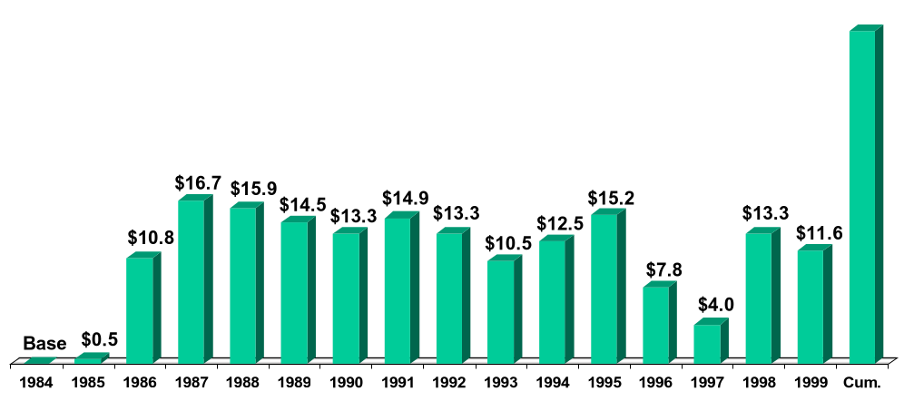
U.S. Natural Gas City Gate Cost Decline
(Billions 1999$)
$174.2
Total savings
since 1984
[Price savings volume]
x
Source: U.S. DOE Natural Gas Annual, Table 21, and Natural Gas Monthly, May 2000

Slide 4
U.S. Natural Gas Spot Price Outlook
(in $/MMBtu Henry Hub, LA.)
2001
5.14
$5.24
2000
5.01
4.30
4.25
2001
4.20
4.05
3.47
2.99
2.66
2.75
2000
$2.37
1999
1999
projected
historical
Source: NYMEX (9-11-00 close)

Slide 5
U.S. Residential Natural Gas Prices Since 1984
(1999$/MMBtu)
2000/2001
Winter Estimate
1984
1986
1988
1990
1992
1994
1996
1998
2000
1985
1987
1989
1991
1993
1995
1997
1999
Residentials will purchase gas this winter
at real prices last paid in 1986/87
Source: U.S. DOE (EIA)

Slide 6
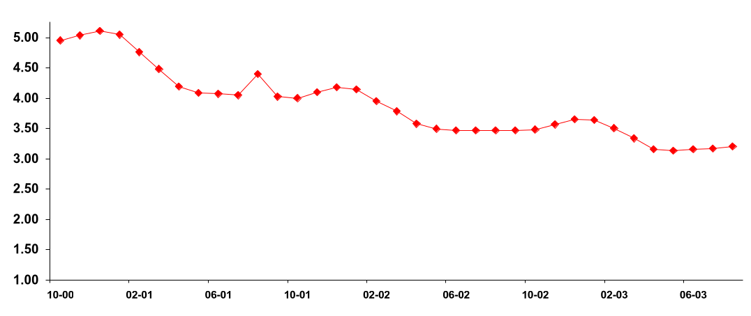
Backwardation Price Curve for Wellhead Gas
($/MMBtu)
$5.15
This Winter
$4.25
Next Winter
$3.75
Winter 02/03
Source: NYMEX (September 11, 2000)

Slide 7
Factors Influencing Natural Gas Prices
Strong Economy - Demand for Power Generation and Manufacturing
Declining Natural Gas Production
Warmer Than Normal Winters the Past 3 Years
U.S. Gas Storage Levels Lowest in Past 6 Years
Other Heating Fuels Showing Significantly Higher Prices & Lower Stock Levels
Notes:
<number>
<footer>
<header>
<date/time>

Slide 8
Increased Price Volatility has Become Common in the Gas Industry
January 1980 - January 2000
1999 Dollars
Nominal Dollars

Slide 9
What Are The Main Drivers Of Short-term Price Volatility?
Affects Supply Affects Demand
Weather
Economic/business conditions
Stock levels
Pipeline capacity
Operational difficulties
Lack of timely,
reliable information

Slide 10
Commodity / Risk Management
Notes:
Welcome,
I'm a bit new to EES, but not to Enron - so while I have industry knowledge I am learning to applyit to the N.A. retail environment. What I am going to attempt to do is explain as simply as possible how our commodity solution will work for Square D and to explain some of your options and the fundamentals of the future energy markets.

Slide 11
Why Hedge?
Eliminate uncertainty
Not hedging, i.e. buying on spot, is the same as speculating
Buying index still leaves you at the mercy of market conditions
Smooth production costs - be able to budget effectively - costs are known up front
Minimizes exposure to cyclical cash flows

Slide 12
2000/01 Winter Price Hedging ($/MMBtu)
8/31/00 Lock-in Price for Dec. ‘00/Jan ‘01 - $4.80/MMBtu
Historic 2000 prices through August
Jan/Feb 2000 Hedge for Dec. ‘00/Jan ‘01 - $2.79/MMBtu
Jan
Feb
Mar
Apr
May
Jun
Jul
Aug
2000

Slide 13
Price Risk Continuum
Many pricing options exist between fixed and index
Fixed Price
Volatility
Index Price
Less
More
Notes:
<number>
<footer>
<header>
<date/time>
We already know that Square D prefers to be toward the index side of this continuum. We want to stress the options however along the spectrum.

Slide 14
Commodity Products Values and Limitations

Slide 15
Basic Tools: Financial Instruments
Risk Management products are all based on the following basic financial instruments
- Forwards/Futures
- Options: Calls and (caps) and puts (floors)
- Swaps
These instruments can be customized to address the specific needs and sensitivities of the hedging firm.

Slide 16
Keys to a Successful Risk Management Program
Risk management is used to decrease uncertainty - not to beat the market
Belief that future outcomes can be changed
Doing nothing is the same as speculating
Risk management is a dynamic, iterative process
Have a view on the market and be prepared to change course

Slide 17
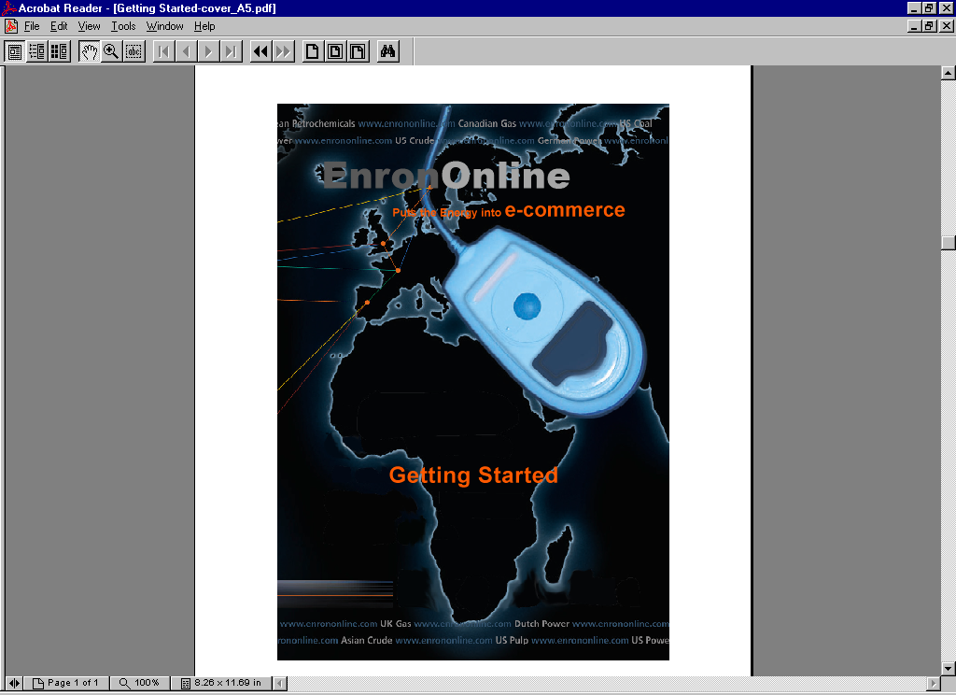
The Future: Electronic Commerce Comes of Age

Slide 18
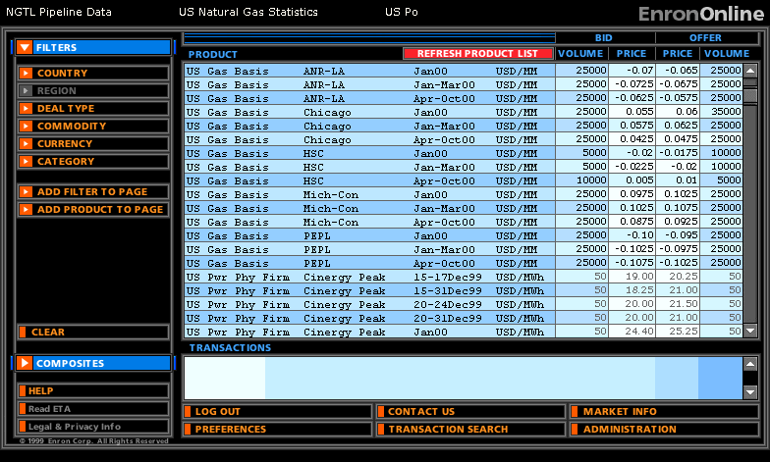
Crude and Products are also available
© 2000 SW-2060214-<number>

Slide 19
Regulatory Death Spiral
Tight Supply
Regulated
Shortages
Less Supply
More Demand
Price Surge
Brownouts
Blackouts
Blackouts
Price Caps

