Slide 1

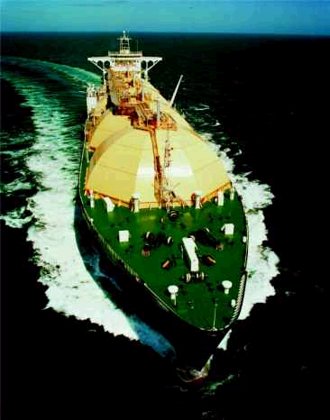



NEW AND DEVELOPING COMMODITY PRODUCTS
Presentation by:
Alan B. Aronowitz
Vice President and General Counsel
Enron Global Markets LLC
Alan.Aronowitz @enron.com
April 2001

Slide 2

OVERVIEW
New Commodity Products
Pulp and Paper
Lumber
Steel
Bandwidth
LNG
Market Background For Each New Commodity
OTC Contracts Used For New Commodities

Slide 3
PULP / PAPER
Underlying Commodity Price Volatility

Slide 4
Historical Containerboard Prices
1991-2001
26 lb. Medium
42 lb. Linerboard
Source: Pulp & Paper Week
PPW East Average Index

Slide 5
Historical Paperboard Prices 1991-2001
SBS
CCN
Source: Pulp & Paper Week
PPW East Average Index

Slide 6
PULP / PAPER
(Cont’d)
How Large is the Market?
Global Industry Revenues > U.S. $370
Billion / Year
Pulp segment alone is as large as aluminum
and copper and is larger than other
commodities with active markets (e.g., coffee,
sugar)

Slide 7
PULP
(Cont’d)
Who Needs Risk Management Services?
Timber Owners
Vendors
Pulp Producers (Mills)
Pulp Consumers

Slide 8
PULP
(Cont’d)
Risk Management Tools
OTC Financial Contracts (well established)
Futures Contracts: Only 1 Contract (Northern
Bleached Softwood Kraft – NBSK) on OMLX/London Exchange
Fixed Price Physical Forward Contracts (rapidly developing)
Physical Option Contracts (rapidly developing)
E-Commerce Platforms
clickpaper.com (one to many)
Physical Pulp Contracts
Financial Pulp Contracts
EnronOnline (one to many)
Financial Pulp Contracts Only

Slide 9
PAPER
Who Needs Risk Management Services?
Paper Producers (Mills)
Recycling and Waste Management
Companies
Newspapers and Other Printers
End Users

Slide 10
PAPER
(Cont’d)
Risk Management Tools
OTC Financial Contracts (well established)
Future Contracts: None
Fixed Price Physical Forward Contracts
(rapidly developing)
Physical Option Contracts (rapidly developing)
E-Commerce Platforms
clickpaper.com (one to many)
Physical Paper Contracts
Financial Paper Contracts
EnronOnline (one to many)
Financial Paper Contracts Only

Slide 11
LUMBER
Underlying Commodity Price Volatility

Slide 12
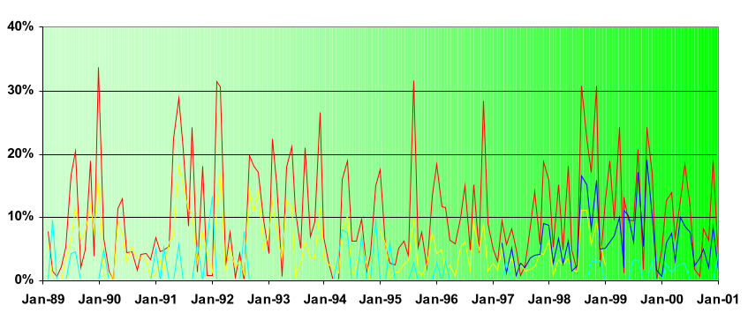
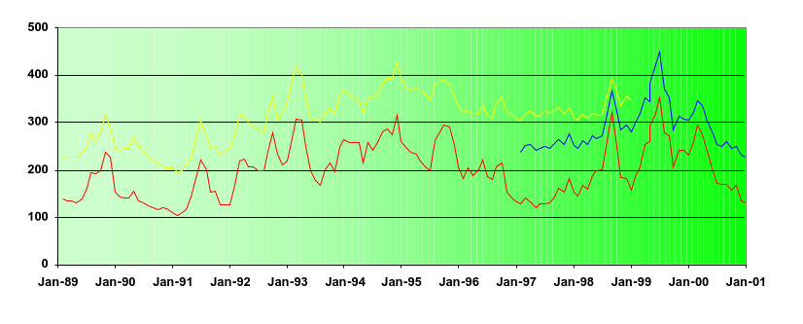
LUMBER (Cont’d)
Comparative Volatilities (Structural Panel to Prime Rate)
Oriented Strand Board 7/16”, 24/16”
Previous Structural Panel Composite Price
Revised Structural Panel Composite Price
US Prime Rate
Through Jan 2001
Structural Panel Spot Price (Random Lengths Index)
$ Per Thousand Square Feet
Oriented Strand Board 7/16”, 24/16”
Previous Structural Panel Composite Price
Revised Structural Panel Composite Price
Through Jan 2001

Slide 13
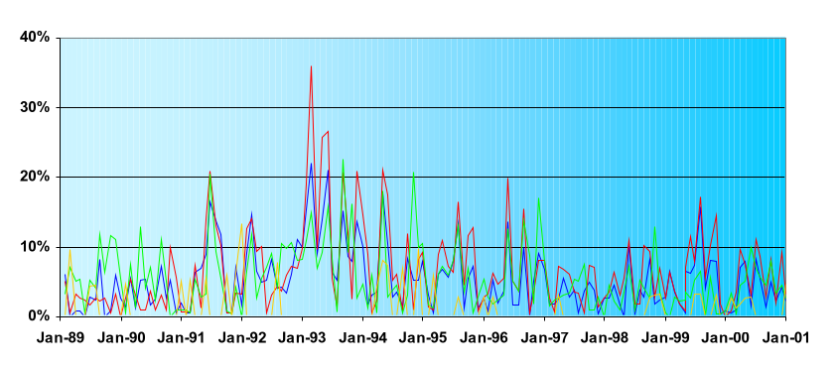
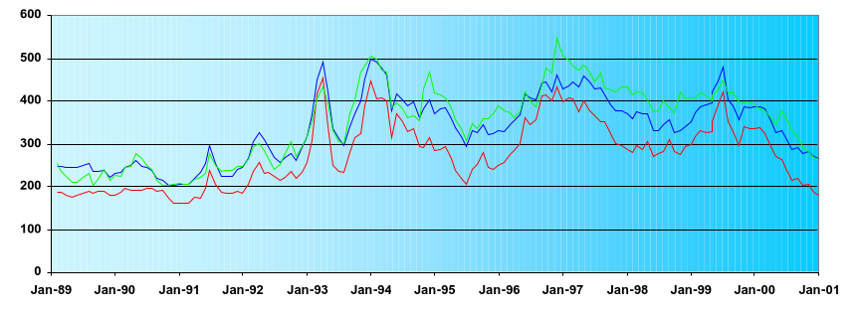
LUMBER (Cont’d)
Comparative Volatilities (Lumber to Prime Rate)
Framing Lumber Composite Price
Spruce-Pine-Fir, Western, 2x4, Std & Btr, Kiln Dried, Random Length
Southern Pine (Central), Kiln Dried 2x4, #2, Random Length
US Prime Rate
Through Jan 2001
Framing Lumber Spot Price (Random Lengths Index)
$/MBM
Framing Lumber Composite Price
Spruce-Pine-Fir, Western, 2x4, Std & Btr, Kiln Dried, Random Length
Southern Pine (Central), Kiln Dried 2x4, #2, Random Length
Through Jan 2001

Slide 14
LUMBER
(Cont’d)
How Large is the Market?
U.S. / Canada $30 billion (soft lumber
and structural panels)
World - $46 billion

Slide 15
LUMBER
(Cont’d)
Risk Management Tools
OTC Financial Contracts (developing)
Futures Contracts
2 Contracts: Western Spruce Pine Fir 2x4 (WSPF)
(liquid) and Oriented Strand Board (OSB) (illiquid) on
Chicago Mercantile Exchange
Fixed Price Physical Forward Contracts (Developing)
E-Commerce Platforms
clickpaper.com (one to many)
Physical Lumber Contracts
Financial Lumber Contracts
Enron Online (one to many)
Financial Lumber Contracts Only

Slide 16
STEEL
Underlying Commodity Price Volatility

Slide 17
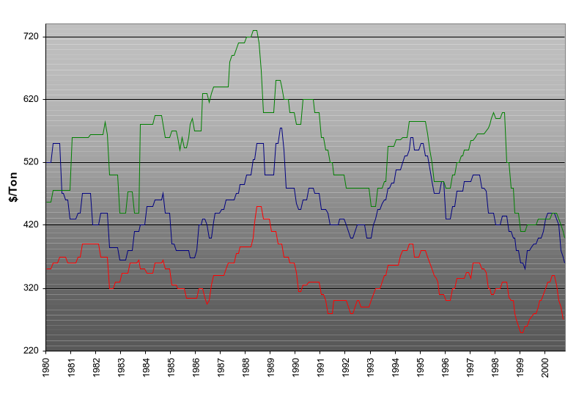
End Product (Steel) Price History
U.S. Midwest Market
Galvanized
Cold Rolled
Hot Rolled
Source: Purchasing Magazine

Slide 18
STEEL
(Cont’d)
How Large is the Market?
Worldwide Steel Industry = U.S. $70 billion
World Steel Supply = 725 MM MT / Year

Slide 19

STEEL
(Cont’d)
Who Needs Risk Management Services?
Steel Producers
Steel Processors
Steel Consumers
Automobile Industry
Appliance Industry
Construction Industry
Shipyards

Slide 20
STEEL
(Cont’d)
Risk Management Tools
OTC Financial Contracts (will develop)
Futures Contracts: None
Physical Fixed Price Forward Contracts (developing)
Physical Option Contracts (developing)
E-Commerce Platforms
EnronOnline (one to many)
Physical Steel Contracts
Financial Steel Contracts
E-Brokers (many to many)
e-steel

Slide 21
BANDWIDTH
Underlying Commodity Price Volatility

Slide 22
BANDWIDTH
(Cont’d)
How Large is the Market?
US $250 billion (bandwidth
capacity market)

Slide 23
BANDWIDTH
(Cont’d)
Who Needs Risk Management Services?
Telecommunication Companies
Network Service Providers
Commercial End Users
Traders

Slide 24
BANDWIDTH (Cont’d)
Risk Management Tools
OTC Financial Contracts (expected in next 2 yrs.)
Futures Contracts: None
Fixed Price Physical Forward Contracts: DS-3;
OC-3; OC-12; OC-48; OC-192; STM-1; STM-3
(rapidly developing)
Physical Options Contracts (rapidly developing)
E-Commerce Platforms
EnronOnline (one to many)
Physical Long-haul and Physical IP Transport
Contracts
E-Brokers (many to many)
Rate Xchange
Arbinet
Band-X

Slide 25
LNG
Historically, demand for LNG largely confined to markets with limited energy alternatives (e.g. Japan because of high infrastructure cost )
But, with natural gas prices at or near all–time high now LNG is viable fuel alternative
LNG sales (Some 91 million MT/year) amount to 25% of cross-border trade market in natural gas (volume expected to reach 166 Million MT/Year by 2020)
Contracts traditionally long term take-or-pay commitments
But, short-term or spot contracts are increasingly occurring in Europe and U.S. reflecting shift toward LNG in regions historically favoring oil and gas
56% of world LNG trade on LNG currently moves from facilities in Indonesia, Malaysia, Australia, about Dhabi and Qatar to Japan terminals, but liberalizing markets in Europe expected to construct additional LNG receiving terminals and U.S.
demand expected to increase to meet new power needs

Slide 26
LNG
(Cont’d)
Who Needs Risk Management Services?
Natural Gas Producers
Power Producers
Power End Users

Slide 27
LNG
(Cont’d)
Risk Management Tools
OTC Financial Contracts: None (should develop
as spot physical market expands)
Futures Contracts: None
Spot Physical Contracts (developing)
E-Commerce Platforms
None (online contracting should develop
as spot physical market expands)

Slide 28
OTC CONTRACT DOCUMENTATION
FOR NEW COMMODITIES
Spot Purchase and Sale Confirmation
(subject to General Terms & Conditions)
Pulp and Paper
Lumber
Steel
LNG
Bandwidth
Master Physical Purchase and Sale Agreement
Similar to ISDA Master Agreement but addresses
physical components of transactions
ISDA Master Used For Derivative Products
Master Physical / Financial Agreement being developed
that would cut across all physical commodities and
financial products trading

Slide 29
PHYSICAL CONTRACT COMPONENTS
Nominations and Scheduling
Transportation: Loading / Discharge
Quality Specifications; Service Level Agreement (Bandwidth only)
Sampling, Analysis and Weighing; Monitoring and Testing (Bandwidth only)
Quality Adjustments; Rejection Rights
Force Majeure
Transfer of Title / Risk of Loss / Taxes
PLUS Standard Master – Type Contract Provisions (e.g., liquidated damages, netting, etc.)

Slide 30
OTHER NEW COMMODITIES
ON HORIZON
Freight
Intermodal (Ocean / Air / Truck / Rail)
Ocean
Air
Truck
Rail
Semiconductor Chips
Data Storage; Data Streams; IP
Transit and Transport
Advertising Time
C0₂ Emissions

