Slide 1
Surviving and Prospering in the New Economy
Arthur Andersen 21st Annual Energy Symposium
Jeffrey K. Skilling President and COO Enron Corporation Houston, Texas November 29, 2000

Slide 2
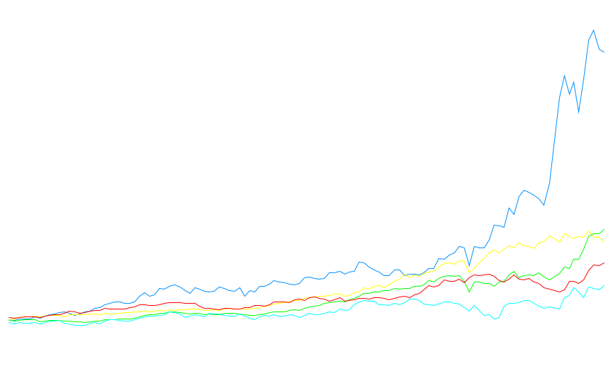
Total Return to Shareholders Jan 1, 1990 to November 2000
1600
1400
Enron Corp.
S&P 500
Pipeline Avg.
Utility Avg.
E&P Avg.
1383%
400%
466%
291%
174%
1200
1000
800
600
400
200
0
-200
Dec 90
Dec 91
Dec 92
Dec 93
Dec 94
Dec 95
Dec 96
Dec 97
Dec 98
Dec 99
Nov 00
Note: Calculated to November 17, 2000

Slide 3
Price Earnings Ratios Enron vs. Peer Groups (as of 11-20-00)
Enron
Energy
Peer Group
S&P 500

Slide 4
Enron’s PE Multiple Growth
EBS Introduces Enron Intelligent Network
Enron Online reaches $1 billion day
EES First Commercial Transaction
57.30
Dabhol Phase I Financial Close
Acquisition of PGE
28.53
23.70
23.89
UK Power and
Gas Trading Begins
37.61
20.95
<number>

Slide 5
Cost of Interaction
Mining
Financial
Institutions
30-40%
60-70%
India
U.S.
40-50%
55%

Slide 6
Business Structure
Transformation
Interaction
1.0
1.0
1.0
.90
.85
.90
.80

Slide 7
Business Structure
1.0
1.0
1.0
.90
Transformation
Interaction
Finished
Product
.85
Transformation
Costs
Interaction
Costs
Total
Costs
.90
3.45
3.00
6.45
.80

Slide 8
Business Structure
1.0
1.0
1.0
.90
Transformation
Interaction
Finished
Product
.85
Transformation
Costs
Interaction
Costs
Total
Costs
.90
3.45
3.00
6.45
.80
Finished
Product
Transformation
Costs
Interaction
Costs
Total
Costs
.95
1.10
1.20
1.10
.20
.20
.20
4.35
.60
4.95

Slide 9
Cost of Teller Transaction
(Bank)
(ATM)
(Internet)

Slide 10
Length of Time to Provision Bandwidth
6-8 months
2-3 months
< 1 second

Slide 11
Length of Time to Execute a Long-Term
Gas Contract
2-3 years
9 months
2 weeks
< 1 second

Slide 12
Change in Economics of Business Structure
1.0
1.0
1.0
.90
Transformation
Interaction
Finished
Product
.85
Transformation
Costs
Interaction
Costs
Total
Costs
.90
3.45
3.00
6.45
3.45
.30
3.75
.80
Finished
Product
Transformation
Costs
Interaction
Costs
Total
Costs
.95
1.10
1.20
1.10
.20
.20
.20
4.35
.60
4.95

Slide 13
Where’s the Opportunity?
.90
.10
.10
.10
.85
.90
.80
.95
.20
1.10
.20
1.20
.20
1.10

Slide 14
Where’s the Opportunity?
.90
.10
.10
.10
.85
.90
.80
Not
Cost
Competitive
.95
.20
1.10
.20
1.20
.20
1.10

Slide 15
Where’s the Opportunity?
.90
.10
.10
.10
Commoditized
Overcapitalized
Globalized
Can’t make compensatory
return in traditional asset
business
.85
.90
.80
.95
.20
1.10
.20
1.20
.20
1.10

Slide 16
Where’s the Opportunity?
.90
.10
.10
.10
Creating low cost, dependable
market interfaces
Market making
Logistics
Back office
Trade finance
.85
.90
.80
.95
.20
1.10
.20
1.20
.20
1.10

Slide 17
Where’s the Opportunity?
.90
.10
.10
.10
.85
.90
.80
Providing packaged turnkey
solutions for customers
Complex structures
Differentiation
Customization
“Virtual” Integration
.95
.20
1.10
.20
1.20
.20
1.10

Slide 18
Creating a New Energy Model
Traditional
Energy Model
Asset intensive
Vertically integrated
Slow moving and rigid
Hierarchical
New Energy Model
Brain power intensive
Networked
Oriented toward “real options”
Fast moving
Entrepreneurial

Slide 19
Enron
Transportation
Services
Enron
Wholesale
Services
Enron
Energy
Services
Enron
Broadband
Services

Slide 20
The Energy Network Model
Applications
Utility Facility
Operations
& Management
Energy
Outsourcing
Fuel
Management
Services
eCommerce
Applications
Physical Delivery
Contracts
Price Risk
Management
Contracts
Settlement
Services
Peaking &
Storage Services
Finance
Market Making
Contract Access
Physical Assets

Slide 21
Total Energy Outsourcing
Traditional Suppliers
Customer Needs
Enron
Utilities
Commodity
Management
Software Vendors
Light
Control Manufacturers
Architects
Energy Information Management
Engineers
Equipment Manufacturers
Conditioned Air
Mechanical Contractors
Energy Asset
Management
Electrical Contractors
HVAC Svc Companies
Consultants
Facilities
Management
Specialty Contractors
Managed Facilities
Lenders
Capital
Management
Internal Treasury

Slide 22

TM
The New Power Company
First national provider of energy and related services to residences and small businesses in deregulated markets
A partnership of industry leaders: Enron, AOL, IBM
Initial investment of $120 million
First customer sign-up in Pennsylvania and New Jersey later this year
<number>

Slide 23
Enron Broadband Services
Enron
Intelligent
Network
Bandwidth Intermediation
Deploy the Most Open, Efficient Network with Broad Connectivity
Content Services
Be the World’s Largest Buyer and Seller of Bandwidth
Be the World’s Largest Provider of Premium Broadband Delivery Services
Fiber
Servers
Pooling Points
Network Control
Bandwidth Marketing & Trading
Comprehensive Bandwidth Management
Broadband Content Management & Delivery
Data Management Services
Notes:
3 Primary Components to Enron’s strategy
Development of EIN, primary components:
Assets
Technology
Intercommunications / liquid markets / pulling points
Network control system
Development of open, robust markets
liquidity, ease of provisioning
offer bandwidth related services, core competency of Enron
Develop the preferred broadband delivery platform for high value applications
This is where the market is going

Slide 24



The Enron Intelligent Network
_{Asia}
Fiber
Servers
Pooling Points
Fiber
(Route Miles)
Servers
Pooling Points
15,848
1,500
13
12,325
5,538
222
415
3
0
0
1998
1999
2000E
1998
1999
2000E
1998
1999
2000E
Route Miles Typically Include 12 Fiber Pairs
Notes:
Primary Components
1. Assets:
credibility
physical delivery, Quality of Service (QoS)
2. Technology:
high capacity servers
state of the art routing techniques
3. Market Access:
Natural liquidity / aggregation points
region network interconnections

Slide 25
Bandwidth Intermediation
Vancouver
Seattle
Calgary
Montreal
Boise
Toronto
Boston
Portland
Detroit
New York
Amsterdam
Salt Lake City
San Francisco
Denver
Chicago
Philadelphia
London
San Jose
Frankfurt
Las Vegas
Washington D.C.
Los Angeles
Atlanta
Tokyo
Dallas
New Orleans
Houston
Miami
DS-3 Month Deliveries
2000
Target
5,170
Added in 2Q
Over 50 Transactions Effected YTD with 17 Counterparties
60 Counterparties Reviewing Contract Terms EnronOnline Offerings Recently Expanded to Over 30 Products in 14 City Pairs
985
432
1Q00
2Q00
Committed for Delivery Before Year-End
Notes:
Active in the market today
Both in North America and Europe
Wholesale and Large Enterprise

Slide 26



Content Services
EIN
ISP
High Quality
Internet
Content
Provider
ISP
Our streaming media applications allow larger on-screen windows, stereo sound and error-free imaging for TV-quality video that can be delivered simultaneously to large audiences, live or on-demand.
Low Quality
Notes:
High QoS due to:
1. Content management techniques
2. Network control techniques
Not just saw bandwidth issue

Slide 27










Enron and Blockbuster
20-Year Exclusive, Worldwide Agreement
Enron Provides End-to-End Connectivity to Deliver Blockbuster’s Movie Library via the EIN
Enron Paid for Services Based on Number of Movies Rented
New Broadband Distribution Agreements Enable DSL Delivery to the TV; Additional Partners and Cable Targeted
Service Available in Multiple U.S. Markets by Year-end; Rapidly Moving Toward Implementation
Significant Expansion Opportunities
Encoding
Storage
Bandwidth Management
Streaming Control
Content
Enron’s Intelligent Network
Enron’s Distribution Partners
Blockbuster’s
Customers
Notes:
Strategic Relationships to develop VOD
Combinations of:
1. Premium Content
2. High QoS delivery
3. Aggregation of millions of end users
Over 1 Billion potential Total contract value (TCV)

Slide 28
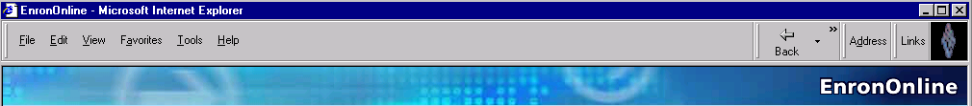
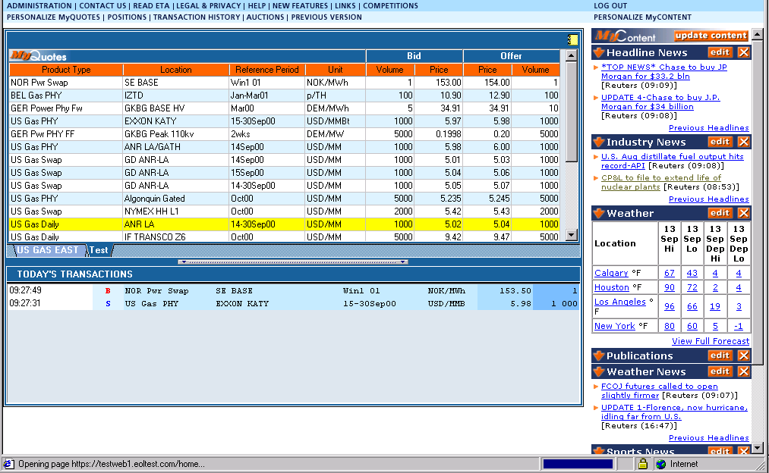
EnronOnline Extending Enron’s Products to the Internet
Free, Reliable Transaction System with Enron as Principal
Fully Integrated into Enron’s Established Risk Management and Logistic Processes
Utilizing Site to Offer Energy-Related Auction Capabilities
Expands Enron’s Information Base and Market Knowledge
“Tried and Tested” Platform for Expanding Enron’s
eCommerce Activity

Slide 29

EnronOnline Transactions Per Day

Slide 30
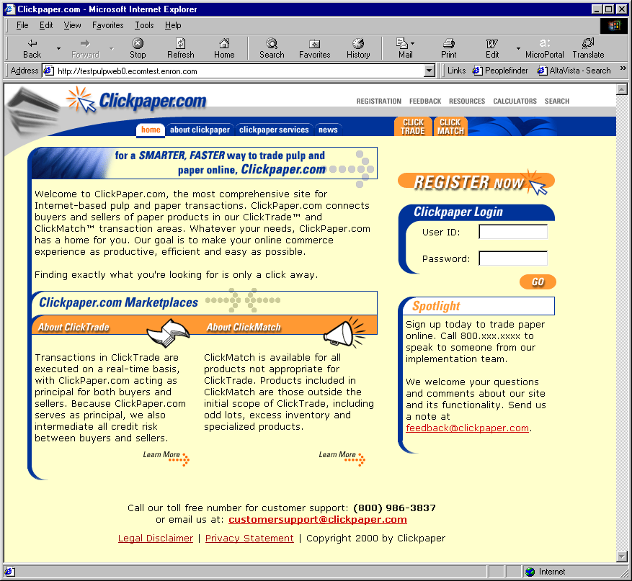
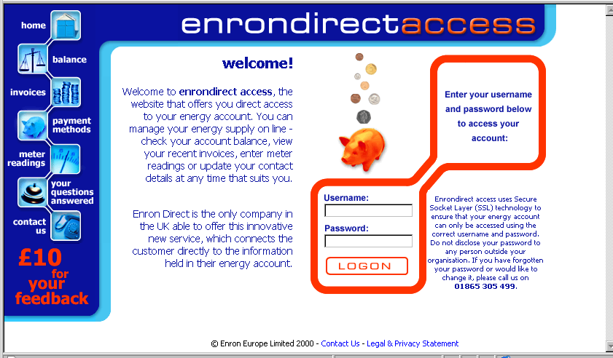
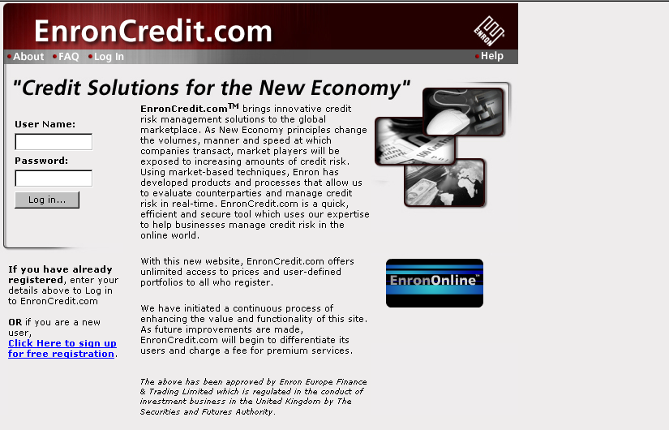
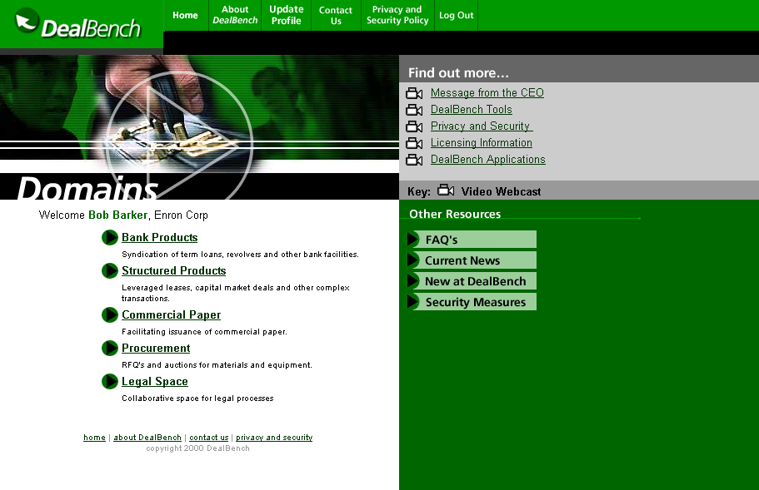
EnronOnline
Clickpaper
Enron Direct
Enron Net Works
Enron Credit
Deal Bench

Slide 31

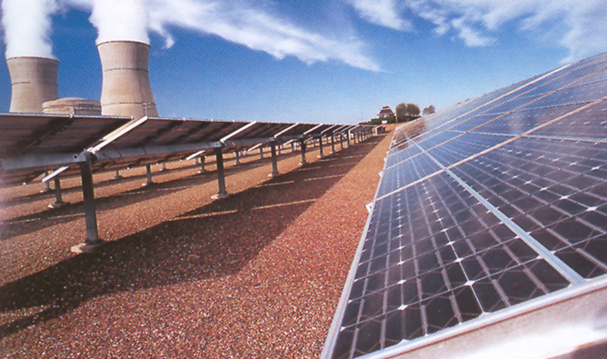
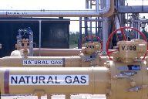

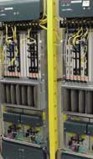
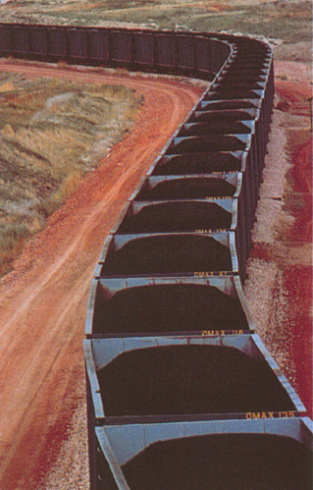

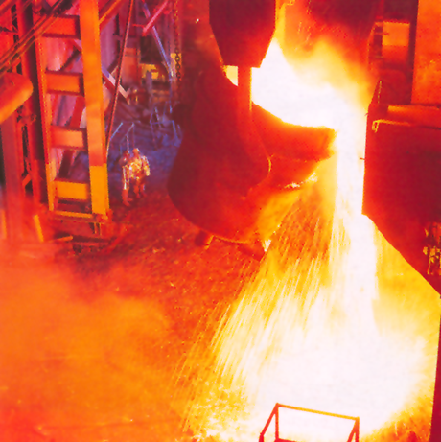
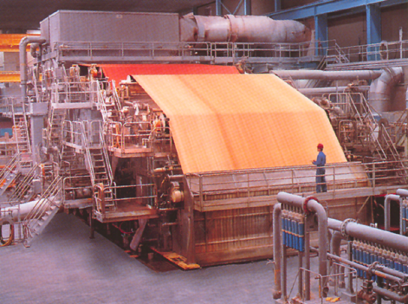
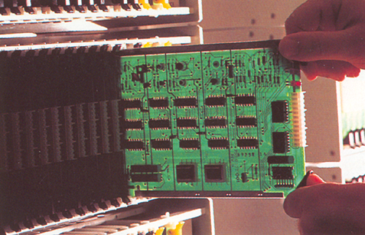

Enron Today vs. Enron Tomorrow
Natural Gas
B2B Backoffice
Broadband
Energy
?
Telecommunications
Metals
Coal
Electricity
Paper
Data Storage
Weather

Slide 32
®

