Slide 1

Enron and the Global Natural Gas & LNG Market Kenneth L. Lay Chairman & CEO Enron Corp.
The 19th International Conference & Exhibition for the LNG, LPG, and Natural Gas Industries
Houston, Texas
November 15, 2000

Slide 2
Enron
Wholesale
Energy
Transportation
&
Distribution
Broadband
Services
Net Works
Retail
Energy
Natural Gas Transportation and Electric Distribution
Marketing and Delivery of Energy Products Worldwide
Expansion Vehicle for New Commodity Market Penetration
Energy Outsourcing to Commercial and Industrial Customers
Bandwidth
Management and Broadband
Delivery Services

Slide 3
Enron Natural Gas Transmission Systems
Northern Border
Second largest pipeline network in the U.S.
Emphasis on intellectual capital services
Capacity offered on EnronOnline
Transwestern Pipeline
Northern Natural Gas
Florida Gas Transmission
Houston Pipeline
LRCI
Enron Transportation Services (Interstate)
Enron North America (Intrastate)

Slide 4
Enron’s Wholesale Markets
Largest and most reliable provider of gas and power worldwide
Unique asset portfolio market-making and ability allow Enron to “package” energy to meet specific customer needs
Risk management expertise provides predictable commodity prices to customers and manages Enron‘s exposure

Slide 5
Enron’s North American Wholesale Network
Marketing Offices
Owned and Leased Capacity
NYMEX Trading
Marketing Hub Owned Gas Storage
Leased Storage
Power Plants
In Operation
Under Development
Energy Marketing Activity
Gas
Power
Coal
Enron: #1 in natural gas and electricity marketing

Slide 6
Enron’s European Wholesale Network
Nord
Pool
Helsinki
Offices
Energy Exchange
LNG Project Under Development
Energy Services
Energy Partnerships
Leased Capacity
Utility Services
Oslo
Stockholm
Teesside
1,875 MW
Wilton
154 MW
Amsterdam
Hamburg
Oxford
APX
Warsaw
Moscow
Power Plants
IPE
EEX
Nowa Sarzyna
116 MW
In Operation
In Construction
Under Development
London
Brussels
Frankfurt
Zurich
Enron/Petrom JV
Budapest
Energy Marketing
Activity
Milan
Mora la Nova
1,600 MW
Bucharest
Gas
Power
Coal
Sarlux
551 MW
Madrid
Marmara
478 MW
Arcos
1,200 MW

Slide 7
Enron Energy Services (energy outsourcing)
Traditional Suppliers
Customer Needs
Enron
Utilities
Commodity
Management
Software Vendors
Light
Control Manufacturers
Architects
Energy Information Management
Engineers
Equipment Mfctrs
Conditioned Air
Mechanical Contractors
Energy Asset
Management
Electrical Contractors
HVAC Svc Companies
Consultants
Facilities
Management
Specialty Contractors
Managed Facilities
Lenders
Capital
Management
Internal Treasury

Slide 8
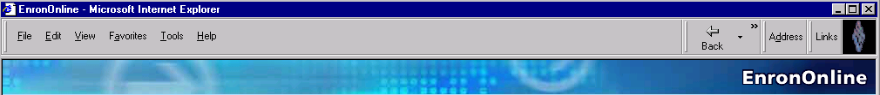
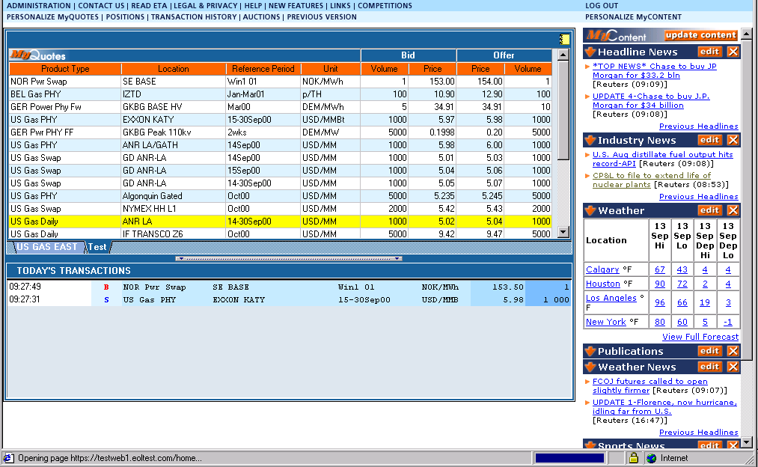
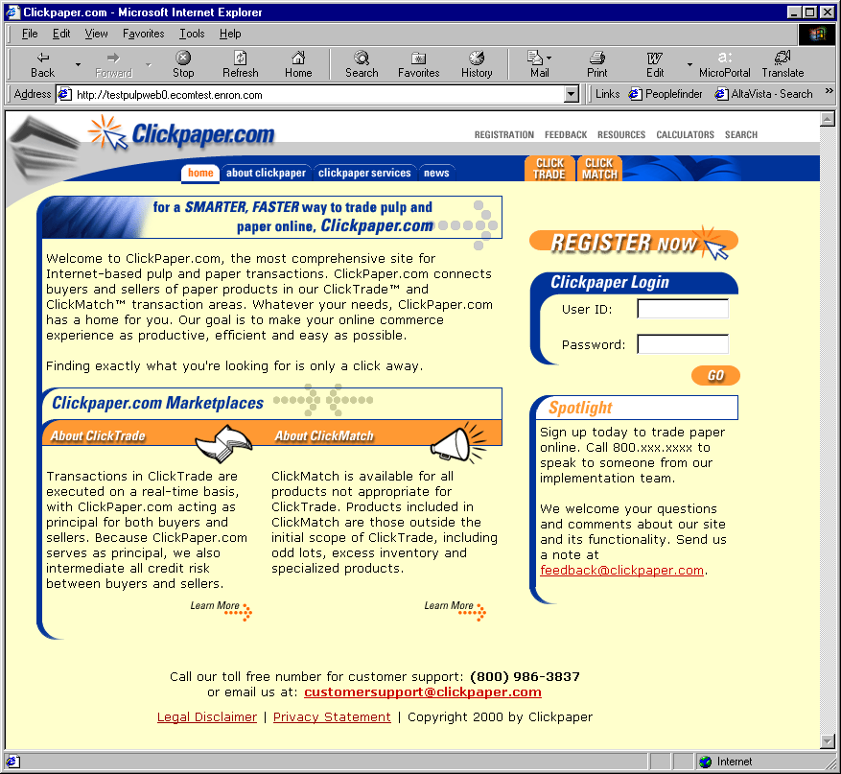
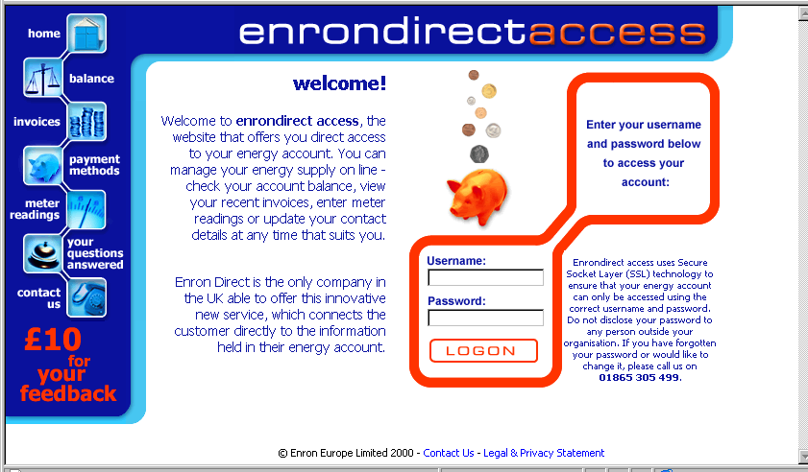

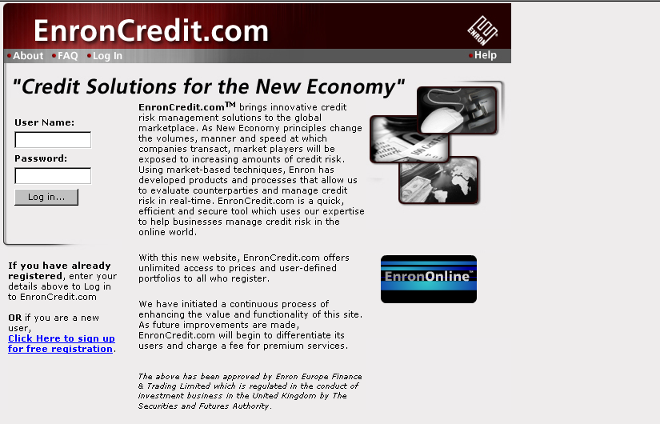
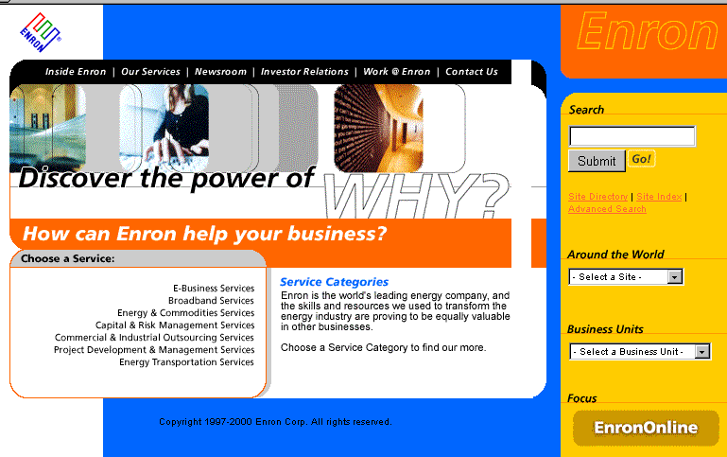
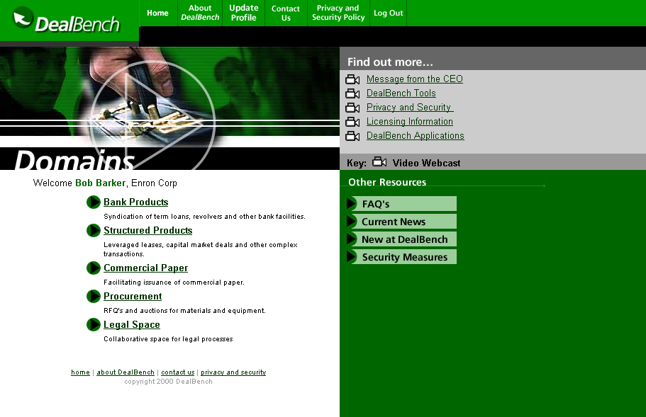
Enron Net Works
®

Slide 9
Creating a New Energy Model
Traditional
Energy Model
Asset intensive
Vertically integrated
Commodity price sensitive
Slow moving and hierarchical
New Energy Model
Brain power intensive
Networked
Risk management; optionality
Fast moving and entrepreneurial

Slide 10
The Energy Network Model
Applications
Utility Facility
Operations
& Management
Energy
Outsourcing
Fuel
Management
Services
eCommerce
Applications
Physical Delivery
Contracts
Price Risk
Management
Contracts
Settlement
Services
Peaking &
Storage Services
Finance
Market Making
Contract Access
Physical Assets

Slide 11
EnronOnline

Slide 12
Benefits of EnronOnline
Free of charge
Enron’s best prices
Real-time pricing information
Downloadable transactions
Price limit orders
Fast & secure execution
Advance customization
Market news and quotes
Industry & weather insights

Slide 13
EnronOnline Natural Gas Products
Products
Locations
U.S.A.
Fixed Swaps
Basis Swaps
Fixed Physical
Index Physical
Nationwide including:
Henry Hub
Waha
Chicago
NGPL, et al
Canada
Basis Physical
Forward Physical
Index Physical
Basis Swaps
Nationwide including:
AECO
Chippawa, TCPL
Union Gas - Dawn, Ontario
Empress, et al
U.K.
Financial Swaps
Physical Forwards
Notional Balancing Plan (NBP)
Continental
Europe
Belgian Gas Physical
Belgian Gas Physical Forward
Dutch Gas Physical Forward
Zeebrugge HUB
Zeebrugge IZT Entry Point
Oude/BEB H-Gas
Oude/Wingas

Slide 14
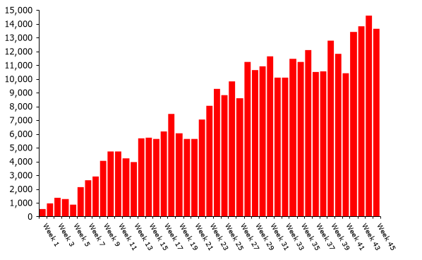
Transactions on EnronOnline (weekly)
46% online
54% traditional

Slide 15
eCommerce Business Comparison
Value of Goods
(Millions)
Business To Consumer (B2C)
eBay
Amazon.com
Dell.com
$ 5,200
2,870
13,100
2000 Data*
Business To Business (B2B)
FreeMarkets
Cisco
Intel
Altrade
$ 1,400
9,480
10,500
9,000
2000 to Date **
~
EnronOnline
~
$ 225,000
* Est. 2000 Annual Results
** Year to Date Notional Value of Transactions

Slide 16
Global Natural Gas Demand 2000 vs. 2005
In Trillion Cubic Feet
2000
2005
Asia
8.6
9.9
North America
24.8
27.5
Europe
15.3
18.5
Latin America
6.4
7.8
FSU/Russia
20.0
21.9
Mid East/Africa
7.9
9.9
Total
83.0
95.5
Global growth of 15% by 2005
Source: Cambridge Energy Research Associates, July 2000

Slide 17
Global LNG Supply: 2000 vs. 2005 (Bcf/d)
2000
0.7
4.7
2.6
7.7
15.7
2005
2.1
5.9
5.6
9.8
23.4
Increase
1.4
1.2
3.0
2.1
7.7
Americas
Africa
Mideast
Asia, Pacific
Total
.0
.3
Egypt
3.0
2.0
4.2
3.6
3.6
3.0
3.8
.2
.2
1.8
Malaysia
Alaska
1.0
1.3
Qatar
.9
.43
Indonesia
Algeria
Trinidad
Brunei
.3
.3
.6
.6
1.6
.6
Libya
1.7
Abu Dhabi
1.3
1.0
.0
.76
.3
Venezuela
.7
Australia
Nigeria
.0
Oman
Yemen
Global LNG supply increases 50% by 2005
Source: CERA, September, 2000

Slide 18
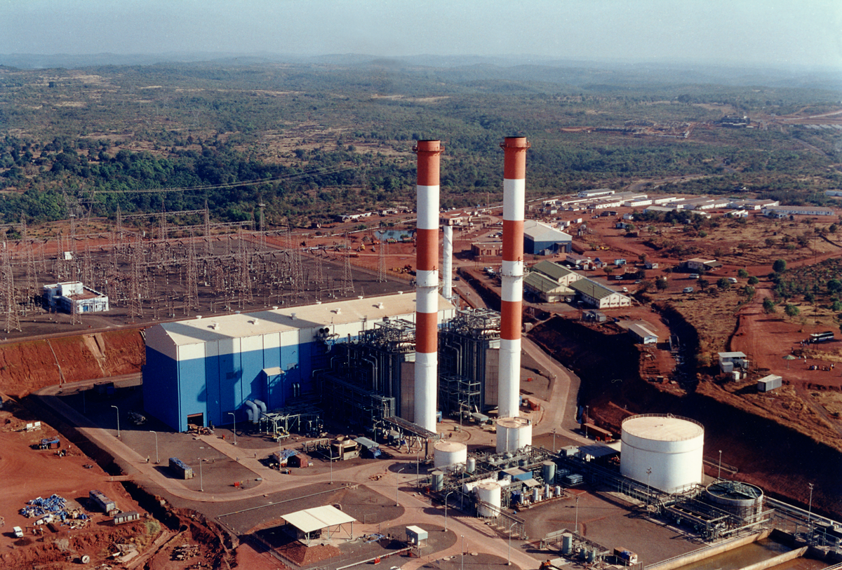
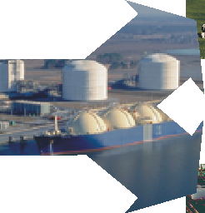

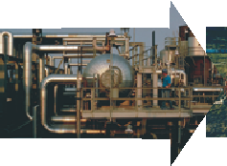
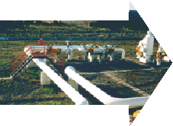

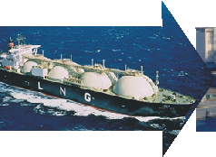

The LNG Chain Today: Little Intermediation
Electric
Power
Gas Well
Field
Processing
Transmission
Pipeline
Liquefaction
Shipping
Receiving
Terminal
Transmission
Pipeline

Slide 19
Today’s LNG Spot Market is Inefficient
Today:
Surplus Always Discounted
Long-term LNG Netback
Short-term LNG Netback
Network:
Increased Liquidity Flattens Price Cycle
Short-term LNG Netback
Long-term LNG Netback

Slide 20
LNG Plants, Terminals, and Routes
To Japan
From Alaska
23 Terminals
2 Terminals
23 Terminals
2 Terminals
3 Terminals
2 Terminals
2 Terminals
LNG Export Facilities (Existing)
LNG Export Facilities (Planned)
Receiving Terminals (Existing)
Receiving Terminal (Planned)

Slide 21
LNG Ripe for Network Model
Supplier A
End user A
Supplier B
Market Maker (Enron)
End user B
Supplier C
End user C
Financial
Products
Risk
Products
Ships

Slide 22
Prerequisites for an Open LNG Market
“Critical mass” of facilities
Liquefaction plants
LNG terminals
Ships
Standardized contracts
Transparent pricing (e.g., FOB/CIF pricing hubs)
Market-responsive risk management products
Price hedging, financing etc.
“Market maker” leadership

Slide 23
Current trading opportunities
“Spare capacity” and “buildup wedge” volumes will increase in the future as new plants are built and older baseload contracts expire

Slide 24
Enron LNG Accomplishments
First new LNG terminal in the US in 20 years
World’s only combined power plants/LNG terminals
First long-term LNG contracts to India
First back-to-back project financings of LNG ship and terminal
First long-term Asian supply commitment to India
First spot cargoes intermediated by third party

Slide 25
Enron’s Competitive Advantage in LNG
Strategic positions in key markets
Enron network
Increased optionality
Increased coverage
Increased liquidity
A “market maker”

Slide 26
®

