Slide 1


E-Commerce:
An Enron View
Mike McConnell
CEO - Enron Global Technology
Arthur Andersen
20th Annual Energy Symposium
December 8, 1999

Slide 2
    “It Is Not the Strongest of the Species That Survives, Not the Most Intelligent, but the Most Responsive to Change”
    Charles Darwin
    The Origin of the Species

Slide 3
Today’s Topics
E-Business Trends
Enron Philosophies
www.EnronOnline.com
Conclusions

Slide 4
Industry Trends
Return on Sales
47
Market
Share Gain
Increase
in Sales
7.4
4.8
0
1.8
- 4
% Difference by
Economic Measures
Source: McKinsey & Company

Slide 5
Industry Trends
Technology has Slashed the
Price of doing Global Business
The Cost of a 3-Minute Phone
Call From New York to London
‘30
‘50
‘70
‘90
‘98
Source: New York Times 2/15/99

Slide 6
Transaction Costs
…and Radically Lowered
Transaction Costs
Average Cost per Transaction
Retail Banking by Channel
Branch
Telephone
ATM
Internet
Source: Downes, Larry and Chunka Hui, Unleashing the Killer App., Boston: Harvard Business School Press, 1998, pp.44-45

Slide 7
E-Business
The Effects of Increasing
Internetworking
Sales $ (Billions)
Business-to-Business
Business-to-Consumer
Source: Forrester Research, Inc.

Slide 8
E-Business Trends
The Internet is a Disintermediary
The Internet Cannibalizes Existing Business
  Law of Diminishing Returns
The Internet Allows for Mass Customization
Barriers to Enter Markets are Dramatically Changing

Slide 9
Enron Philosophies
Run Technology as a Business
Develop and Implement Enron’s Global
E-Business Strategy
Spending Focused on Achieving Competitive Advantage
Highly Robust and Flexible Infrastructure
Develop Several Proprietary Applications

Slide 10
Enron Philosophies Continued
Expansion and Extension of our Existing Business
Enabler of Unparalleled Information Dissemination
Incubator of New Ideas and Business Models
Challenge Existing Ideas and Beliefs

Slide 11
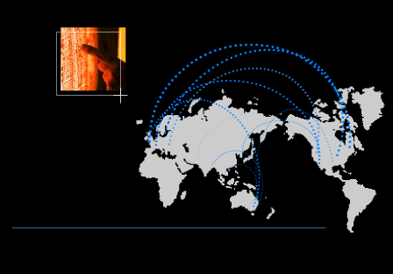
E-Commerce is Becoming Core to the Global Energy Business
01010
91919
01382
83710
91817
01010
91919
01382
83710
91817
01010
91919
01382
83710
91817
01010
91919
01382
83710
91817
91919
010102374621985712398571928509129759812659821598601010237462198571239857192850912975981265982159860101023746216
010102374621985712398571928509129759812659821598601010237462198571239857192850912975981265982159860101023746298
global networks

Slide 12
Sizing the Online Natural Gas and Electricity Trade
Source:Forrester Research, Inc. September 1999

Slide 13
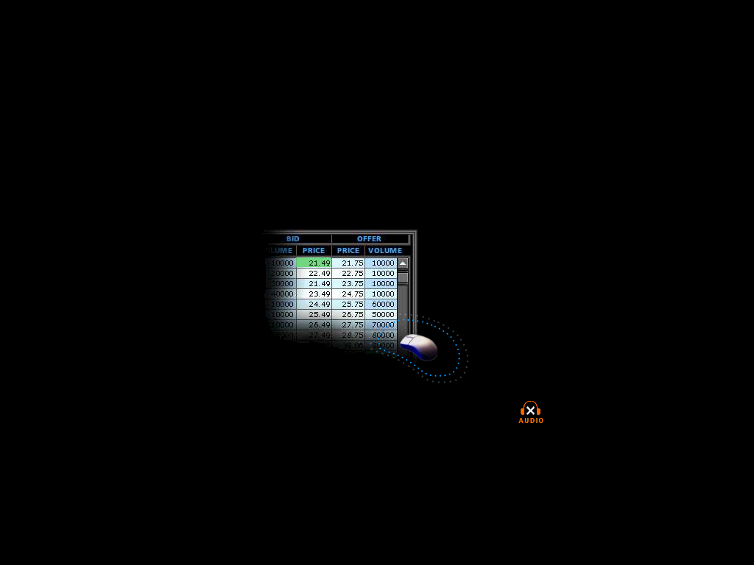
Introducing EnronOnline
A free, Internet-based wholesale global transaction system which allows Enron’s counterparties to view real time prices from Enron’s traders and transact on those prices online.
click & transact

Slide 14
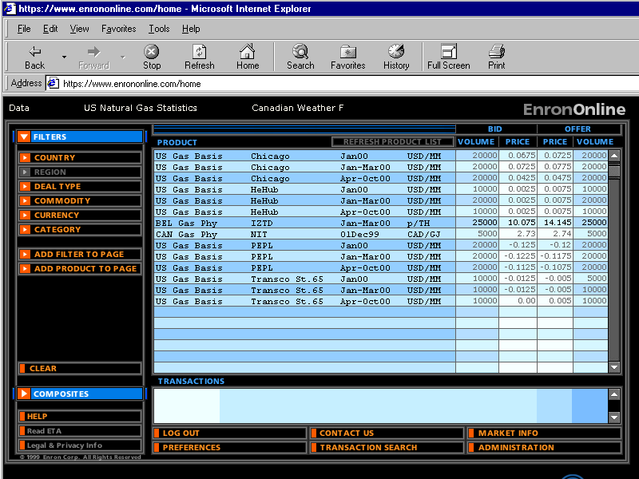

Slide 15
Markets
29th November 1999 US Gas & Canadian Gas
13th December 1999 US Power
5th January 2000 Coal
Crude & Refined Products
Emissions
European Gas
European Power
Nordic Power
Plastics
Pulp & Paper
Weather
To follow Australian Power
Bandwidth

Slide 16
Enhancing customer service
Simple Access via the Internet
Easy to use
Real-time transparent pricing
Increased liquidity
Fast, Secure Execution
Complementary to other electronic markets
……. through EnronOnline

Slide 17
Conclusions
Technology is More than Just Support
Must Move Quickly
Must Change the Culture
It is a Matter of Survival

