Slide 1
Energy in Today’s Economy:
Challenges and Opportunities
Dr. Kenneth L. Lay
Chairman, Enron Corp.
Economy Roundtable
Austin, Texas
January 3, 2001
For further information, contact
Steven Kean, EVP, Enron Corp.
[713-853-1586
skean@enron.com]

Slide 2
Energy Market Overview
Enormous market
Huge price increases in recent months (much of the gas and power price increase is lagged due to public utility regulation)
Extraordinarily volatile prices, but largely unhedged by consumers and producers
Public policy imperatives
  greater supply and infrastructure
  competition in electricity markets
  real prices signals to encourage conservation

Slide 3
Importance to U.S. Economy of Energy
Expenditures
In Billion Dollars (Nominal)
$771
$695
$536
Natural Gas
Power
Petroleum
Estimated U.S. energy expenditure in 2001 is 44% higher than 1999 (+$235 billion)
Source and Assumptions: Enron Corp. Government Affairs; DOE EIA Actuals for 1999; 2001 assumes $2 MMBTU higher gas wellhead prices than 2000 and demand up 10%;
assumes 2¢/KWH higher wholesale power prices on half of U.S. volumes and demand growth at 3%/year. Year 2001 oil prices 10% lower and
use up 2%

Slide 4
Relevance of the Increase in Energy Expenditures
The $235 billion yearly additional spending is:
More than the budget surplus for 1998 and 1999 ($193 billion)
More than half the proposed tax cut over the next 5 years ($230 billion)

Slide 5
Electricity in the New Economy
Digital age increasing the growth of electricity (demand growing at twice the forecasted level)
“Information power” must avoid even momentary interruption
Power growth driving natural gas growth (new capacity over 90% gas fired)
Electricity has become more important to the U.S. economy in the information age

Slide 6
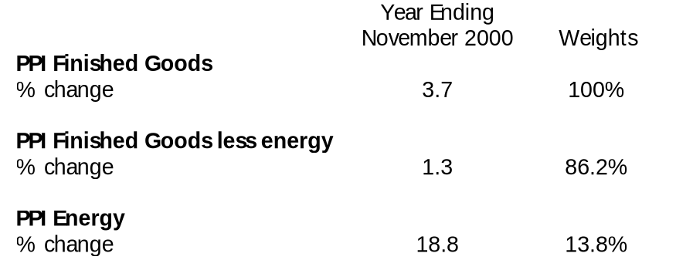
Producer Price Index Effects
Energy leading PPI increase and increases inflation by reducing economic output

Slide 7
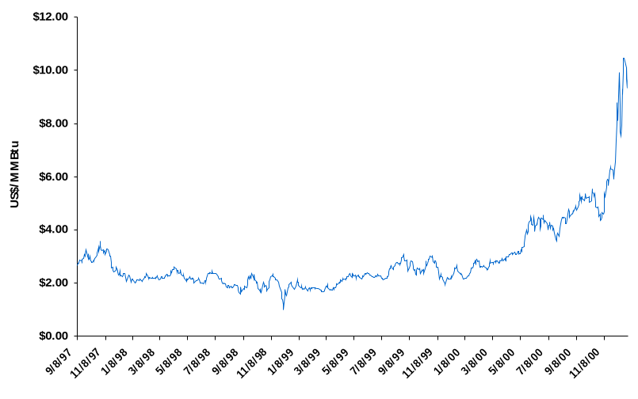
Historical U.S. Natural Gas Prices
2x-3x
price spike
Henry Hub Spot Prices

Slide 8
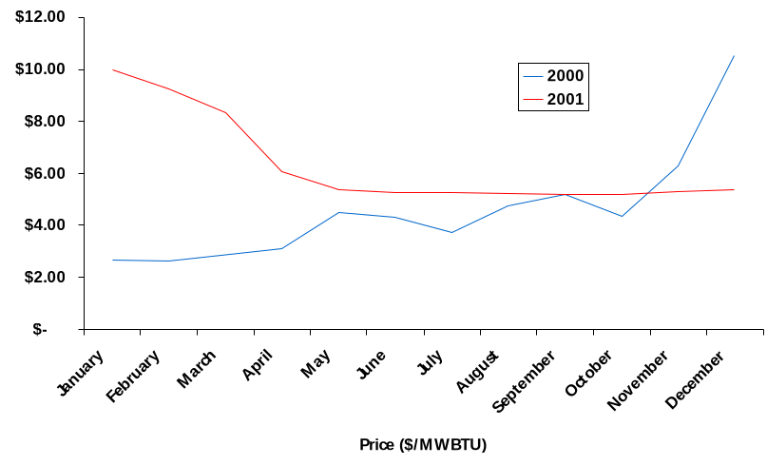
Impact of Higher U.S. Natural Gas Prices
$ MMBTU
Increased Spending*
Industrial $62B Immediate
Commercial $16B 30-360 day lag
Residential $27B 30-360 day lag
Total $105B
* Assumes 2001 demand at 10% above 2000 levels -- NYMEX prices
<number>
AA-FedReserve-1200

Slide 9
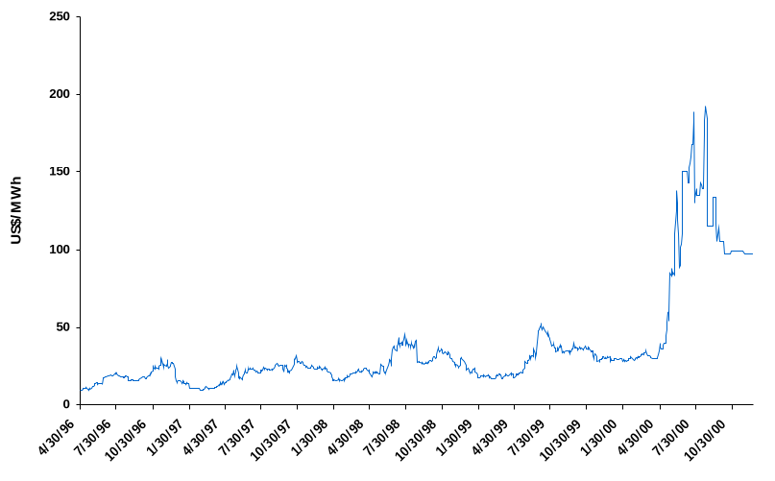
Historical U.S. Power Prices
2x-4x
price spike
California-Oregon Border Prompt Month

Slide 10
Impact of Higher U.S. Power Prices
$ MWH
Industrial* $24B Immediate
Commercial $28B 30-360 day lag
Residential $30B 30-360 day lag
Total $82B
* Assumes wholesale U.S. electricity costs are 50% higher than 2000 on half of U.S. volumes
<number>

Slide 11
Annualized Volatility
Spot Price Electricity CALPX (Peak-Weighted)
NYMEX Natural Gas Prompt
NASDAQ
30-Year Treasury Bond Yield
Power
Gas
NASDAQ
Bond

Slide 12
Solutions for an Electricity Price Relief
Incentives for forward contracting in place of regulatory reliance on unhedged risk
Demand response
  open access to the grid/customer choice
  real time pricing (on-peak conservation)
  energy outsourcing for reductions in energy usage and total bill
Increased supplies
  access to gas reserves
  expedited pipeline and transmission line siting
Congress, state and federal regulators must take an uncompromised approach to power (much of the problem today is that deregulation was “negotiated” with the incumbents)

Slide 13
California–How Not To Do It
Public Policy Imperative
Expand generation infrastructure to meet load growth
Hedge price volatility in bilateral contracts
Promote retail customer choice from non-utility suppliers
Allow real time pricing to guide usage
    California Policy
    Siting and permit delays allow demand to outrace generation
    Total dependence on spot prices from a single pool
    Restructuring results in <1% of customers leaving the utility
    Retail rates capped

Slide 14
Access Restrictions to U.S. Gas Resources
Rocky Mountains
137 Tcf of the area’s 380 Tcf natural gas resources is either off limits or under restrictions. This amounts to 10% of all lower-48 U.S. gas resources
Offshore
The federal moratorium on developing offshore U.S. Atlantic and Pacific resources, which had been set to expire in 2002, was extended to 2012 by President Clinton
This moratorium impacts 31 Tcf of Atlantic resources and 21 Tcf in the Pacific. Another 24 Tcf in East Gulf of Mexico are inaccessible due to state and other federal moratoria. These limitations restrict another 5% of U.S. gas resources
Bottom Line
15% of U.S. gas resources are either off limits or subject to restrictions
Source: NPC Study, December 1999
<number>

Slide 15
Summary: Importance of Sound Energy Policy
We need a sound U.S. energy policy because...
Combination of
  essential nature of the commodities (all consumers and businesses depend on them)
  lack of demand response
  unavailability of storage
  unhedged volatility
Leads to
  Crisis Potential
Energy is a large part of overall economic picture
  can affect inflation
  affects every major business; can threaten economic growth

Slide 16

®

