Slide 1
Enron Broadband Services
Jeff Skilling
President & CEO-Elect
Enron Corp

Slide 2
Enron Annual Sales
100.8B
9.2B
5.5B

Slide 3
Enron Market Value
72.1B
9.6B
2.7B

Slide 4
Enron Price/Earnings Ratio
46.4
16.4
17.4
*Continuing operations

Slide 5
Enron Assets
53B
10B
12B
* As of Q3 2000

Slide 6
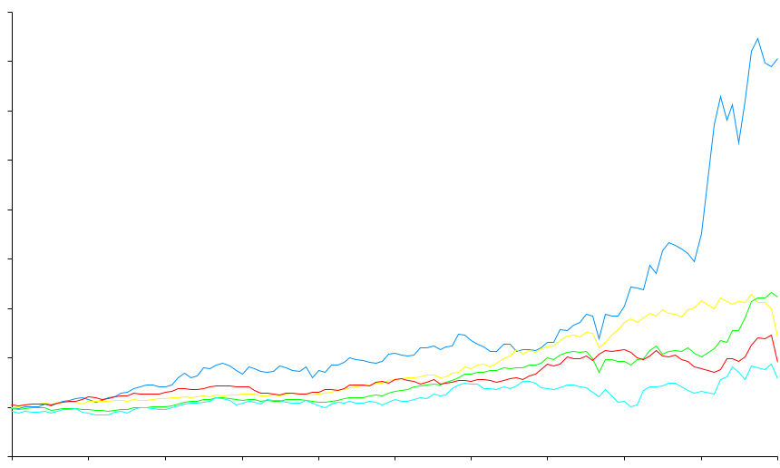
Total Return to Shareholders
Jan 1, 1990 to Dec 31, 2000
1600
1400
Enron Corp.
S&P 500
Pipeline Avg.
Utility Avg.
E&P Avg.
1,415%
383%
545%
281%
217%
1200
1000
800
600
400
200
Aug 00
0
-200
Dec 90
Dec 91
Dec 92
Dec 93
Dec 94
Dec 95
Dec 96
Dec 97
Dec 98
Dec 99
Nov 00
Dec 00
Note: Calculated to December 31, 2000

Slide 7

®
Enron
Transportation
Services
Enron
Wholesale
Services
Enron
Energy
Services
Enron
Broadband
Services

Slide 8
Market Capitalization (Billions)
World’s Largest Gas-Fired Power Plant Completed in the U.K.
Enron Broadband Services Established
Leading U.S. Wholesale Power Marketer
Leading U.S. Wholesale Gas Marketer
Largest U.S.
Gas Pipeline Company from HNG/InterNorth Merger
EnronOnline Introduced
Leading European Wholesale Gas & Power Marketer
Enron Oil & Gas Company IPO
Enron Energy Services Established

Slide 9
Economic Trade-Off
Cost of
Interaction
$
Value of
Specialization
Volume

Slide 10
Evolution of Economic Trade-Off
1300’s
Creation of
Money
$
Barter
Economy
Volume

Slide 11
Evolution of Economic Trade-Off
1300’s
1800’s
Creation of
Money
$
Transportation &
Communication
Barter
Economy
Volume

Slide 12
Evolution of Economic Trade-Off
1300’s
Creation of
Money
1800’s
2000’s
$
Transportation &
Communication
Internet &
InfoTech
Barter
Economy
Volume

Slide 13
Types of Interaction Costs
Credit
Legal &
Regulatory
Logistics
Price of
Successful
Economic
Transactions
Information
Seeking &
Gathering
Payments
Inventory

Slide 14

Cost of Interaction
Mining
Financial
Institutions
U.S.
30-40%
60-70%
55%
India
40-50%
Source: McKinsey

Slide 15
Business Structure
1.0
1.0
1.0
Transformation
Interaction
.90
Finished
Product
.85
Transformation
Costs
Interaction
Costs
Total
Costs
.90
3.45
3.00
6.45
.80
Finished
Product
Transformation
Costs
Interaction
Costs
Total
Costs
.95
1.10
1.20
1.10
.20
.20
.20
4.35
.60
4.95
<number>

Slide 16
Cost of Teller Transaction
$1.50
$0.30
$0.01
1985
(Bank)
1995
(ATM)
2000
(Internet)

Slide 17
Length of Time to Provision Bandwidth
6-8 months
2-3 months
< 1 second
1995
Today
Next
Year

Slide 18
Length of Time to Execute a Long-Term Gas Contract
2-3 years
9 months
2 weeks
< 1 second
1981
1989
1997
2000

Slide 19
Change in Economics of Business Structure
Transformation
Interaction
1.0
1.0
1.0
.90
.10
.10
.10
Finished
Product
.85
Transformation
Costs
Interaction
Costs
Total
Costs
.90
3.45
3.00
6.45
3.45
.30
3.75
.80
Finished
Product
Transformation
Costs
Interaction
Costs
Total
Costs
.95
1.10
1.20
1.10
.20
.20
.20
4.35
.60
4.95
<number>
<number>

Slide 20
Where’s the Opportunity?
.90
.10
.10
.10
.85
.90
.80
.95
.20
1.10
.20
1.20
.20
1.10
<number>

Slide 21
Where’s the Opportunity?
.90
.10
.10
.10
.85
.90
.80
Not
Cost
Competitive
.95
.20
1.10
.20
1.20
.20
1.10
<number>

Slide 22
Where’s the Opportunity?
.90
.10
.10
.10
Commoditized
Overcapitalized
Globalized
Can’t make compensatory
return in traditional asset
business
.85
.90
.80
.95
.20
1.10
.20
1.20
.20
1.10
<number>

Slide 23
Where’s the Opportunity?
.90
.10
.10
.10
Creating low cost, dependable
market interfaces
  Market making
  Logistics
  Back office
  Trade finance
.85
.90
.80
.95
.20
1.10
.20
1.20
.20
1.10
<number>

Slide 24
Where’s the Opportunity?
.90
.10
.10
.10
.85
.90
.80
Providing packaged turnkey
solutions for customers
  Complex structures
  Differentiation
  Customization
“Virtual” Integration
.95
.20
1.10
.20
1.20
.20
1.10
<number>

Slide 25
Enron Opportunity
Traditional
Business Model
Asset intensive
Vertically integrated
Slow moving and rigid
Hierarchical
New
Business Model
Brain power intensive
Networked
Oriented toward “real options”
Fast moving
Entrepreneurial

Slide 26
Enron–Accelerating Market Development
Metals
Commodity
Product
Financial
Bandwidth
Australian Power & Gas
Pulp & Paper
Coal
Weather
Scandinavian Power & Gas
Plastics
Emissions
Financials (interest rate, equity)
UK Power & Gas
Electricity
Currencies
Natural
Gas
1985
1986
1987
1988
1989
1990
1991
1992
1993
1994
1995
1996
1997
1998
1999
2000
* Lighter shading indicates a developing market
Darker shading indicates a mature market

Slide 27
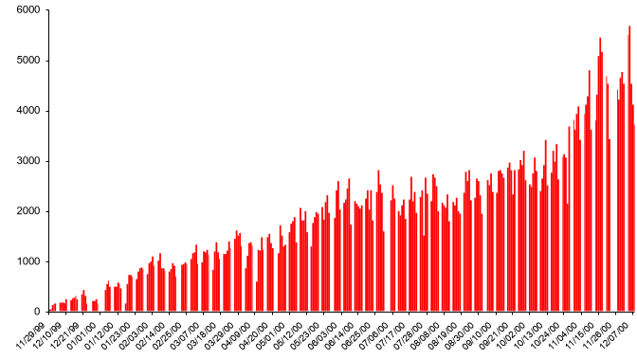
EnronOnline – Changing the Way Commodities Are Traded
Free, Reliable Transaction System with Enron as Principal
Transactions per day

Slide 28
Enron Efficiency Gains
Transactions
Per Market Maker
Marginal
Cost Per Transaction
(Indexed)
100
3,084
25
672
1999
2000
1999
2000

Slide 29
®

