Slide 1
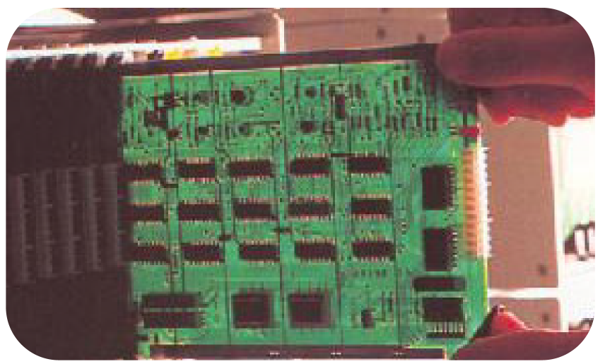
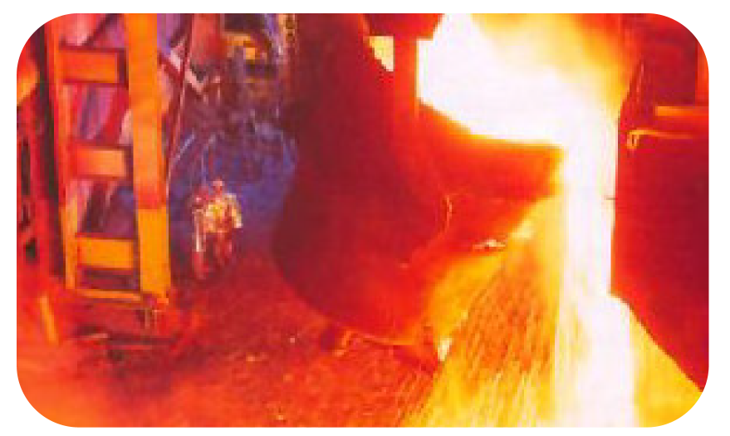

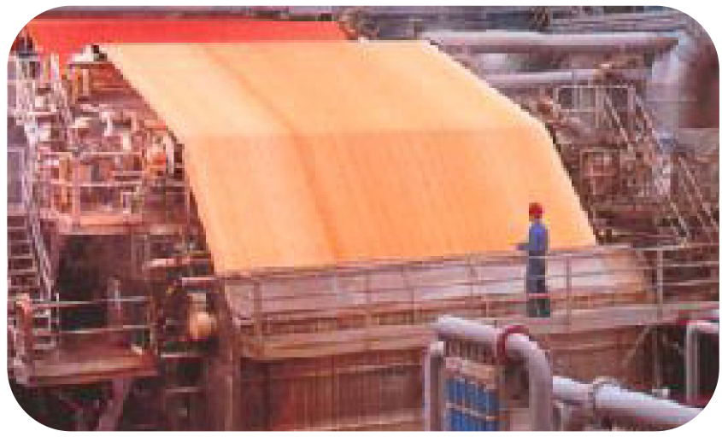

Solutions for Turbulent Markets
Steven Kean
Executive Vice President and Chief of Staff
American Iron and Steel Institute 2000 Fall Leadership Conference
November 2, 2000
®

Slide 2
Overview
What’s happening?
Business Structure
Energy
What are the solutions?

Slide 3
What’s Happening

Slide 4
Business Structure
1.0
1.0
1.0
Transformation
Interaction
.90
Finished
Product
.85
Transformation
Costs
Interaction
Costs
Total
Costs
.90
3.45
3.00
6.45
.80
Finished
Product
Transformation
Costs
Interaction
Costs
Total
Costs
.95
1.10
1.20
1.10
.20
.20
.20
4.35
.60
4.95

Slide 5
Change in Economics of Business Structure
1.0
1.0
1.0
.90
Transformation
Interaction
.10
.10
.10
Finished
Product
.85
Transformation
Costs
Interaction
Costs
Total
Costs
.90
3.45
3.00
6.45
3.45
.30
3.75
.80
Finished
Product
Transformation
Costs
Interaction
Costs
Total
Costs
.95
1.10
1.20
1.10
.20
.20
.20
4.35
.60
4.95

Slide 6
Global Commodity Industry Issues
Highly cyclical market
Capital intensive
Volatile energy / materials costs
“Old” economy label
Significant pressure on:
Margins
Cash flow
Capital access
Earnings
Market valuations

Slide 7
What’s Happening in Energy Markets

Slide 8
Selected Commodity Annualized Volatility
1997-2000
Spot Price Electricity ERCOT
NYMEX Natural Gas
NYMEX Sweet Crude
30-year Treasury Bond Yield

Slide 9
Long term gas prices 1984-1999
Industrial Natural Gas Prices in Real Terms (Dollars per Thousand Cubic Feet)

Slide 10
Gas Prices
Henry Hub Gas Prices (Dollars per Thousand Cubic Feet)

Slide 11
Backwardation of Gas Prices
Backwardation Price Curve for Wellhead Gas
($/MMBtu)

Slide 12
Power Prices
PJM Prices (Dollars per Thousand Cubic Feet)

Slide 13
Backwardation of Power Prices

Slide 14
Underlying Causes
Economic growth spurring rapid demand
Power markets
Incomplete transition to competitive markets

Slide 15
Pressure Points
Gen
Wholesale Market
Retail Market
Customers
Utility resisting new generation
Regulatory barriers to siting new facilities
Shortage
Economic growth spurring growing demand

Slide 16
Pressure Points
Gen
Wholesale Market
Retail Market
Customers
Scenario 1
Volatile
commodity
market
Losses
Fixed
rate
cap
Scenario 2
Pass through mechanism
Inadequate customer choice
Price Spike

Slide 17
Way Forward
Regulators - Find the courage to finish the job of opening the
system to competition
- Time for compromise is over
Utilities - Get out of the commodity business
Customers - Exercise choice
Can’t go back, can’t stand still… must move forward.

Slide 18
Solutions
Lockout risks which are outside your control
Energy
Commodity products
Outsourcing energy—the commodity
Equipment
Services

Slide 19
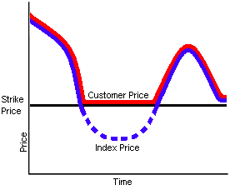
Hedging Price Risk – Price Floor Example
Steel
Manufacturer
Put
Option
Premium
($)
Steel
Index ($)
Steel
Purchaser

Slide 20
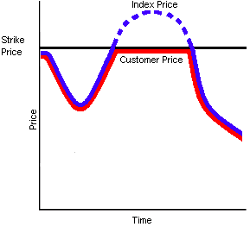
Hedging Price Risk – Price Cap Example
Steel
Manufacturer
Call
Option
Premium
($)
Index ($)
Nat Gas
Utility

Slide 21
EnronOnline
Commodities Traded
Results
Natural Gas
Power
Crude Oil
Weather Derivatives
Emissions Allowances
Plastics
Petrochemicals
Pulp
Paper
Coal
Broadband
Metals
Average Weekly Transactions
Capabilities
Proprietary Technology - Dynamic real-time pricing
Scalable - over $178 Billion notional value transacted since inception (11/99)
Flexible - adaptable to unlimited products in multiple currencies
Reliable - a principal-based trading system
Leading e-commerce platform
Most liquid e-marketplace
>50% of all Enron’s transactions

Slide 22
Enron’s Approach to Energy and Facility Management
Traditional Approach
Enron Approach
Customer Receives
Utilities
Software Vendor
Controls Manufacturers
Commodity
Management
Improved Core Business Focus
Redeployment of Capital
Reduced Operating Costs
Risk Transference
Access to World-Class Capabilities
Architects
Engineers
Energy Information Management
Equipment Manufacturers
Conditioned Air
Light
Managed Facilities
Mechanical Contractors
Energy Asset
Management
Electrical Contractors
HVAC Svc Companies
Facilities
Management
Consultants
Specialty Contractors
Lenders
Capital
Management
Internal Treasury

Slide 23
Total Energy and Facility Management Outsourcing
What is it?
The comprehensive long-term management of energy-related assets, information and facility services to minimize costs while maximizing reliability and service for all U.S. operations
Energy Asset Management
Energy Information Management
Commodity Management
Capital
Design & Engineering
Construction
Operations & Maintenance
Facility Management
Commodity supply and metering in deregulated markets
Tariff management in regulated markets
Utility representation
Tariff arbitrage
Reduced commodity consumption through optimization of capital investment
Reduced demand charges through load management
Lower operation and maintenance costs
Improved worker productivity and/or customer experience through better environment
Increased labor productivity through elimination of craft specialization and application of best practices
Reduced administrative and purchasing costs
Competitive cost of capital
Customized realization
Asset/Contract monitizations
Reduced administrative costs
Consolidated billing for services
Correction of utility over billing
Improved decision making through better use of information

Slide 24
®

