Slide 1

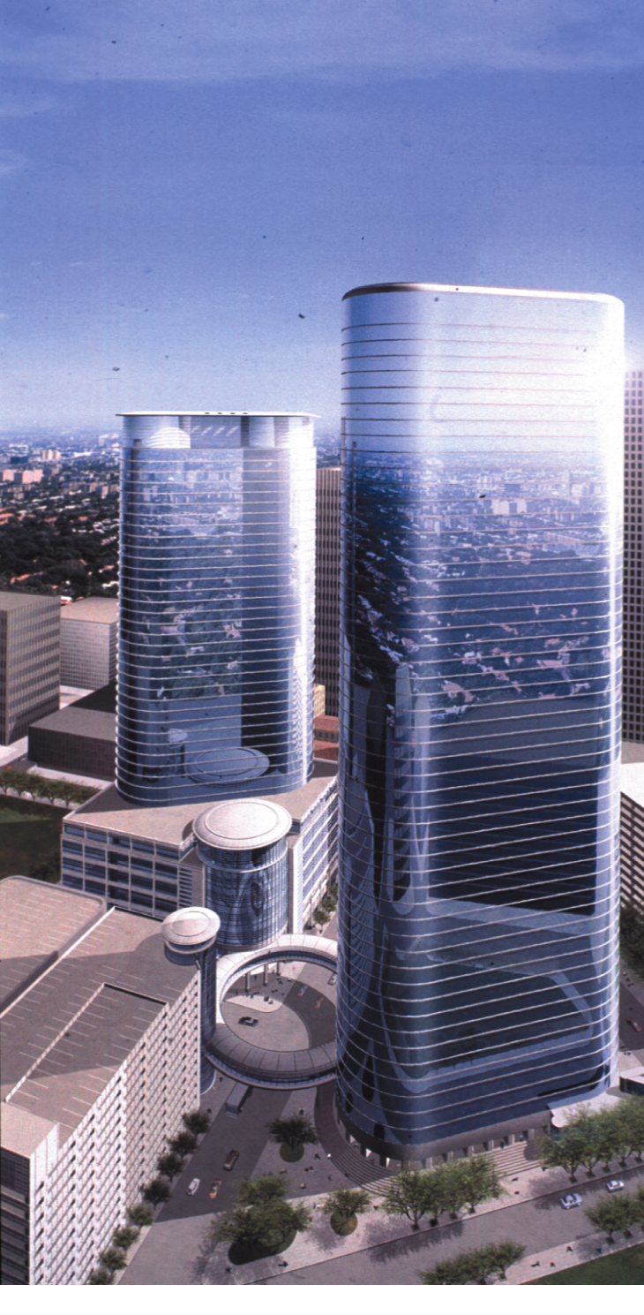
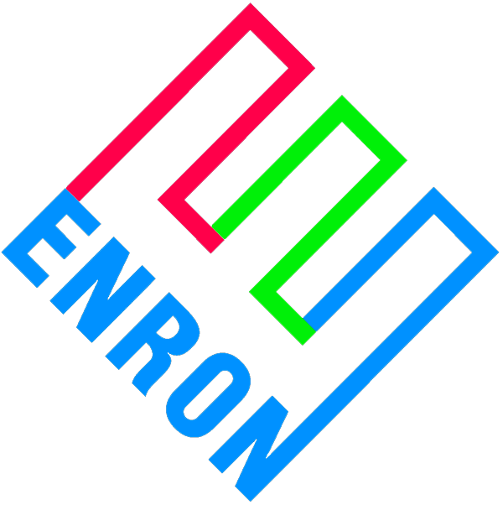
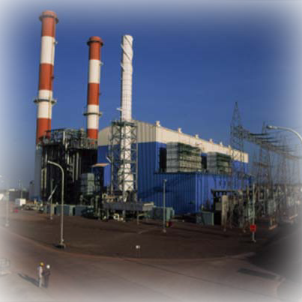
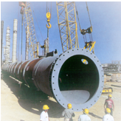
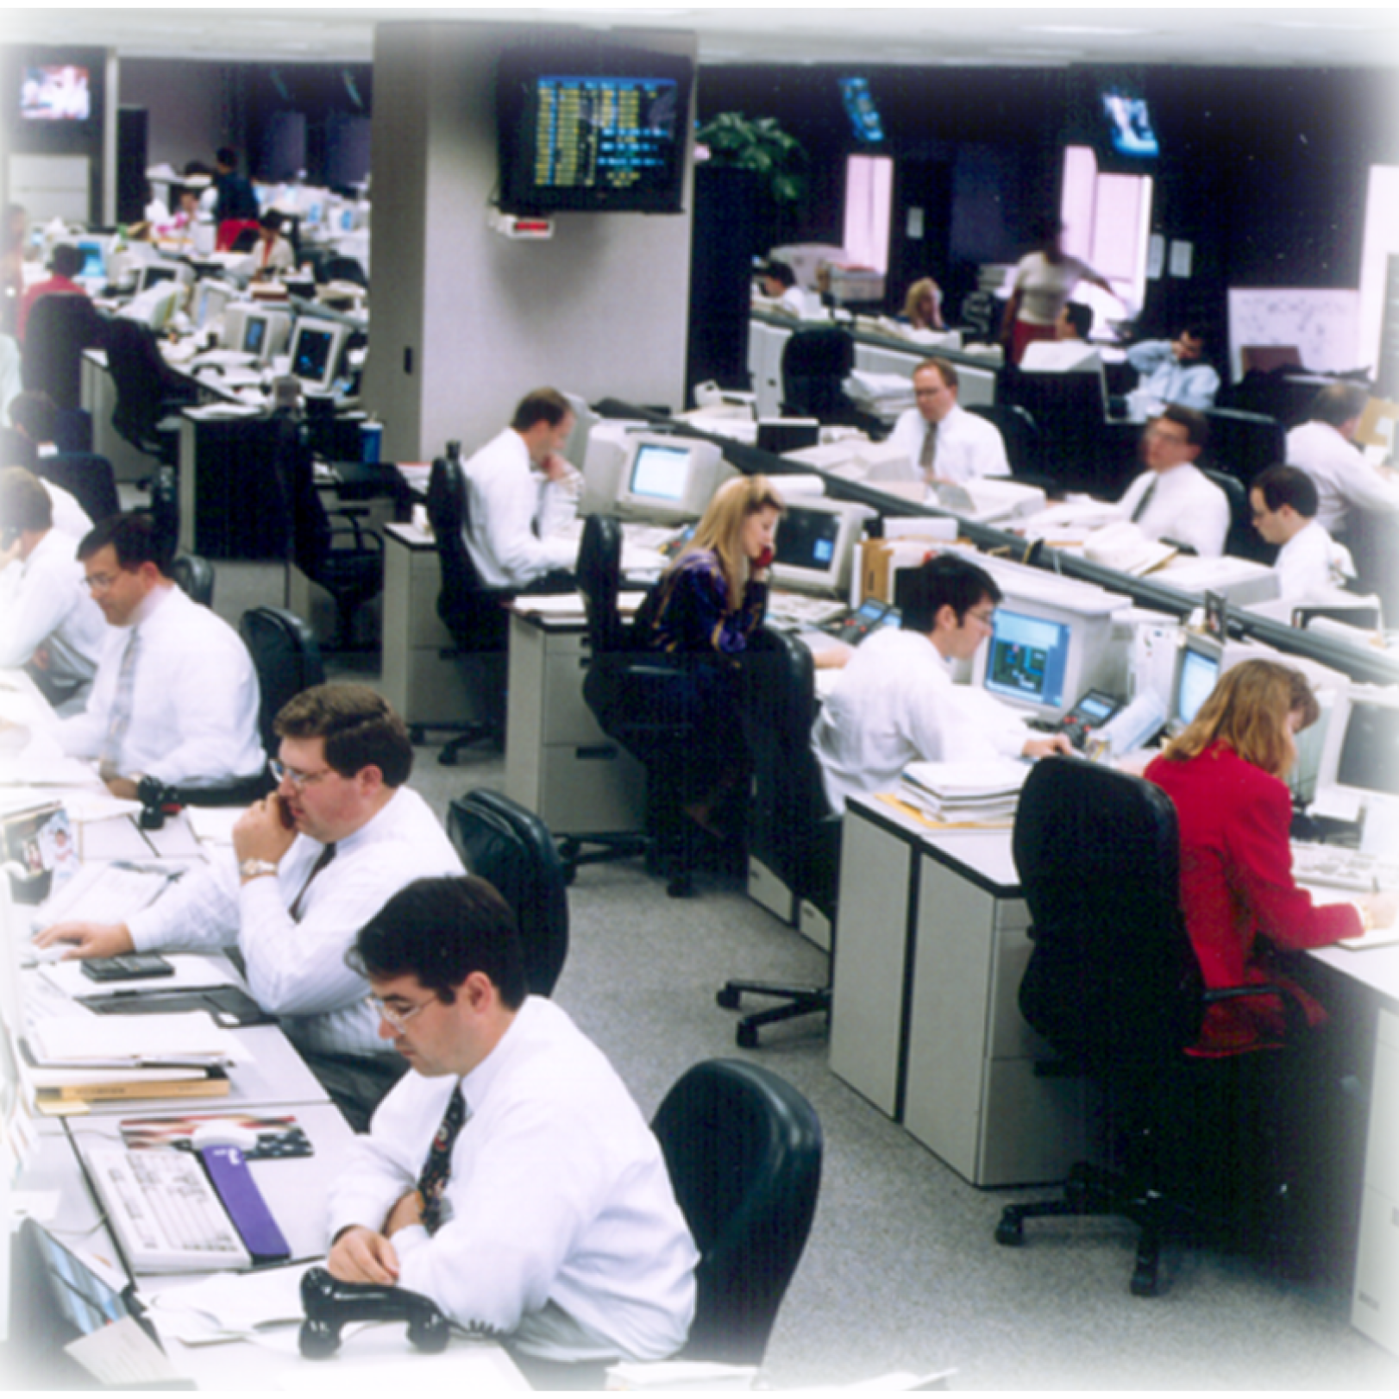
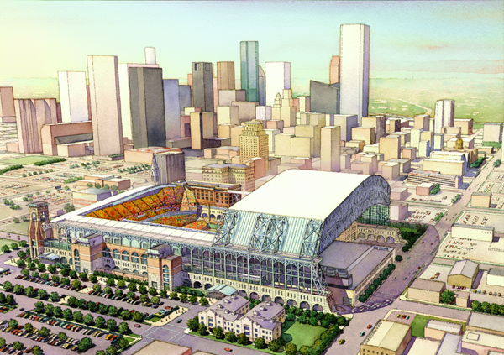
Enron Corp. Public Affairs Executive Business Review September 21, 1999
<date/time>
<footer>

Slide 2
Context Distinguishing Enron’s Approach to Public Affairs
Key Facts
Implications
Highly Regulated Environment - Public policy decisions dramatically affect business
Significant Public Scrutiny
High Profile - Enron wants to change the world
Business to Business Focus
Regulatory/Political expertise and influence are critical to success
Need regulatory information - - understanding the environment and how it’s changing
Need to accurately assess and manage regulatory and political risk
Need aggressive and effective media relations - to manage crises - to exploit opportunities
Advertising focused on opinion and business leaders (not mass markets)

Slide 3
Objectives
Privatization; divestiture
Open access; choice; free trade; deregulation of competitive functions
Write the “source code” for restructuring
Assessment
Mitigation
Resource allocation
Brand Advertising
Active media relations
Focus attention on opinion leaders (politicians, regulators, NGOs)
Enable Enron to build Flexible, Non-regulated Network
- “Atomize” the market
- Increase transaction flexibility/repackaging opportunities
Best system for assessing and managing regulatory risk and opportunity
Enhance Enron’s Image
- Most innovative
- Shift to Energy and Communications

Slide 4
Functions and Organization
Government Affairs
PR/Communication
Advocacy
- Driving change
Business Unit support
- Transaction support
- Ongoing business
Regulatory risk/opportunity assessment and management
Organized geographically and by substantive area
Media Relations
Advertising
Internal Communication
Manage Enron’s public image
Crisis management
Domestic and International organizations
Network of internal and external resources
Worldwide scope
Substantive expertise in energy, environment, communications and trade

Slide 5
Approach
Potential
Transactions
New Market Development
Opportunities
Existing Assets
and Positions
Privatization
Liberalization
Free Trade
OPIC
Image Building
Advertising
American Indian Affairs
Regulatory transactions
Media Relations
Project Advocacy-lobbying, regulatory affairs
Risk/Opportunity Management

Slide 6
Approach
Get Leverage
- Form/lead coalitions
- Get control of the Pen
- Serve as resource for decision makers, media
- Make noise
Measure
- Measurements and analytical framework for managing risk, identifying opportunity, measuring success and allocating resources
Business Focus
- Embed people in the business units
- Shared objectives
- Involve business unit leaders

Slide 7
Update
Key Trends
Initiatives
Privatization/Liberalizationmore complex
WTO
Uniform business rules
Privatization/Liberalization transition guide
Social responsibility program
Environmental Affairs function
Complete risk/opportunity measures and framework
Increasing issues with NGOs
Environmental image at risk
Enron increasingly exposed to regulatory risk

Slide 8
Update
Accomplishments
Measurable value created in excess of Public Affairs budget
$68 billion of electric and gas revenues opened to competition
Positive media profiles of Enron
WTO coalition (formed and led by Enron) adding energy services to USTR list for 2000 round

Slide 9
Regulatory Risk Management

Slide 10
Objectives
Develop system and process to manage regulatory risk/opportunity
Develop framework for valuation of regulatory and political activities

Slide 11
Regulatory Risk
Regulatory
Risk
Sovereign
Risk
Risk that an administrative agency or government takes legal action which results in modified business environment (e.g., tax policy; tariff rules)
Risk that a host government may take
“supra-legal” action resulting in
adverse impact on trade
or investment (e.g., expropriation)
Political Risk Continuum

Slide 12
Approach
Identify
Analyze and Quantify
Mitigate / Manage
Follow Through (audit/review)
Existing Assets and Positions
New Investments / Transactions
New Market Development
Inventory
Risk Controls / Underwriting
Risk Assessment
Retained
Formalized Mitigation Plan
Reserve
Transfer
Contract Terms
Purchase Price
Assign Responsibility for Mitigation Plan
Track/Audit Update
Government Affairs
Market Opening Timeline/Quality
Indices
Publish
Identify Opportunities

Slide 13
Measure Success
To measure how Public Affairs’ advocacy is advancing Enron’s
network vision, there needs to be an independent metric.
Public Affairs is working with industry sources to publish structured Indices (domestic and global) which quantify overall energy market liberalization.
Value of Publishing Market Reform Indices
Measure Public Affairs’ success in meeting Enron’s internal needs in liberalizing markets = our “score”.
Support public discourse and advocacy by identifying market successes and failures for policymakers and stakeholders.
Provide tool to direct Public Affairs’ resources.

Slide 14
Indices
Global Energy Investment Index
Measure 20 countries versus “ideal” market model on 100 point scale.
Primary Attributes:
1. Financial stability, 2. % assets private, 3. % market access
Least Open Markets:
20. India - 23, 19. China - 25, 18. France - 27
Oil & Gas Journal will publish
US Retail Electric Competition Index
Measure retail competition versus “key” market elements on 100 point scale.
Primary Attributes:
1. Divestiture, 2. Default Service Model, 3. Unbundling
Most Competitive Markets:
1. Maine - 63, 2. Pennsylvania - 57, 3. New Jersey - 53
Center for Advancement of Energy Markets may publish

Slide 15
Corporate Communication

Slide 16
Functions
Corporate Public Relations
• Earned Media
• Visitor Center
• Internet
• Business Unit Public Relations Coordination
Corporate Brand Advertising
• Paid Media
• Internet
Internal Communication
• Enron Business
• Hello Enron
• Employee Meetings/Orientations
• Intranet

Slide 17
Strategy / Approach
Consistent Delivery Of The “Message”
Coverage On Our Terms
Ask “How Can We Help You Make Money?”
Investor Relations’ Audience is Primary

Slide 18
Advertising Approach
Move Toward Endless Possibilities, Innovative, “Network”
Deemphasize sole focus on “Energy Company”
Focus on categories/examples, not individual testimonials
Message
Business Decision Makers (45%)
- CXOs and Their Advisors
Opinion Leaders (45%)
- Regulators, Politicians, Media
Employees (10%)
- Current/Prospective
Target Audience
Measurement
Awareness Tracking to Measure Effectiveness of Media Plan
Opinion Research to Measure Impact on Target Audience

Slide 19
Objectives
Increase familiarity & favorability rankings by 20 percentage points among CXO audience
Continually improve website
Generate favorable profile pieces (comparable to NYT)
Provide a platform for information movement across Enron

Slide 20
Initiatives
PUBLIC RELATIONS
Financial Times Profile
Communications Media Tour
Visitor Center
Internet
ADVERTISING
“Why” Campaign
Internet
INTERNAL COMMUNICATION
“eThink” Intranet Platform

Slide 21
International Marketing, Communication and Public Relations

Slide 22
Objectives
Support business goals by actively contributing to the success of projects in development and operation.
Enhance Enron’s image with key audiences.
Anticipate/manage issues and opportunities in rapidly changing markets.

Slide 23
1999 Significant Developments
EVENTS
Changing business landscape; attacks by NGOs on human rights and environmental grounds
Enron “First-Mover”
Enron’s evolution to a truly global company
IMPLICATIONS
Reputation management problems
Manage concerns by lenders, investors, government
Requires policies, advocacy and strong community interface
Significant interest in and visibility for Enron worldwide
Being first may result in later controversy over issues such as tariffs, transparency
Emerging economies often have unstable governments
Opportunity to create understanding of new products and services
Stakeholders expectations differ
Cultural/ethical issues
Consistent brand and marketing strategy

Slide 24
Functions
Public Relations Strategy
Business development
Image enhancement
Promote strategic initiatives
Opinion Research
Media Relations
Crisis Planning/Management
Issues Management/Policy Development
Marketing/Market Entry
Events and Protocol
Employee Communication
Community Relations

Slide 25
1999 Significant Accomplishments
Opinion Research
Media Relations
Crisis Planning/Management
Issue Management/Policy Development
Marketing/Market Entry
Events and Protocol
Employee Communication
Advertising
Guatemala, Brazil, Bangladesh
WSJ Dabhol story, dedication publicity; Project Finance Best Sponsor award; Sutton Class of 2000; Gazeta Mercantil features; Pipeline & Gas Journal cover story; Nikkei (5 mm circulation) Enron/Sutton feature; Infrastructure Journal cover story
Nicaragua ROW, Promigas explosion
Cuiabá, Human Rights Watch
Korea, Jamaica, Australia, Thailand, Dominican Republic, Haina, Panama, Venezuela, Argentina
Africa Summit, S. American Ministerial
Downsizings: Elektro, Panama, Puerto Rico
Brazil and Argentina

Slide 26
1999 Initiatives
Establish benchmarking research in major markets.
Conduct international best practices audit.
Introduce written international media relations policy.
Roll out cost effective targeted communication tools for various markets.
Ensure that community relations, crisis plans are in place for key assets in construction and operation.
Introduce Enron Social Responsibility and Environmental program.
Roll out field test of community relations program with worldwide entities, such as CARE and the Red Cross.

Slide 27
Central America/Caribbean/ South America
Supporting 30 operating units and business initiatives
Argentina
Oil & Gas Expo/Art Exhibit
Bolivia
Cuiabá/Transredes crisis, media, collateral, trainings
Brazil
Opinion research/marketing/ PR strategy/ad campaign
Colombia
PR strategy for new pipeline
Dominican Republic
Haina closing 9-30/PR plan for transition and downsizing
Ecuador
Oil pipeline issues management
Guatemala
New barge mktg. support/ research/media/CR
Jamaica
Consumer marketing programs for growth/retention/winbacks
Nicaragua
Inauguration/CR plan
Panama
Media/stakeholder/employee programs
Puerto Rico
Media/community relations
Trial/labor/new pipeline/ ECO
Venezuela
ACCRO/CALIFE/Ventane
Media/crisis/community/mktg.

Slide 28
Asia Pacific/Africa/China, India & Middle East
Supporting 25 operating units and business initiatives
Algeria
Australia - Create image as first mover in trading/commodity based finance
Bangladesh - Differentiate from EOG
Benin
China - Name recognition & coal-fired plant issues
Cote d’Ivoire
Egypt
Gaza Strip - Regional publicity
Guam - High profile community relations to overcome utility opposition
India - Human rights & Dabhol renegotiation issues
Indonesia - Manage press interest in MIGA political risk claim/past partners
Japan - Deregulation & market entry
Malaysia
Mozambique - Reverse negative perception
Morocco
Nigeria - Leveraged Africa Summit for gov. contacts/Comm. relations part of bid
Oman
Philippines
Qatar
Saipan - Manage gov. corruption issues to maintain viability of Enron bid
Saudi Arabia
Senegal
South Africa
South Korea - Increase Enron recognition and develop gas use campaign
Taiwan
Thailand - Publicly/appropriately sever link with past partner. Promote regional gas hub
Togo
United Arab Emirates
Vietnam - Lawsuit reputation threat

Slide 29
State Government/
Federal Regulatory Affairs

Slide 30
Approach
Rely on outstanding base of internal resources
Leverage firmly established position as leader of open market perspective
Objectives tied directly to asset and transaction enhancement/protection/creation
Rigorous resource allocation process
• 2000 budget 12% less than 1999 budget

Slide 31
Objectives and Accomplishments
Support Potential
Transactions
New Market Development
Create and Exploit
Opportunities
Protect and Enhance
Existing Assets
and Positions
Control areas
Day-to-day support for trading activities
East Coast Power
Mitigating tariff risk--e.g. California CTC
Outsourcing transactions
Gas commodity
Bandwidth Trading
E-Commerce
Natural Gas Asset Management
Industrial customer solutions
2000 peakers
EnerConnect
Hedge fund
Federal facilities: access
Simon redistribution
Fiber build
Legislation passed in 9 States
$50 billion new open market revenues added
RTO NOPR
Utilities Merchant Function Changing, e.g. ComEd; UI
Continuing utility generation asset divestitures
Uniform business rules
NHEC
UI
Standard offer provision
ENA
EES
ECI

Slide 32
Asset Base: The Effects of Restructuring
38% Merchant
270
259
229
177
149.4
MW(000’s)
117.6
90.5
Sources: DOE/EIA, Electric Power Supply Association, Resource Data International

Slide 33
1999 Advocacy Results: Increased Network Size
$50B increase
188
180
$ Billions
142
112
86

Slide 34
Valuation of Selected Efforts
Project
FERC Complaint: BPA Shaped Transmission Service
FERC Order : MAPP Transmission Services Refund
Texas Legislation (w/o Electric Utility Restructuring)
NEPOOL Billing Error Correction
BC/Alberta Firm Transmission
California PUC Revenue Adjustment Proceeding
United Illuminating
Dismissal of MAPP Investigation
New Jersey Restructuring Settlements
FERC Annual Fees
ECI: Louisiana Fiber Siting
Value
$400,000
$600,000
$1,200,000
$1,300,000
$2,000,000
$2,500,000
$2,500,000
$3,100,000
$3,900,000
$12,500,000
$14,650,000
$44.5 Million
165% of Budget

Slide 35
Federal Government Affairs

Slide 36
Summary
Protecting and Enhancing Existing Assets and Positions
Facilitating
Potential
Transactions
New Market Development
Opportunities
Project Advocacy with USG
CFTC
Bankruptcy code amendments
Clean Air Act Issues
Telecommunications
Universal services
Taxation
Electricity restructuring legislation
OPIC reauthorization
Domestic/intern-ational project development
TVA
WTO
Electric Restructuring Legislation
Africa Growth and Development Act
Trade
Tax Code Changes

Slide 37
Update
US WTO Energy Service Coalition (ESC)
Enron is leading the effort to have the World Trade Organization (WTO) include energy services in its GATS 2000 service negotiations.
Organized the US WTO Energy Services Coalition.
Successfully lobbied USTR to include ESC in the US negotiation list.
Met with international industry representatives and embassy officials to have other countries include energy services as a priority.
Enron representatives will participate in the upcoming World Services Congress and the WTO Seattle Ministerial.
Fighting Anti-Competitive Sanctions
Enron is leading the effort to waive the sanctions on India, Azerbaijan, as well as opposing other unilateral sanctions as they arise.
Opposed efforts to repeal NTR for China.
Worked to enhance US trade with Vietnam.
Opposed the Save Domestic Oil anti-dumping petition.
Opening Markets
Enron is leading a coalition to pass the Africa Growth and Opportunity Act as well as the Caribbean Basin Initiative which will provide the framework to expand US trade in these regions.
Through our active engagement in CEE, we support a 4-year reauthorization and maximum funding for OPIC, and support other export finance agencies.
US Bolivia Business Partnership
Enron, working with the Bolivian Embassy, established the US Bolivia Business Partnership - a coalition of US industries with projects and interest in development in Bolivia.

Slide 38
Update: Trading & Finance Issues
Issues
Coalitions
Status/
Activities
Political
Factors
Potential
Impact on
Enron
Prevent regulation of OTC derivatives
Legal certainty-- statutory
exemption for OTC derivatives
Prevent regulation of electronic trading (EnronOnline)
The Energy
Group ISDA
Hearings held in 1999 and expected in 2000
Draft bill late 1999, action in 2000
Advocacy ongoing with Congress, CFTC, banking regulators
Tours of Enron for key policy makers conducted
Illinois Rep. Ewing guided by Chicago Exchanges
Texan allies Reps. Combest, Stenholm need education on energy/OTC
Position of new CFTC Commissioners unclear
Regulation of OTC derivatives - Potentially large ($???) if business moves offshore
Regulation of electronic trading - Potentially large ($???) if innovation stifled

Slide 39
Update: Bankruptcy Code Amendments
Issues
Coalitions
Status/Activities
Political Factors
Potential Impact
on Enron
Enron Technical Correction on Productions Payments
Prevent DOI proposal on Oil/Gas leases
Enron Technical Amendments on Derivatives
DOI - Oil/Gas Associations, American Bankers Assn.
Derivatives - ISDA, Bond Market Assn.
Advocacy ongoing before Congress, financial regulators, DOI, DOJ
H.R. 833 passed full house -- includes production payments; excludes DOI proposal; no derivatives fix
S. 625 Senate floor action 9/21/99 should include production payments; exclude DOI proposal; include derivatives fix
All Enron provisions should be included in conference committee, DOI provision excluded
Democrats, Clinton may kill bill due to opposition on unrelated consumer issues
May need to seek alternate vehicle (appropriations) for production payment fix
Production payment - certainty would lesson litigation costs, add security for product
DOI - success would avoid detriment impact on energy lending
Derivatives - clarification would add security for products, contracts

Slide 40
Update: Clean Air Issues – NOx, SO₂, Mercury
Issues
Coalitions
Status/Activities
Political Factors
Potential Impact
on Enron
NOx trading -
SIP call states
and Ozone
Transport Region
SO2/acid rain
program
amendments
Mercury under
consideration
EPSA
Enron led coalition of competitive generators
Coalition for Gas Based Environmental Solutions
INGAA
States developing NOx SIPs - delay by court stay
Future Nox/PM regulations delayed by litigation
Legislation on SO2 introduced but not moving in Congress
Nox Cap and Trade language included
Battle being
fought between
EPA and
Northeast
states and
Midwest states
over NOx
Litigation
causing delay
in
implementation
of regulations
EPA
contemplating
next 10 years –
integrated air
regulations?
CAA legislation
of any kind will
not proceed
until likely after
2000 elections
NOx Cap and
Trading
Program :
benefit for
emissions
trading, green
power, gas,
clean
technologies,
renewables;
potential
downsides for
generation
and coal

Slide 41
Update: Global Climate Change
Issues
Coalitions
Status/Activities
Political Factors
Potential Impact
on Enron
Development of
Domestic,
International
carbon
regulations
Credit for Early
Action
Leading
formation of a
multi-industry
coalition on
efficiency-
based solutions
Ad Hoc Gas
Industry
Coalition on
Climate Change
Coalition for
Gas Based
Environmental
Solutions
Business
Council for
Sustainable
Energy
Alliance to Save
Energy
Pew Center
INGAA Climate
Change Task
Force
Kyoto treaty
ratified but U.S.
Senate
ratification
unlikely
Battles fought
in
appropriations
legislation over
climate R&D
Early crediting
legislation
introduced but
stalled
Enron
developing pro-
active carbon
programs now –
setting high
credit standards
Action on any
major carbon
regulations
unlikely until
after 2000
elections
Republican
presidency
could change
debate in U.S.
Short term
focus will
remain on R&D
funding
Early Crediting
legislation lacks
environmental,
business
support
Needs overall
assessment for
impact on
Enron Corp.;
potential large
benefits for CO2
trading
business, gas,
renewables,
green power,
energy
efficiency,
control
technologies;
potential
detriment to
coal,
generation

Slide 42
Update: Electricity Deregulation
Issues
Coalitions
Status/Activities
Political Factors
Potential
Impact on
Enron
PUHCA
PURPA
Renewables
Market Power
Transmission Access
Interconnection
Private Use
Reliability
PMA’s
TVA
BPA
Reciprocity
State vs. Federal
Distributed Energy
Metering/Billing
Aggregation
R.P.S.
Systems Benefit Trust
Stranded Costs
Grandfathering
Divestiture
Code of Conduct
Transmission Siting
8th Circuit
Standardized Interface
Slamming, Cramming
Universal Service
Mergers
Cross Subsidies
Anti-trust
NERC
FERC
Eminent domain
Tax
RTOs
Americans for Affordable Electricity (AAE)
Consumers for Fair Competition (CFC)
Coalition for Business Reforms (CUBR)
House Hearings Completed
House Subcommittee/ full committee and sequential committee referrals to be completed in 1999
Senate mark-up draft vehicle released in 1999
Lobbying, bill/amendment drafting, consensus media events, op-eds, paid print, radio, TV
BPA lead title drafting/ consensus
TVA strategy to address control area and peaker interconnection
Process breakdown
Demonopolization vs. deregulation (FERC attack)
Barton vs. Bliley
Bliley not Chairman next Congress
Murkowski (Alaska)
Lott (Southern Company)
EEI front groups $$$
Time
House and Senate Majorities in play
Re-election - Presidential
Wholesale access all users and separation functions ($$)
Uniform Business Rules ($$)
Green tags ($$)
Reciprocity and PUHCA (PGE problem) Meter/Billing access

Slide 43
Update: Telecommunications
Issues
Coalitions
Status/Activities
Political Factors
Potential
Impact
on Enron
E-commerce
Internet taxation
Universal service exposure
Privacy
Electronic signature
Regulation
Decency
Encryption
WTO (service vs facilities)
May need to create own
Internet caucus
Hearings
FCC
Courts
Governor
Gilmore’s Tax
Commission
Congressional
dissatisfaction with
FCC and
Telecommunications
Act implementation
States looking for
tax revenues
Regulation
Taxation

Slide 44
Value Created in 1999
Issues
Impact
Done MTBE Duty Drawback
Projected Tax Bill (Foreign Tax Simplification Act)
Projected Appropriations
Wind Energy R&D
Gas R&D
Gas Turbine R&D
TVA
Projected Foreign Operations Authorization and Appropriations (OPIC)
$3 million retroactively, $1-2 million a year
Tax Department has stated huge benefits-but impossible to enumerate…one of the tax simplification provisions alone could provide a $127 million benefit to Enron
Enron Wind has a 3 year $20 million contract with the National Renewable Energy Lab to develop next generation wind turbine and receives approximately 15% of these funds=> $2.5 million
Lowering TVA’s debt ceiling will mean less investment in their own peaking generation
4 Year Reauthorization of OPIC alone would add value of $2 billion in insurance and guarantees
$4 Million

Slide 45
International Government Relations
and Environmental Affairs

Slide 46
Summary
Potential
Transactions
New Market Development
Opportunities
Existing Assets
and Positions
Korea-Tax
Southern Cone
TGS
Elektro
China-pipeline/ power pools
OPIC
Cuiaba
Gaza
PQPZ
Rio Hondo
APEC
WTO
Japan-MITI reform
Thailand privatization
GHG tracking system
Carbon Trading
Metgas
Caribbean Basin
EGEMINSA
Mozambique Steel Project

Slide 47
Organization and Functions of the Group
Market Reforms/Liberali-zation/Privatization
Value Added Initiatives
Political Due Diligence
Regulatory Due Diligence
Capacity Building
Protect Value
Restructuring
Environmental Policy
International NGO Relations
EIA/Due Diligence/ Compliance
Carbon Trading
Loan Support
Bank Policy and Lending Practices
Liaison: OPIC, IADB, WB, ADB,..etc.
USG Advocacy
Embassy Liaison
International Trade Initiatives : WTO, APEC
WTO Services Negotiations
APEC Natural Gas Initiatives

Slide 48
Strategy/Approach
Provide regulatory and policy support for projects and assets in-country
Help Business Units to identify and mitigate regulatory and governmental risk and monitor business environment
Mobilize USG Advocacy for policy in projects
Use bilateral and regional associations for intelligence and access to senior officials
Maintain high-profile advocacy for market and policy reforms through direct government contacts, policy forums and Enron sponsored seminars

Slide 49
Environmental Affairs Organization Domestic & International
Chief Environmental
Officer
Business Units
Other Govt. Affairs
Compliance
“Officers”
Research &
Analysis
Advocacy
Business units
EIS quality control
Objectives
Quality control for EIS process
Due diligence/risk assessment
Best practices
Coherent public policy position
Policy and practices standards across organization
World class information gathering/dissemination to support trading & environmental marketing groups (forward view of environmental policy)
International/emerging market environmental policy
Monitor legislative changes in key jurisdictions (20)

Slide 50
Environmental Affairs Approach
EIS “Quality control”
Pre-acquisition due diligence and risk management
Developing ‘forward view” on environmental policy
21st Century Co.
NGO relations
Risk/Opportunity
Mgmt Identification
Compliance
Compliance at ongoing projects/assets
Transaction
Support
Mitigation
Environmental marketing support
Public Policy
Global warming/climate change
Market based mechanisms

Slide 51
Representative Projects by the Major Regions-Update
IGA/IRA
Korea - Tax
Japan- MITI Reforms
Thailand - PTT/EGAT Privatization
Indonesia - PGN
Southern Cone - TGS, Tax, Elektro
Caribbean Basin - Rio Hondo, EGEMINSA
Africa - Power Barge Nigeria
India - Metgas
China - Pipeline/Power Pools
Environmental Affairs
Sustainable Enron
Cuiaba CFCP
Implement the GHG tracking system
Translate Climate change policy into commercial opportunities
International Financial Affairs
OPIC:
Rio Hondo
Cuiaba
Gaza
PQPC
Dominican Republic
Bangladesh: Barge-mounted emergency power project
Nicaragua: Corinto Power Project
Cote d’Ivoire: Offshore Project
International Federal Affairs
WTO - Energy Services
APEC - Natural Gas Initiatives
Top USG Advocacy Issues:
Croatia Power Project
Nicaragua Power Barge
Mozambique Steel Project MISP

Slide 52
Indicators of Value Added
Cuiaba:
$200 million of OPIC funding -- $18 million
Korea tax issue:
80% exclusion worth $1.5 - 4.0 million annually (starting 2000) -- $12 million NPV
Thailand:
PTT system opening to third party access
Japan:
Transparent, cost based transmission tariffs to large customers
$30 Million

Slide 53
ENRON EUROPE Government & Regulatory Affairs

Slide 54
Summary
Potential
Transactions
New Market Development
Opportunities
Existing Assets
and Positions
UK climate change levy
UK origination unaffected by pending reforms
UK market restructuring
Repeat
Mare
Coal
Dutch power market
UK trading reforms
Germany -TPA
Poland - wholesale market reform
Italy - access to import capacity
BG Transco refund
Danish - German Border capacity
Norwegian - Danish Interconnector

Slide 55
Current Major Initiatives
Harmonisation of cross-border transmission rules - charges, capacity allocations, definition of available capacity
Completion of UK electricity trading arrangement reforms
Critical to ending moratorium; increased liquidity and counter-parties likely; Enron’s central role produced information advantage
Key countries
Germany - Implementation of new TPA regime - lower costs, simpler methodology
Italy - Access to import capacity, versus incumbent
Poland - Wholesale power market reform
Spain - Remove obstacles/barriers to completion and financing of Arcos

Slide 56
Indicative Strategies
Formation of coalitions of traders (all initiated or led by Enron)
European Forum for Energy Traders (EFET) (Pan-European)
ACIE (Spain)
VOEG (The Netherlands)
In Germany, within consensus model, work with existing industry groups, notably VIK (industrial users), VKU (municipal utilities), BDI (Chamber of Commerce equivalent)
Information sharing with allies
Energy user groups
Consumer advocacy groups
Regulators
Adversarial/Litigation
Principally rely upon competition, i.e., anti-trust law - abuses of dominant position, discrimination, essential facilities doctrine, market power mitigation

Slide 57
Longer-Term Developments
Re-visit EU Directives, particularly market opening levels
Hammer away at Negotiated Third-Party Access (German power, most European gas)
Re-visit German energy law - need for a regulator
Iberian Power Market Reform - vertical integration, pool limitations, stranded costs
Whatever the business requires

Slide 58
Valuation of Selected Efforts
Climate Change Levy - $47 million savings
Danish-German Border Capacity Enron - led, Enron - only; easily in excess of $3 million
BG Transco refund Q1 income of $1 million
Norwegian - Danish Interconnector Enron - led, Enron - only; value to be seen in second half ‘99
Dutch power market entry Enron a leader
UK origination unaffected by pending reforms
UK market restructuring - Project Repeat, Project Mare, coal origination
$51 Million

Slide 59
European Power Markets Annual Consumption (TWh)
Traditional Sales
Competitive Market

Slide 60
European Gas Markets Annual Consumption (bcf)
50,000
45,000
40,000
35,000
30,000
bcf
Traditional Sales
25,000
Eastern and Nordic
Markets start to open
20,000
15,000
Western Markets open
Competitive Market
10,000
UK Market
5,000
-
1990
1991
1992
1993
1994
1995
1996
1997
1998
1999
2000
2001
2002
2003
2004
2005
2006
2007
2008
2009
2010
Nordic
UK
Continental (W.Europe, excl. UK and Nordic)
Continental (E.Europe, incl. Turkey)
Russia
Open Markets (Total)
Projected Eastern Market Opening

Slide 61
EU Contestable Electricity Market Year to Year Expected vs. Actual
$ Billions

Slide 62
Government Affairs-Mexico

Slide 63
Objectives
To promote, accelerate and influence change in those activities in which Enron has an interest
This year our efforts have been directed to electricity and natural gas
We are in the process of initiating an effort in telecommunications and water

Slide 64
Functions
Advocacy. In Mexico, a great part of the process has consisted of informing the different parties (Congress, private sector, regulators and policy makers) of the benefits of change and of convincing them of the extra benefits of doing things within the most competitive environment possible.
Transaction Support. Around 30% of the time is dedicated to commercial projects: looking for new opportunities resulting from deregulation, developing clients, getting the resources to serve those clients, putting proposals together and trying to close transactions.

Slide 65
Strategy
Build personal relationships, keeping low profile in order not to attract attention during the energy
sector reform process.
Become a reliable and trustworthy source of information and opinion on the restructuring of the energy
sector, on the development of energy markets and on regulatory change and its implementation.

Slide 66
Update
ELECTRICITY
With the Government
Secured changes in bidding rules which enhance our opportunities
Enron executives meeting with President Ernesto Zedillo and the Secretary of Energy to support
regulatory reform
Support to the Secretary in lobbying efforts with the private sector and members of Congress
Exploring business opportunities in Hydro power and discussing Hydro generation policy
Our opinions on the proposed specific regulation have been handed to the Secretary of Energy
With the Private Sector
Information support for press releases and interviews of business leaders
Organization of the most important foreign business leaders in order to send more than 200
letters to members of Congress
With the Parties
Interviews with the highest ranking party members of the Energy Commission and of
the Industry Promotion Commission of the House of Representatives to discuss the reforms
to the electricity regulation
Organization of a discussion panel with the private sector and members of Congress
Wrote, for the PAN, a counterproposal to the Executive which included Enron’s views, and
that was agreed upon by the Secretary of Energy

Slide 67
Update
NATURAL GAS
With the Government
Have successfully argued against an unregulated Pemex natural gas marketing subsidiary.
Have sent numerous opinions to the Secretary of Energy and the President of the Energy Regulatory
Commission (CRE) with respect to the unbundling of the gas industry and competition principles for
the gas market. Many of these opinions have been sent to them at their request.
Have worked with the CRE on the directives for the first hand sales of natural gas.
With the Parties
Included the proposal to restructure and unbundle the natural gas industry within the
counterproposal written for the PAN with respect to the electricity reform.
We argued that guaranteeing competition throughout fuel supply chain was indispensable for a
competitive electric industry.
OTHER
Water
Have worked with Azurix in finding opportunities and introducing them to State Government officials.
Commercial
Have started development of several customers.

Slide 68
Initiatives
Currently developing an initiative for Enron on how to advocate for change in the electric industry by orienting and informing the policy makers on a case by case basis, offering examples on how to solve relatively common problems.

Slide 69
American Indian Affairs

Slide 70
Objectives
Build existing tribal relationships and Alliances into mutual PROFIT CENTERS
Use tribal Alliances as platforms to
PROMOTE ENRON PRODUCTS AND BUSINESSES
Offer our success in commercial tribal relations to CREATIVELY RESOLVE TRIBAL ROW AND OTHER OPERATIONS ISSUES

Slide 71
Strategy
Analyze each tribe/tribal entity with respect to:
- Size and wealth
- Location of reservation or jurisdiction of entity
- Reservation location vis-à-vis transmission lines, gas pipelines, water resources, Federal facilities, other reservations
- Commercial sophistication of tribe
- Commercial activities and energy use
- Politics of tribe: size and stability of tribal council
- Existing natural resources
Define commercial capabilities/products of Enron businesses
Match strengths of respective tribal energy picture with defined Enron business capabilities/products
Assign potential project value and likelihood of success
Prioritize potential projects

Slide 72
Major Initiatives
American Indian Economic Development Fund
BIA Facilities/Federal ESPC contracts
- Chemawa Indian School; Santa Fe Indian School; Southwestern Indian Polytechnic Institute; Indian Health Services
Tribal Energy partnerships
- MOU in place: White Mountain Apache Tribe
Sea Alaska Native Corp.
- MOUs pending: Mushantucket Pequot Tribe
Mohegan Tribe
Laguna Pueblo
Seminole Tribe
Mille Lacs band of Ojibwe
Grand Travers Tribe
Arctic Slope Regional Corp.
National Tribal Energy Conferencing
Bimini Island, Bahamas
Political Support
- Counsel to, and intervenors in, Energy Issues affecting American Indians arising from DOE, DOI, BIA and at other Federal/State levels

Slide 73
Major Initiatives (cont.)
Commercial Support
- Operating companies ROW, NAGPRA, Permits
Diversity Support
- Linking American Indian Corps. with Enron Diversity Contracting (Native Corp. now bidding on FGT Phase IV)
- Diversity Task Force
- American Indian Student Mentoring
- American Indian Week/E-Cafe

Slide 74
What We Need to Succeed
Support for risk management approach
- building the inventory and quantifying
- follow through on mitigation
Resources
- reduce “tin-cupping”
- increase emphasis on international
Support for corporate responsibility program
- Board approval
- compliance
- participation (esp. with NGOs)

Slide 75
Appendix

Slide 76
Appendix-
Regulatory Risk Management
Retail Electric Competitive Index
State Ranking
5
63
44
5
44
5
31
27
5
5
5
21
16
41
5
3
24
5
57
53
5
12
50
43
23
29
5
DC 9
5
5
5
3
40
5
05
5
5
5
9
5
13
31
43
5
5
5
5
22
5
Most Competitive [Score >= 45]
Least Competitive [Score <= 10]
Data as of 9/3/99

Slide 77
Appendix-
Regulatory RiskManagement
Global Energy Index
USA 72
England 69
Australia 66
Chile 66
Norway 64
Germany 58
Argentina 57
Canada 54
Spain 51
Brazil 51
Bolivia 42
Italy 38
Japan 38
Mexico 36
Philippines 34
Thailand 33
South Korea 27
France 27
China 25
India 23

Slide 78
Appendix-
Corp Communications
Advertising

Slide 79
Appendix-
Corp Communications
Advertising Decision Process
Measurement
(Focus Group)
(Awareness Tracking)
(Opinion Research)
Message
Communication
Target
Audience
What Do We Want
Our Target Audience
to Think (and Do)?
How Do We Deliver the
Message?
Advertising
- Media Plan
Other Communication
- Direct
- Indirect
Who Do We Want?

Slide 80
Appendix-
Corp Communications
Recommendations
Brand Advertising
- As part of a broader communications plan
Commit to Sustain Investment in Brand Advertising
- At corporate level
Periodic Review
- Driven by measurement results

Slide 81
Appendix-
Corp Communications
Recommendations
Brand Advertising, but ….
In Addition to:
Direct Contact with Audience
- IR
- Government Affairs
- “Enron University”
Earned Media Values Can be Higher or
Lower than Paid Media Values

Slide 82
Appendix-
Corp Communications
Recommendations
Media Plan
3-4 Ads Developed/Rotated
Develop 1-2 New Spots Per Year
Predominantly TV, with Print Support
- 75/25 TV to Print ratio
Purchase Media to Reach CXO, Opinion Leaders
- CNBC, etc.
- At 80% Reach and 13x Frequency
Opportunistic Buys
- Surrounding Events Like Major Conferences, Speeches, Recruiting Trips

Slide 83
Appendix-
Corp Communications
Recommendation
Periodic Review
Consistent Measurement Process will Drive
Internal/External Review
Internal
Departmental Level Review of Each Message (as Developed)
Departmental Level Review of Each Media Flight (=8x/yr)
Executive Level Review of Opinion Research (2x/yr)
Agency Level Review Consistent with Above
Agency Performance Review Annually
Consider Placing Agency Compensation at Risk
~
External

Slide 84
Appendix-Federal Gov’t Affairs
Committee Chair Priority
Leadership Agenda
Bill Introductions
Committee Work
Mark-up
Sequential
Announced Priority
Subcommittee
Committee
Final Passage
Referrals
Jan.
Jan. - Feb.
Feb. - Mar.
Mar. - Aug.
Mar. - Sept.
Oct. - Nov.
Jan. - Oct. 2000
•
Early January
•
Late January
•
•
Administration:
•
House
•
House Floor
•
Senate
•
Bliley - Richmond speech
•
Lott - announcement
Paxon/Moler to head
April 14
Subcommittee
Consideration
Passage
•
Barton - “should do” not
•
Armey -
coalition
•
Largent/Markey bill:
mark-up:Sept. 21
•
Senate Energy
•
Conference
•
Milestone:
“must do” to “will do”
announcement
Senate PUCHA
May 26
•
House Full
Cmte
. mark-up
completed
•
Murkowski - says he is
legislation passed/
•
Murkowski
Committee mark
(Oct.)
•
Signing
working on bill
held
•
Bliley draft: June 29
-up
•
Barton: March 18
Hearings begin and
are concluded July
22.
•
Barton drafts
(July/Sept.)
•
Contact with Barton
•
Grass roots focused on
•
Drafting
•
Barton meeting w/ Ken Lay
•
Lobbying
•
Lobbying
•
Lobbying
•
Contact with Murkowski
leadership districts
•
Working Group
•
Enron testifies before
•
Contact with Hall
•
Lobbying leadership
•
Coalition support
House/Senate/
•
Earned media
•
Earned media
•
Earned media
•
AAE
Paxon
Moler
Working Group
Activity:
•
Contact with Bingaman
/
Chairs
•
Bipartisan/
•
Lobbying individual
•
•
TV & Print Buys
•
TV & Print
•
Texas Legislation
•
Contact with House and
Bicameral
members, soliciting co-
TV & Print Buys (2)
Buys
•
Write bipartisan bill
Senate
Coordination
•
sponsors, bill drafting
•
Coalition contacts
Leadership/recruit bill
•
Meetings with every
•
TV & Print Buys
sponsors
Committee member
•
Earned media
•
Grasstops contracts
•
Contact with
•
Governor project
•
Attempt Chamber
•
Polls
Administration
support
•
NW Title drafting
•
Op-eds (Moler, Sharp
•
Largent/Markey drafting
Paxon
, etc.)
•
TVA
•
NAM support
•
Nickles & Bingaman bills
•
Fundraisers
Unified coalition additions:
co-ops, public power,
environmentalists,
consumer groups
•
Drafting
$80,000
•
Drafting
$40,000
•
Drafting
$80,000
•
Drafting
$40,000
•
Special TVA
•
Coalition Fundraiser
Projected cost = No
•
(A Cost
$20,000)
•
(A Cost
$70,000)
•
(A Cost
$50,000)
•
(A Cost
$20,000)
•
(Cost
$90,000)
increase from 1999
•
Polling
$40,000
•
Polling
$60,000
•
(A Cost
$30,000)
•
Polling
•
TV/Radio
$1,260,000
•
Polling
$0.00
•
($3.31 Million)
•
(A Cost
$10,000)
•
Polling
$20,000
•
(A Cost
$35,000)
•
(Cost
$50,000)
•
(A Cost
$10,000)
•
Consulting
$500,000
•
(A Cost
$10,000)
•
Consulting
$25,000
•
(A Cost
$300,000)
•
Consulting
$62,500
•
Consultant
•
Consulting
$62,500
•
(A Cost
$185,000)
•
Print
$120,000
•
(Cost
$225,000)
•
Total Surplus
•
(A Cost
$70,000)
•
(A Cost
$150,000)
•
(A Cost
$55,000)
•
(A Cost
$220,000)
•
TV/Radio
$840,000
•
(+$255,000)
•
Print/Radio
•
(Cost
$910,000)
•
Line item for TVA
•
(A Cost
$235,000)
•
Print
$80,000
•
Cost $250,000
Cost
•
(Cost
$300,000)
Estimate:
•
A Costs
$110,000
•
A Costs
$465,000
•
A Costs
$95,000
•
A Costs
$270,000
•
A Costs
$540,000
•
Costs
$1,585,000
•
Budgeted
$120,000
•
Budgeted
$600,000
•
Budgeted
$162,500
•
Budgeted
$65,000
•
Budgeted
$1,480,00
•
Budgeted
$982,500
•
Surplus
+$10,000
•
Surplus
+$135,000
•
Surplus
+$67,500
•
Deficit
(-$205,000)
•
Surplus
$940,000
•
Deficit
(-$250,500)
A Cost = Actual Cost

Slide 85
Appendix-Mexico
Change in the Electric Industry
Introduction
Today, potential changes are underway that will alter the framework of Mexico’s electric industry. If successful, these proposals represent significant steps forward for the establishment of power markets in Mexico. At the minimum, they include increased private participation in electric power generation, a pool or similar structure that would provide access for generated power to Mexico’s transmission and distribution networks, restructuring Comision Federal de Electricidad (CFE) and Luz y Fuerza del Centro (LFC) and a potential closer relationship to the U.S. and Canada for cross border exchanges and wheeling.
Changing constitutional law and other existing legal frameworks and securing political support within Mexico is not an easy task, and many risks exist as these proposals are moved forward. It has been revealing to observe during the past months the positions being taken by key groups and individuals with interests at stake.
The objective of this presentation is to inform you about the proposed structure of the electric industry, the market organization and the regulatory framework that would be established in Mexico if the proposal is approved by Congress. This document will also try to portray the political environment around the proposal for the restructuring of the Mexican electric industry as well as the general situation in a pre-election year.

Slide 86
Appendix-Mexico
Proposed Regulatory Change
The Mexican electric industry will have a larger number of participants through the segmentation of functions currently in the hands of the state-owned vertically integrated monopoly.
PROPOSED STRUCTURE THE MEXICAN ELECTRIC INDUSTRY
Market and System operation
COSEN
Regional
distributors
Producers
Consumers
Independent
Market
Operator
Independent
System
Operator
National Transmission System CFE
Qualified consumers
Qualified consumers
Non-interconnected
Private Transmission
Qualified consumers
Power Marketers

Slide 87
Appendix-Mexico
Political Environment
There is a high level of diversification of opinions. Those who appeal to nationalism and demonstrate in the streets are for now winning the battle against the initiative.
KEY PLAYERS AND THEIR POSITIONS
Positions:
Key Players:
In Favor
Against
Friends
PRIVATE
SECTOR
Pricing, availability, dependability, quality, foreign investment, economic growth
Doubts regarding the benefits for medium and small industries and businesses.
Party in power for last 70 years supports position of executive branch.
Some constituents have formed groups in Congress that question and even oppose the initiative.
PRI
National Electric Workers Union. Their leaders have strongly supported the initiative.
Support is conditioned to the control of the national grid by CFE. Some sectors of the union oppose the initiative.
SUTERM
Party off the center to the right, ideologically in favor. They have a more advanced proposal
The PAN feels that this is not the right political moment to vote together with the PRI in an election year
PAN
Party off the center to the left. They would vote for restructuring, and competition
Their strategy is to oppose any initiative of the party in power and would vote against privatization of assets.
PRD
None
Electric workers union for LFC, the power
utility for the central part of Mexico.
Have demonstrated heavily against the
initiative
SME
Foes

Slide 88
Appendix-Mexico
Most Likely Scenarios
Regulatory reform will be discussed in Congress this autumn and next spring. If approved, the most likely scenario would be better than the existing conditions but could still be improved. If the reform is not approved the electric sector would undergo a deep restructuring, nevertheless, competition would be very limited.
REGULATORY REFORM
RESTRUCTURING
Competition in generation would be allowed
The incumbent utilities would be restructured to promote competition
A centralized pool market would be established
Bilateral contracts would be permitted
The sale of government owned assets will remain pending
The CFE would be divided into 10 generation companies and 15 distribution entities
These utilities would compete in a virtual centralized market
There is a possibility that the rules for the sale of excess power by independent producers will change

