Slide 1
Third Quarter 2001

Slide 2

Forward Looking Statement
®
All statements contained in this presentation, as well as oral statements made by Enron’s officers, directors or employees acting on Enron’s behalf, that are not statements of historical fact, constitute “forward-looking statements” within the meaning of Section 27A of the Securities Act of 1933 and Section 21E of the Securities Exchange Act of 1934. The Private Securities Litigation Reform Act of 1995 provides a safe harbor for forward-looking statements made by Enron or on its behalf. These forward-looking statements are not historical facts, but reflect Enron’s current expectations, estimates and projections. Such forward-looking statements include, but are not limited to, statements which address future operating performance, events or developments that are expected to occur in the future (including statements relating to earnings expectations, sales of assets, or statements expressing general optimism about future operating results). Although Enron believes that its expectations are based on reasonable assumptions, it can give no assurance that its goals will be achieved. Important factors that could cause actual results to differ materially from those in the forward-looking statements herein include success in marketing natural gas and power to wholesale customers; the ability to penetrate new retail natural gas and electricity markets, including the energy outsource market, in the United States and Europe; the timing, extent and market effects of deregulation of energy markets in the United States and in foreign jurisdictions; development of Enron’s broadband network and customer demand for intermediation and content services; political developments in foreign countries; receipt of regulatory approvals and satisfaction of customary closing conditions to the sale of Portland General; and conditions of the capital markets and equity markets during the periods covered by the forward-looking statements. Enron is not obligated to revise or update any forward-looking statements in order to reflect events or circumstances that may arise after the date of this presentation.

Slide 3
®
Transportation
& Distribution
Wholesale Services
Retail
Services
Natural Gas Transportation, Electric Distribution and Global Assets
Commodity Marketing and Delivery
Energy Services for Commercial and Industrial Customers

Slide 4
Earnings Summary (Millions)
3Q00
3Q01
IBIT:
Transportation & Distribution
$ 176
$ 87
Natural Gas Pipelines
83
85
Portland General
74
(17)
Global Assets
19
19
Wholesale Services
589
754
Americas
536
701
Europe and Other Commodity Markets
53
53
Retail Services
27
71
Broadband Services
(20)
(80)
Corp. & Other
(106)
(59)
Total IBIT
$ 666
$ 773
Interest & Other
302
255
Taxes
72
125
Net Income – Recurring
$ 292
$393
Non-Recurring Items
-0-
($1,011)
Reported Net Income
$ 292
($618)

Slide 5
®
Transportation
& Distribution
Wholesale Services
Retail
Services
Natural Gas Transportation, Electric Distribution and Global Assets
Commodity Marketing and Delivery
Energy Services for Commercial and Industrial Customers
Stan Horton
Chairman & CEO

Slide 6
Enron’s Transportation & Distribution Businesses Worldwide Asset-Based Operations
Transportation
& Distribution
®
Natural Gas Pipelines
Portland General
Global Assets
Interstate Natural Gas
Transportation
Electric Distribution
International Assets

Slide 7

Natural Gas Pipelines
Strong Growth Opportunities in All Markets Served
Steady Earnings Growth
Predictable Net Cash Contribution to Enron
Rate Case Certainty
Near Term Expansions in High Growth Markets
Florida Expanding to 2.2 Bcf/d by 2003
Transwestern Expanding Capacity to California
Northern Natural Bolstered by Increased Gas-Fired Plant Demand
Significant Future Growth Opportunities Serving New Gas-Fired Generation
Northern Border Partners (11.8%)
Northern Natural (100%)
Transwestern (100%)
Florida Gas (50%)
Transports 15% of U.S. Gas Demand; Peak Capacity of 10.8 Bcf/day

Slide 8
Florida Gas Expansion Activity
Capacity
(Bcf/d)
Third Party
Power Plants
0.1
2.2
Pipe
0.4
Existing
Phase V
2001
2002
0.3
2003
Ft. Myers
0.5
Major Pipeline Expansions Underway
New Demand-Driven Expansion Opportunities
Over 15,000 MW of New Generation Proposed in Florida Through 2003
Evaluating Supply Connections to Proposed LNG Facilities
Capacity
(MMcf/d)
Cost
(Millions)
Contract Term
(Years)
Expected
In-Service
0.1
0.8
Phase V 428 $460 20 April 2002
Phase VI 120 $80-100 20 Mid 2003
Phase I
Phase II
Phase III
Phase IV
Phase V
Phase VI
<footer>
09_01_3rd Quarter-<number>
Notes:
Over the last decade, the FGT system has doubled in size.
FGT has won regulatory treatment that has allowed expansions with staggered in-service dates. This means that we are always adding just enough capacity to match market growth. This has been key to maintaining our competitive edge.
In 2000, FGT began gas service to Fort Myers, a market previously not served by natural gas.
In May, 2001, FGT placed in-service the Phase IV expansion.
We received final FERC approvals in late July to construct our Phase V expansion. This project is due to be in-service by 2003.
Together, Phase IV, V, VI will add about 700 million cubic feet per day of new capacity by 4th quarter, 2003. More important, these expansions are secured by firm long-term contracts.
Gulfstream has started construction on their pipeline to enter the Florida market. Before now, FGT was the only gas pipeline in peninsular Florida. This means that FGT will have to remain competitive and efficient to attract new customers and beat the competition.

Slide 9

Global Assets
Stand-Alone Assets Not Part of Wholesale and Retail Operations
Largest Assets
Elektro – Electric Distribution Company (Brazil)
Dabhol – Power Plant (India)
Cuiaba – Power Plant (Brazil)
Management Focus
Efficient Asset Operations
Sale of Targeted Assets
Minimal Current Income or Cash Impacts of Currency Fluctuations
Asset Mix by Location
Other
8%
India
14%
Asia
8%
Caribbean
14%
South America
56%
$6.5 Billion of Assets
As of June 30, 2001

Slide 10
Capital Spending* ($ in Millions)
Capital Spending - Gross
Capital Spending - Net of
Proceeds from Sale
Capital Spending
2000 2001E
Capital Expenditures $ 2,381 $ 1,925
Equity Investments 933 1,150
Proceeds from Sale (494) (2,325)
Capital Spending, Net $ 2,820 $ 750
1,305
1,007
610
670
599
1,262
568
436
339
307
317
440
169
529
356
62
238
53
212
232
12
153
2000 2001E
2000
2000 2001E
2000 2001E
2000 2001E
2000 2001E
(353)
2001E
Transportation & Distribution
Americas
Europe & Other Commodity Markets
Retail Services
Broadband Services
Corp. & Other
*Includes PP&E and Equity Investments; Excludes Business Acquisitions and Other Investing Activities

Slide 11
®
Transportation
& Distribution
Wholesale Services
Retail
Services
Natural Gas Transportation, Electric Distribution and Global Assets
Commodity Marketing and Delivery
Energy Services for Commercial and Industrial Customers

Slide 12
Enron’s Wholesale Businesses
Wholesale Services
®
Americas
Europe & Other Commodity Markets
Natural Gas
Power
Europe Natural Gas
and Power
Metals
Energy-Related Markets
Industrial Markets

Slide 13
Performance Highlights
Physical Settlements
(Bcfe/d)
Income Before Interest and Taxes
(Millions)
88.2
$754
$589
53.5
65%
28%
3Q00
3Q01
3Q00
3Q01
Diversified Businesses Drive Consistent Volume and Profit Growth

Slide 14
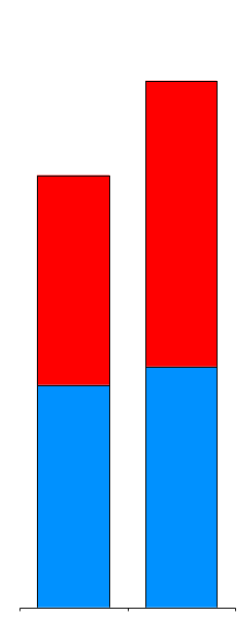
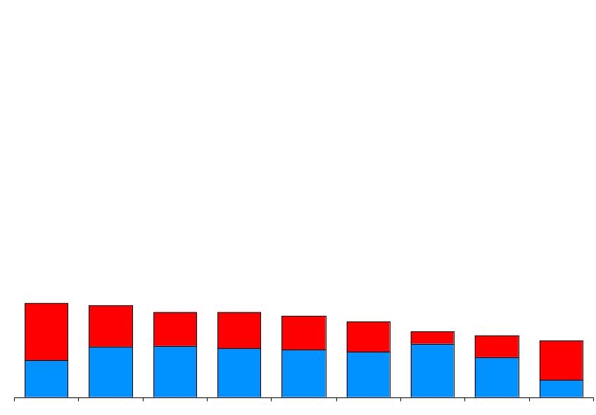
Enron’s Leading Market Position (Physical Settlements in Bcfe/d)
78.8
64.7
Power
Gas
21.6
21.1
19.5
19.4
18.6
17.3
15.0
14.2
12.9
Enron
AEP Reliant Mirant Duke Dynegy Aquila BP El Paso PG&E
2Q01
3Q01
Second Quarter 2001
Source: Gas Daily, Power Markets Week, Company Reports

Slide 15
Financial Settlements
Financial Settlements
(Bcfe/d)
Contracts Settled with Net Cash Payments Without Physical Deliveries
Comprises Significant Portion of Enron’s Longer Term Products
Enron’s Lead Role Provides Distinct Competitive Advantages
Valuable Market Insight
Important Tool to Manage Enron’s Broad-Based Portfolio
319.4
212.2
51%
3Q00
3Q01

Slide 16
New Contract Execution
Transacted Volumes
(New Contracts in Bcfe/d)
Volumes Originated During Current Period for Future Settlement
Record Level Transacted in 3Q01; Driven by Both Gas and Power
Power Comprises Almost 45% of Physical Activity - Up from 20% in 3Q00
Financial Product Expansion Driven by Enron’s Distinct Ability to Make Term Commitments
Average Term Lengthening; Delivery Commitments through 2003
887.7
Financial
Physical
669.8
33%
3Q00
3Q01

Slide 17

EnronOnline Average Daily Transactions
Since Inception
1,550,000 Transactions
$860 Billion Gross Value
>1,800 Products Offered
Nov 1999
Mar 2000
Jul 2000
Oct 2000
Jan 2001
May 2001
Oct 2001

Slide 18
Transaction Mix
Total Enron Transactions
550,000
Traditional
38%
Longer-Term Structured Transactions
Additional Opportunities for Transition to EnronOnline
349,000
EnronOnline
57%
High Penetration in North America Gas & Power; Growing Acceptance in Europe
Rapid Acceptance in Non-Energy Products
Integrated with Logistics and Back Office for Scale Efficiencies
62%
43%
3Q00 3Q01

Slide 19
Enron’s Wholesale Businesses America’s Leading Energy Company
Wholesale Services
®
Americas
Europe & Other Commodity Markets
Natural Gas
Power
Europe Natural Gas
and Power
Metals
Energy-Related Markets
Industrial Markets
John Lavorato
President & CEO
Louise Kitchen
COO

Slide 20
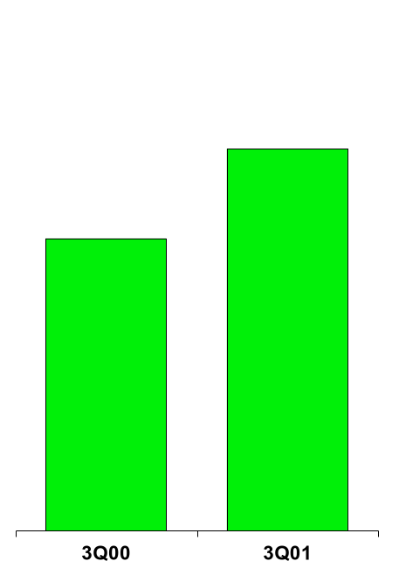
Enron Americas The Most Flexible, Reliable and Valuable Energy Network
Income Before Interest and Taxes
($ in Millions)
701
536
31%

Slide 21
Americas Business Expansion
718.9
540.8
35%
51%
33%
Physical
Financial

Slide 22
Business Highlights East Power
Physical Volumes
(Million MWh)
Number of Transactions
(Per Day)
Making Markets Across the Entire Price Curve
Key Provider of Liquidity
Conducts Majority of Industry’s Long-Term Business
Significant Increase in Long-Term Contracting (Over 40% > One Year)
Growth Driven by Enron’s Core Competitive Advantages
Compares Favorably with Most Merchant’s Entire U.S. Power Operations
Settled
Transacted
196
816
631
73
249
224
168%
264%
153%
OTC
EOL

Slide 23
Regional Transmission Organizations
Current
Proposed
5
# Regions/ISO’s
15+
Not all Users on the System Take Service in a Nondiscriminatory Manner
Non-Discriminatory Access for All Market Participants
Access to Transmission
Very Little Coordination of Service and Planning for Transmission Between Regions
System-wide Planning, Outage Coordination and Congestion Management
Operations
Inefficiency and Lack of Price Transparency Increases Costs Unnecessarily
Cheapest and Most Effective Products for More Customers
Customers
Generation
Lack of Grid Information Hinders Best Siting Decisions
Optimal Siting & Development Decisions Facilitated
Total Portion of Wholesale Market Open
20%-25%
100%
Significant Increase in Available Market with Improved RTO’s

Slide 24
North America Recent Structured Transactions
Canadian Power
Canadian Gas
700 MW Alberta PPA
Operations Outsourcing
West Gas
Long-Term Capacity
East Power
West Power
Load Following
Transaction
Prebuild Package Sale
Midwest Power
Rockies Power
Power Plant Site Sale
West Power
Prebuild Package Sale
QF Expansion & Sale
Southeast Power
Utility Asset Management
Mexico Gas
Price Risk Management
Texas Power
Long-Term Wind PPA

Slide 25
Enron’s Wholesale Businesses Europe’s Most Established Energy Merchant
Europe & Other Commodity Markets
Europe
Other Commodity Markets
Natural Gas
Power
Metals
Energy-Related Markets
Industrial Markets
John Sherriff
President & CEO
Michael Brown
COO

Slide 26
Enron Europe The Only Major Pan-European Energy Network
Nord Pool
Helsinki
Strong Deal Flow; Low Market Volatility Currently
Successful Deployment of Select Assets
Penetrating New Markets by Packaging from Enron’s Broad Product Slate
Transacting with Over 300 Wholesale Customers
Oslo
Stockholm
Teesside
1,875 MW
Wilton
International
85 MW
Amsterdam
Oxford
APX
Hamburg
Warsaw
Moscow
IPE
London
EEX
Nowa Sarzyna
116 MW
Brussels
Frankfurt
Zurich
Offices
Energy Exchanges
Energy Partnerships
Third-Party Capacity
Leased Gas Storage
Power Plants
In Operation
Under Development
Marketing Activity
Gas Coal
Power Metals
Milan
Sarlux
551 MW
Madrid
Arcos
1200 MW
Marmara
478 MW

Slide 27
European Business Expansion
51.2
27.8
338%
(4%)
84%
Physical
Financial

Slide 28
Enron’s Wholesale Businesses Extending to New Markets
Other Commodity Markets
Energy-Related Markets
Industrial Markets
Coal
Weather
LNG
Crude & Products
Emissions
Forest Products
Steel
Mike McConnell
President & CEO
Jeff McMahon
President & CEO
Jeff Shankman
COO
Ray Bowen
COO

Slide 29
Enron’s Energy-Related Markets Coal
Market Opportunity
Strong, Worldwide Demand for Coal Related to Power Generation
Increased Opportunities for Risk Intermediation
Coal Transport Needs
Enron’s Approach
Broad Physical Access to Supply
Transacting with Over 50 Producers Worldwide
Physical and Financial Risk Management Products
Transport Management
Manage Over 100 Barges per Month in U.S.
Ship Over 1 Million Tonnes per Month into Europe
151%

Slide 30
Enron’s Energy-Related Markets Weather
Enron’s Hydro-Generator Product
Customer’s Risks
Enron’s Solution
Low Snow/Rainfall
High Alternative Fuel Price
Physical Call Option
Triggered by Low Snow/ Rainfall
Physical Delivery of Natural Gas
Financial Collar
Triggered by Range of Snow/ Rainfall
Settled Based on Gas Price
Customer Benefits
Single Source for Alternative Fuel Source
Flexible Terms and Pricing
Choices to Settle Physically or Financially
85%
Largest Provider of Weather Risk Management Services Worldwide

Slide 31
Enron’s Industrial Markets Forest Products
Singapore
Canada East
Quebec City Mill
515,000 Tonnes/Year
Financial
New England
Physical
Pac NW
899
1,344
3,549
3,614
Garden State Paper
210,000 Tonnes/Year
San Francisco
North East
811
Denver
Chicago
Mid-Atlantic
Los Angeles
101
Southeast
Establishing Physical Presence to Ensure Reliable Delivery
Creating Benchmark Indices and Trading Hubs
Leveraging Liquidity and Introducing Structured Products
Newsprint Facility
Hub – Existing
Hub - Planned
Seventh Largest Producer of Newsprint in North America

Slide 32
®
Transportation
& Distribution
Wholesale Services
Retail
Services
Natural Gas Transportation, Electric Distribution and Global Assets
Commodity Marketing and Delivery
Energy Services for Commercial and Industrial Customers
Dave Delainey
Chairman & CEO
Janet Dietrich
President

Slide 33
Enron Energy Services Income Before Interest and Taxes (Millions)
$171
$111
$71
$100
$60
$40
1Q01 2Q01 3Q01
($50)
1999
2000
2001

Slide 34



Large Consumer Business
Includes Customers with Annual Energy Spend >$10 Million
Bundled Services for Customers with Broad, National Footprints
Served by Enron Sales Force and Dedicated Managers
Well-Established in U.S.; Extending into Europe
54
Europe
U.S.
16
238%
JCPenney

Slide 35


Major Energy Agreements
U.K. Energy
J Sainsbury Supermarkets
U.S. Power
Equity Office Properties
7½-Year Energy Management Agreement
Total Contract Value of $450 Million
12% Energy Reduction Targeted First 2 Years
Covers All 490 Supermarkets in U.K.
First U.K. Contract to Combine Commodity Contract with Demand Side Management
5-year Power Management Agreement
Total Contract Value of $219 Million
First Year Projected Savings of $14 Million
Covers Management Services for Over 66 Million Square Feet for 235 Sites
Power Management Commodity Contract With Guaranteed Savings

Slide 36
Small Consumer Business
Includes Customers with Annual Energy Spend <$10 Million
Highly Standardized Products (Primarily Energy Commodity)
Served through Multiple Channels; Short Sales Cycle
Significant Success in the U.K.; Rapid Recent Expansion in the U.S.
U.S.
95,642
Europe
48,973
95%

Slide 37
Enron Broadband Services
Reduced Counterparties Resulting from:
Credit Deterioration
Consolidation
Industry Revenues Remain at Low Levels
Enron’s Restructuring Continues
Headcount Reductions Complete
Network Optimization Focus
Exploring Alternatives to Preserve Business Option Value at Reasonable Prices

Slide 38
Enron Management Committee Key Participants in Significant Company Growth
Age
Experience:
Enron
Business
Average
(In Years)
42
11
20
51.7 Bcfe/d
Volumes (Bcfe/d):
Crude & Other
Power
Gas
Joined 1996 - 98
Ray Bowen
Ben Glisan
Joined 1988 - 95
Mark Haedicke
Rick Causey
Jim Derrick
Andy Fastow
Janet Dietrich
Jeff Shankman
Steve Kean
Greg Whalley
Jim Fallon
John Lavorato
Rick Buy
Dave Delainey
Michael Brown
Jim Hughes
Mike McConnell
Louise Kitchen
Jeff McMahon
John Sherriff
Joined Prior to 1988
Ken Lay Mark Frevert
Stan Horton Mark Koenig

Slide 39
Conclusion
Continued Strong Operating Performance
Increased Transparency of Financial and Operating Results
Active Management of Non-Core Businesses
Enron’s Diversified Franchise Provides Solid Platform for Sustainable Growth

Slide 40
®

