Slide 1

®
Transportation
& Distribution
Wholesale Services
Retail
Services
Natural Gas Transportation, Electric Distribution and Global Assets
Commodity Marketing and Delivery
Energy Services
for Commercial and
Industrial Customers

Slide 2
Enron’s Wholesale Businesses
Wholesale Services
®
Americas
Europe & Other Commodity Markets
Natural Gas
Power
Europe Natural Gas
and Power
Metals
Energy-Related Markets
Industrial Markets

Slide 3
Performance Highlights
Physical Settlements
(Bcfe/d)
Income Before Interest and Taxes
(Millions)
88.2
$765
$590
53.5
65%
30%
3Q00
3Q01
3Q00
3Q01
Diversified Businesses Drive Consistent Volume and Profit Growth

Slide 4
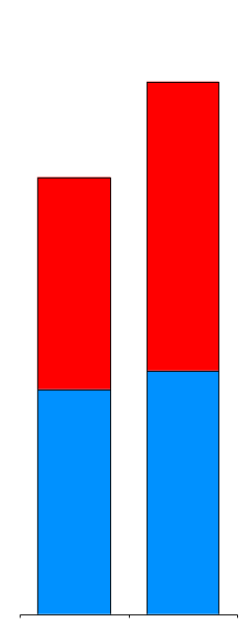
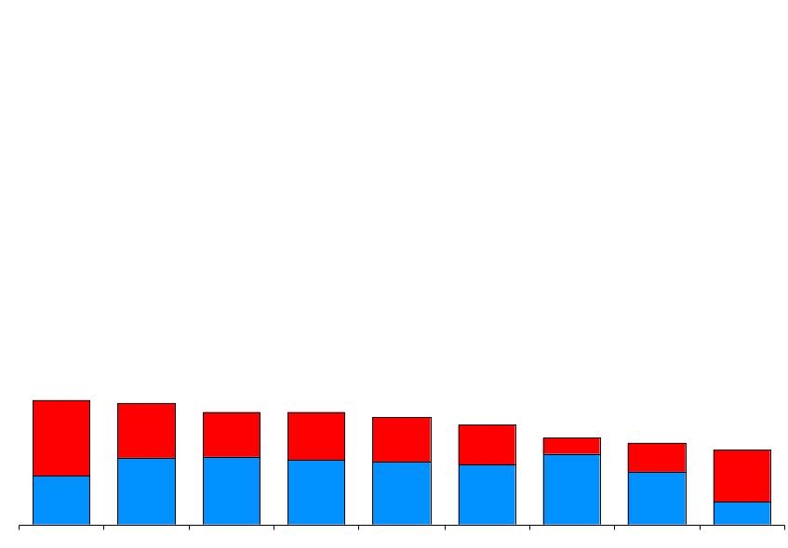
Enron’s Leading Market Position
(Physical Settlements in Bcfe/d)
78.8
64.7
Power
Gas
21.6
21.1
19.5
19.4
18.6
17.3
15.0
14.2
12.9
Enron
AEP Reliant Mirant Duke Dynegy Aquila BP El Paso PG&E
2Q01
3Q01
Second Quarter 2001
Source: Gas Daily, Power Markets Week, Company Reports

Slide 5

Financial Settlements
Financial Settlements
(Bcfe/d)
Contracts Settled with Net Cash Payments Without Physical Deliveries
Comprises Significant Portion of Enron’s Longer Term Products
Enron’s Lead Role Provides Distinct Competitive Advantages
  Valuable Market Insight
  Important Tool to Manage Enron’s Broad-Based Portfolio
319.4
212.2
51%
3Q00
3Q01

Slide 6
New Contract Execution
Transacted Volumes
(New Contracts in Bcfe/d)
Volumes Originated During Current Period for Future Settlement
Record Level Transacted in 3Q01; Driven by Both Gas and Power
Power Activity Comprises Almost 50% of Physical Activity - Up from 20% in 1Q00
Financial Product Expansion Driven by Enron’s Distinct Ability to Make Term Commitments
  Average Term Lengthening; Delivery Commitments through 2003
887.7
Financial
Physical
669.8
33%
3Q00
3Q01

Slide 7

EnronOnline
Average Daily Transactions
Since Inception
1,550,000 Transactions
$860 Billion Gross Value
>1,800 Products Offered
Nov 1999
Mar 2000
Jul 2000
Oct 2000
Jan 2001
May 2001
Oct 2001

Slide 8

Transaction Mix
Total Enron Transactions
550,000
Traditional
38%
Longer-Term Structured Transactions
Additional Opportunities for Transition to EnronOnline
349,000
EnronOnline
57%
High Penetration in North America Gas & Power; Growing Acceptance in Europe
Rapid Acceptance in Non-Energy Products
Integrated with Logistics and Back Office for Scale Efficiencies
62%
43%
3Q00 3Q01

Slide 9
Enron’s Wholesale Businesses
America’s Leading Energy Company
Wholesale Services
®
Americas
Europe & Other Commodity Markets
Natural Gas
Power
Europe Natural Gas
and Power
Metals
Energy-Related Markets
Industrial Markets
John Lavorato
President & CEO
Louise Kitchen
COO

Slide 10
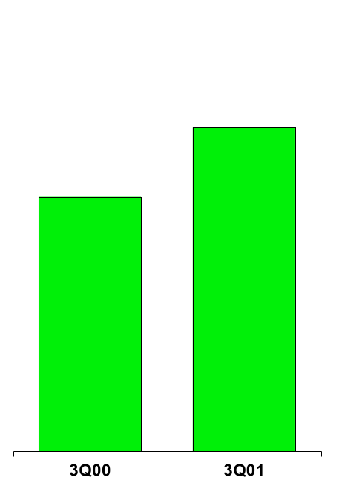
Enron Americas
The Most Flexible, Reliable and Valuable Energy Network
Cinergy
MAAC
Hub
Palo
Verde
Hub
Henry
Entergy Hub
Henry
Henry
Henry
Hub
Hub
Hub
Hub

Slide 11
Americas Business Expansion
718.9
540.8
35%
51%
33%
Physical
Financial

Slide 12
Business Highlights
East Power
Physical Volumes
(Million MWh)
Number of Transactions
(Per Day)
Making Markets Across the Entire Price Curve
  Key Provider of Liquidity
  Conducts Majority of Industry’s Long-Term Business
  [____] MWh contracted through 2005
Growth Driven by Enron’s Core Competitive Advantages
Compares Favorably with Most Merchant’s Entire U.S. Power Operations
Settled
Transacted
196
816
631
73
249
224
168%
264%
153%
OTC
EOL

Slide 13
Regional Transmission Organizations
Current
Proposed
5
# Regions/ISO’s
15+
Incumbent Utilities May Discriminate Against IPP’s and Marketer’s
Non-Discriminatory Access for All Market Participants
Access to Transmission
Very Little Coordination of Transmission Between Regions
System-wide Planning, Outage Coordination and Congestion Management
Reliability
Inefficiency and Lack of Price Transparency Increases Costs Unnecessarily
Cheapest and Most Effective Products for More Customers
Customers
Generation
Lack of Grid Information Hinders Best Siting Decisions
Optimal Siting & Development Decisions Facilitated
Total Portion of Wholesale Market Open
20%-25%
99%
Significant Increase in Available Market with Improved RTO’s

Slide 14
North America
Recent Structured Transactions
Canadian Power
Canadian Gas
700 MW Alberta PPA
Operations Outsourcing
West Gas
Long-Term Capacity
Midwest Gas
Utility Outsourcing
East Power
West Power
Load Following
Transaction
Prebuild Package Sale
Rockies Power
Midwest Power
West Power
Power Plant Site Sale
Prebuild Package Sale
QF Expansion & Sale
Southeast Power
Utility Asset Management
Mexico Gas
Price Risk Management
Texas Power
Long-Term Wind PPA

Slide 15
Enron’s Wholesale Businesses
Europe’s Most Established Energy Merchant
Europe & Other Commodity Markets
Europe
Other Commodity Markets
Natural Gas
Power
Metals
Energy-Related Markets
Industrial Markets
John Sherriff
President & CEO
Michael Brown
COO

Slide 16
Enron Europe
The Only Major Pan-European Energy Network
Nord Pool
Helsinki
Strong Deal Flow; Low Market Volatility Currently
Successful Deployment of Select Assets
Penetrating New Markets by Packaging from Enron’s Broad Product Slate
Transacting with Over 300 Customers
Oslo
Stockholm
Teesside
1,875 MW
Wilton
International
85 MW
Amsterdam
Oxford
APX
Hamburg
Warsaw
Moscow
IPE
London
EEX
Nowa Sarzyna
116 MW
Brussels
Frankfurt
Zurich
Offices
Energy Exchanges
Energy Partnerships
Third-Party Capacity
Leased Gas Storage
Power Plants
In Operation
Under Development
Marketing Activity
Gas Coal
Power Metals
Milan
Sarlux
551 MW
Madrid
Arcos
1200 MW
Marmara
478 MW

Slide 17
European Business Expansion
51.2
27.8
338%
(4%)
84%
Physical
Financial

Slide 18
Enron’s Wholesale Businesses
Extending to New Markets
Other Commodity Markets
Energy-Related Markets
Industrial Markets
Coal
Weather
LNG
Crude & Products
Emissions
Forest Products
Steel
Mike McConnell
President & CEO
Jeff McMahon
President & CEO
Jeff Shankman
COO
Ray Bowen
COO

