Slide 1
Our Experience: Enrons Strategy supported Development of Continental Power Wholesale Market (1998-2001)
Increase Liquidity
Cross Border Access
Begin Wholesale Transactions
New Market Entrants
Wholesale Volatility (first at borders)
Long term Physical
First Structured Deals
Inter-regional Access
Power/Gas Convergence
Tightened Volatility
Structured Financial Deals
Complex Risk Management
Asset Related Structures
Build Transparency
Open Access
Distributor Supply Deals
Example: German power market
1998:
First power delivery in Germany
1999:
EnronStrommarktFax
www.EnronStrommarkt.de
First full requirement deal
2000:
Focus on wholesale trading and structured transactions
2001:
Longer term power transactions
Customer specific solutions
Asset Based Projects
Risk Management
Portfolio Management
Trading Cooperations

Slide 2
2000: Start of German Gas Competition Before Liberalization
- Pace of Enrons Progress Relative to Power -
1st Enron power deal in Germany
1st deal on online energy platform www.EnronStrommarkt.de
1st Enron ‘Stalking Horse’ agreement in German power
Power
Energy Act Enforced
1st ‘full requirement’ energy supply deal
June 99
May 97
May 98
May 99
May 00
May 01
START
1 YEAR
2 YEARS
3 YEARS
4 YEARS
May 99
May 00
Oct 00
Jan 01
May 01
July 01
May 02
May 03
Feb 00
Jan 02
Gas
2 further gas delivery contracts
Additional gas delivery contract
Implementation of EU Gas Directive; expected
1st gas deal in Germany
3 further gas delivery contracts
4 further gas delivery contracts
Additional gas delivery contract
1st ‘pre-scheduled’ gas delivery contracts in Germany
1st Enron ‘Stalking Horse’ agreement in German gas

Slide 3
Behavioural Metrics in Gas Market:
Incumbents on Defensive
Predicted Incumbent Tactic
Occurrence on Continent
Refusal of access
✓
Unreasonable terms and conditions
✓
Incomplete terms and conditions
✓
Concealed cross-subsidies b/w eligible and competitive markets
✓
✓
Sign long term contracts
Source: Five Steps to Liberalization in European Gas Markets, Enron Europe Limited,
Doug Wood & Kyran Hanks

Slide 4
Progress Metrics German Gas Market:
Consolidated Enron Gas Delivery Deals
Stadtwerke Heidelberg- OCT ’00 (6 months)
Stadtwerke Tubingen- OCT ‘00 (1 year)
GGEW Bensheim- OCT ’00 (1 year)
Stadtwerke Menden- Jan ’01 (2 years)
Stadtwerke Memmingen- April ’01 (2 years)
GVT- April ’01 (1 year)
GEW Cologne- April ’01 (6 months)
Stadtwerke Heidelberg- April ’01 (6 months)
Blugas SpA- May ‘01
GETEC- July ’01 (1 year)
GGEW Bensheim- OCT ’01 (1 year)
Total Enron Delivery Deals
11
3
0
1999
2000
2001
For double the capacity of Enron’s 10/01 deal

Slide 5
Progress Metrics German Gas Market:
Enron Gas Transmission Deals
Enron Transmission contract counter-parties in Germany:
  Ruhrgas (12)
  GVS (3)
  MVV (2)
  SHGW
  RWE Gas
  EVG
  Bayerngas
  Erdgas Schwaben
  VNG
  AVACON
  Stadtwerke Stendal
  WINGAS
  EnBW
Total Enron Transmission Deals
27
9
0
1999
2000
2001

Slide 6
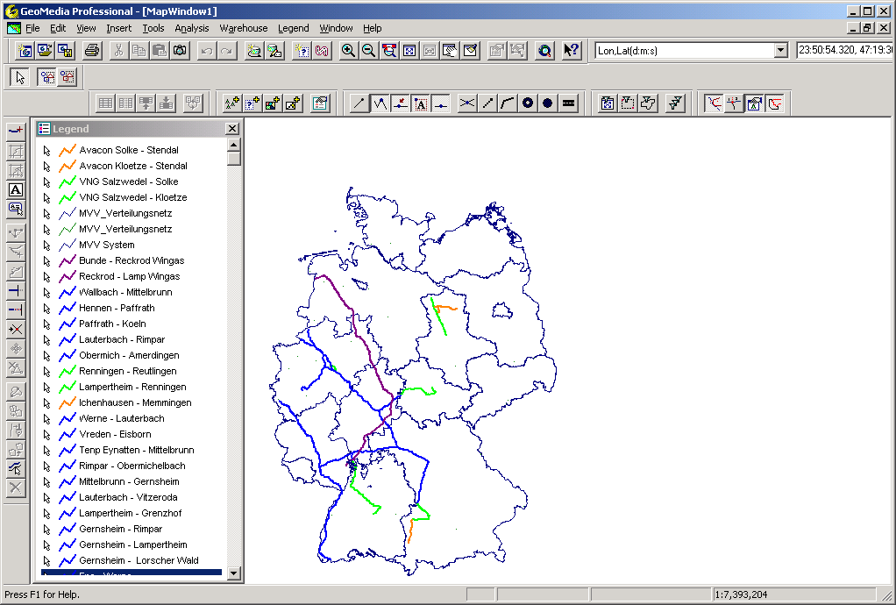
Enron’s German Transmission and Delivery Network
Transmission by Customer:
Heidelberg
(Ruhrgas, GVS, MVV)
Tübingen
(Ruhrgas, GVS)
Bensheim & Ruhrgas
(Ruhrgas, SHGW)
Menden
(Ruhrgas, WFG)
Memmingen
(Ruhrgas, Bayerngas, EGS)
GVT (Erfurt)
(Ruhrgas, EVG)
GEW (Köln)
(Ruhrgas)
Trading
(Wingas)
Trading
(Ruhrgas)
Bluegas
(Ruhrgas)
Industriekunde
(VNG, Avacon, SW Stendal)
Industrie-
kunde
VNG
Avacon
SW Stendal
Wingas
GVT (Erfurt)
Menden
WFG
GEW
Ruhrgas
EVG
Ruhrgas
MVV
SHGW
Bensheim
GVS
Heidelberg
Bayerngas
Tübingen
EGS
Memmingen

Slide 7
Strategic Goal: Destroying Monopoly Revenues to Achieve Market Shake-Up and Increase Need for New Products
Examples of German monopolists’ revenues destroyed on account of competition from Enron and others:
The cost to Ruhrgas and GVS of undercutting offers from Enron and others, in order to merely retain current customers, has, in the state of Baden-Wuerttemberg alone, to date totalled over 100 million DM
Examples of GVS losses as a result of undercutting Enron offers alone⁽¹⁾:
    With Stadtwerke Pforzheim 15 million DM
    With GVO Friedrichshafen 13 million DM
    With Stadtwerke Tubingen 7 million DM
The estimated cost to Ruhrgas and GVS of being forced to introduce new pricing systems in response to the introduction of competition in the state of Baden-Wuerttemberg alone totals over 240 million DM
(1) All 3 contracts part of the 100m DM estimate quoted above, and account for roughly 8% of total GVS volume

Slide 8


Gas Origination Activity Report from the German Front
Signed contracts
  Stadtwerke Heidelberg (2x)
  GGEW Bensheim (2x)
  Stadtwerke Tübingen
  Stadtwerke Menden
  Stadtwerke Memmingen
  Gasversorgung Thüringen
  GETEC (Industrial)
  GEW Köln
Stadtwerke
  Stadtwerke Dessau
  Stadtwerke Gotha
  Gasversorgung Delitzsch
  LET (RWE Gas area)
  Stadtwerke Gaggenau
  Stadtwerke Weinheim
  Stadtwerke Ludwigsburg
  Stadtwerke Speyer
  Stadtwerke Rosenheim
  SHGW (Darmstadt
  Stadtwerke Rottweil
  Stadtwerke Schramberg
  Stadtwerke Lutherstadt Eisleben
  Stadtwerke Regensburg
  Stadtwerke Peine
  Stadtwerke Villingen-Schweningen
  Stadtwerke Uelzen
  Spreegas (Cottbus)
  Pool Münsterland
  Badenova (GVS area)
  Stadtwerke Rotenburg (Wümme)
  Braunschweiger Versorgungs AG
  Stadtwerke Ulm
  Stadtwerke Erlangen
  Stadtwerke Schwäbisch Gmünd
  Stadtwerke Unna
  Stadtwerke Hechingen
  Techn. Werke Kaiserslautern
  Stadtwerke Bad Säckingen
  Stadtwerke Stendal
  Stadtwerke Ingolstadt
  Stadtwerke Straubing
Ongoing Negotiations
Industrials
  Eckes-Granini
  JohnsManville
  MoDo Paper
  Bertelsmann (Gütersloh)
  Krupp Mannesmann
  Getec Energie AG
  DK Recycling und Roheisen
  Kraft (Bremen)
  Merck
  GGEW Werk Salzgitter
  Josef Meindl GmbH
  Südsalz (Bad Friedrichshall - near Heilbronn
  BMW
Negotiations leading to Incumbent slashing price
  Stadtwerke Pforzheim
  Stadtwerke Altenburg
  Stadtwerke Bretten
  Stadtwerke Mühlacker
  Stadtwerke Friedrichshafen
  Stadtwerke Tübingen
  Stadtwerke Heidenheim
  Stadtwerke Augsburg
  Stadtwerke Speyer
  Stadtwerke Saarbrücken
  Stadtwerke Detmold
  Stadtwerke Neumünster
  Stadtwerke Cuxhaven
  Stadtwerke Schwäbisch-Hall
  Neubrandenburg
  Fulda
  Erdgas Schwaben (Augsburg)

Slide 9
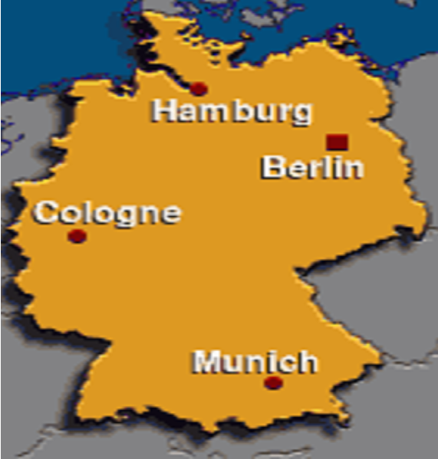
Contract
signed
Current negotiation w/ Stadtwerke
Current negotiation w/ Industrials
Negotiation
harmful to
incumbent

