Slide 1

Energy Businesses
New Businesses
Transportation
&
Distribution
Wholesale
Energy
Retail
Energy
Broadband
Services
Net Works
Expansion vehicle
for new industry
penetration

Slide 2
Current Market Conditions
Enormous inefficiencies exist in the pricing of commodity products.
All incumbent companies are vulnerable due to reduced barriers to entry.
Possible rate of return opportunities are multiples of historical rates of return (“Winner Takes All”).

Slide 3
Why Enron?
We have been B2B for years
We have a proven Business Model and track record of transforming markets (Gas, Power, Broadband, Coal, etc.)
We have strong skills in risk intermediation and good systems to control risk
We have already successfully migrated from an “old economy” company to a “new economy” company

Slide 4
Vertical Integration
Marketing
Marketing
Applications &
Content Delivery
Distribution
Distribution
Local Access
Long-Line
Transportation
Transmission
Long Haul
Transportation
Production
Generation
Content
Producers
Natural Gas
Power
Broadband

Slide 5
The Enron Business Model
Retail Services
Distribution
Distribution
Local Access
Wholesale Services
Long-Line
Transportation
Transmission
Long Haul
Transportation
Supply Aggregation
Production
Generation
Content
Producer
Natural Gas
Power
Broadband
Enron Intermediation Roles

Slide 6
Business to Business Market Activity Spectrum
Term Structured
Products and
Services
Standardized
Commodity
Markets
Producer to
Consumer
Markets
Transactions
Logistics
Settlements
Retail Services
Wholesale Services
Supply Aggregation

Slide 7
Business to Business Market Activity Spectrum
Pure B2B
Exchanges
Term Structured
Products and
Services
Standardized
Commodity
Markets
Producer to
Consumer
Markets
Transactions
Logistics
Settlements
Retail Services
Wholesale Services
Supply Aggregation

Slide 8
Business to Business Market Activity Spectrum
Old Economy
Companies
Term Structured
Products and
Services
Standardized
Commodity
Markets
Producer to
Consumer
Markets
Transactions
Logistics
Settlements
Retail Services
Wholesale Services
Supply Aggregation

Slide 9
Business to Business Market Activity Spectrum
Term Structured
Products and
Services
Enron
Pure B2B
Exchanges
Old Economy
Companies
Standardized
Commodity
Markets
Producer to
Consumer
Markets
Transactions
Logistics
Settlements
Retail Services
Wholesale Services
Supply Aggregation

Slide 10
Business to Business Market Activity Spectrum
Logistics
Chemicals
Agriculture
Steel
Data Storage
Credit
Metals
Finance
Pulp & Paper
Petrochemicals
Bandwidth
Coal
Power
Natural Gas
Term Structured
Products and
Services
Standardized
Commodity
Markets
Producer to
Consumer
Markets
Transactions
Logistics
Settlements
Retail Services
Wholesale Services
Supply Aggregation

Slide 11
MG PLC
Leading Merchant of Base Metals
Significant Customer Overlap with Enron’s Existing Energy Customers
Provides Domain Expertise
Accretive to Earnings
Metals Market Receptive to Enron-like Products

Slide 12
MG PLC
Term Structured
Products and
Services
MG PLC
Standardized
Commodity
Markets
Producer to
Consumer
Markets
Transactions
Logistics
Settlements
Retail Services
Wholesale Services
Supply Aggregation

Slide 13
Enron Metals
Term Structured
Products and
Services
Enron Metals
MG PLC
Standardized
Commodity
Markets
Producer to
Consumer
Markets
Transactions
Logistics
Settlements
Retail Services
Wholesale Services
Supply Aggregation

Slide 14
Garden State Paper
Compliments existing pulp and paper business (#1 derivatives position)
Provides access to physical product
Enables deployment of Enron’s eCommerce business model (Clickpaper.com)

Slide 15
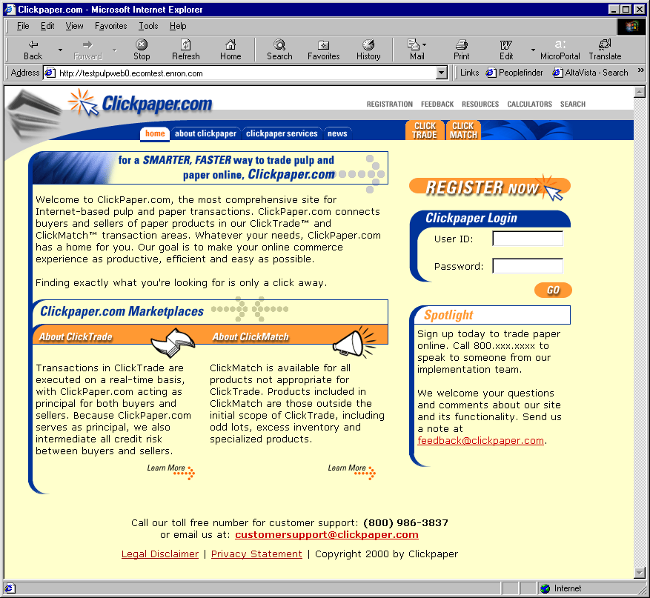
Clickpaper.com
Principal Based
Free of Charge
Real Time
Financial and Physical Products

Slide 16
Garden State Paper
Garden State
Paper
Term Structured
Products and
Services
Standardized
Commodity
Markets
Producer to
Consumer
Markets
Transactions
Logistics
Settlements
Retail Services
Wholesale Services
Supply Aggregation

Slide 17
Enron Paper
Term Structured
Products and
Services
Enron Paper
Garden State
Paper
Standardized
Commodity
Markets
Producer to
Consumer
Markets
Transactions
Logistics
Settlements
Retail Services
Wholesale Services
Supply Aggregation

Slide 18
Networks Funding Plan
No equity issuance anticipated
Targeted investors for each vertical
Limited Enron financial support anticipated
Capital available by third quarter

