Slide 1
Second Quarter 2001

Slide 2
Financial Performance
Net Income
(Millions)
Earnings Per Share
(Diluted)
$404
$0.45
$0.34
$289
40%
32%
2Q00
2Q01
2Q00
2Q01

Slide 3
Earnings Performance
(Recurring Per Diluted Share)
15%
18%
25%
22%
19%
20% Average Annual Growth Rate

Slide 4

Recent Investor Concerns
California
India
Enron Broadband Services
Cash Flow & Financing Vehicles
“Trading” in Enron’s Business Model

Slide 5
California
Receivables Exposure
  Fully Reserved
  Active PG&E Creditors’ Committee Member
Potential Wholesale Refunds
  Minimal Enron Amounts Cited
  Possible Net Amount Owed to Enron
Contempt Issue
  Enron Stance Centered Around Due Process
  Near Resolution/ Compliance
No Impact Expected on 2001 Earnings Results

Slide 6

India
Dabhol Power Update
740 MW Phase I Operational; 1,444 MW Phase II 95% Complete; Construction Suspended
Customer Has Multiple Defaults and Has Repudiated the Contract
Owners and Lenders Pursuing Well-Defined Contractual Remedies
  Declared Political Force Majeure
  Initiated 6-Month Cure Period
  Continued Enforcement of Contractual Rights
$875 Million Total Investment by Enron

Slide 7
Enron Broadband Services
General & Administrative Costs
(Millions)
($40)
($55)
($73)
2Q01 Actual
4Q01 Est.
Target Level
Quarterly

Slide 8
Cash Flow From Operations
(Millions)
  Reported in Financial Statements
  Cash Flow Impact of Deposits
  $4,779
  First Half
  $1,880
  $1,640
  $1,228
  $651*
Negligible
  ($900)
  ($2,300)
  1997 1998 1999 2000 2001E
  1997 1998 1999 2000 2001E
  First Half
  First Half
*Excluding J-Block Settlement

Slide 9
Cash Flow from Operations
Excluding Deposits
(Millions)
  $2,899
  $3,000
  First Half
  $1,640
  $1,228
  $651*
  1997 1998 1999 2000 2001E
*Excluding J-Block Settlement

Slide 10
Off-Balance Sheet Transactions
Funding Cost-Effectively Expands Enron’s Credit Capacity
  Primarily Reflects Whitewing and Marlin Issuances
Eliminating Related Party Relationship with LJM
Primarily Supported by Asset Values; Secondary Support from Equity-Backed Commitments

Slide 11
Contingent Equity Commitments
Components
Impacting Share Count
2Q01 vs. 2Q00
(Million Shares)
Basic:
Option Exercises
Diluted:
Options - Treasury Method
Contingent Equity Commitments
Other
Total
24
(21)
29
(3)
29
Natural Offset with Stock Price Changes

Slide 12

Contrasting Business Approaches
Example: Providing Reliable Power Supply
Utilities
Source from Dedicated Plant
Merchants
Aggregate Power from Market Sources
Enron
Aggregate Cheapest Power from Numerous, Deep Market Sources
Retail Customer
Utility Customer
Plant
Merchant Role
Power Market

Slide 13

Enron’s Unique Network Alternatives
Example: Providing Reliable Power Supply
Enron
Aggregate Cheapest Power from Numerous, Deep Sources
Toll
Contract for Capacity; Aggregate Cheapest Gas Supply
Site, Permit, Build
Build Plant; Aggregate Cheapest Gas Supply
Retail Customer
Utility Customer
Plant
Merchant Role
Power Market
Gas Market
Displace Utility Load; Source Alternate Fuel
Influence Demand
Reduce Consumption

Slide 14
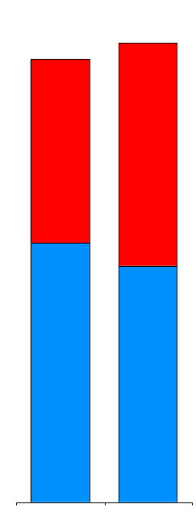
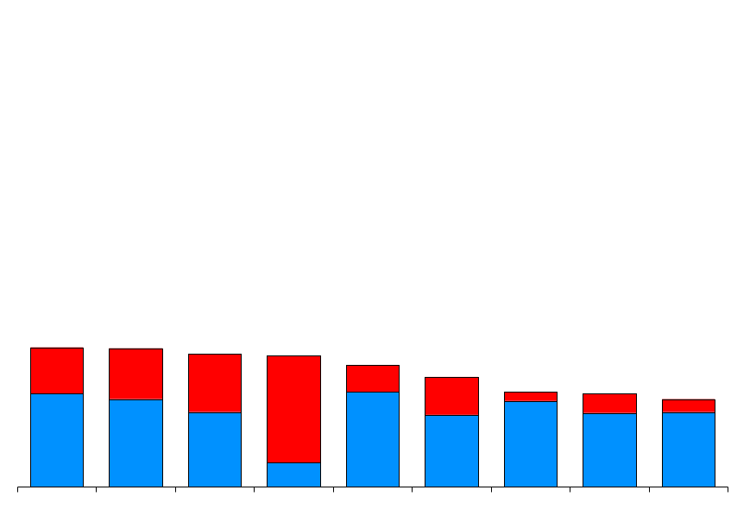
Enron’s Leading Market Position
(Bcfe/d)
64.7
62.3
Power
Gas
20.2
20.1
19.3
19.0
17.7
15.9
13.8
13.6
12.8
Enron
Duke Mirant Reliant AEP El Paso Aquila BP Dynegy Sempra
1Q01
2Q01
First Quarter 2001
Source: Company Reports, NGI, Natural Gas Week

Slide 15

®
Transportation
&
Distribution
Wholesale
Services
Retail
Energy
Broadband
Services
Natural Gas
Transportation and Electric Distribution
Marketing and Delivery
of Commodities Worldwide
Energy Services
for Commercial and
Industrial Customers
Bandwidth Intermediation and Content Services

Slide 16
®
Transportation
&
Distribution
Wholesale
Services
Retail
Energy
Broadband
Services
Natural Gas
Transportation and Electric Distribution
Marketing and Delivery
of Commodities Worldwide
Energy Services
for Commercial and
Industrial Customers
Bandwidth Intermediation and Content Services

Slide 17
Enron Wholesale Services
Marketing and Delivery of Commodities Worldwide
Wholesale
Services
®
North America
Energy
Europe &
Other
Global Assets
Natural Gas
Power
Natural Gas
Power
Global Markets
Industrial Markets
International Operations

Slide 18
High, Long-Term Correlation in Volumes and Profitability
Physical Volumes
(Bcfe/d)
Income Before Interest and Taxes*
(Millions)
51.7
Other*
Power
Gas
32.4
27.3
18.0
12.4
8.1
9.0
4.4
4.9
6.6
31% CAGR
29% CAGR
*Excludes Products Such as Steel, Metals and Forest Products not Convertible to Bcfe/d
*1997-2000 Have Been Restated

Slide 19
Volume Growth and Strong Margins Drive Profitability
Physical Volumes
(Bcfe/d)
Average Per Unit IBIT Margin
(Cents per Mcfe)
51.7
14.6
15.7
13.7
12.6
12.2
11.9
Europe & Other*
North America
10.3
11.1
9.6
9.4
32.4
27.3
18.0
12.4
8.1
9.0
4.9
6.6
4.4
1991 1992 1993 1994 1995 1996 1997 1998 1999 2000
*Excludes Products Such as Steel, Metals and Forest Products not Convertible to Bcfe/d

Slide 20
Second Quarter Performance
Physical Volumes
(Bcfe/d)
Income Before Interest and Taxes
(Millions)
Average
Per Unit IBIT Margin
(Cents per Mcfe)
Other
Power
Gas
$802
11.8
74.8
9.8
46.7
$415
60%
93%
21%
2Q00
2Q01
2Q00
2Q01
2Q00
2Q01

Slide 21
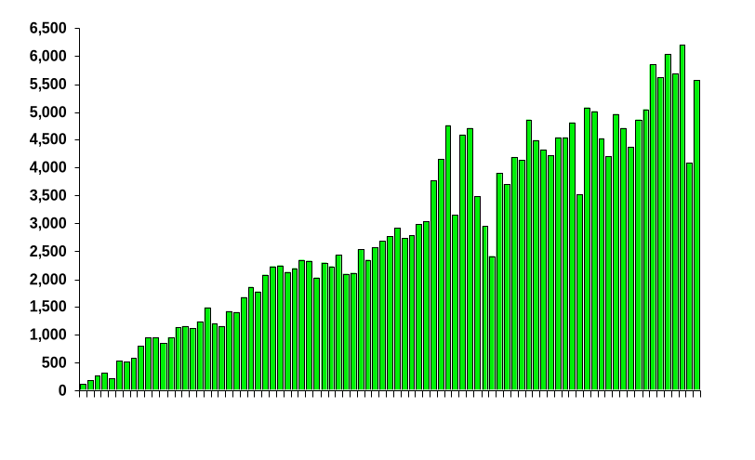

EnronOnline
Average Daily Transactions
Since Inception
1,200,000 Transactions
$705 Billion Gross Value
>1,800 Products Offered
Nov 1999
Mar 2000
Jul 2000
Dec 2000
July 2001

Slide 22
EnronOnline Statistics
Customers
Products
Delivery Locations
335
1,855
162
65
34
415%
2,711%
376%
66
12/31/99
6/30/01
12/31/99
6/30/01
12/31/99
6/30/01
EnronOnline Enables Significant Scale Expansion

Slide 23
Enron North America
The Most Flexible, Reliable and Valuable Energy Network
Cinergy
MAAC
Hub
Palo
Verde
Hub
Henry
Entergy Hub
Henry
Henry
Henry
Hub
Hub
Hub
Hub

Slide 24
North America Natural Gas Volumes
(Bcf/d)
West
Canada
Central
East
3.9
7.5
7.2
9.0
6.5
5.8
7.0
2.0
95%
(23%)
11%
29%
2Q00 2Q01
2Q00 2Q01
2Q00 2Q01
2Q00 2Q01
Delivering to Over 2,000 Customers

Slide 25
North America Power Volumes
(Million MWh)
West
East
56
158
46
78
22%
103%
2Q00 2Q01
2Q00 2Q01
Delivering to Almost 500 Customers

Slide 26

Enron North America
Generation Activities
Product Components
Product Offerings
Sites
  High Value Optionality, Low Capital Intensity
  2,215 MW of Announced Projects
Turbines
  Access Enhances Site Values
  Proven Competitive Advantage
Capacity
  Owned or Contracted Capacity Access
  Evaluating Opportunities in Key Regions
Component Sales
  Site and Permits
  Turbines
Bundled Products
  Sites, Permits and Turbine Packages
  Gas and Power Supplies
  Utility Off-Take and Tolling Contracts
Plant Sales
  Over 2,600 MW Sold Within Three Years from Inception

Slide 27
Early Integral Role of Enron’s Peaker Plants in Reliable Delivery
Power Supply Sources
Peaker Plants
Purchase Contracts
Power Sales Commitments
Sales Contracts
Power Price Changes:
Impact on Value of:
Decrease No Change Increase
Lower Neutral Higher
Higher Neutral Lower
Neutral Neutral Neutral
Power Supply Sources
Power Sales Commitments
Net Economics

Slide 28
Enron North America
Regional Transmission Organizations
Recent FERC Order Very Favorable to Power Industry
  Movement Towards Formation of Four Large RTO’s
  Expedites Moving Northeast & Southeast to Single RTO’s
Facilitates More Supplies To More Customers
Drives Deeper, More Liquid Power Markets
Provides New Opportunities for Enron
  Ability to Leverage Extensive Power Network
  New Demand for Risk Management Products
  Accelerates Retail Market Development

Slide 29
Enron Europe
The Only Major Pan-European Energy Network
Nord Pool
Helsinki
Volume Growth
(Bcfe/d)
Oslo
Stockholm
Teesside
1,875 MW
21.8
Wilton
154 MW
Power
Natural Gas
Amsterdam
Oxford
APX
Hamburg
Warsaw
Moscow
IPE
London
EEX
Nowa Sarzyna
116 MW
Brussels
Frankfurt
9.6
Zurich
Milan
Offices
Energy Exchanges
Energy Partnerships
Third-Party Capacity
Leased Gas Storage
Power Plants
In Operation
Sale Pending
Under Development
Marketing Activity
Gas Coal
Power Metals
Sarlux
551 MW
127%
Madrid
Marmara
478 MW
Arcos
1,200 MW
2Q00
2Q01
Physical and Financial Settled Volumes
Leading Market Position
Extending Enron’s Market-Making Model
Early Entry, Scale, Scope and Local Workforce Providing
Tremendous Competitive Advantages

Slide 30
Europe Natural Gas Volumes
(MMcf/d)
U.K.
Continent
6,090
1,342
3,286
440
85%
205%
2Q00 2Q01
2Q00 2Q01
Physical and Financial Settled Volumes
Transacting with Over 100 Customers

Slide 31
Europe Power Volumes
(Million MWh)
U.K.
Continent
Nordic
43.6
48.7
38.3
24.6
16.5
12.8
77%
280%
132%
2Q00 2Q01
2Q00 2Q01
2Q00 2Q01
Physical and Financial Settled Volumes
Transacting with Almost 200 Customers

Slide 32
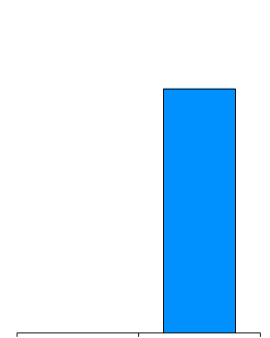
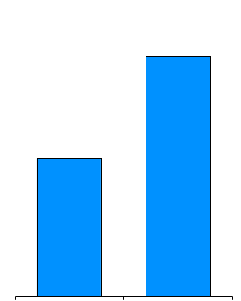
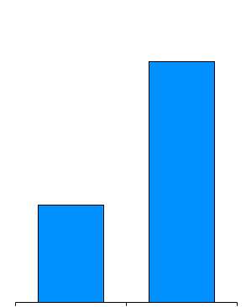
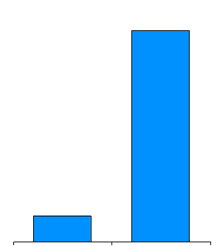
Enron Global Markets
Liquids
(MM BBL)
Coal
(Thousand Metric Tonnes)
Weather
(Notional Value $MM)
LNG
(BBtue)
165
22,774
185
5,978
95
9,229
23
74%
147%
704%
0
2Q00
2Q01
2Q00
2Q01
2Q00
2Q01
2Q00
2Q01

Slide 33
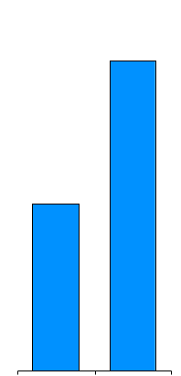
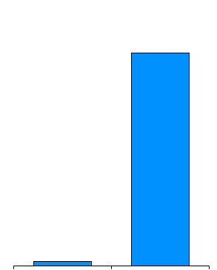
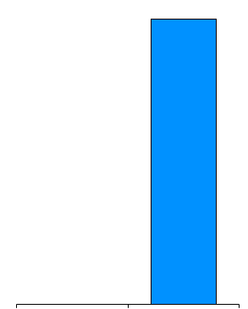
Enron Industrial Markets
Metals
(Thousand Tonnes)
Forest Products
(Thousand Metric Tonnes)
Steel
(Thousand Metric Tonnes)
1,775
584
99
959
85%
4,392%
13
0
2Q00
2Q01
2Q00
2Q01
2Q00
2Q01

Slide 34
®
Transportation
&
Distribution
Wholesale
Services
Retail
Energy
Broadband
Services
Natural Gas
Transportation and Electric Distribution
Marketing and Delivery
of Commodities Worldwide
Energy Services
for Commercial and
Industrial Customers
Bandwidth Intermediation and Content Services

Slide 35
Income Before Interest and Taxes
(Millions)
$60
$225
$46
$111
($50)
($33)
2Q99 2Q00 2Q01
1999 2000 2001E
Quarterly
Annual

Slide 36
Total Contract Value
(Billions)
$7.2
  First Half
$30.0
$3.8
$16.1
$8.5
$1.7
2Q99 2Q00 2Q01
1999 2000 2001E
Quarterly
Annual
Reflects Customers Energy Expenditures Over Contract Life

Slide 37
Business Highlights
Enron Continues as Leading Provider of Retail Energy Services in North America and Europe
“Energy Awareness” Very High
Penetrating New Markets With Proven, Standardized Products
Achieving Significant Scale
Rapidly Increasing Profitability

Slide 38
Core Functions
Enron Energy Services
  Contract Origination
    Marketing/Sales
    Product Development
    Upsell/Portfolio Management
  Customer Services
    Customer Relationship Management
    Energy Information Services
    Demand Side Management
    Commodity and Risk Management
Enron Wholesale Services
Enron’s Distinct Capabilities Combine
For a Compelling Value Proposition

Slide 39
Dimensions of Scale
Enron Offices
HVAC Service
Facility Management
Energy System Design & Installation
Customer Sites
Leveraging Enron’s Commodity Capabilities
Achieving Significant Operating Scale
Standardizing Products; Reducing Sales Cycle

Slide 40







Customer Segments
>$30 Million
Annual Energy Spend
$10 - 30 Million
Annual Energy Spend
<$10 Million
Annual Energy Spend
Large National and Multi-National Companies with Multiple Facilities
National and Regional Companies with Numerous Facilities
Single-to-Multiple Site Businesses
Comprehensive, Packaged Energy and Facilities Management
Gas, Power and Energy Management Services
Standardized Gas and Power Services
Enron Direct
JCPenney
USA Canada UK

Slide 41
®
Transportation
&
Distribution
Wholesale
Services
Retail
Energy
Broadband
Services
Natural Gas
Transportation and Electric Distribution
Marketing and Delivery
of Commodities Worldwide
Energy Services
for Commercial and
Industrial Customers
Bandwidth Intermediation and Content Services

Slide 42
Broadband Market Overview
Severe Imbalance of Supply and Demand for Bandwidth; Extreme Commodity Price Pressures
Deteriorated Creditworthiness of Major Industry Counterparties
Enormous Slowdown in Industry-Wide Commercial Activities
Long-Term Opportunities for Innovation

Slide 43
Enron’s Broadband Focus
Network
Maintain Functionality to Support Highly Focused Commercial Activities
Intermediation
Make Liquid, Transparent Markets for Broadband-Related Products
Provide Reliable Delivery at Predictable Prices
Content Services
Provide Bundled Services to Large-Scale Users on Usage-Based Terms
Objective: Cost Effectively Maximize Option Value

Slide 44

Enron Intelligent Network
Seattle
Tokyo
Portland
Boston
New York
Salt Lake City
Chicago
Philadelphia
San Francisco
Denver
Washington
London
San Jose
Amsterdam
Las Vegas
Brussels
Los Angeles
Dusseldorf
Atlanta
Paris
Dallas
Frankfurt
New Orleans
Pooling Points Complete
Controlled Capacity
Houston
Miami
Operations Center
Low Cost, Interconnected, Scalable Global Network
$1.2 Billion Total Investment Expected at Year-End 2001
Network Layers Include Dark Fiber, Lit Capacity and Pooling Points

Slide 45
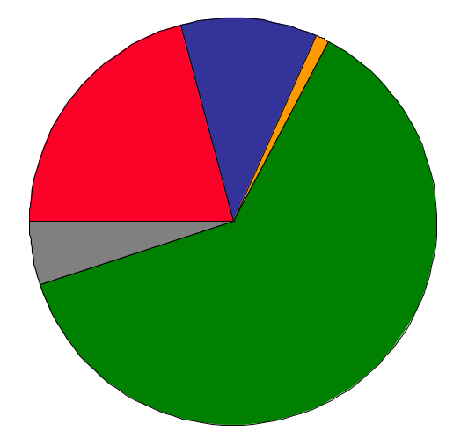
Intermediation
Transactions
Transaction Mix
759
11%
1%
Circuits
IP, Storage and Other
21%
5%
63%
Carriers
Network Service Providers
Enterprises
Marketers/Resellers
Media and Other
23
Customers
45 New
165 Total
2Q00
2Q01
  Marketers/Resellers Typically Opt for Financial Settlements
  Traditional Industry Participants Demand Enron’s Reliable Physical Delivery

Slide 46

Enron and MSN
®
Enron Provides Broadband On-Demand for MSN with Usage-Based Terms
Multi-Year Contract
Combines Enron’s Intermediation Expertise and Network Capabilities for Valuable Enterprise Service

Slide 47
Conclusion
Attentive to Investor Concerns; Some Matters May Be Noisy But All are Well Managed
Well-Positioned Balance Sheet; Expanding Cash Flows
Record First Half Earnings, Volume and Contracting Results Demonstrate Enron’s Very Strong Business Fundamentals
Recent Broadband Initiative Lowers Costs While Retaining Valuable Option on Future Opportunities
Firmly On Track For Continued Strong Earnings Growth

Slide 48
®

