Slide 1
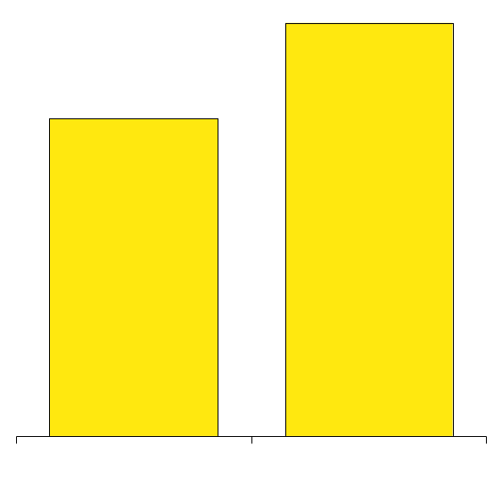
Enron Corp. Second Quarter Performance
Revenues
(Millions)
Net Income
(Millions)
Earnings Per Share
(Diluted)
$16,886
$289
$0.34
$222
$0.27
$9,672
+75%
+30%
+26%
2Q99
2Q00
2Q99
2Q00
2Q99
2Q00

Slide 2

Wholesale
Energy
Transportation
&
Distribution
Retail
Energy
Broadband
Services
Net Works
Natural Gas Transportation
Electric Distribution
Marketing and Delivery of Energy Products Worldwide
Energy Outsourcing to Commercial and Industrial Customers
Bandwidth Management and Broadband
Delivery Services
Expansion Vehicle for New Commodity Industry Penetration

Slide 3
Earnings Summary
(Millions)
Change
%
2Q 99
2Q 00
IBIT:
Transportation & Distribution
Wholesale Energy
Retail Energy
Broadband
Corp. & Other*
Total IBIT
Interest and Other
Taxes
Net Income
%
$ 128
356
26
11
469
217
30
$ 222
$ 139
437
24
17
609
256
64
$ 289
$ 11
81
50
8
6
140
9
23
NM
NM
NM
30
30
( )
-
8
( )
( )
%
( )
( )
( )
( )
%
* 2Q99 Includes E&P

Slide 4
Wholesale
Energy
Transportation
&
Distribution
Retail
Energy
Broadband
Services
Net Works
Marketing and Delivery of Energy Products Worldwide

Slide 5
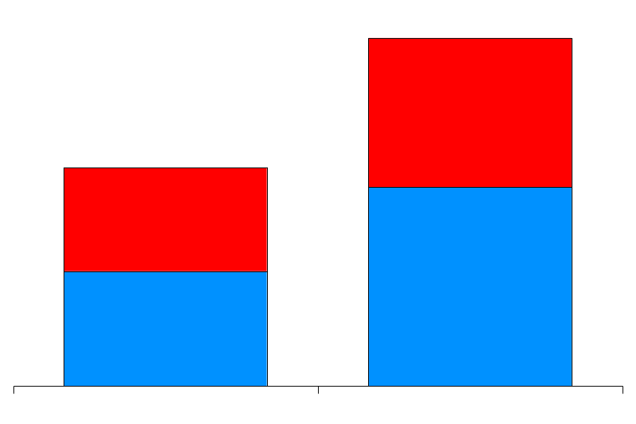
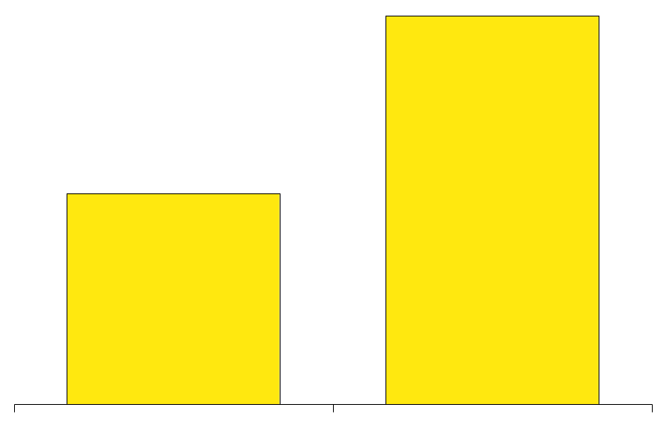
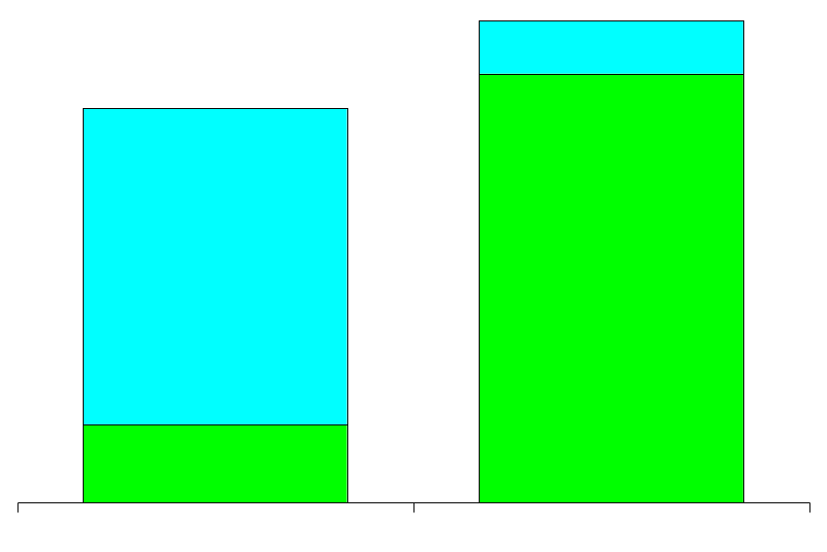
Wholesale Energy Operations and Services
Physical Volumes
(BBtue/d)
Financial Settlements
(BBtue/d)
Income Before Interest
and Taxes
(Millions)
46,730
152,627
$437
$356
33,708
82,699
+39%
+85%
+23%
2Q99
2Q00
2Q99
2Q00
2Q99
2Q00
Power and Other
Gas
Commodity Sales and Services
Assets and Investments

Slide 6
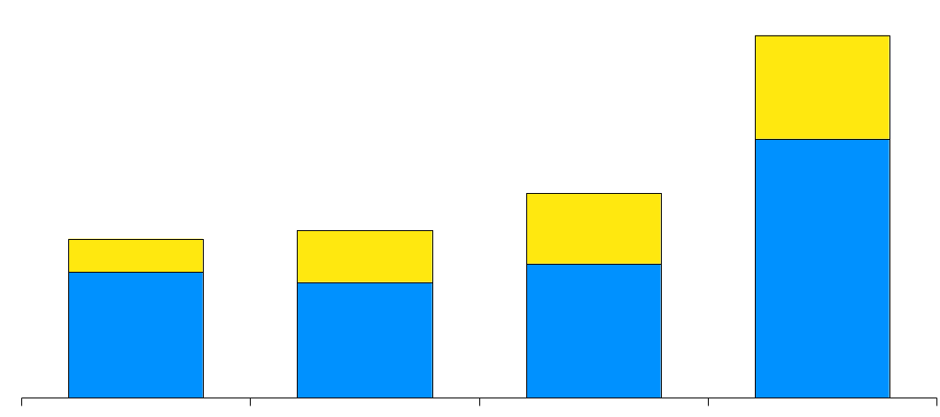
North America Natural Gas Volumes
Second Quarter
(Bcf/d)
23.0
Canada
US
13.0
10.1
10.6
1997
1998
1999
2000

Slide 7

Enron’s Wholesale Gas Network
Enron’s Wholesale Gas Network
Canada
Central
Volumes
(Bcf/d)
Counterparties
Volumes
(Bcf/d)
Counterparties
6.6
136
143
4.7
231
4.5
203
1.6
2Q99
2Q00
2Q99
2Q00
2Q99
2Q00
2Q99
2Q00
West
Volumes
(Bcf/d)
Counterparties
East
2.0
120
Volumes
(Bcf/d)
Counterparties
109
7.0
337
0.9
Henry
230
Henry
Henry
Henry
3.5
Hub
Hub
Hub
Hub
2Q99
2Q00
2Q99
2Q00
Texas
2Q99
2Q00
2Q99
2Q00
Marketing Offices
Owned and Leased Capacity
NYMEX
Owned Gas Storage
Leased Storage
Volumes
(Bcf/d)
Counterparties
2.5
2.7
173
155
Gas Marketing Activity
2Q99
2Q00
2Q99
2Q00

Slide 8
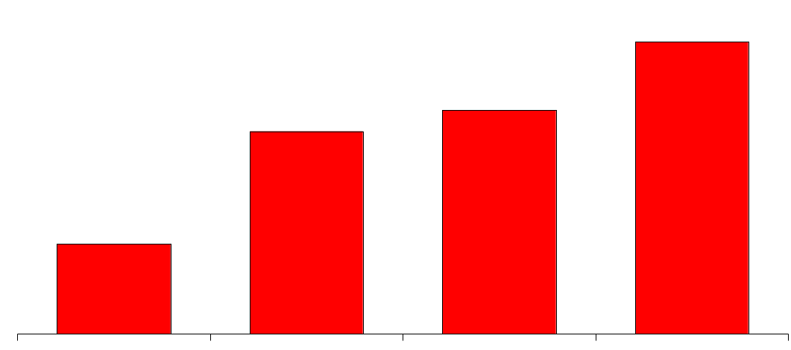
North America Power Volumes
Second Quarter
(Million MWh)
124
95
86
38
1997
1998
1999
2000

Slide 9
Enron’s Wholesale Power Network
West Volumes
(Millions MWh)
East Volumes
(Millions MWh)
MAPP
78
46
MAIN
70
25
ECAR
NPCC
COB
ComEd
Hub
PJM
Hub
Hub
MAAC
Cinergy
Cinergy
Cinergy
Hub
Hub
Hub
Cinergy
2Q99
2Q00
WSCC
Hub
2Q99
2Q00
SPP
Marketing Offices
NYMEX
Marketing Hub
SERC
Palo
Palo
Palo
Palo
Verde
Verde
Verde
Verde
Hub
Hub
Hub
Power Plants
Hub
TVA
Hub
Entergy
Entergy
In Operation
Under Development
Entergy
Hub
Hub
ERCOT
Hub
Power Marketing Activity
Transmission Grid
FRCC
Peaking Generation
(MW)
Contract Term
2,930
<1Yr
1,340
1-5Yr
>5Yr
0
1998
1999
2000

Slide 10



Enron’s European Wholesale Network
U.K.
Volumes
(Bcfe/d)
Nordic
Volumes
(Bcfe/d)
6.0
Nord
Pool
Helsinki
1.8
Oslo
2.1
Stockholm
0.7
Teesside
1,875 MW
2Q99
2Q00
Wilton
154 MW
2Q99
2Q00
Offices
Energy Exchange
LNG Project Under Development
Energy Services
Energy Partnerships
Leased Capacity
Utility Services
Amsterdam
Hamburg
Oxford
APX
Warsaw
Moscow
IPE
EEX
Nowa Sarzyna
116 MW
London
Brussels
Number of
Transactions
Frankfurt
Zurich
Enron/Petrom JV
Continent
Nordic Region
U.K.
18,687
Budapest
Power Plants
Milan
In Operation
In Construction
Under Development
Bucharest
Mora la Nova
1,600 MW
Continental Europe
Volumes
(Bcfe/d)
Sarlux
551 MW
Energy Marketing
Activity
Madrid
1.8
Arcos
1,200 MW
Marmara
478 MW
5,129
Gas
Power
Coal
+264%
0.1
1999
2000
2Q99
2Q00
2Q99
2Q00
Note: Volumes Include Natural Gas and Power

Slide 11
This Slide is Not in Your Book

Slide 12
Rapidly Increasing Utilization of EnronOnline (Transactions)
100%
100%
100%
100%
100%
100%
100%
25%
33%
39%
45%
45%
52%
59%
Dec
Jan
Feb
Mar
Apr
May
Jun
EnronOnline
Traditional

Slide 13
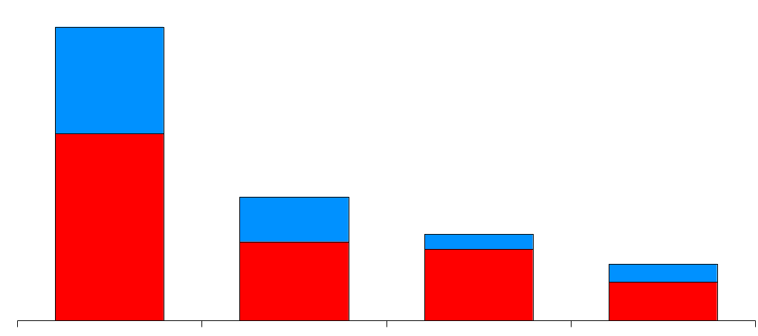
Leading Energy Marketers
Second Quarter 2000
(TBtue/d)
41.7
Power
Gas
17.6
12.3
8.0
Enron
Duke
Dynegy
El Paso

Slide 14
Wholesale
Energy
Transportation
&
Distribution
Retail
Energy
Broadband
Services
Net Works
Energy Outsourcing to Commercial and Industrial Customers

Slide 15
Enron Energy Services Second Quarter Performance (Millions)
Contracting
(Total Contract Value)
Revenues
$3,800
$840
$1,700
$340
$650
$144
2Q98
2Q99
2Q00
2Q98
2Q99
2Q00

Slide 16
New Total Contract Value - Quarterly (Billions)
$3.7
$3.8
$2.5
$2.6
$1.7
$1.7
$1.5
$0.8
$0.9
$0.6
1998
1999
2000
$3.8
$8.5
$7.5 (1H)

Slide 17
Income Before Interest and Taxes - Quarterly (Millions)
$24
$16
$7
$(18)
$(23)
$(27)
$(26)
$(26)
$(31)
$(43)
Q1
Q2
Q3
Q4
Q1
Q2
Q3
Q4
Q1
Q2
1998
1999
2000
$(119)
$(68)
$40 (1H)

Slide 18



Recent Contracting Activity
$1 Billion, 10-Year Agreement to Service 66 Facilities in 28 States
QUEBECOR INC
$180 Million, 10-Year Agreement to Service 19 Facilities in 6 States
$210 Million, 10-Year Agreement to Service 100 Facilities in 27 States
Sonoco Inc.
Consumer Food Products Company
$150 Million, 10-Year Agreement to Service 19 Facilities in 11 States

Slide 19
Wholesale
Energy
Transportation
&
Distribution
Retail
Energy
Broadband
Services
Net Works
Bandwidth Management and Broadband
Delivery Services

Slide 20
Enron Broadband Services
Enron
Intelligent
Network
Bandwidth Intermediation
Deploy the Most Open, Efficient Network with Broad Connectivity
Content Services
Be the World’s Largest Provider of Premium Broadband Delivery Services
Be the World’s Largest Buyer and Seller of Bandwidth
Fiber
Servers
Pooling Points
Network Control
Bandwidth Marketing & Trading
Comprehensive Bandwidth Management
Broadband Content Management & Delivery
Data Management Services

Slide 21
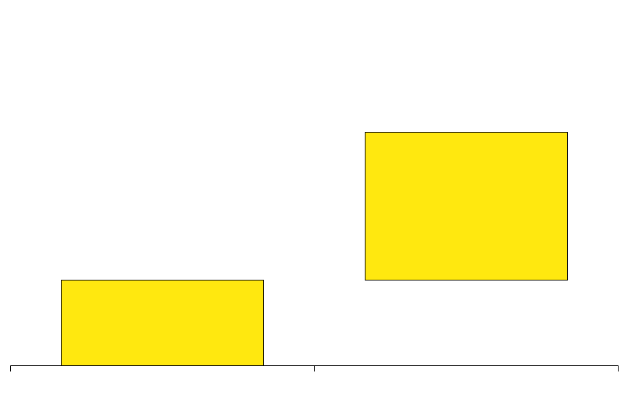
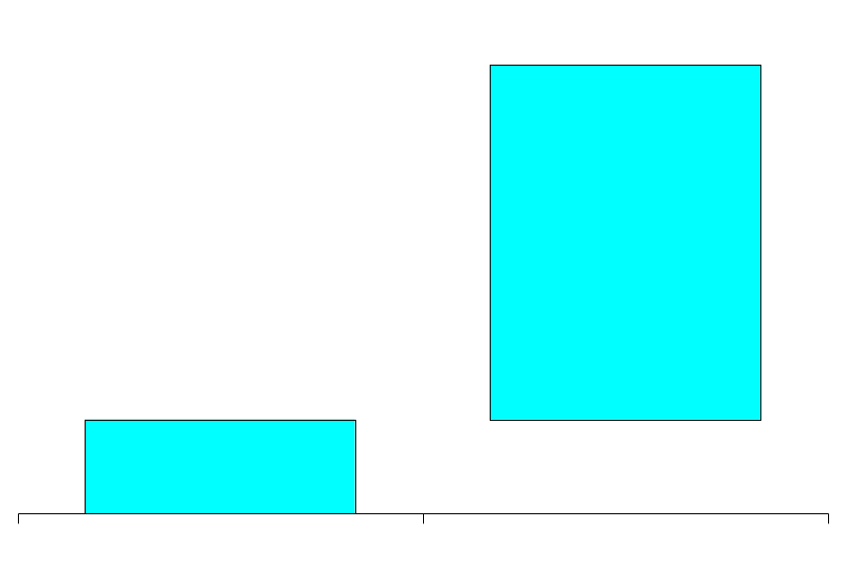
Enron’s Intelligent Network
Deployment Update
Fiber
Route Miles
Servers
Pooling Point Cities
14,500
525
19
9,175
15
5,325
4
Complete
In Construction
Deployed
Complete
In Installation

Slide 22
Broadband Distribution Partners
U.K.
Points of Presence (PoPs)
In Operation
In Progress
15 Million
Market
Reach
29
Partners
58
Cities

Slide 23
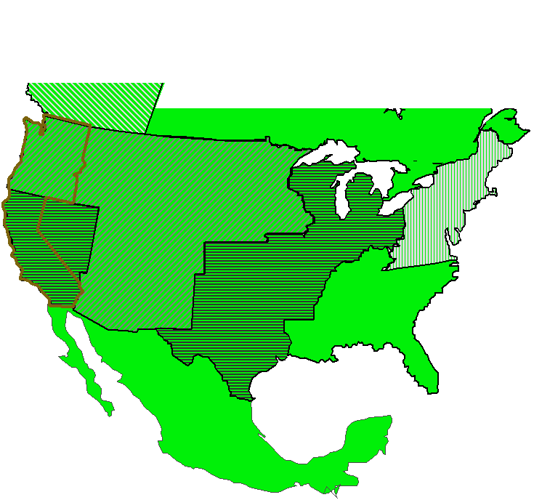
New Broadband Distribution Partners
Entertainment-on-Demand
Telus
Reflex
Qwest
Verizon
SBC
SBC
Covad
Nationwide
“Last Mile” Broadband Connectivity to Over 80% of the U.S. DSL Market
Minimum Quality and Speed Guarantees to Ensure TV Quality
End-User Customer Service

Slide 24




Enron Broadband in Europe
Initial Operating Presence in Major Markets in the U.K., Germany, France and the Netherlands
Oslo
Stockholm
Pooling Point
POPs and Connectivity
In Operation
In Progress
Copenhagen
Major Broadband Distribution Partners Signed
Hamburg
Amsterdam
Berlin
To Be Announced
Frankfurt
New York
London
Brussels
Very Successful Worldwide Streaming Debut
Paris
Los Angeles
Zurich
Munich
Milan
Extending Reach Throughout Europe and the Nordics
50 Employees Today;
Over 100 Targeted by Year-end
www.wimbledon.com
Barcelona
Madrid

Slide 25
Advancement of Enron’s BOS
(Broadband Operating System)
Provides Network Control Across the EIN
Risk Management and Delivery Logistics
Forward Reservation of Bandwidth
Quality of Service Differentiation and Monitoring
Network Information and Management
WarpSpeed MetaRouter Significantly Enhances Scalability and Dynamic Circuit Provisioning
Instantaneously Maps Bandwidth Requisitions to Best Available Network
At Full Scale, Manages 10,000 Connection Requests Per Minute
Enron’s Application Programming Interface (API) Allows Third Party Applications to Configure and Use Enron’s Network
Incorporated into Sun’s Java Community Process
Facilitating I2’s B2B Marketplace

Slide 26
Bandwidth Intermediation
Enron’s Top Tier Markets
Vancouver
Seattle
Calgary
Montreal
Boise
Toronto
Boston
Portland
Detroit
New York
Amsterdam
Salt Lake City
Chicago
San Francisco
Denver
Philadelphia
London
San Jose
Frankfurt
Las Vegas
Washington D.C.
Los Angeles
Atlanta
Tokyo
Dallas
New Orleans
Houston
Miami
DS-3 Month Deliveries
2000
Target
5,170
Added in 2Q
Over 50 Transactions Effected YTD with 17 Counterparties
60 Counterparties Reviewing Contract Terms
EnronOnline Offerings Recently Expanded to Over 30 Products in 14 City Pairs
3,793
985
432
1Q00
2Q00
Committed for Delivery Before Year-End

Slide 27
Wholesale Bandwidth Intermediation
Second Quarter Activity
Marketers and Resellers
Network Services Providers
Purchases and Sales of Off-Net Protected DS-3 Circuits
Terms Range Up to 12 Months; Committed 6 Weeks to 6 Months Forward
Predominantly Fixed Price Contracts
Transacting Between Multiple City Pairs
Primarily Sales of On-Net OC-48 Channels
Up to Five-Year Terms
Strong Demand for Fixed Price Commitments
City Pairs Track Enron’s Network Build-Out
U.S. Carriers
International
Purchases and Sales of Off-Net Protected Circuits and OC-48 Channels
Terms Range from 6 Months to 3 Years
Fixed Price Commitments and Option Structures
Transacting Between Multiple City Pairs
Purchases and Sales of Off-Net Protected Circuits and Channels
Includes Address-to-Address Connectivity
Terms Range up to 10 Years; Committed Up to 3 Years Forward
Primarily Fixed Price Commitments

Slide 28










Enron and Blockbuster
20-Year Exclusive, Worldwide Agreement; Over $1 Billion Potential Contract Value for Enron
Enron Provides End-to-End Connectivity to Deliver Blockbuster’s Movie Library via the EIN
Enron Paid for Services Based on Number of Movies Rented
New Broadband Distribution Agreements Enable DSL Delivery to the TV; Additional Partners and Cable Targeted
Service Available in Multiple U.S. Markets by Year-end; Rapidly Moving Toward Implementation
Significant Expansion Opportunities
Encoding
Storage
Bandwidth Management
Streaming Control
Content
Enron’s Intelligent Network
Enron’s Distribution Partners
Blockbuster’s
Customers

Slide 29

Content Services
Total Contract Value Originated
(Millions)
Over $1 Billion
Enron’s Premium Broadband Service Offering
Tailored for Over 100 Kbps Access
Very High Quality of Service
New Broadband Content Entrants Accelerating
Major New Contract with Blockbuster Evidences Enron’s Network Advantages
2000 Target
$19
$31
1Q00
2Q00

Slide 30




















Content Services
Second Quarter Activity
Content Providers
Enterprises and ASPs
Columbia Tristar

Slide 31
Wholesale
Energy
Transportation
&
Distribution
Retail
Energy
Broadband
Services
Net Works
Expansion Vehicle for New Commodity Industry Penetration

Slide 32
Current Market Conditions
Many Industries Exist That Sell Commodity Products Through Legacy Distribution Channels
Channels Often Consist of Complex Sales Forces and Long Term Relationships with Little Price Transparency
Enormous Inefficiencies Exist in the Pricing of Commodity Products
The Internet Provides a Unique Opportunity to Have Immediate and Inexpensive Access to Customers

Slide 33
Opportunity for Enron
Use Proven Enron eCommerce Platforms As Accelerators
Leverage Off Enron’s Proven Skills in Logistics, Risk Management and Back Office Capabilities
Provide High-Margin, Structured Products to Customers
Move Quickly and Minimize Effect on Enron’s Balance Sheet

Slide 34
Enron Has the Capabilities Required
to Capture this Market Opportunity
Market Making Capabilities
Operating
Capabilities
Other
Capabilities
Cash Markets
Forward Markets
Futures Markets
Transactions
Logistics
Settlement
eCommerce Platforms
Risk Management Process
Capital

Slide 35
Target Markets and Approach
Enron Business Plan Upon Entering New Markets:
Upgrade Streamline Process to Do Business the Best, Most Efficient Way Possible
Expand Grow Market Share in Current Business
Penetrate Rapidly Establish Significant Stakes in New Markets
Target Markets
Upgrade
Expand
Upgrade
Upgrade
Penetrate
Metals
Pulp & Paper
Steel
Chemicals
Credit/Finance
Data Storage
Settlements
Logistics

Slide 36
Recent Net Works Transactions
MG PLC
Garden State Paper
Leading Merchant of Base Metals
Significant Customer Overlap with Enron’s Existing Energy Customers
Metals Market Receptive to Enron-Like Products
U.S. Based Newsprint Manufacturer
Complements Existing Pulp and Paper Business
Complements Deployment of Enron’s eCommerce Business Model (Clickpaper.com)

Slide 37
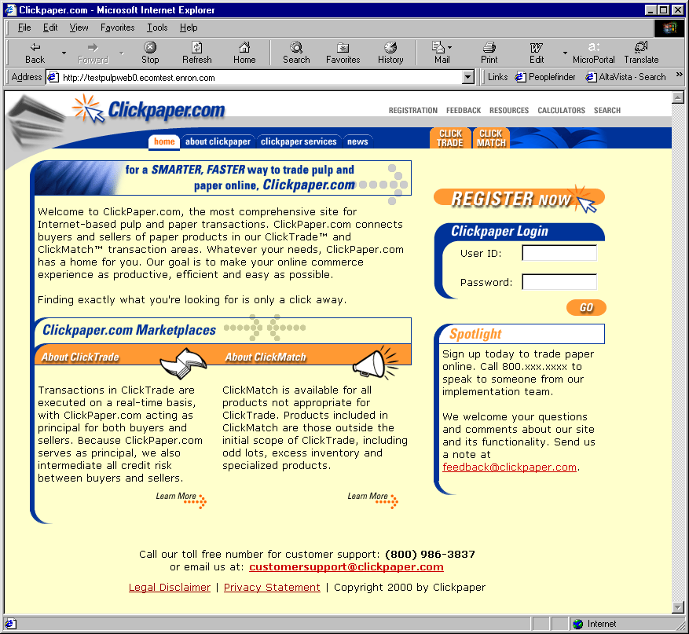
Clickpaper.com
Extension of EnronOnline Platform
Principal-Based
Free of Charge
Real Time
Financial and Physical Products
Tailored to Paper Industry Participants

Slide 38
Net Works Funding Plan
No Enron Equity Issuance Anticipated
Targeted Investors for Each Vertical Markets
Limited Enron Financial Support Required
Capital Available by Third Quarter

Slide 39
Conclusion
Market-Leading Positions of Solid Core Businesses Providing Consistent, Sustainable Earnings Growth
New Businesses and New Technology Adding to Earnings Power and Valuation
Evaluating All Methods to Increase Return on Investment

Slide 40

®

