Slide 1
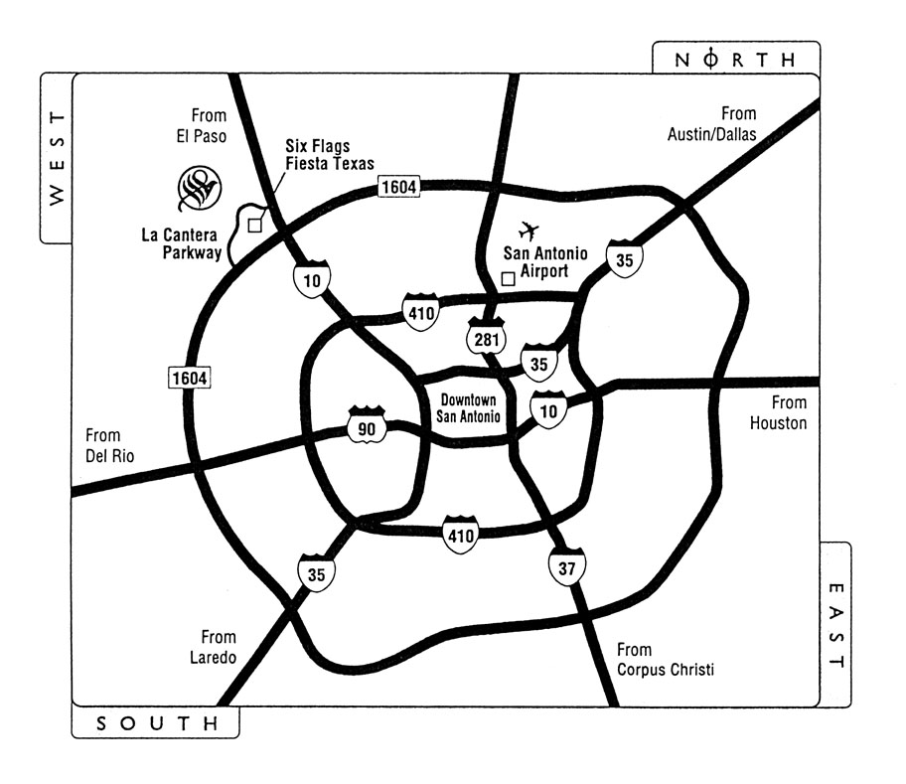
The Westin La Cantera Resort
16401 La Cantera Parkway
San Antonio, Texas 78256
Phone: (210) 558-6500 Fax: (210) 641-0721

