Slide 1
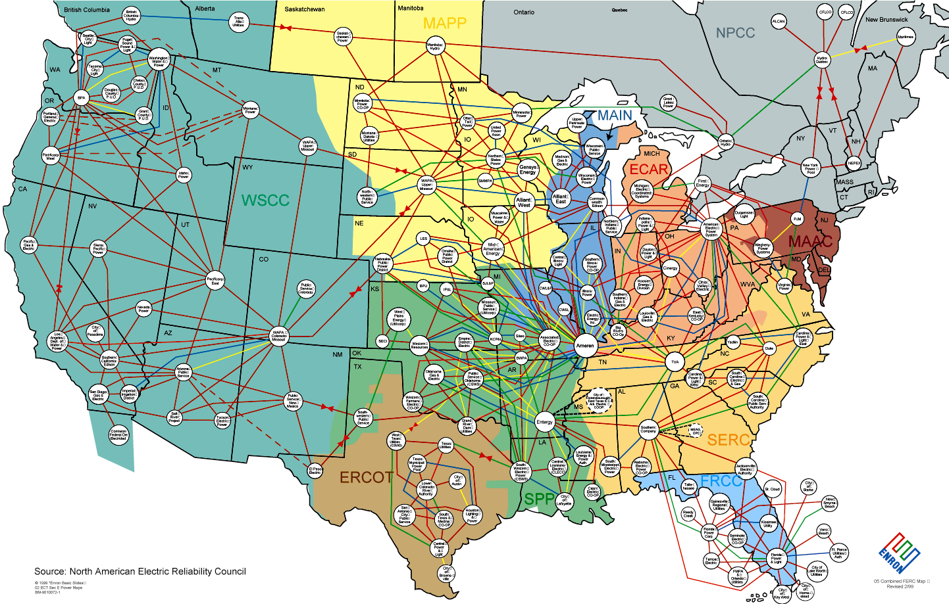
The original of this map is in illustrator

