Slide 1

EnronOnline Competitive Assessment
Enron Tiger Team #1
Tulika Bhalla Deepa Mallik
Vincent Chen Jack Rejtman
Nick Levitt Kim Whitsel
Project Discussion
February 15, 2001

Slide 2
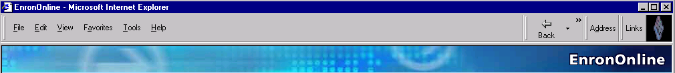
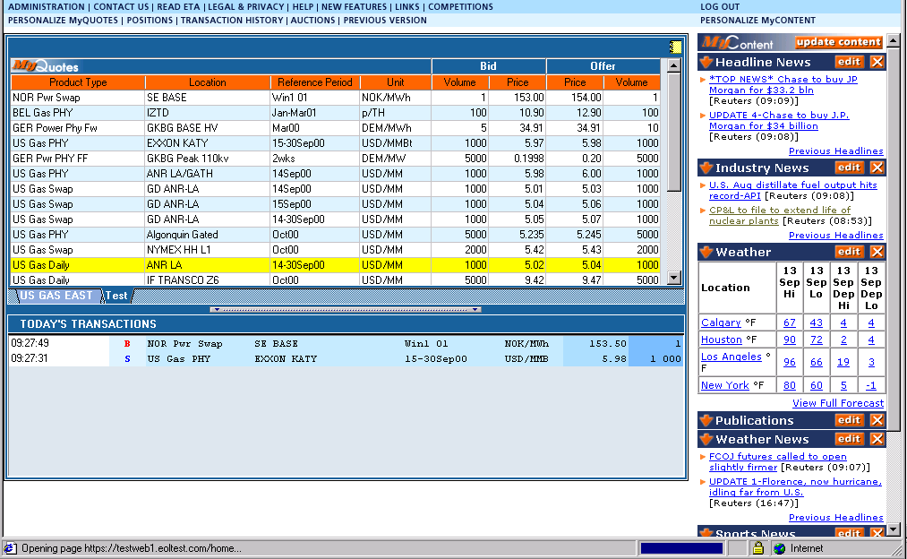
Project Scope
Compare EnronOnline’s business model with the business models of other online trading platforms

Slide 3


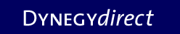


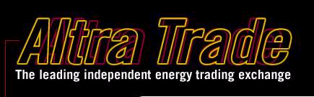


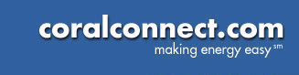



EnronOnline Competitors

Slide 4
Approach
Framing
Analysis
Connection
☑
Identify resources
Research platforms and features
Gather competitive intelligence
Assess trends and new ideas
Develop ranking criteria
Develop ranking methods based on available resources
Customers
Competitors
Websites
Rank platforms against criteria
Assess Enron’s advantages over competitors
Identify weak areas and potential threats for EnronOnline
Recommend actions for Enron to maintain competitive advantage
Suggest areas for further analysis
◻
◻
◻
☑

Slide 5
Resources
Framing
◻
Enron customers
Competitor website contacts
Wharton professors
Louis Thomas, competitive strategy
Eric Clemons, e-commerce strategy
Howard Kunreuther, risk management
Paul Kleindorfer, energy and network strategy
Marshall Blume, trading
Nicholas Souletti and Andrew Metrick, finance
Eric Johnson (Columbia)
Wharton students
Wharton library – industry publications, trade journals, newspapers, magazines, analyst reports
Competitor websites and annual reports
☑
☑
☑
◻
☑
◻
◻
◻
◻
☑
☑

Slide 6
Ranking Criteria
Framing
Liquidity
Speed of transaction
Bilateral vs. multilateral
Depth
Volume of standing trades
Impact on price volatility
Efficiency
Spread (price reflects supply/demand)
Transaction costs
Ease-of-use for customers
Credit rating of traders

