Slide 1

Pre-Filing Presentation
November 2001

Slide 2

Transaction Summary

Slide 3

Transaction Summary
Terms of Agreement
$1.8 billion purchase price
$1.55 billion cash
$0.25 billion seller financing
Seller financing from Enron
$50 million common equity, 4.9% voting rights
$200 million FELINE PRIDESSM
Restrictions on public sale of securities held by Enron
$75 million payment obligation from Enron to Portland General assumed by NW Natural
$1.1 billion of Portland General debt assumed
New holding company to own NW Natural and Portland General
Enron to designate up to 2 board members of holding company
Expected to close 2H 2002

Slide 4
Transaction Summary
Capitalization and Anticipated Ratings
(a) Before the issuance of $150 million of public equity at closing for HoldCo.
(b) After the issuance of $150 million of public equity at closing for HoldCo.
(c) Refinance the Capital Markets Tranche.

Slide 5
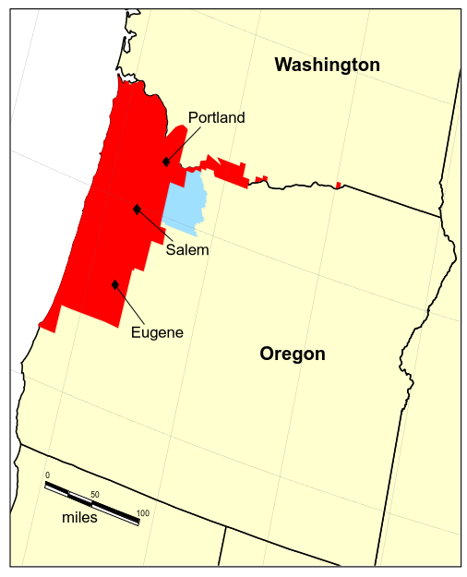
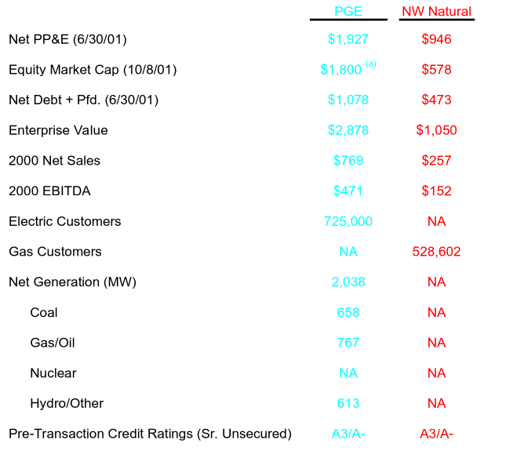
Transaction Summary
Comparison of Selected Statistics for PGE and NW Natural ($ in Millions)
PGE and NW Natural Service Areas
Operating and Financial Statistics
(a) The purchase price of common equity.

Slide 6
Transaction Summary
Oregon - Strong Economic Growth
1994 - 2000 Economic Growth Oregon vs. U.S.
Projected Growth of the Oregon Economy
Source: Oregon Economic & Revenue Forecast.

Slide 7
Transaction Summary
Regulatory Approval Overview
The transaction will require a number of regulatory approvals:
Oregon Public Utility Commission (“OPUC”)
Washington Utilities and Transportation Commission (“WUTC”)
Federal Trade Commission (“FTC”) and Department of Justice (”DOJ”)
Federal Energy Regulatory Commission (“FERC”)
Nuclear Regulatory Commission (“NRC”)
Securities and Exchange Commission (“SEC”)
HoldCo is expected to be an exempt holding company under the Public Utility Holding Company Act (“PUHCA”) due to adjacent state operations
NW Natural anticipates rapid regulatory approvals given the benefits that will accrue to Oregon energy users

Slide 8
Financial Overview

Slide 9
Financial Overview
The Customer Value Proposition
Retain commitment to safety, reliability, growth and improvement of electric and gas transmission and distribution (T&D) systems
Enhance customer services
Manage commodity costs, hold down electric and gas T&D rates over the long run
Implement marketing strategy that emphasizes efficiency, customers’ interests
Confirm commitment to terms and schedule of electric restructuring plan
Retain commitment to investment-grade credit ratings
Share transaction benefits with customers consistent with viability of transaction
Restore local ownership and accountability

Slide 10
Financial Overview
Historical Financial Summary ($ in millions)
Net Sales
EBITDA
(a) New rate case in effect at PGE.

Slide 11
Financial Overview
Financial Strategy
Both NW Natural and PGE have historically maintained strong capital discipline
Strong investment grade credit ratings
Mature / disciplined approach to financing
The capital structure and financing plan are designed to achieve and maintain investment grade ratings at the two operating utilities
Expectation that HoldCo will achieve investment grade rating within 3 years after closing
HoldCo credit profile exhibits strong positive trend due to
Benefits from reduction of bank debt (scheduled amortization and excess cashflow sweep)
Additional equity issuance 2 years after closing

Slide 12
Financial Overview
Selected Credit Ratios ^{(a)}
Interest Coverage
Total Debt / EBITDA
Total Debt / Total Capitalization
(a) Includes the issuance of $150 million of equity at closing in 2002 and an additional $150 million of equity in 2005

Slide 13
Financial Overview
Structure
New HoldCo Credit Facilities $100 Million Revolver $150 Million Term Loan A ^{(a)} $500 Million Term Loan B $300 Million Term Loan C
New HoldCo Expected Senior Secured Ratings Baa3/BB+
Enron FELINE PRIDESSM Investment $200 Million
Enron Common Equity Investment $50 Million
$450 Million Senior Notes^{(b)}
Common Equity Issued to public at Closing^{(a)} $150 million
New Revolving Credit Facility $150 Million
Expected Senior Unsecured Baa1/BBB-
New Revolving Credit Facility $300 Million
Expected Senior Unsecured Baa1/BBB-
Existing Net Debt $439 Million ^{(c)}
Existing Net Debt $1,049 Million ^{(c)}
(a) NW Natural intends to issue $150 million of common stock at or soon after closing to reduce HoldCo debt, which will be used to reduce Term Loan A from $300 million to $150 million
(b) Assumes Senior Notes offering is completed simultaneously with transaction closing to refinance Capital Markets Tranche.
(c) Existing debt balances are as of June 30, 2001.

Slide 14
Financial Overview
Sources and Uses ($ in Millions)
Sources
Uses
HoldCo Revolving Credit Facility $60.0
Term Loan A ^{(a)} 150.0
Term Loan B 500.0
Term Loan C 300.0
Senior Notes ^{(b)} 450.0
FELINE PRIDESSM 200.0
Common Equity to Enron 50.0
Common Equity Offering to Public ^{(a)} 150.0
Total $1,860.0
Purchase Price of Equity $1,800.0
Transaction Expenses 60.0
Total $1,860.0
(a) Assumes $150 million of common equity is issued to the public upon closing and proceeds are used to repay a portion of Term Loan A.
(b) Assumes Senior Notes offering is completed simultaneously with transaction closing to refinance Capital Markets Tranche.

Slide 15
Financial Overview
Summary Terms of the Credit Facilities ($ in Millions)

Slide 16
Financial Overview
Summary Terms of the Credit Facilities ($ in Millions)

Slide 17
Financial Overview
Summary Terms of the Credit Facilities ($ in Millions)

Slide 18
Financial Overview
Synergy Analysis
Significant synergies and cost savings
Joint meter reading
Combined call centers
Combined billing
Combined marketing and support crews
Back-office consolidation (e.g. information technology)
Opportunity to link NW Natural’s gas procurement and storage capabilities to PGE’s generation supply portfolio
Expertise in trading around supply assets and retail load for combined gas/electric resources

Slide 19
Financial Overview
Synergy Analysis
Operating Synergies – Percent Expected by Category

Slide 20
Financial Overview
Treatment of Transaction Benefits
In order for the transaction to close and succeed, there must be an ability to meet lenders’ requirements, to provide earnings growth potential for shareholders and to provide benefits for customers
Maintaining current T&D rates (with specified exceptions) and retaining most transaction benefits within the organization are critical to meeting the Financial Projections, thereby ensuring the availability of lenders’ credit facilities
The Financial Projections assume cost savings due to synergies growing to $30 million annually, and credits to customers of transaction benefits totaling $31.5 million over six years
Alternative treatments of synergies might be acceptable as long as they do not create a material deviation from the Financial Projections

Slide 21
Financial Overview
Dividends and Debt Service

Slide 22
Pre-Filing Presentation: Appendices
November 2001

Slide 23
Appendix I: NW Natural Overview

Slide 24
NW Natural Overview
Strengths
Organic service territory growth at three times the national average
Existing gas storage and development of new gas storage add to reliability of service and growth potential
Ability to contribute to regional energy requirements by supplying gas to power generation market
Experienced management team recognized as strong operators
Focused on enhancing productivity through reduction of operational costs per customer
Recognized expertise in gas purchasing and hedging programs
Widely recognized financial discipline
Excellent customer service and satisfaction record

Slide 25
NW Natural Overview
Natural Gas Utility – Issues in Operating Environment
Status of industry structure
Open access
Wholesale trading
Supply / Pipeline access
Underground storage
Unregulated business
Regulatory climate

Slide 26
NW Natural Overview
NW Natural at a Glance
528,602 customer accounts
12,000 miles of gas mains
12 years of >4% customer growth
10.5 billion cubic feet gas storage capacity
1,315 employees
Constructive regulatory environment
Widely recognized financial discipline
Shareholder-focused strategy
Experienced management team

Slide 27
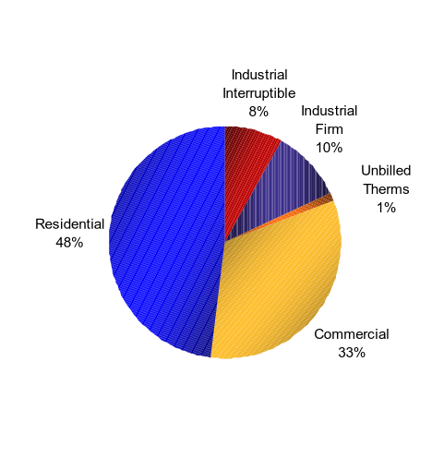



NW Natural Overview
Diverse Customer Base
Top 10 customers account for 3% of margin revenue
No single customer accounts for more than 1% of margin revenue
2000 Gas Sales
(in millions of therms)
Top 10 Customers (Listed Alphabetically)
2000 Retail Sales = 749 million therms

Slide 28
NW Natural Overview
Net Customer Gains
NW Natural has added customers at 3 times (on average) the national average for natural gas distribution companies
Historical Net Customer Gains and Customer Growth Year-Over-Year
5.7 %
5.0 %
5.7 %
4.4 %
5.2 %
4.7 %
4.2 %
1.5 %
Natural Gas Distribution Industry Average Annual Growth : ~1.5 %

Slide 29
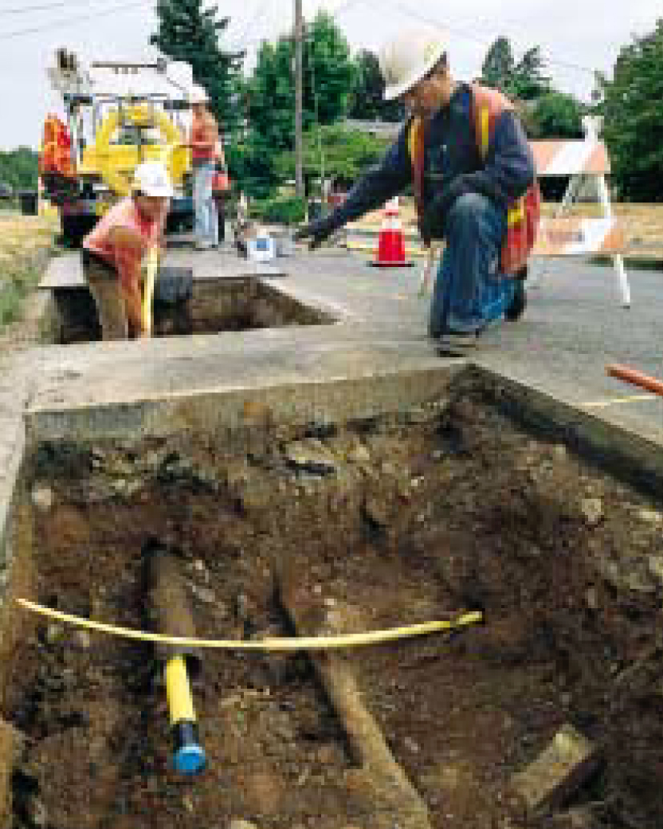
NW Natural Overview
Distribution System
$928.8 million net distribution plant
$80.0 million O&M (2001E)
$84.0 million Capex (2001E)
11,825 miles of main lines, as well as service pipes, meters and regulators, and gas regulating and metering stations
1,295 distribution employees
911 union members represented

Slide 30
NW Natural Overview
Productivity Improvements
NW Natural has achieved a 2.2% average expense reduction per customer since 1994
Total Expense Per Customer

Slide 31
NW Natural Overview
Distribution Network
Distribution network among the most efficient in the United States
Miles of Aging Pipes Not Yet Replaced
Total Low Pressure (Cast Iron, Bare, Coated & PE Mains)
Miles
Cast Iron

Slide 32
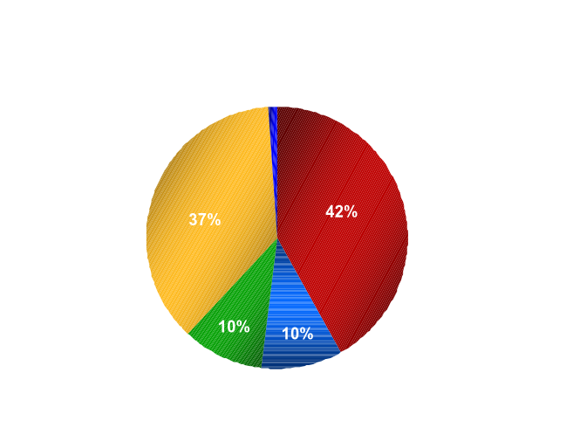
NW Natural Overview
Natural Gas Supply
Numerous available sources of natural gas/large storage capacity
Access to two major pipelines
Design Peak 2000 - 2001 Winter
Local Production
1%
Transport Gas
NW Natural Storage
Recall Agreements
Contract Storage
Total = 8.9MMth

Slide 33
NW Natural Overview
Mist Gas Storage Facility
Mist storage facility provides price and storage flexibility
Additional storage and pipeline facilities expected to be developed in 2003-2004
Mist has 11 BCF of storage capacity

Slide 34
Appendix II: Portland General Electric Overview

Slide 35
Portland General Electric Overview
Strengths
Service area economy and population growing at rates well above national average
Diversified, balanced, flexible, low cost power portfolio that minimizes supply costs
Wholesale marketing expertise to profitably balance load and power supply
Well positioned transmission network with scheduling rights to California-Oregon and Oregon-Nevada Interties
Excellent customer service and satisfaction with the lowest complaint rate among Oregon utilities

Slide 36
Portland General Electric Overview
Electric Utility – Issues in Operating Environment
Status of industry structure
Generation asset ownership
Open access
Wholesale trading
California situation
Western States Coordination Council (“WSCC”)
Intertie
Distributed generation
Regional Transmission Organization (“RTO”)
Unregulated business
Regulatory climate

Slide 37
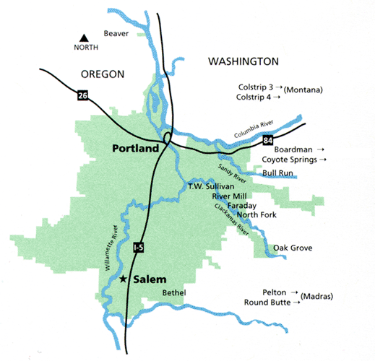
Portland General Electric Overview
Portland General at a Glance
725,000 customer accounts
51 cities served – Portland and Salem are the largest
Net plant-in-service – $1.8 billion:
Distribution $804 million
Generation $620 million
Transmission $218 million
General/intangible $170 million
3,150 square-mile service area
26,000 miles of T&D lines
2,038 MW of generation
Average annual demand of 2,400 MW
Peak load of 3,900 MW
2,780 employees

Slide 38
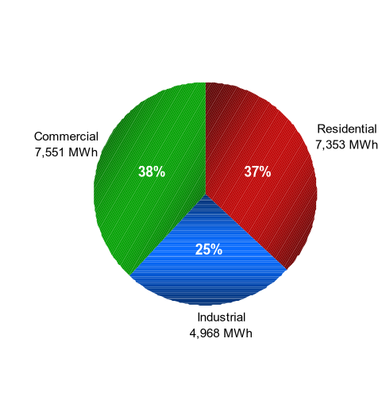







Portland General Electric Overview
Diverse Customer Base
Top 10 customers account for 13% of retail revenues
No single customer accounts for more than 3% of retail revenues
2000 Retail MWh Sales
Top 10 Customers (Listed Alphabetically)
2000 Retail MWh Sales = 19,872 MWh

Slide 39
Portland General Electric Overview
Above Average Customer Growth
In the past 10 years, two-thirds of new Oregon residents have located within the Portland General service territory
Portland General’s normalized load growth for 2000 was 2.3%
Customer Growth ^{(a)}
Customer Growth ^{(a)}
Retail Sales Growth ^{(a)}
1989 – 1999
1996 – 1999
1989 – 1999
1996 – 1999
(a) Source: RDI PowerDat.

Slide 40
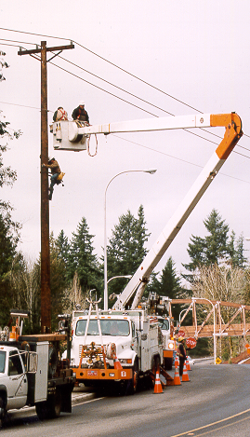
Portland General Electric Overview
Distribution System
$804 million net distribution plant
$55 million O&M (2001E)
$101 million capex (2001E)
9,000 miles of overhead and 6,000 miles of underground distribution lines
150 substations
10 service centers
1,000 total distribution employees
610 union members represented

Slide 41
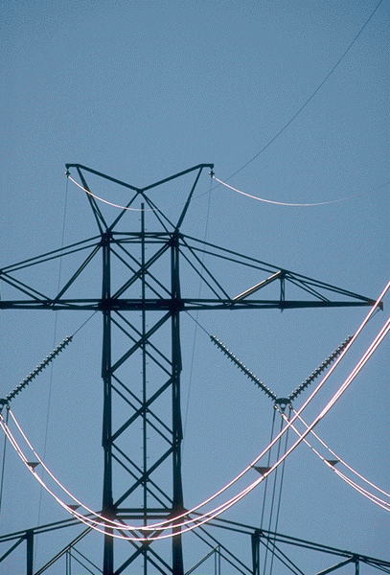
Portland General Electric Overview
Transmission System
$218 million net book value
Diversified revenue stream
Wholesale expertise
Pacific Northwest Intertie
Transmission backbone connecting Northwest and Southwest
Provides supply flexibility
Excess capacity fully contracted on long-term basis
Portland General share
850 MW contract rights on AC
100 MW contract rights on DC
Actively participating in the development of RTO West and TransConnect

Slide 42
Portland General Electric Overview
Strategic Position Within WSCC Grid
Access to liquid Western trading hubs
Connected to 32 service areas via robust transmission system
Access to NW hydro
Low-cost power
Operational flexibility
Increased market liquidity
Resource diversity
Positioned to capitalize on resource and load diversity
Portland General Plants

Slide 43
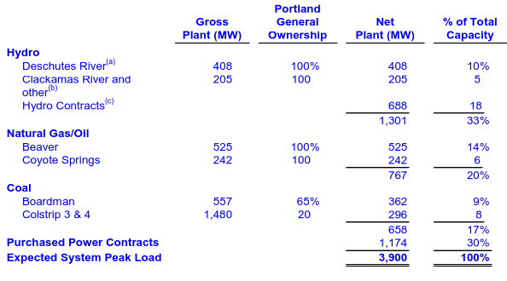
Portland General Electric Overview
Power Supply Portfolio
Power Supply Sources
2000 Power Sources as a
Percentage of Retail MWh Load
Firm Purchase
Hydro^{(c)}
27%
28%
24%
21%
Gas/Oil
Coal
Total 2000 Retail Load = 19,872 MWh
(a) PGE has entered into an agreement to sell one-third of its Pelton hydroelectric plant, which is located in Deschutes River, Oregon to Warm Springs Tribes on 1/1/02. Pelton currently has a net capacity of 108MW and net output of 466Gwh.
(b) Includes Sullivan (16MW) and Bull Run (22MW).
(c) Includes Portland Hydro contract (36MW) and Mid-Columbia contracts (652MW).

Slide 44
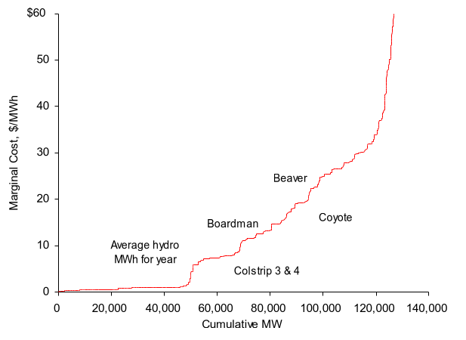
Portland General Electric Overview
Object type: Excel
Path: V:\CIBD Global Power\Granite II\[1999 wscc marginal cost.xls]Graph (2)
Low Cost Portfolio with Unique Optionality
Portland General’s location provides a sustainable competitive advantage
Optionality
Costs
(WSCC Marginal Cost in 1999)
Optionality
Hydro plants
Ability to shift and shape power
Gas plants
Oil-burning capability
Ability to run simple or combined cycle
Coal plant
Displaceable rail contract
All thermal plants can be expanded
Hydro and thermal operations are complementary

