Slide 1
Supply, Demand, and Storage Overview
West Gas Offsite
September 10, 2001
Phil Polsky

Slide 2
Fundamentals Outline
Demand Trends
Supply Trends
Transportation
Storage
Price Perspective
Weather
Conclusion

Slide 3
I. Demand Trends

Slide 4
Gross Domestic Product
The Economy is the Story
Torpid economic growth is affecting gas consumption
U.S. GDP grew .2% in real terms during the second quarter of 2001
This was the lowest growth in 8 years
On a year on year basis this was the lowest growth since 1980Q2
The deceleration in real GDP growth is largely due to decreases in exports and private inventory investment.

Slide 5
Industrial Growth
Contracting Industrial Growth
Total industrial production contracted .8% in August. On an annual basis it contracted 4.8%
This is the eleventh consecutive monthly decline
The manufacturing component reflected the trend, contracting 1%. On an annual basis it contracted 5.5%
There is significant slackness in U.S. industrial capacity
Capacity utilization for total industry was 76%
This is more than 5 percentage points below the 1967-2000 average

Slide 6
U.S. Electric Power Use
1999
2000
2001

Slide 7
Western Power Demand Reduction
The Demand Story
Demand decrease of 8% relative to July 2000
Average retail price increase of approximately 25%
Cooler weather
Increased public awareness and conservation efforts
Curtailed production
Changed production schedules

Slide 8
Regional Demand Reduction
Conservation Has Been Key
In the PNW over 1,700 average MWs of industrial load have come off line to date
In California, demand is about 10% lower than expected
Rockies/SW conservation reached 5% in June
2000
2001

Slide 9
II. Supply Trends

Slide 10
U.S. Rig Counts
Record Levels of Drilling Activity
9/28/01 total gas rig count of 953
Activity is tapering off from the 7/13/01 high of 1,068
Gulf rigs are down 9% from their highs
1999
2000
2001

Slide 11
U.S. Supply Update
But, Moderate U.S. Supply Growth
U.S. Supply growth increased from 53.4 Bcf/d in Q2 to 53.5 Bcf/d in Q3 – A .2% increase
Represents a marked slowdown from Q3’s 2% production growth
On a year-on-year basis, U.S. production is up 2% from 2000Q3

Slide 12
Canadian Imports
Importance of Canadian Supply
U.S. market is highly dependent on Canadian supply
Over 56% of Canadian gas is exported to the U.S.
Year to date, Canadian imports have increased an average of 8% relative to last year
9.22% CAGR in Canadian Imports

Slide 13
III. Transportation

Slide 14
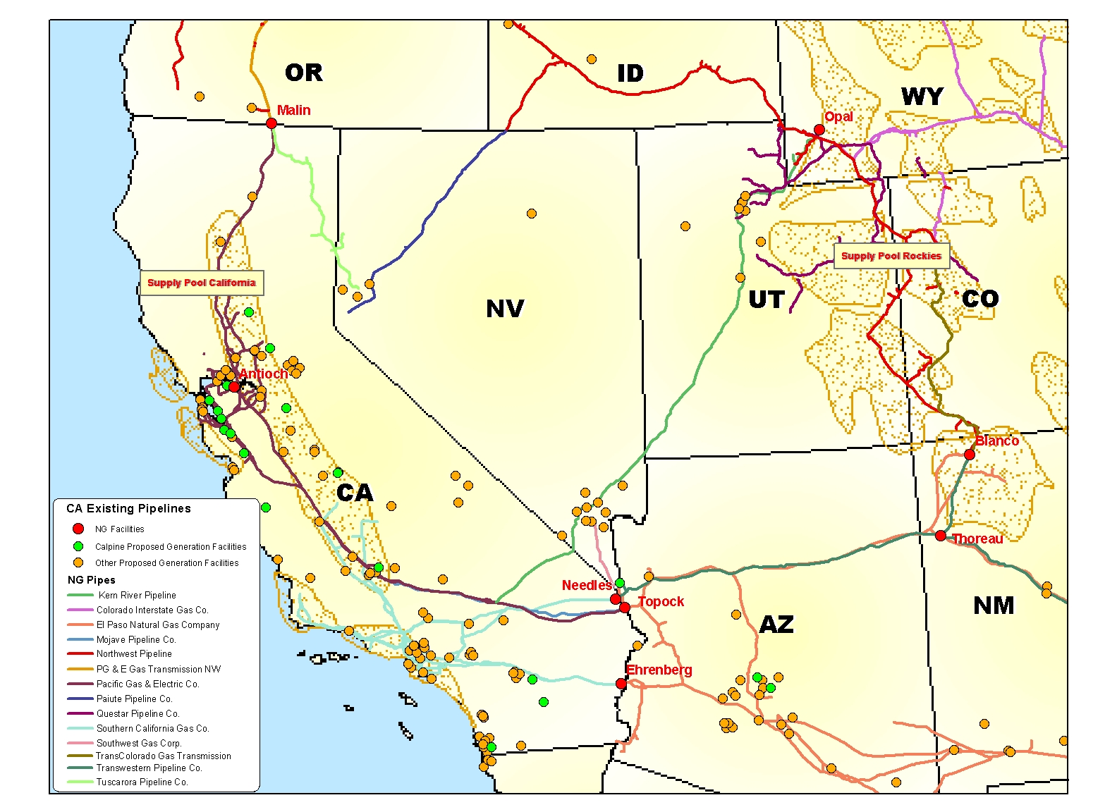
Existing Pipelines to California

Slide 15
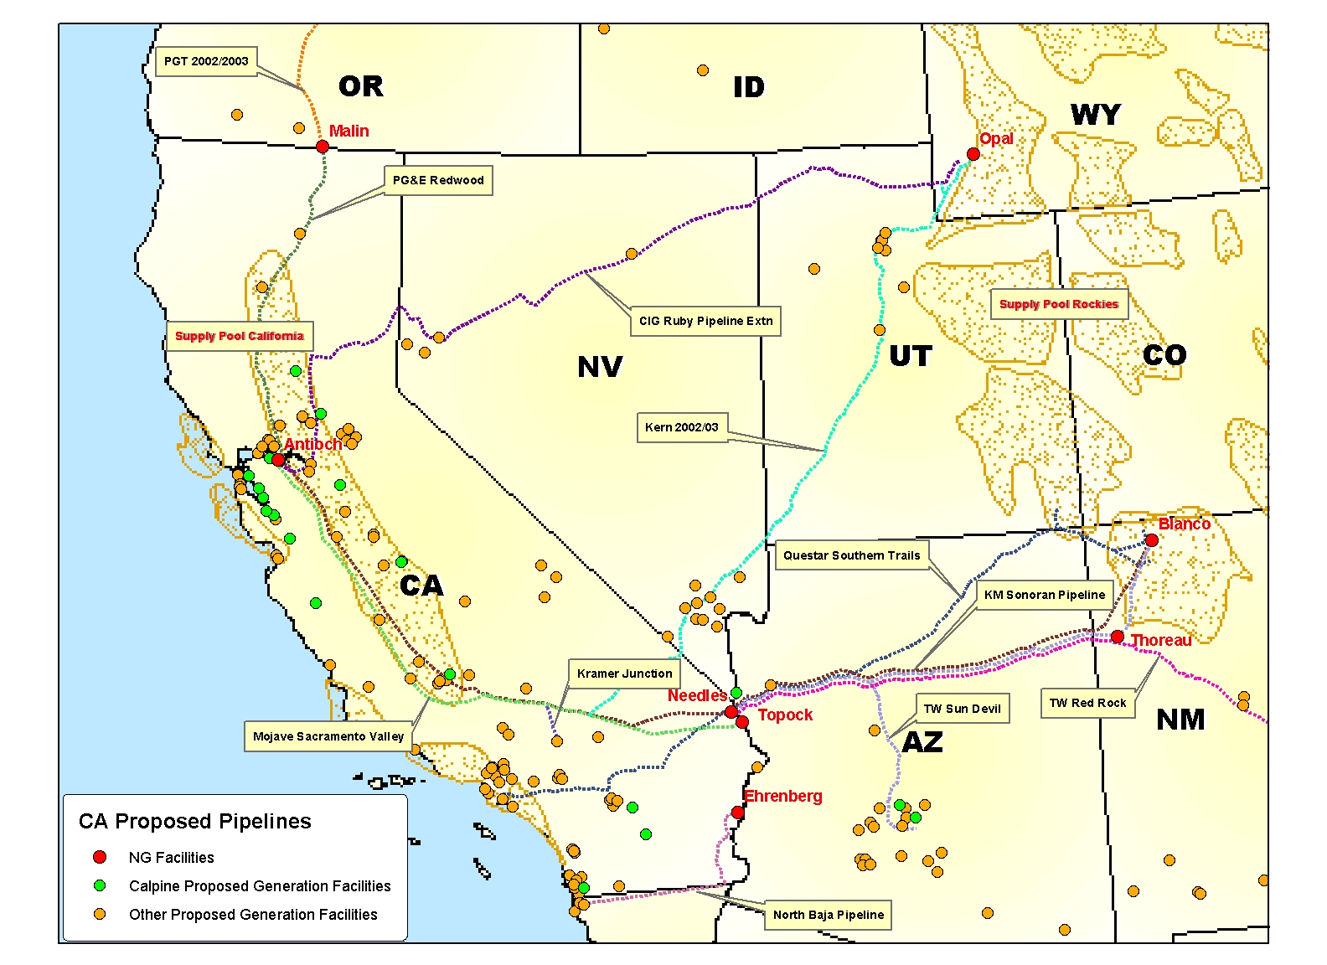
Proposed Pipelines to California

Slide 16
California Additions Generation vs. Interstate Capacity
2001
2002
2003
2004
8/04 | Ruby | 0 | 0 | 0 | 600
7/03 | Sonoran | 0 | 0 | 1,000 | 0
1/03 | PGE Redwood | 0 | 0 | 200 | 0
12/01 | SoCal | 175 | 0 |  | 0
5/03 | Kern | 130 | 200 | 550* | 0
Capacity
TOTAL:
305
200
1,750
600
Generation
Running Total: 305 505 2,255 2,855
Generation** 298 542 598 38
Yearly Short or Long: +7 (335) +817 +1,379
*85% of Kern’s 863 mmcf/d expansion to California less 200 at Kramer Junction
**assumes 80% LF at 7,200 HR

Slide 17
Mismatch of Capacity
Interstate mainline delivery capacity exceeds intrastate takeaway by 1.2 Bcf/d
Socal = 680 MMcfd PG&E = 550 MMcf/d
Socal plans to add a mere 175 MMcf/d (85 Wheeler Ridge, 50 MMcf/d Needles, 40 MMcf/d production area)
New Kramer Junction interconnect with Kern (200 MMcf/d) may alleviate Wheeler Ridge allocation problem
PG&E can add 200 MMcf/d to Redwood path at rolled in rates, Baja expansion expensive
- Kern interconnect on Line 300 provides most economic expansion of Baja path

Slide 18
Existing Interconnect Capacities California Border
Capacity (mmcf/d)
Receipt
Location
Intra
Inter
Delivery
PGE (Redwood) | Malin | 1,905 | 1,905 | PGT
PGE (Baja) | Topock and Daggett | 1,140 | 150* | TWPL
 |  |  | 1,140 | EPNG
 |  |  | 400 | Kern/Mojave
Total:
3,045
3,595
*TWPL meter capacity is 400 mmcf/d

Slide 19
Existing Interconnect Capacities California Border
Capacity (mmcf/d)
Receipt
Location
Intra
Inter
Delivery
SoCal | Needles and Hector Rd | 770 | 800 | TWPL
 |  |  | 50 | Kern/Mojave
 | Topock | 540 | 540 | EPNG
 | Ehrenberg | 1,210* | 1,240 | EPNG
 | Wheeler Ridge | 680* | 800 | Kern/Mojave
 |  |  | 500 | PG&E/KRS
Total:
3,200
3,880
*can receive IT: 120 @ Wheeler, 80@ Ehrenberg

Slide 20
IV. Storage

Slide 21
U.S. Storage Overview
The Rapid Pace Continues
Strong storage levels reflective of weak fundamentals
Unprecedented level of injections have been a critical factor in market declines
As of September 30, the year-over-year storage surplus was 434 Bcf
2,914 Bcf in inventory with 4 weeks left in injection season
High probability of reaching 11/5/98 storage high of 3,094 Bcf

Slide 22
Total U.S. Storage Levels
Winter
Summer

Slide 23
Western U.S. Storage Levels
Strong Western Storage
Despite a slow start, storage is now in year-on-year surplus
As of 9/30/01 storage levels stand at 452 Bcf
On a year-on-year basis, this is 33 Bcf over the previous record set in 1999
This is also 63 Bcf over the 6-year average
Going into the withdrawal season, the West has already beat the previous record - 435 Bcf on 11/5/98

Slide 24
Western U.S. Storage Levels
Winter
Summer

Slide 25
V. Price Perspective

Slide 26
Historical Nymex Prices
Period Low on Feb 26, 1998 - $1.628
Period High on Dec 27, 2000 - $9.98
Oct 8, 2001 Close - $2.275

Slide 27
A Return to Normalcy?
Long Term (25 Yr) Perspective
In January 1976, the monthly average price was $.54
The September 2001 NYMEX contract closed at $2.295
The median price for the period is $1.85.
The maximum is $8.06, and was reached in January 2001
Medium Term (5yr) Perspective
In September 1996, the monthly average price was $1.85
This is 24% lower than the September 2001 NYMEX contract close.
At $2.295 the September contract is equal to the 5 year median monthly price.

Slide 28
The End of the Blowout?
NGI-MALIN
NGI-SoCal
IF-NWPL_ROCKY_M
IF-ELPO/SJ
IF-ELPO/PERMIAN
CGPR-AECO

Slide 29
VI. Weather

Slide 30
U.S. Cooling Degree Days
Non-Eventful Summer Weather
Across the United States, the week ending 9/29/01 had 34% fewer CDDs than normal
Cooling season to date, temperatures are 1.5% cooler than last year, but 4.6% warmer than normal

Slide 31
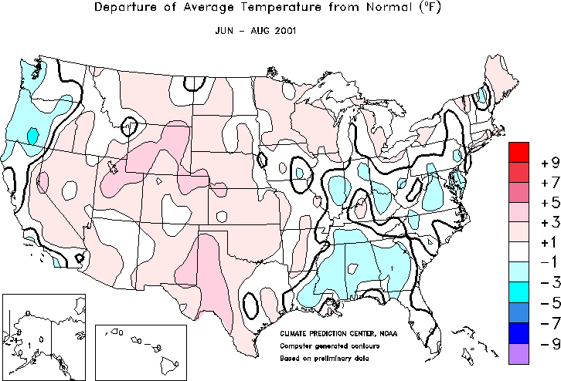

Moderate Summer Weather
Notes:
http://www.cpc.ncep.noaa.gov/products/analysis_monitoring/regional_monitoring/usa.html#seasonal

Slide 32
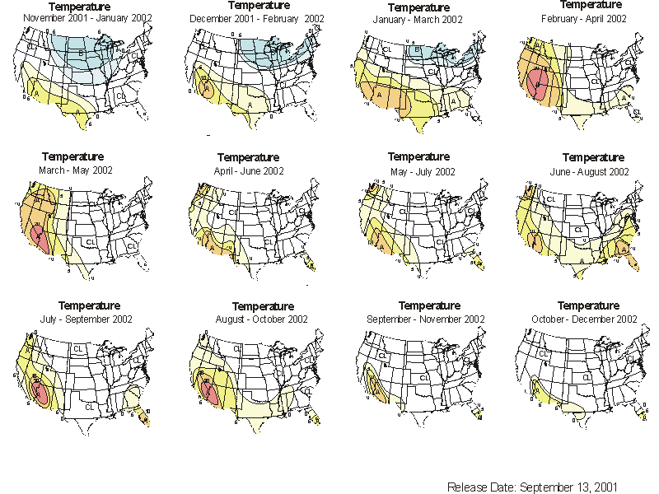
Mild Winter Forecast
Notes:
http://www.cpc.ncep.noaa.gov/products/analysis_monitoring/regional_monitoring/usa.html#seasonal

Slide 33
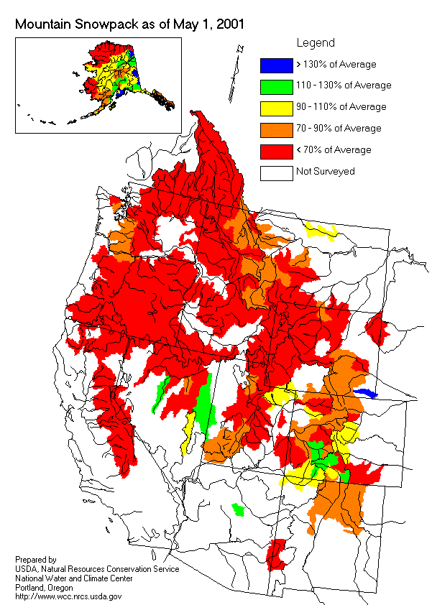
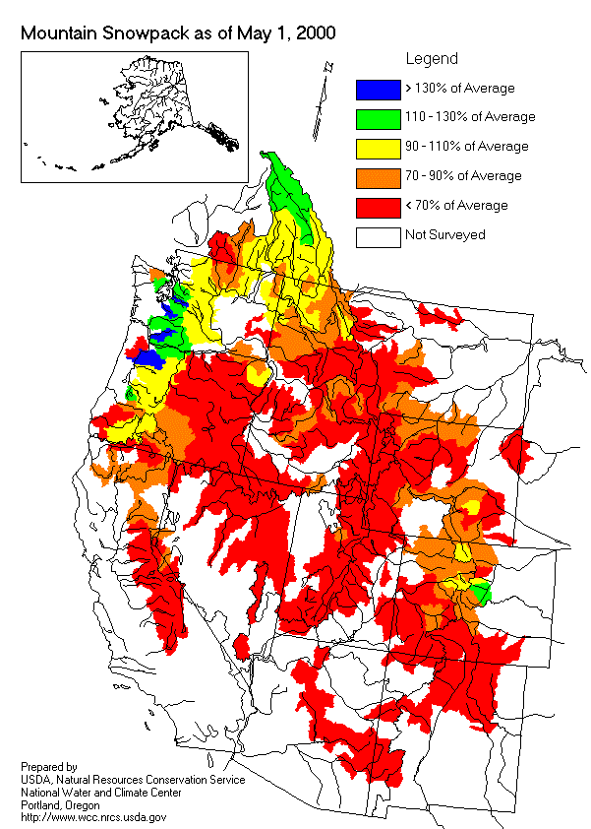
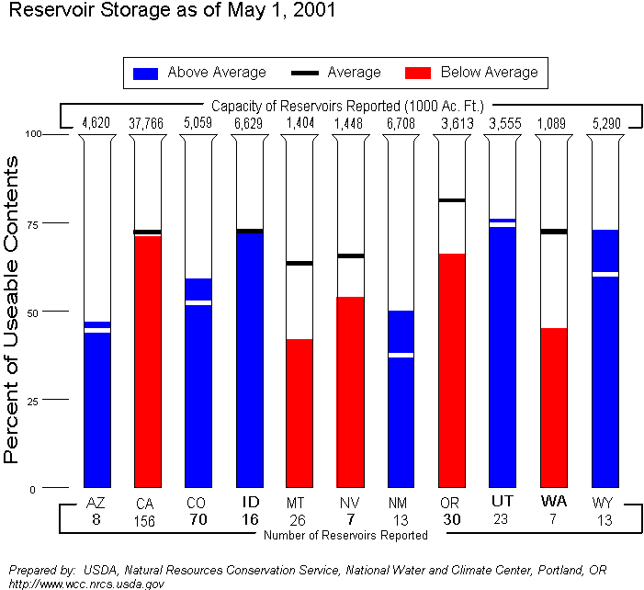
Western Snowpack Levels
Extremely Low Hydro Conditions
In the PNW, water year 2001 streamflow will be among one of the lowest since records began in 1929
For the rest of the West, well below average (<70%) streamflows are forecast

Slide 34
VI. Conclusion

Slide 35
The Bottom Line
Weakening fundamentals continue to pressure gas prices across the country
Gas supply, though on the upswing, is not the primary driver of the bearish environment
Similarly, unremarkable summer weather has not sparked demand
The weak economy combined with successful conservation efforts are key drivers in driving down demand and prices
The resulting rapid pace of injections has set the stage for record inventories going into the withdrawal season

