Slide 1

Metal Bulletin World Steel Congress
October 31, 2000
New Orleans, LA
Enron Corp. - A Catalyst for Change
Jeffrey McMahon
Enron Industrial Markets
President and Chief Executive Officer

Slide 2


®
Transportation
&
Distribution
Retail
Energy
Broadband
Services
Wholesale
Services
Natural Gas
Electricity
Transportation
Distribution
Energy Outsourcing
Commercial and
Industrial Customers
Bandwidth Management
Broadband Delivery Services
Marketing & Delivering Physical and Financial Commodity Products
Risk Management and Intermediation Services
Global Scope
© JM-1031

Slide 3
Overview of Enron Corp.
Explosive Growth
Total Assets
(in billions)
Annual Revenues
(in billions)
Net Income
(recurring, billions)
$45.0
$52.8
$1,109
$9.1
$9.8
$226
1989
June 30, 2000
1989
LTM
June 30, 2000
1989
LTM
June 30, 2000
Price-to-Earnings Ratio
Market Capitalization
(in billions)
Annualized Return
(1/1/90 to 6/30/00)
55.0x
$57.2
26.3%
17.2%
16.8%
14.4x
$2.9
1989
October 25, 2000
1989
October 25, 2000
Peer Group
S&P 500
Enron
America’s Leading Commodity Risk Management Organization
© JM-1031

Slide 4
The Enron Business Model
Retail Services
Distribution
Distribution
Local Access
Wholesale Services
Long-Line
Transportation
Transmission
Long Haul
Transportation
Supply Aggregation
Production
Generation
Content
Producer
Natural Gas
Power
Broadband
Enron Intermediation Roles
© JM-1031

Slide 5
The Enron Business Model
Define
Product
Standards
and Contracts
Obtain Access
to Physical
Product
Develop
Physical
Distribution
Market Making
Establishes
Liquidity
Innovative
Structured
Products
Risk
Management
Transformed Markets
Markets in Transformation
Natural Gas
North America
United Kingdom
Power
North America
United Kingdom
Nordic Region
Australia
Continental Europe
Global Coal
Base Metals
Broadband
Emissions Credits
Weather
Steel
Lumber
Pulp & Paper
© JM-1031

Slide 6
Natural Gas Market
Product Evolution
© JM-1031

Slide 7
Natural Gas Transformation
Old Economy
Producer
Pipeline
LDC
Consumer
© JM-1031

Slide 8
U.S. Natural Gas Market
Industry Characteristics (1980’s)
Problems
Extremely Volatile Product Prices
© JM-1031

Slide 9
Natural Gas Prices
Annualized Daily Volatility
NYMEX Natural Gas
Source: Bloomberg, Enron Calculations
© JM-1031

Slide 10
U.S. Natural Gas Market
Industry Characteristics (1980’s)
Problems
Solutions
Extremely Volatile Product Prices
Fixed Price Contracts Available
Best Efforts Delivery Contracts
“Price Majeure”
Firm Contracts with Liquidated Damages is the Standard
Lack of Price Transparency / No Spot Market
Liquid Transparent Spot Market
No Accurate Forward Price Signals
Transactable Multi-year Forward Market
Depressed Stock Prices and Limited Access to Capital
Stable Stock Prices and Ready Access to Capital
© JM-1031

Slide 11
Natural Gas Transformation
Old Economy
“New” Economy
Producer
Producers
Pipeline
Speculators
Resellers
LDC
Over the Counter Market
Spot Market
Futures Market
Consumer
Pipelines
LDC
Consumers
© JM-1031

Slide 12
Steel Industry
© JM-1031

Slide 13
Steel Transformation
Old Economy
Mill
Processors
Service
Centers
Consumer
© JM-1031

Slide 14
Global Steel Market
Industry Characteristics (2000)
Problems
Extremely Volatile Product Prices
© JM-1031

Slide 15
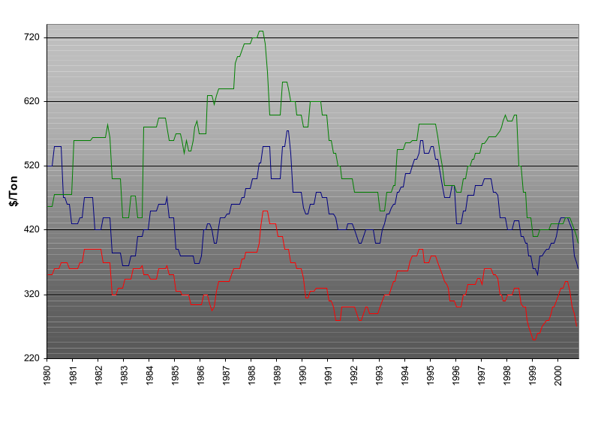
End Product Price History
U.S. Midwest Market
Galvanized
Cold Rolled
Hot Rolled
Source: Purchasing Magazine
© JM-1031

Slide 16
Conversion Charge History
U.S. Midwest Market
Cold Rolled less
Hot Rolled
Source: Salomon Smith Barney
© JM-1031

Slide 17
Global Steel Market
Industry Characteristics (2000)
Problems
Solutions
Extremely Volatile Product Prices
Fixed Price Contracts
Best Efforts Delivery Contracts
Firm Contracts with Liquidated Damages
Lack of Price Transparency / No Spot Market
Create Liquid Transparent Spot Market
No Accurate Forward Price Signals
Create Transactable Multi-year Forward Market
Depressed Stock Prices and Limited Access to Capital
Stable Stock Prices and Ready Access to Capital
© JM-1031

Slide 18
Steel Transformation
Old Economy
“New” Economy
Mill
Mills
Processors
Speculators
Resellers
Service
Centers
Over the Counter Market
Spot Market
Futures Market
Consumer
Processors
Service
Centers
Consumers
© JM-1031

Slide 19
Enron’s Steel Strategy
Recognizing that further commoditization of the steel
markets is inevitable...
  Enron will focus on pre-determined steel product specification on commercial quality gauges and widths
  Central index pricing points to build liquidity and price transparency
  Market-making function - a bid and ask will be offered for all products traded using Enron’s BBB+ credit rating as the counterparty
  EnronOnline will provide an existing, functional, and successful e-commerce platform to enhance our steel market making operations
© JM-1031

Slide 20
Wholesale Segment
Wholesale
Services
Division
Enron
North America
Enron
Industrial Markets
Enron
Global Markets
Enron
Europe
Gas
Power
Crude & Products
Coal
Weather
Insurance
Gas
Power
Credit
Target Markets:
Pulp & Paper
Steel
Lumber
© JM-1031

Slide 21
Why is Enron the Right Agent for Change?
Experience Enron has participated in many market transformations
Culture Enron has a unique entrepreneurial culture that thrives on developing new products and services for existing “old economy” markets
  “Most Innovative Company in America”, 5 Years in a Row
  Fortune Magazine, March 2000
  “Most Innovative Company in the World”
  Fortune Magazine, September 2000
Risk Enron has successfully applied its risk intermediation and risk management expertise in both energy and non-energy markets
Capital Enron can access the capital markets to provide the funding necessary to establish and grow financial/physical trading positions
Scale Enron possesses the scale, commitment and human resources necessary to transform the steel market
© JM-1031

Slide 22
Enron’s Competitive Advantage
Brokers/ Producers
Electronic Platform
e-Commerce
Physical
®
Financial
Financial
Institutions
© JM-1031

Slide 23
EnronOnline Overview
© JM-1031

Slide 24
EnronOnline
Commodities Traded
Results
Natural Gas
Power
Crude Oil
Weather Derivatives
Emissions Allowances
Plastics
Petrochemicals
Pulp
Paper
Coal
Broadband
Metals
Average Weekly Transactions
Capabilities
Proprietary Technology - Dynamic real-time pricing
Scalable - over $178 Billion notional value transacted since inception (11/99)
Flexible - adaptable to unlimited products in multiple currencies
Reliable - a principal-based trading system
Leading e-commerce platform
Most liquid e-marketplace
>50% of all Enron’s transactions
© JM-1031

Slide 25
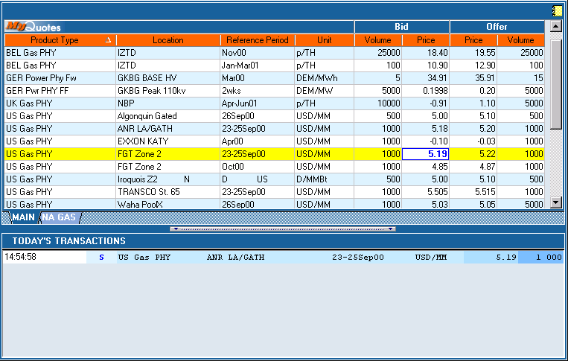
EnronOnline
© JM-1031

Slide 26
EnronOnline
(Example)
Short Tons
100,000
50,000
60,000
40,000
Bid
230
70
300
390
Offer
240
80
320
400
Short Tons
100,000
70,000
30,000
55,000
Hot Rolled
Conversion Charge (HR-CR)
Cold Rolled
Galvanized
EnronOnline will provide users with the
capability to trade steel within the Fourth Quarter of 2000
Prices are for illustrative purposes only
© JM-1031

Slide 27
Products and Services
© JM-1031

Slide 28
Products and Services
Physical Delivery
&
Logistics
Risk Management
Finance
Buy/Sell
Fixed Price
Price Swaps
Consignment
Buy/Sell
Index Price
Options
Caps, Floors, Collars
Asset Monetization
Hybrids
Cross Commodity, Etc.
Structured Finance
© JM-1031

Slide 29
Sell (Buy) Fixed Price
Terms
  Steel Co. sells physical steel to Enron
  Steel Co. receives a fixed price
  Benefits
    Controls directional price risk
    Stabilizes earnings
    Potentially improves credit rating
Steel Co.
Steel
Fixed ($)
Enron
  Legend
  Physical Commodity
  Financial Option
  Dollars ($)
© JM-1031

Slide 30
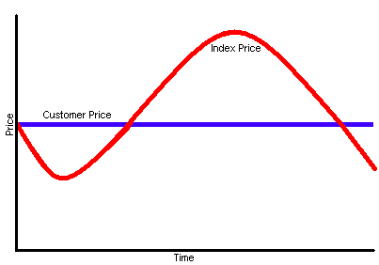
Sell (Buy) Fixed Price
(Example)
Steel Specs
Hot Roll - 1008 CQ
Gauge - 10
Width - 60”
Price - $250/Short Ton(ST)
Notes
Price for physical delivery is fixed irrespective of current market conditions
Prices are for illustrative purposes only
© JM-1031

Slide 31
Sell (Buy) Index Price
Terms
  Steel Co. sells physical steel to Enron
  Enron pays Steel Co. an Index-based price
  Utilize agreed-upon Index
  Benefits
    Insures pricing reflects current market conditions
Steel Co.
Steel
Index ($)
Enron
© JM-1031

Slide 32
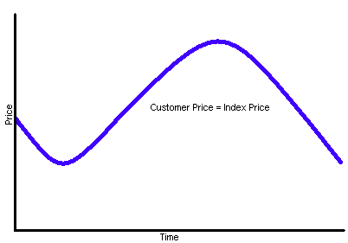
Sell (Buy) Index Price
(Example)
Steel Specs
Hot Roll - 1008 CQ
Gauge - 10
Width - 60”
Settlement (Index)
Metal Bulletin
Purchasing Magazine
Notes
Price for physical delivery reflects current market conditions
© JM-1031

Slide 33
Fixed for Index Swap
Terms
  Steel Co. continues to sell steel to Purchaser at Index, or an agreed-upon price
  Steel Co. pays Index price to Enron and receives a fixed price from Enron in return
  Net effect
    Steel Co. sells steel for a fixed price
  Benefits
    Mitigates directional price risk
    Reduces earnings volatility
    Stabilizes cash flows
    Potentially improves credit rating
Steel
Purchaser
Physical
Relationship
Unchanged
Index ($)
Steel
Steel Co.
Index ($)
Fixed ($)
Enron
© JM-1031

Slide 34
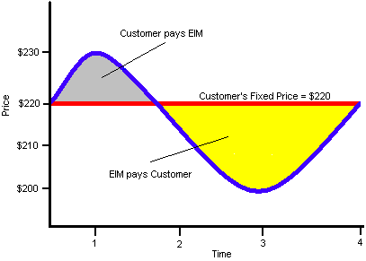
Fixed for Index Swap
(Example)
Swap Price: $220/ST
Term: 4 periods
Prices are for illustrative purposes only
© JM-1031

Slide 35
Natural Gas Price Impact
I ton of Steel can buy x MMBTU of gas
Note: Steel prices based on Purchasing Magazine and Gas Prices based on Henry Hub
© JM-1031

Slide 36
Cross-Commodity Swap (Gas Co.)
Terms
  Gas Co. sells physical gas to LDC at Gas Index
  Gas Co. buys physical steel from Steel Producer at Steel Index
  Gas Co. pays Gas Index to Enron and receives from Enron the Steel Index
  Transaction value is based upon conversion ratio (CR) of gas (in MMBtu’s) to steel (in tons)
  Net effect
    Gas Co. buys steel in terms of gas price
  Benefits
    Transaction is based on a core commodity of the customer’s business
    Mitigates exposure to steel price volatility
LDC
Gas
Gas Index ($)
Gas Index ($)
Enron
Gas Co.
Steel Index/CR ($)
Steel
Steel Index ($)
Steel
Producer
© JM-1031

Slide 37
Cross-Commodity Swap (Steel Co.)
Terms
  Steel Co. receives physical gas from LDC at Gas Index
  Steel Co. sells physical steel to User at Steel Index
  Steel Co. receives Gas Index from Enron and pays Enron the Steel Index
  Transaction value is based upon conversion ratio (CR) of gas (in MMBtu’s) to steel (in tons)
  Net effect
    Steel Co. purchases gas in terms of steel price
  Benefits
    Transaction is based on a core commodity of the customer’s business
    Mitigates exposure to gas price volatility
LDC
Gas
Gas Index ($)
Gas Index ($)
Enron
Steel Co.
Steel Index ($)/CR
Steel
Steel Index ($)
User
© JM-1031

Slide 38
Buy a Put Option (“Price Floor”)
Terms
  Steel Co. selects a strike price
  Steel Co. receives a financial put and pays Enron a premium
  Steel Co. continues to sell physical steel at Index
  Should Index fall, Steel Co. has the option to effectively sell steel to the market at the strike price
  Benefits
    Limits Customer’s price exposure to the strike price
    Participate in all upward price movement
    Cost of the protection is known and fixed
Steel Co.
Put
Option
Enron
Premium
($)
Steel
Index ($)
Steel
Purchaser
© JM-1031

Slide 39
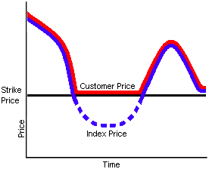
Put Option (“Price Floor”)
(Example)
The strike price is the minimum price at which Steel Co. will effectively sell its steel
Steel Co. continues to sell physical steel at Index
When exercised, Enron pays Steel Co. the difference between the strike price and Index
The protection has a cost, or option premium
© JM-1031

Slide 40
Costless Collar
Terms
  Steel Co. buys a put from Enron
  Steel Co. sells a call to Enron
  Premiums paid in transaction directly offset one another
  Net effect
    Locks price of steel within a desired price range
  Benefits
    Effectively, no premium
    Reduces earnings volatility
    Stabilizes cash flows
    Potentially improves credit rating
Enron
Premium ($)
Put Option
Steel Co.
Index ($)
Steel
Producer
Steel
Premium ($)
Call Option
Enron
© JM-1031

Slide 41
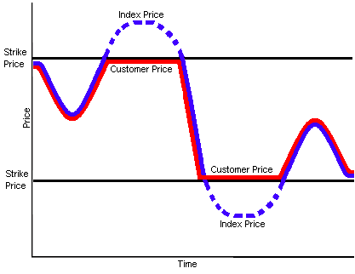
(Example)
Costless Collar
Limits price risk exposure in both directions
Minimum price Steel Co. sells steel for is the strike price of the put
Maximum price Steel Co. sells steel for is the strike price of the call
Steel Co. “pays” for the put option by giving up the benefits above a certain price level
© JM-1031

Slide 42
Consignment
Terms
  Enron acquires steel inputs from Producer through lump-sum payment
  Steel Co. pays Enron for steel inputs as consumed (“just-in-time”), on a pre-determined drawdown schedule
  Benefits
    Increases liquidity with reduced working capital
    Higher advance rate than banks
    Off-balance sheet treatment
  Performance bonds may be necessary to help off-set credit risk
Steel Co.
Steel
Inputs
Payment
as consumed
Enron
Steel
Market
Opportunities
$
Steel
Inputs
Lump Sum $
Producer
© JM-1031

Slide 43
A Catalyst for Change
Q & A
© JM-1031

