Slide 1
The California Power Crisis:
What Happened, Why, and Key Lessons Learned
09/27/25 01:19
CONFIDENTIAL
EPNG PRACTICE DOCUMENT
Sebastian Barth, Tim Bleakley,
Peter Glynn, Tommy Inglesby,
Adrian Reed, Thomas Seitz
February 21, 2001
This report contains information that is confidential and proprietary to McKinsey & Company and is solely for the use of McKinsey & Company personnel. No part of it may be used, circulated, quoted, or reproduced for distribution outside McKinsey & Company. If you are not the intended recipient of this report, you are hereby notified that the use, circulation, quoting, or reproducing of this report is strictly prohibited and may be unlawful.

Slide 2
TODAY’S DISCUSSION
  Background – from deregulation to default
  The current crisis
    Why power prices rose dramatically
    Why the electric utilities are poised on the edge of bankruptcy
  Lessons learned and key takeaways
  Appendices
    A: California deregulation basics
    B: The impact of natural gas costs on the California market
    C: Estimating the impact of demand elasticity
    D: Supply and demand estimates and drivers
    E: Market behavior observations
    F: NOx credits in California
    G: Back-up
    H: Glossary
Notes:
<number>
txho/10209 zxd414.ppt

Slide 3
CALIFORNIA’S DEREGULATION PROCESS BEGAN IN 1994
1994
1995
1996
1997
1998
  Blue book proposal
    Proposes direct access in 1996 for industrial customers with full access by 2002
  CPUC policy decision
    Adopts hybrid pool/bilateral market structure and 5-year (1998-2002) phase-in of full access
  AB 1890 legislation
    Authors CPUC policy decision
    Suggests 4-year phase-in to full access (1998-2001)
  CPUC order
    Requires full access implementation in 1998
  SCE and PG&E auction of substantial portions of generation portfolio
  FERC authorizes operation of CalSO and CalPx
  AB 1890 implemented
    Customers free to choose alternative providers
    CalPx begins operations
    CalSO begins operations
    Stranded cost recovery begins
Notes:
<number>
txho/10209 zxd414.ppt

Slide 4
MANY CONSTITUENCIES WITH DISPARATE AGENDAS FORCED A PROTRACTED NEGOTIATION PROCESS . . .
“Utilities want their CTC, small customers want to be sure they don’t get shafted, IPP producers want access to customers, and renewable power producers want subsidies . . .”
– Utility negotiator
Small customers (e.g., TURN)
  Reliable electricity supply
  Lower rates
  No full recovery of stranded costs
  No advantages of large customers over small ones
Utilities (e.g., Southern California Edison, PG&E)
  No retail wheeling
  No vertical deintegration
  Full recovery of “stranded” costs
  Regulation-intensive alternative to direct access
Governors (e.g., Pete Wilson)
  Economic growth through lower energy prices
Deregulation
legislation
(a negotiated
settlement)
Independent power producers and marketers (e.g., AES)
  Assurance that existing contracts will be respected
  Some certainty as to the calculation of avoided costs
  Retail head room
Labor unions
  Assurance that existing labor agreements will be maintained
  Assurance that retraining and severance will be included in stranded costs
Large customers/industrial organizations (e.g., California Large Consumer Association, Agricultural Energy Consumer Association)
  Lower rates
  Direct access
  Vertical deintegration
  No full recovery of “stranded” costs
Environmentalists (e.g., Sierra)
  Subsidy for renewable energy sources in the competitive market
  No relaxation of emission limits
FERC (Federal Energy Regulatory Commission)
  Replace ROR regulations with competitive market structure
  Full recovery of utilities’ stranded cost
Notes:
<number>
txho/10209 zxd414.ppt

Slide 5
IN THE END, AB I890 SEEMED TO PROVIDE SOMETHING FOR EVERYONE, INCLUDING A RELATIVELY QUICK TRANSITION TO COMPETITION
Key features of AB 1890 (passed August 31, 1996)
Intention
Major provision
Intended primary beneficiary
Provide an efficient market-based wholesale price-setting mechanism and ensure grid reliability
Prescribe quick transition to customer choice
Accelerate recovery of stranded costs and speed market to full competition
Ensure consumers would realize rate reductions immediately
  Established the creation of non-profit ISO and PX entities to enable orderly wholesale market and dispatching operations
  Directs the CPUC to establish customer-direct access schedule to reach 100% access by 1/1/02
  Stranded investment recovery
    To be completed prior to 12/31/01
    Beyond 2001, IOUs at risk for recovery of any remaining stranded costs
    Competitive transition charge (CTC) calculated as the difference between frozen retail rates and cost to supply electricity*
  Retail prices
    Frozen for large C&I and industrial customers
    10% automatic rate reduction for small commercial and residential customers
  All participants
  Retail customers
  PG&E, SDG&E, SoCal Edison
  Retail customers
* Wholesale commodity price as determined by PX plus T&D charges
Source: Regulatory Research Associates; Team analysis
Notes:
<number>
txho/10209 zxd414.ppt

Slide 6
CLEARLY, MOST PARTIES TO THE NEGOTIATIONS ANTICIPATED A SMOOTH TRANSITION TO LOWER PRICES
“A powerful new stimulant for any new business looking to grow or move to California.”
– Pete Wilson
California Governor
September 24, 1996
“It is the best way to move to a desirable competitive market that will benefit all customers, large and small.”
– John Bryson, CEO
Southern California Edison
December 21, 1995
“Consumer groups . . . can combine to negotiate for a lower basic contract rate supplemented by less expensive power from the spot market.”
– C. Edward Wolf, President
Sr. Utility Ratepayers of California
September 15, 1996
“We think the aggregation of our power purchases . . . will bring us substantial savings.”
– Bob Largent,
Director of Energy Management
McDonald’s Corp.
September 30, 1996
“This [legislation] is designed to reduce costs to all customers of all classes and simultaneously bring stability to the system.”
– Senator Steve Peace
California Legislature
August 27, 1996
Source: Press releases
Notes:
<number>
txho/10209 zxd414.ppt

Slide 7
HOWEVER, DEREGULATION PROVED TO BE MORE COMPLEX
THAN ANTICIPATED
Key market issues emerging after ISO/PX start-up in 1998
Issue/challenge
Observations
No retail competition
System
implementation
Grid expansion
Gaming behavior
Ancillary service market design
  The mechanism for CTC recovery did not allow for retail headroom, effectively pushing back retail competition to 2002
  Problem with key system software threatened to delay operations and complicate system management
  Bottlenecks on the south to north transmission system impacted ability to receive inputs of power and ancillary services
  Inconsistencies in rules surrounding bid process and settlement methodology at times may have allowed participants to realize higher prices
  The local nature of service requirements may have effectively reduced competition to only a few players in each market, driving up prices
Source: CaISO Annual report on Market Performance, June 1999
Notes:
<number>
txho/10209 zxd414.ppt

Slide 8
. . . SUCH THAT THE DEREGULATORY PROCESS NEVER TRULY ENDED REVISIONS TO RULES AFTER PASSING AB 1890
EXAMPLES
AB 1890
1996
Key legislation
Principal issues
  AB 360
  SB 1305
  AB 1775
  CPUC Order 166
  SB 110
  SB 90
  AB 1154
  AB 265
  AB 1970
  AB 1156
  SB 1388
  SB 1194
  AB 995
  AB 918
  AB 94
  SB 552
  SB 1771
  AB 2705
  SB 38
  AB 58
  SB 36
  SB 47
  AB 1
  Refine rules to address issues surfaced during implementation
  Coordinate participants and expand procedural detail
  Provide transparency and environmental safety
  Skyrocketing wholesale prices
  Capacity shortages
  Transmission constraints
  Inadequate pricing regulations
  Permitting/environmental impediments
Deregulation was a “moving target” as, on average market rules were changed or amended many times per month
San Diego price run-up 2000
2001
Plus over 35 additional legislative amendments
Source: California State Assembly Web site
Notes:
<number>
txho/10209 zxd414.ppt

Slide 9
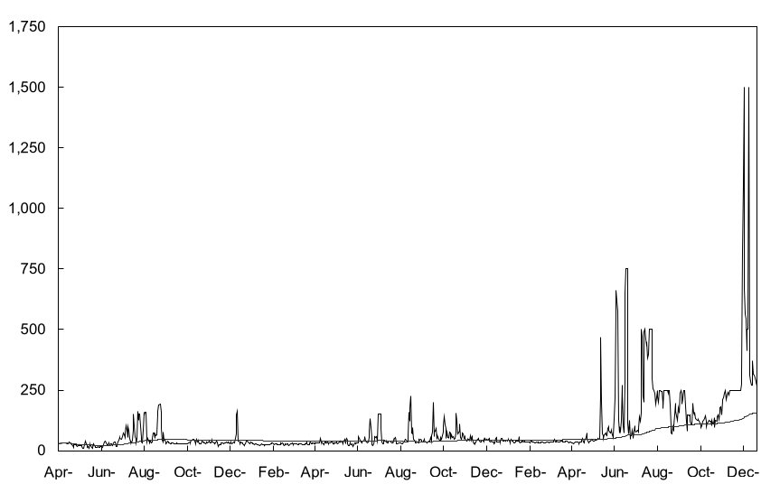
DESPITE FREQUENT RULE REVISIONS, SPOT PRICING BECAME MORE VOLATILE AND AVERAGE PRICES INCREASED
12-month average
Dollar per megawatt-hour peak price
Daily peak price
Investigations into ancillary services market power 7/00
CaISO authorized to invest $750 million over 3 years in new power plants to battle capacity shortages 11/1/00
SDG&E recovers stranded costs and increase rates for customers 7/1/99
SCE and PG&E warn of impending bankruptcy
12/1/00
CalPx and CaISO begin operations 3/31/98
CA Attorney General to investigate San Diego price spikes 7/28/00
San Diego customers scream for price relief 7/26/00
CalPx suspends day-ahead and day-of market operations 1/30/01
Independent generators threaten to stop selling power to California fearing credit risk 12/00
FERC grants ISO authority to cap ancillary and balance prices 7/17/98
CaISO orders PG&E to begin rolling blackouts in Bay Area 6/15/00
1998
1999
2000
Source: California Power Exchange; California Independent System Operator
Notes:
<number>
txho/10209 zxd414.ppt

Slide 10
TODAY’S DISCUSSION
  Background – from deregulation to default
  The current crisis
    Why power prices rose dramatically
    Why the electric utilities are poised on the edge of bankruptcy
  Lessons learned and key takeaways
  Appendices
    A: California deregulation basics
    B: The impact of natural gas costs on the California market
    C: Estimating the impact of demand elasticity
    D: Supply and demand estimates and drivers
    E: Market behavior observations
    F: NOx credits in California
    G: Back-up
    H: Glossary
Notes:
<number>
txho/10209 zxd414.ppt

Slide 11
THE CURRENT CRISIS
Why power prices rose dramatically
Why the electric utilities are poised on the edge of bankruptcy
  What were the key drivers of high prices and price volatility?
  Why, specifically, did the IOUs bear much of the financial burden?
Two related, but very much separate, issues
Notes:
<number>
txho/10209 zxd414.ppt

Slide 12

THERE WERE 3 PRIMARY DRIVERS OF HIGHER
POWER PRICES
CONCEPTUAL
Higher variable production costs
Higher value of generation capacity (up to full reinvestment economics)
Higher prices due to power market inefficiencies (beyond full reinvestment economics)
Total increase in power prices
Notes:
<number>
txho/10209 zxd414.ppt

Slide 13

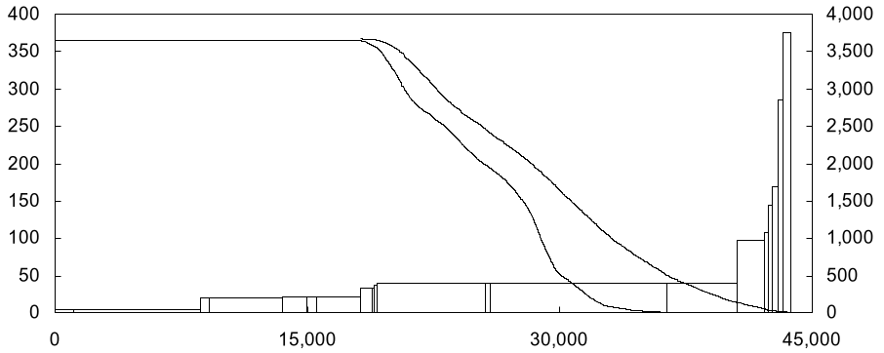
NATURAL GAS-FIRED UNITS ARE GENERALLY ON THE
MARGIN IN CALIFORNIA
CaISO power and load duration cost curves, 2000
ESTIMATE
Gas-fired capacity
Load duration
Marginal generation costs*
$/MWh
Actual load
Hours**
900
Gas-fired
capacity was virtually
always on the margin
setting price in California during 2000
Winter Loads
Summer Loads
CaISO generation capacity
MW
* Based on capacity weighted average of generator reported monthly fuel costs for May-September 2000 variable operating costs; estimated unit by unit; does not include NOx credit costs
** Total hours at given level of demand for Winter 10/99 through 2/00, Summer demand hours between 5/00 through 9/00
Source: RDI base case; RDI PowerDat; CaISO; Team analysis
Notes:
<number>
txho/10209 zxd414.ppt

Slide 14
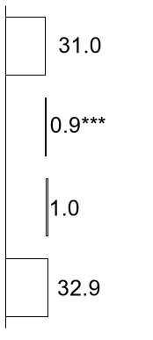
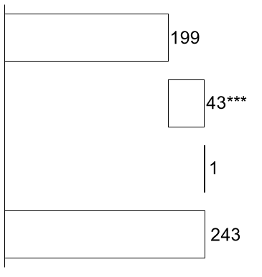
VARIABLE PRODUCTION COSTS INCREASED OVER 650% YEAR ON YEAR FOR A TYPICAL MARGINAL GAS UNIT
The variable cost structure of a 12,000 heat rate simple cycle gas unit
Dollars per megawatt hour
ESTIMATE
December 1999
December 2000
Natural gas at
$2.56/MMBtu*
Natural gas at
$16.56/MMBtu
NOx credits at
$1.0/lb.**
NOx credits at
$46.0/lb.**
Other variable costs
Other variable costs
Total variable cost of production
Total variable cost of production
Dramatically higher delivered natural gas costs and NOx credits are largely responsible for the increase
* For more on the impact of higher natural gas costs on the California power crisis, see Appendix A
** Represents typical values for 2000 vintage NOx RTC credits during December 1999 and 2000 respectively
*** California gas turbines with heat rates from 11,000 to 13,000 MMBtu/kWh running January to June 2000 emitted an average 0.93 lbs/MWh of NOx. Range of gas fined power plant NOx emissions in 2000 was 0.06 to 5 lbs/MWh
Source: DRI; Western Natural Gas Market Review; CaISO; EPA; Team analysis
Notes:
<number>
txho/10209 zxd414.ppt

Slide 15
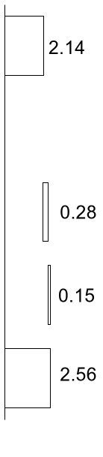
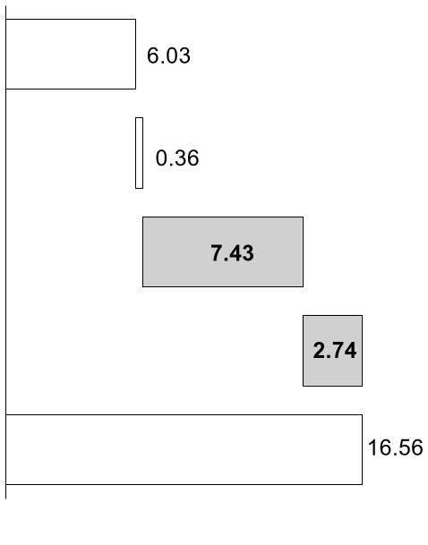
THE HIGHER NATURAL GAS PRICES ARE, IN TURN
DRIVEN BY 4 KEY FACTORS *
$/MMBtu **
While natural gas
prices across the nation
were much higher, much
of the increase in delivered
gas costs can be attributed
to higher interstate and
intra-California
transport/basis costs
December 1999
December 2000
Higher Henry Hub Pricing
Permian basin basis
differential with Henry Hub
increased
(0.01)
Greater interstate basis
differential CA border
(Topock) – Supply Basin
Greater intrastate transport
costs – CA border to PG&E
Citygate
Total PG&E Citygate
* For more in the impact of higher natural gas costs on the California power crisis, see Appendix A
** Natural gas prices are volume weighed monthly average index prices based from Natural Gas Week
Source: DRI; Western Natural Gas Market Review; Natural Gas Week
Notes:
<number>
txho/10209 zxd414.ppt

Slide 16
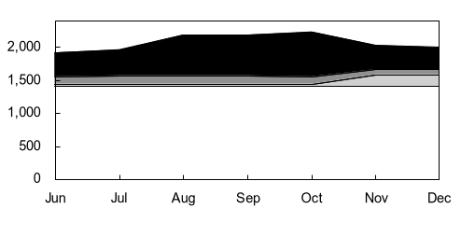
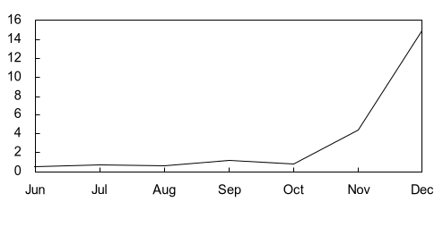
NATURAL GAS TRANSPORT CAPACITY INTO CALIFORNIA WAS CONTROLLED BY ONLY A FEW PLAYERS
EL PASO PIPELINE EXAMPLE
Purchased Release Capacity at California Border 2000
MMcf/day - released volume*
Potential total gross profit generation of
El Paso release capacity holders during Q4 2000**
100 = $1.148 billion
Other
Other***
Enron
Reliant
Enron
El Paso
merchant
services
Reliant
El Paso merchant services
Basis differential – Permian to California border (Topock)
$/MMBtu
It is not just the
merchant generators
that fared well in
California
* Assumes that Enron capacity reverted to El Paso when contract was canceled by Enron 1/31/00. Release volumes were aggregated to parcel number rather than delivery point to avoid double counting on contracts with option for multiple delivery points
** Represents maximum value assuming all release volumes flow. Calculations: Total monthly volume x [(basis differential – (reservation + commodity + fuel)], where basis differential is Permian to California border (El Paso Topock) using average monthly prices, and average monthly commodity charges (4¢/MMBtu), fuel costs (4.85% of Permian price ~$4.00/MMBtu), and reservation charges(20¢/MMBtu).
*** Other include 21 participants during Q4 including BP, KN Energy, Duke, Williams and other marketers
Source: RDI/Gas Dat for release capacity data; Topock prices – Natural Gas Week; Permian prices – Gas Daily; Team analysis
Notes:
<number>
txho/10209 zxd414.ppt

Slide 17
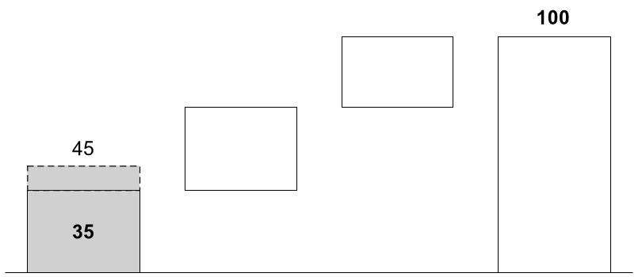
HIGHER VARIABLE PRODUCTION COSTS ACCOUNTED FOR ROUGHLY 35% TO 45% OF THE TOTAL INCREASE IN CALIFORNIA POWER PRICES
ESTIMATE
2000 over 1999 annual CaISO generation revenues
Percent
?
The
California crisis
is not a power
crisis, it is an integrated gas,
gas delivery,
and power
generation
crisis
?
Variable costs*
Capacity value up to FRE
Market inefficiencies beyond FRE
Total**
* $8.2 billion (40% of the wholesale revenue increase) in incremental variable costs estimated as the difference between the 2000 and 1999 sums of variable cost x total CalSO load for all hours when CalSO price exceeds variable cost for a 10,000 heat rate gas plant (= 10,000 x California volume weighted average border daily gas price + 0.93 lb. NOx/MWh x monthly average NOx RTC price $/lb. + $1.03/MWh variable O&M)
** The difference in 2000 vs. 1999 CalSO total energy + ancillary services costs of $20.6 billion as reported in CalSO 1/16/01 market analysis report
FRE = Full reinvestment economics
Source: Platt’s Gas Daily; Cantor Fitzgerald; CalSO; RDI PowerDat; Team analysis
Notes:
<number>
txho/10209 zxd414.ppt

Slide 18
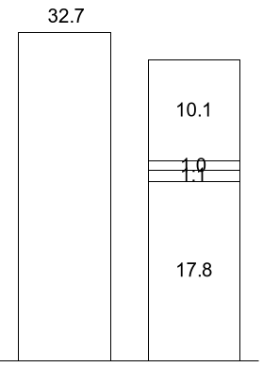
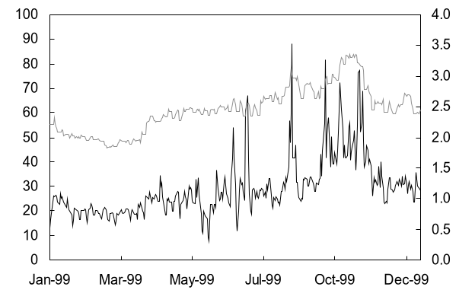
BY 1999, AVERAGE WHOLESALE PRICES IN CALIFORNIA EXCEEDED THE FULL REINVESTMENT ECONOMICS OF A CCGT
ESTIMATE
California 1999 power and gas prices
$/MWh
1999 CalPX price
$/MWh¹
1999 gas price
$/MMBtu²
30.1
Return on reinvestment
Fixed O&M
Variable O&M⁶
Fuel cost⁵
1999 average CalSO power price³
Full
reinvest-ment costs⁴
1 Power price calculated as day-ahead volume weighted market clearing price; CalPX
2 PG&E city gate daily average price; Gas Daily
3 Includes PX, bilateral, ISO real-time and ancillary service costs; CalSO Market Analysis Report 1/16/01
4 Assumes 6,800 heat rate; 10% return, 90% utilization; $500/kW capex; 20-year life, 38% tax rate; $8/kW/year fixed O&M; $1.03/MWh variable O&M
5 Fuel cost at volume weighted PG&E daily city gate average price of $2.62/MMBtu for 1999; Gas Daily
6 Includes $0.16/MWh NOx omission cost at 0.4 lbs/MWh on $0.4/lb. RTC credit/ CEMS and Cantor Fitzgerald
Notes:
<number>
txho/10209 zxd414.ppt

Slide 19
A FEW OBSERVATIONS
  Despite recent trade press reports to the contrary, the market was receiving clear indication by 1999 via price signals from the PX that new capacity was necessary
  In fact, full reinvestment economics for new CCGT construction had been fully met in 1999
  The increase in power price between 1999 and 2000 therefore cannot be attributed to the higher value of generation capacity (up to fuel reinvestment economics) but must instead be attributed to a number of market inefficiencies that led to the price fly-ups* beyond full investment costs
* The (arguably) slow response by generators to the market price signals in 1999 is a form of market inefficiency

Slide 20
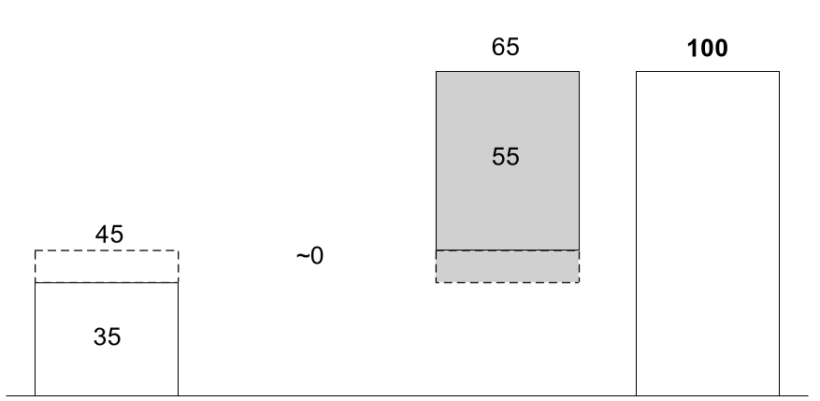
WE THEREFORE ESTIMATE THAT WHILE 35-45% OF THE PROBLEM WAS DUE TO VARIABLE COSTS, THE REMAINDER CAN BE ATTRIBUTED TO A VARIETY OF MARKET INEFFICIENCIES
ESTIMATE
2000 over 1999 annual CaISO generation revenues
Percent
We now turn
our attention to
the drivers and sources of market inefficiency
Variable
cost*
Capacity
value up to FRE**
Market
Inefficiencies beyond FRE**
Total***
* $8.2 billion incremental variable cost (40% of revenue increase) estimated as the difference between the 2000 and 1999 sums of variable cost x total CalSO load for all hours when CalSO price exceeds variable cost for a 10,000 heat rate gas plant (= 10,000 x California volume weighted average border daily gas price + 0.93 lb. NOx/MWh x monthly average NOx RTC price $/lb. + $1.03/MWh
** Full reinvestment economics
*** The difference in 2000 vs. 1999 CalSO total energy + ancillary services costs of $20.6 billion as reported in CalSO 1/16/01 market analysis report
Source: Platt’s Gas Daily; Cantor Fitzgerald; CalSO; RDI PowerDat; Team analysis
Notes:
<number>
txho/10209 zxd414.ppt

Slide 21
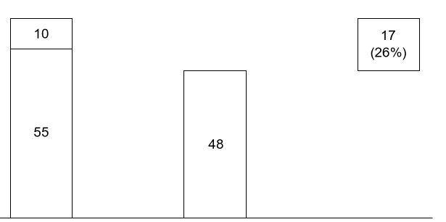
WHEN THE CALIFORNIA DEREGULATION DEBATE BEGAN IN 1994, THERE WAS CONSIDERABLY MORE SUPPLY (CAPACITY) THAN DEMAND
ESTIMATE
Gigawatts
100% =
65
Import capacity*
California reserve
margins were roughly
26% at the time the deregulation debate
began
Internal capacity**
Nameplate summer capacity and net imports
Peak
demand***
Reserve
margin
* Firm transmission capacity contracted (net of export) forecast in 1993 for 1994: ES&D database; this compares to 9.5 GW and 15.2 GW available capacity for import in 1994 assuming minimum reserve margins in the WSCC ex-California of 15% and 7% respectively and assuming a coincident peak demand in California and the WSCC ex-California
** Actual summer peak capacity for CANV subregion (Nevada has no generation capacity within the CANV subregion); ES&D database
*** Actual peak day demand for California (includes: PG&E, SCE, SDG&E, LADWP, SMUD, Pasadena, IID): CaISO – “Historical Coincident Peak Demand and Operating Reserve Peak Demand . . .”, FERC form 861
Source: FERC; NERC ES&D database; CaISO; Team analysis
Notes:
<number>
txho/10209 zxd414.ppt

Slide 22
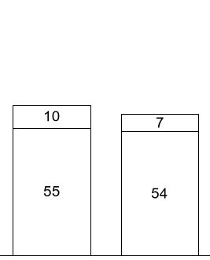
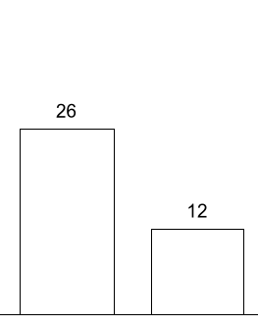
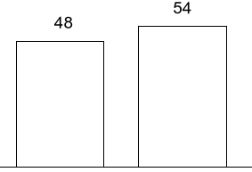
. . . AND, OVER THE NEXT 6 YEARS, CAPACITY APPEARED TO BE MORE THAN SUFFICIENT
ESTIMATE
Gigawatts
Peak day reserve margin⁵
Percent
Capacity
Peak demand³
-1.1%
CAGR
2.0%
CAGR
65
-12.1%
CAGR
Import capacity¹
61
⁴
Internal capacity²
1994
2000
1994
2000
1994
2000
Capacity actually dropped . . .
. . . while peak-day demand grew . . .
. . . leaving California with significantly lower but still somewhat comfortable reserve margins
1 Firm transmission capacity contracted (net of export) forecast in 1993 for 1994 and 1999 for 2000 respectively: ES&D database
2 Actual summer peak capacity for CANV subregion (Nevada has no generation capacity within the CANV subregion); ES&D database
3 Actual peak day demand for California (includes: PG&E, SCE, SDG&E, LADWP, SMUD, Pasadena, IID): CaISO – “Historical Coincident Peak Demand and Operating Reserve Peak Demand . . .”, FERC form 861
4 Includes 1.7 GW of voluntary curtailments
5 Reserve margin = (capacity – peak demand)/capacity
Source: EIA; RDI PowerDat; CaISO; NERC; Team analysis
Notes:
<number>
txho/10209 zxd414.ppt

Slide 23
HOWEVER, SEVERAL FACTORS LED TO THE COLLAPSE OF THIS RESERVE MARGIN
5 key reasons
Increased outages
Poor hydro year
Price caps
Inflexible NOx credit availability and pricing
Increased demand
  Lack of coordination among nuclear plant operators led to large scale coincidence planned outages in the September-October 2000 time frame
  At the same time, old gas fired generators began breaking down as a result of higher than average utilization during the summer of 2000
  California, indeed the entire WSCC, is highly sensitive to rainfall. As a result of low precipitation, hydro power output was down roughly 43% from 5,639 MW in August 1999 to 3,215 MW in August 2000
  Increased overall energy demand forced more rapid depletion of reservoirs leading to lower availability during off-peak hours
  Price differentials between California and neighboring states disincented generators, marketers and utilities from selling into the state
  Historically, generators could not produce past their allowed NOx credit limits. Almost 4 GW were taken offline in December 2000 despite very high prices because no credits were available to generators
  The CEC and other regulatory groups expected strong growth in demand as a result of strong economic growth on the west coast, yet nothing was done to bring on new supply
  The summer of 2000 proved to be extremely hot with June being the fourth-hottest month in 69 years; this drove air conditioning load and peak demand up significantly
Source: NERC; ISO
Notes:
<number>
txho/10209 zxd414.ppt

Slide 24
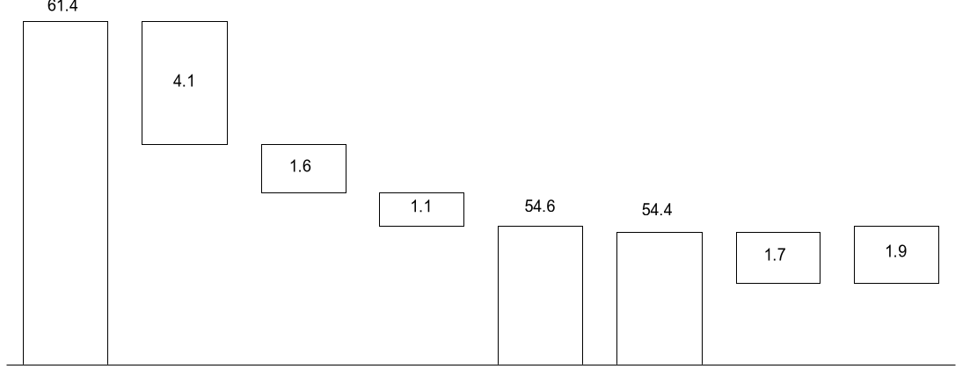
AS A RESULT, THE SUMMER OF 2000 SAW DANGEROUSLY LOW NET RESERVE MARGINS
August 2000 California reserve margin
ESTIMATE
Gigawatts
3.5%
Supply (capacity)*
Actual
outages**
Reduced hydro imports***
Reduced thermal imports***
Actual available capacity
8/16/00 peak demand
Voluntary curtailments
Net
reserve margin
* Estimated as sum of actual summer peak capacity for CANV subregion and firm transmission capacity contracted (net of export) forecast in 1999 for 2000; this compares to 5.7 GW and 12.4 GW available capacity for import in 2000 assuming minimum reserve margins in the WSCC ex-California of 15% and 7% respectively and assuming a coincident peak demand in California and the WSCC ex-California; assumes no planned or unplanned downtime; ES&D database
** Actual hourly average capacity out during August 2000 (3.4 GW unplanned, 0.7 GW planned); FERC
*** Average 2000 August total imports were 3.4 GW below 1999 levels; hydro/thermal split estimated assuming imports into NP15 are hydro, imports into SP15 are thermal; 2.7 total import reduction estimated as plug between supply, actual outages and actual available capacity
Source: CaISO; WSCC Summer 2000 Assessment; RDI PowerDat; FERC; Bonneville Power; Team analysis
Notes:
<number>
txho/10209 zxd414.ppt

Slide 25
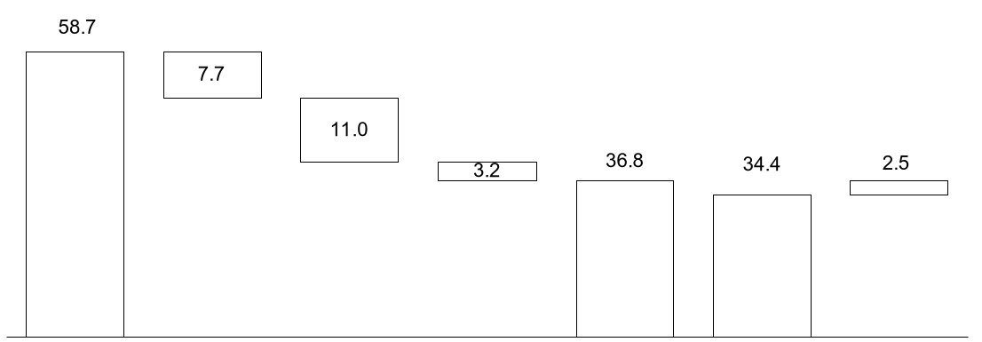
. . . AND, AS SUMMER TRANSITIONED TO WINTER, NEW
ISSUES EMERGED
December 2000 CaISO reserve margins
ESTIMATE
Gigawatts
6.8%
Supply (Capacity)¹
Non CalSO capacity²
Outages³
Reduced imports⁴
Available capacity
Peak demand 12/8/00⁵
Net
reserve margin
1 NERC Winter 2000 Assessment of California available generation capacity including estimated net firm capacity sales and purchases.
2 Includes LADWP (5.8 MW, SMUD (0.2 GW), Pasadena Water (1.1 GW) & Imperial Irrigation (0.6 MW).
3 Roughly 11 GW total capacity offline at peak on 12/8/00 (FERC Staff Report on November & December 2000); 3,956 GW due to insufficient emissions credits according to AES, Duke and Reliant press releases during the week of 12/15/000.
4 Actual (12/8/00) peak imports below forecasted net imports from October 2000 WSCC Forecast for Winter Assessment in California.
5 Peak demand includes 1,704 MW interrupted load.
Source: Company press releases; CaISO; WSCC; NERC; FERC; RDI PowerDat; Team analysis
Notes:
<number>
txho/10209 zxd414.ppt

Slide 26
A NUMBER OF OTHER POWER MARKET INEFFICIENCIES*
FURTHER EXACERBATED THE SITUATION
EXAMPLES
1. Limited supply response to higher prices
2. No demand response to higher prices
  California state and local regulations make it difficult and time consuming to permit and construct new plants. It takes at least 20 months to permit a new plant in California vs. 7 months for Texas on average
  The utilities were forced to purchase essentially all their power needs on an hourly basis through the PX. As a result, no forward market emerged, and potential generators who might have built plants had they been able to manage their risks by selling forward were unable to do so
  Frequent rule changes, an intrusive regulatory (and reregulatory) process, and a number of activist stakeholders made it difficult for potential investors in new generation plants to feel comfortable that they would receive a compensatory return on their investments.
  AB 1890 mandated fixed prices for most residential, commercial, and even industrial consumers. Despite skyrocketing wholesale energy prices, over 84% of residential and industrial/commercial customers continued to pay fixed prices.* As a result, there was very little demand response to the higher prices
* Either through price caps or long-term fixed price negotiated contracts
Notes:
<number>
txho/10209 zxd414.ppt

Slide 27
A NUMBER OF OTHER POWER MARKET INEFFICIENCIES *
FURTHER EXACERBATED THE SITUATION (CONTINUED)
EXAMPLES
3. Market design flaws*
Bidding optimization
Price cap distortions
  California officials and noted economists have pointed to market design flaws that they believe lead to the exercise of market power by marketers, generators and utilities
  Regulators made pricing data readily available, so bidding behavior and strategies of most players could be interpreted easily. Over time, and especially under tight supply/demand conditions, game-theoretic “optimal” solutions could be obtained through trial and error
  Government imposed price caps exacerbated market distortions in several ways
    IOUs, believing that they could capture lower prices in the CalPX day-ahead markets, began shifting the demand curve to the right until the MCP matched the $750 price cap
    Dropping the price cap from $750 to $500 actually increased generator margins
    Finally, the $250 price cap had the unintended consequence of driving sorely needed imports out of California
* E.g., poor market design, regulation
Notes:
<number>
txho/10209 zxd414.ppt

Slide 28
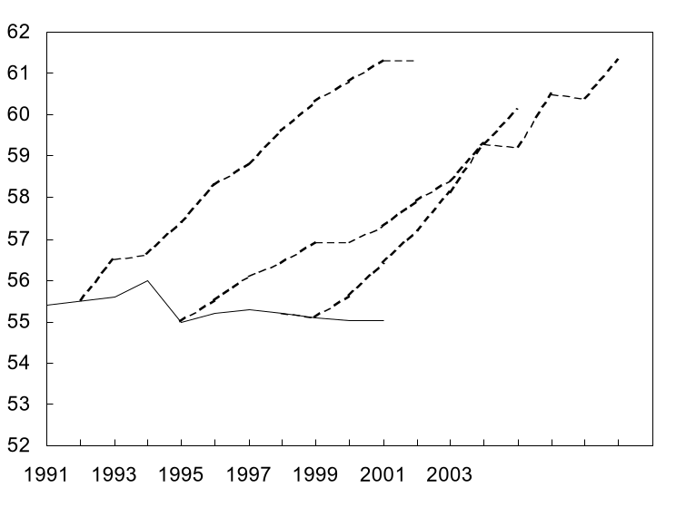
1. LIMITED SUPPLY RESPONSE
Anticipated new capacity never got built
ESTIMATES
California nameplate capacity
Gigawatts
  Arduous permitting process with numerous stake holders takes twice as long as other U.S. locations
  High regulatory uncertainty
  No forward market to allow project sponsors to hedge price risks
1992 forecast
1998 forecast
1995
forecast
“… projected reserve capacity is expected to be adequate throughout the WSCC region for the 2000 through 2009 10-year period. The assessment assumes that approximately 30,200 MW of new generation will be built when and where needed.”
– WSCC 10-year coordinated
plan summary 2000-09
October 2000
Actual*
* Beginning year actual capacity for entire State of California
** Estimates based on capacity growth rate forecasts for California/Mexico system (1992,1998) and California/Nevada/ Arizona system (1995) as defined by the WSCC and applied to California actual nameplate capacity
Source: ERA; RDI PowerData; NERC ES&D database; Team analysis
Notes:
<number>
txho/10209 zxd414.ppt

Slide 29
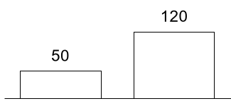
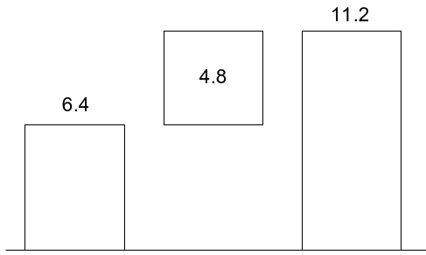
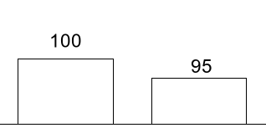
2. NO DEMAND RESPONSE
San Diego experience indicates that demand elasticity could have made a significant impact on reserve margins
ILLUSTRATIVE
San Diego monthly residential bill (including wires)
$/month
Hypothetical impact on reserve margins
Percent
1999 Summer
2000 Summer
San Diego electric usage***
Index
-5%
Reserve margin 12/08/00*
Demand response**
Estimated reserve margin with demand response
1999 Summer
2000 Summer
* Beginning of stage 3 emergency due to 12 GW offline
** San Diego observed demand elasticity applied to all of California assuming retail prices like those seen in San Diego
*** Consumer response came 2 months after price increase
Source: The Sacramento Bee; CaISO; Team analysis

Slide 30
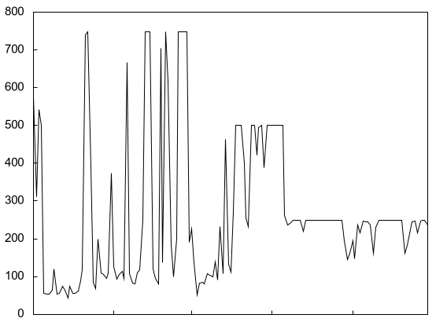
3. MARKET DESIGN FLAWS
Many academics and officials believe price increases were exacerbated by design flaws leading to an increase of market power*
Dollars per megawatt hour (peak)
Electricity prices in real time energy market
Summer 2000
Summer 2000 price
spikes drive CalSO board
to request investigation into
potential market abuses
“Market design flaws have enhanced the ability of market participants to exercise market power in the real-time and ancillary service markets.”
– Frank Wolak, Professor of Economics, Stanford University
“Limits on formal contracting enhanced the ability of generation owners to exercise market power during high demand conditions”
– CaISO, Market Surveillance Report 2000
“After considering variable components there remains a resulting “price gap attributable to market power and related market power imperfections”
– Paul Joskow, Professor of Economics, MIT
“California’s new generation owners have exercised significant market power over the states ancillary services markets but have drawn only scant profits from their dominant position.”
–CalPx, March 1999
May
June
July
August
September
* Market power is defined as the ability of companies to price above marginal cost without sales dropping to zero. Outside theoretical condition of perfect competition, all companies maintain some degree of market power
Source: CaISO Market Surveillance Committee Report June 2000; Joskow Report on Wholesale Electricity Markets Summer 2000; Platt’s Electric Power Daily, March 12, 1999
Notes:
<number>
txho/10209 zxd414.ppt

Slide 31
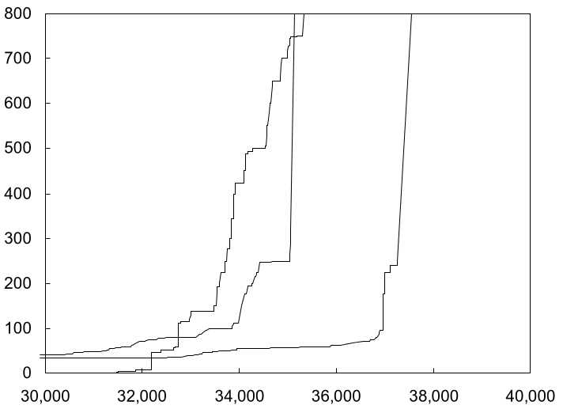
4. BIDDING OPTIMIZATION
Generators and marketers moved capacity out of the CalPX day ahead market
EXAMPLE
CalPX supply bids adjusted for outages and import reductions*
$/MWh CaISO bid
  The generators learned to optimize bidding strategy as the market clearing price settlement process was repeated several times each day, 365 days per year
  Suppliers moved capacity out of the CalPX day-ahead market into real time energy and export markets where higher prices were achieved
June 29, 2000
Hour 14
June 30, 1999
Hour 17
July 15, 1998
Hour 17
MW capacity CalPX bid
* Bids plotted for 7/15/98 hour 17 (day ahead forecasted load 41,083 MW), 6/30/99 hour 17 (40,796 MW), 6/29/00 hour 14 (41,360 MW), and adjusted for monthly average outages. 7/98 – 1,804 MW, 6/30/99 – 2,398 MW, 6/29/00 – 4,037 MW; 6/29/00 also adjusted for 3,400 MW reduced hydro and thermal imports over 1999 levels. Outages and imports added back into total capacity bid at a price of 0 (shifting entire curve to right)
** Delayed 90 days starting October 2000
*** Registered CalSO participants only
Source: Electric Power Daily; CalSO; WSCC; CalPX; FERC, RDI PowerDat; Team analysis
Notes:
<number>
txho/10209 zxd414.ppt

Slide 32
MULTIPLE MARKETS IN OPERATION SIMULTANEOUSLY CREATED MANY ARBITRAGE OPPORTUNITIES FOR GENERATORS
Markets trading in advance of delivery in Hour H in California
Before H-18 to H-40 (day-ahead window)
H-2
H-1
Hour H
Day-ahead energy market
D
S
Each megawatt-hour delivered in Hour H has been sold in 1 and only 1 of these markets
Day-ahead adjustment and congestion pricing market
Day-of energy market
Day-ahead ancillary services market
Bilateral energy market
D
S
D
S
Day-ahead ancillary services market
D
S
Day-of ancillary services market
D
S
Standard (7x24, 6x18)
D
S
D
S
D
S
D
S
D
S
D
S
D
S
D
S
D
S
Zone 1
Zone 2
Long-term
Custom or APX
Spinning
Non-
spinning
Transmission
Spinning
Non-
spinning
D
S
D
S
Bilateral services market
Interscheduling coordinator adjustment energy market
D
D
S
S
D
D
S
S
D
S
Day-of adjustment and congestion pricing market
Real-time imbalance energy market
Regulation
Regulation
Replace-ment
D
S
Replace-ment
. . . but it may have made multiple trips “in and out” before physical delivery
D
S
D
S
D
S
Black start
D
S
D
S
Reactive power
Source: California Power Exchange
Notes:
<number>
txho/10209 zxd414.ppt

Slide 33
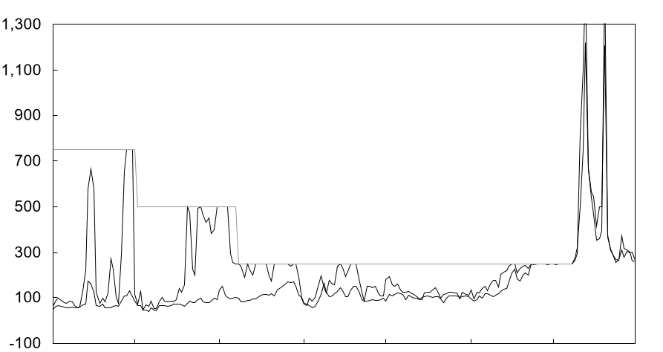
5. PRICE CAP DISTORTIONS
Price caps further distorted market price signals
June through December 2000 CalPX prices
Dollars per megawatt
Maximum peak*
Maximum off peak*
Price cap
Price cap lifted 12/9
$750 price cap
through 7/1
$500 price cap 7/1-8/7
$250 price cap 8/7-12/15
Jun
Jul
Aug
Sep
Oct
Nov
Dec
* Maximum hourly price for daily peak (7 a.m.-10 p.m.) and off peak (11 p.m.-6 a.m.) time periods
Source: Cantor Fitzgerald; RDI Basecase; California Power Exchange; Team Analysis
Notes:
<number>
txho/10209 zxd414.ppt

Slide 34
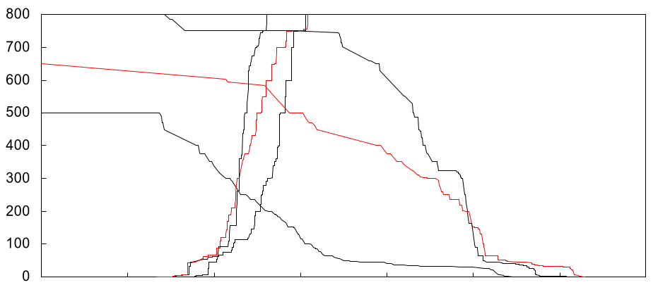
IOUs ALTERED DEMAND BIDDING STRATEGIES TO FORCE VOLUMES INTO LOWER PRICED CalPX DAY-AHEAD MARKETS
Aggregate CalPX Summer 2000 day-ahead market demand and supply curves
Dollars per megawatt-hour
Aggregate supply bids for Hour 16 on given date
    The $750 price cap in the CalSO real-time market during June 2000 did not exist in the CalPX day ahead market
    IOUs sought to purchase more of their load in the CalPX day-ahead market in order to avoid higher prices in the day-of and real time markets and potential under-scheduling penalties from the ISO
    A dramatic demand curve shift up and to the right resulted
June 28
June 13
June 14
Aggregate demand bids for Hour 16 on given date
15
20
25
30
35
40
45
50
Capacity bid, gigawatts
Note: CalSO forecast loads were 44.8, 46.8, and 42.3 GW for June 13, 14, and 28, 2000 respectively
Source: CaISO; CalPX
Notes:
<number>
txho/10209 zxd414.ppt

Slide 35
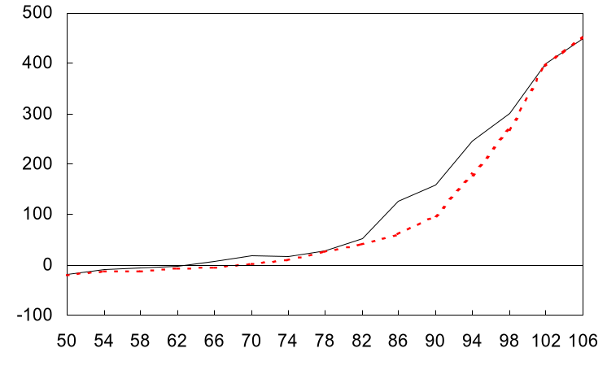
MOREOVER, THE $500 PRICE CAP ACTUALLY INCREASED AVERAGE MARGINS TO GENERATORS
Average peak generator margin during Summer 2000 periods of $750 and $500 price caps *
$/MWh
Generators see
improved margins
  Average peak hour margins increased by 11% under the $500 cap vs. those under the $750 cap
  At loads of 37 GW to 42 GW, average generator margins rose 36%
$500 cap
(July 1 to August 7, 2000)
$750 cap
(June 1 to
July 1, 2000)
Capacity utilization
Percent**
* Generator margin calculated for a 10,000 Btu/kWh gas turbine using daily spot CA border gas prices, monthly NO_{x} emission credit charges and average variable O&M charges and averaged for all hours when a given capacity utilization occurred over the $750 (6/1/00-7/1/00) and $500 (7/1/00-8/7/00) price cap periods respectively
** Capacity utilization calculated using CaISO load / (max supply bid during week in PX + max real time imports into CaISO during week.); capacity utilization over 100% spill over into CalSO real-time markets from CalPX day-ahead market
Source: CaISO; California Power Exchange; Cantor Fitzgerald; Team analysis
Notes:
<number>
txho/10209 zxd414.ppt

Slide 36
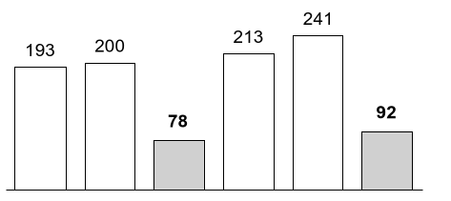
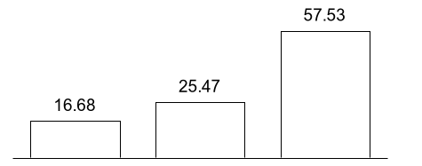
ON THE OTHER HAND, THE $250 PRICE CAP REDUCED PEAK PRICES AND MARGINS BUT ALSO DROVE IMPORTS AWAY
Average peak margin
$/MWh
Average peak hour net imports to California
MW
$750 cap
$500 cap
$250 cap
$750
cap
$500
cap
$250
cap
$750
cap
$500
cap
$250
cap
Total
@ >85% capacity
utilization
California border to CalPX differential
$/MWh Peak-hour Differential 8/7/00 to 8/31/00
4,744 MW average
imports
3,736 MW average
imports
2,340 MW
average imports
Palo
Verde
Mead
Nevada
Four
Corners
Source: RDI Basecase; California Power Exchange; California ISO; Megawatt Daily; Team Analysis
Notes:
<number>
txho/10209 zxd414.ppt

Slide 37
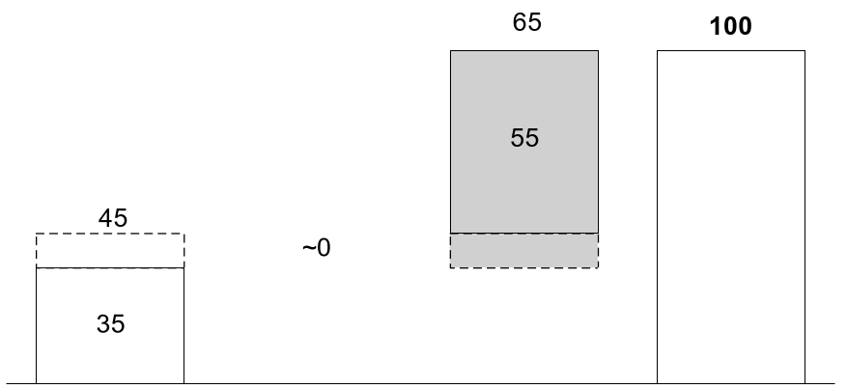
IN SUMMARY, THE CALIFORNIA “CRISIS” IS REALLY COMPRISED
OF 2 MAIN PROBLEMS
2000 over 1999 annual CaISO generation revenues
Percent
ESTIMATE
Many “solutions” currently under
debate fail to
address the full
range of problems – from gas to the
market
inefficiencies
that exist
Variable
cost¹
Capacity
value up to FRE²
Market
Inefficiencies³ beyond FRE²
Total⁴
1 $8.2 billion incremental variable cost (40% of revenue increase) estimated as the difference between the 2000 and 1999 sums of variable cost x total CalSO load for all hours when CalSO price exceeds variable cost for a 10,000 heat rate gas plant (= 10,000 x California volume weighted average border daily gas price + 0.93 lb. NOx/MWh x monthly average NOx RTC price $/lb. + $1.03/MWh
2 Full reinvestment economics
3 Estimated as difference between total increases in wholesale revenue and the sum of available cost and capacity value increases
4 The difference in 2000 vs. 1999 CalSO total energy + ancillary services costs of $20.6 billion as reported in CalSO 1/16/01 market analysis report
Notes:
<number>
txho/10209 zxd414.ppt

Slide 38
THE CURRENT CRISIS
Why power prices rose dramatically
Why the electric utilities are posed on the edge of bankruptcy
  What are the key drivers of high prices and price volatility?
  Why, specifically, did the IOUs bear much of the financial burden?
Two related, but very much separate, issues
Notes:
<number>
txho/10209 zxd414.ppt

Slide 39
WHY THE ELECTRIC UTILITIES WERE FORCED CLOSE
TO THE EDGE OF BANKRUPTCY
3 key reasons
Overly focused on regulatory solution – miscalculated regulatory exposure
  The IOUs struck a regulatory deal that allowed them to recover their stranded costs at the risk that unregulated wholesale prices might rise above the fixed prices they had agreed to provide their customers
  As early as August 2000, SoCal Edison sought to exercise its option to forgo additional collection of CTC monies in order to escape the fixed retail price regime. The CPUC compelled Edison to continue the price freeze
  The utilities remained optimistic that they could come to a solution in early 2001 by the means they know best: legal and regulatory, while neglecting forward contracting solutions
  The senior management of the California IOUs came predominately from legal/regulatory backgrounds. The “solution” they negotiated solved a problem they understood (the stranded investment) at a cost/risk they did not understand
  Until December 2000, the IOUs were prohibited from participating in bilaterals or using certain price risk management tools to help hedge their risk exposure. Some utilities were able to mitigate a limited portion of their fuel-related risks but, overall, the design of the pool left the utilities completely exposed
  When forced to sell some of their generation plant, the utilities chose to sell those assets (i.e., gas fired) that were essentially setting price much, if not all, of the time. Furthermore, these assets were sold in blocks to relatively few players, leaving the IOUs painfully exposed to potential market manipulations. Rather than sell the (mandated) 50% of gas assets, the utilities chose to sell them all
Poor understanding/ appreciation of market risks
Lack of micro-economic foundation for asset decisions
Notes:
<number>
txho/10209 zxd414.ppt

Slide 40
THE KEY CHALLENGE FACING MANY UTILITY MANAGEMENT TEAMS
The (de)regulatory trade-off
Potential
settlement
risks
Stranded costs/
CTC recovery, other potential benefits
Many utility management teams may be more willing to trade off what they know and understand – stranded costs – for risks they cannot or do not fully understand and value

Slide 41
TODAY’S DISCUSSION
  Background – from deregulation to default
  The current crisis
    Why power prices rose dramatically
    Why the electric utilities are poised on the edge of bankruptcy
  Lessons learned and key takeaways
  Appendices
    A: California deregulation basics
    B: The impact of natural gas costs on the California market
    C: Estimating the impact of demand elasticity
    D: Supply and demand estimates and drivers
    E: Market behavior observations
    F: NOx credits in California
    G: Back-up
    H: Glossary
Notes:
<number>
txho/10209 zxd414.ppt

Slide 42
OUR KEY LESSONS LEARNED FALL INTO 3 MAJOR CATEGORIES
High-level observations
Broad observations on what appears to work – and not work – in electric power deregulation
Wholesale market rules and structure
First thoughts on wholesales rules and structure improvements
“Do’s” and “Don’ts” for IOUs
Deregulation from the point of view of the IOUs
Notes:
<number>
txho/10209 zxd414.ppt

Slide 43
DON’T ANALYZE USING AVERAGES
While on average these
2 market participants are doing fine, neither is particularly comfortable

Slide 44
A NUMBER OF STOCHASTIC VARIABLES MAKE AVERAGES MEANINGLESS
Uncertainties
ILLUSTRATIVE
Description
  Plant availability
  Hydro availability
  Weather (demand)
  Planned downtime (such as nuclear unit turnaround and refueling) can take significant capacity offline for an uncertain length of time
  Forced outages such as plant breakdowns vary by plant type, utilization and age
    Number of occurrences
    Duration of occurrences
    Timing of occurrences
  Precipitation fluctuations have significant impact on available hydro capacity in the Pacific Northwest and California
  Uncertain temperature variation directly drives peak loads
Each variable alone is not likely to create a crisis situation, but simultaneous occurrences of extreme conditions in two or more variables can be catastrophic

Slide 45
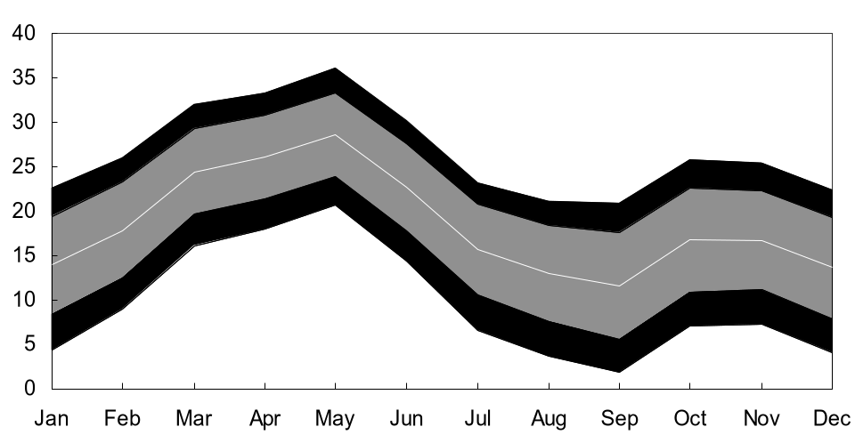
AS A RESULT, THE RESERVE MARGIN NEEDS TO BE
VIEWED AS A DYNAMIC VARIABLE
Modeled 2000 WSCC reserve margin and range of uncertainty*
ESTIMATE
Mean, +1/-1sd
Percent
+95%, -5%
* Based on Monte Carlo simulation of the following stochastic inputs: planned and forced outages, and hydro peak capacity on the supply side and peak demand as a function of HDD and CDD; hydro capacity assumed to be 80% peaking with a peak to average monthly capacity ratio of 2:1
Source: NERC (WSCC summer and winter plant capacity by GADS type); GADS database (1991-98 annual planned outage hours and forced outage hours and number of occurrences by GADS type); RDS PowerDat (1970-2000 monthly WSCC hydro energy output); National Oceanic and Atmospheric Administration National Weather Service Climate Analysis Center (1931-99 population-weighted monthly HDD and CDD data for the WSCC); RDI PowerDat (1988-99 monthly WSCC peak demand); Team analysis
Notes:
<number>
txho/10209 zxd414.ppt

Slide 46
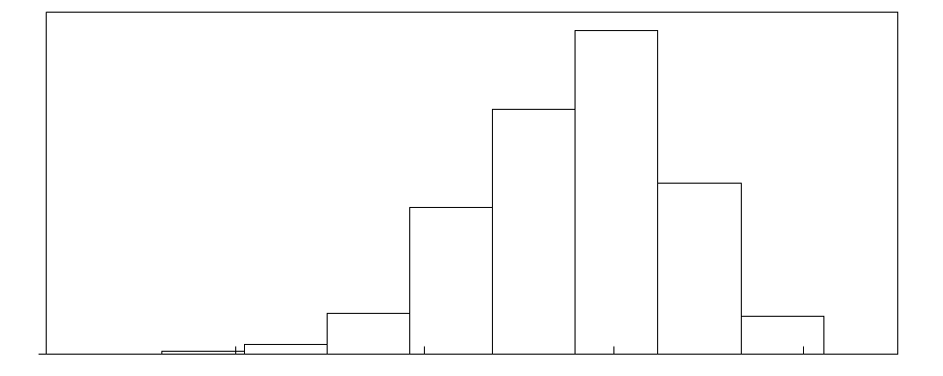
FOR ANY GIVEN AUGUST, ONE WOULD EXPECT ABOUT
A 5% CHANCE FOR A PEAK RESERVE MARGIN OF LESS THAN 2.5% IN THE WSCC
Distribution for reserve margin*, August
ESTIMATE
Mean = 13%
Frequency
-15
-5
5
15
25
Reserve margin, percent
5%
90%
5%
* Based on Monte Carlo simulation of the following stochastic inputs: planned and forced outages, and hydro peak capacity on the supply side and peak demand as a function of HDD and CDD; hydro capacity assumed to be 80% peaking with a peak to average monthly capacity ratio of 2:1
Source: NERC (WSCC summer and winter plant capacity by GADS type); GADS database (1991-98 annual planned outage hours and forced outage hours and number of occurrences by GADS type); RDI PowerDat (1970-2000 monthly WSCC hydro energy output); National Oceanic and Atmospheric Administration National Weather Service Climate Analysis Center (1931-99 population-weighted monthly HDD and CDD data for the WSCC); RDI PowerDat (1988-99 monthly WSCC peak demand); Team analysis
Notes:
<number>
txho/10209 zxd414.ppt

Slide 47
FOR CALIFORNIA, THE LIKELIHOOD OF DANGEROUSLY LOW RESERVE MARGINS ARE EVEN HIGHER
Issue
Impact to California
  Current analysis is done at the WSCC level
  Conservative estimates of plant outages based on U.S. averages
  Hydro Peaking capacity assumptions are optimistic
  Correlation among variables
  Transmission constraints between sub-regions likely increase volatility of reserve margins
  Power price basis differentials driven by regional weather variation, transmission constraints and regulatory based wholesale pricing (price caps) magnify the volatility observed at the WSCC level
  California gas fired steam turbines are old and subject to failure more often than U.S. averages suggest
  Nuclear plant availability should be modeled using specific plant refueling schedules and historical unplanned outages
  Better data on run of river vs. peaking capacity and the ratio of peak to average will likely result in a deterioration of reserve margins
  Positively correlated variables lead to increased variance: higher loads lead to longer running times and more plant outages, for example
We have changed from a regulatory process of setting reserve margin targets to a stochastic process of trying to dynamically measure the margin

Slide 48
THIS LEADS TO AN INTERESTING QUESTION: WHO GUARANTEES – AND PAYS FOR – RELIABILITY IN A DEREGULATED WORLD?
Gas deliverability
Gas transportation
Power plants
In one in every 10 or 20 years, a confluence of events will lead to very tight supply/demand conditions and resulting price spikes. Who will guarantee that sufficient capacity exists at each stage of the value chain for potentially anomalous events?

Slide 49
GUARANTEEING – AND PAYING FOR – RELIABILITY
The 2 competing schools of thought
Deregulation:
Allow the market to price and value, reliability
Quasi deregulation:
Indirectly mandate reserve margins
  Force 2-part pricing mechanisms
  (e.g., separate capacity and energy markets like PJM)
  Force retail aggregators to contract for more supply than they have demand
  Provide the ISO the ability to contract for sufficient supplies to maintain system security and pass costs on average to all market players
  Establish both bilateral as well as forward markets
  Allow industry to develop – and price – product/service suites with different levels of price and reliability certainty
  Use insurance industry to price risks
  (e.g., business interruption) related to weather, unit-contingent operations, etc.
There is considerable debate in the market as to which method is more efficient/effective. The demand for market-based offerings that price reliability will grow dramatically
Notes:
<number>
txho/10209 zxd414.ppt

Slide 50
KEY LESSONS LEARNED: SOME OTHER HIGH-LEVEL
OBSERVATIONS
Partial deregulation is an economic oxymoron
Deregulation works better when (surprise!) supply is much greater than demand
“Too many cooks spoil the broth”
Regulators should get real jobs
  The California market never truly deregulated. The need to satisfy numerous stakeholders led to a hybrid model that failed to provide true economic price signals to either end users or generators. Partial deregulation yields significant risk and fails to provide for the traditional advantages deregulation typically brings
  One could argue that California had many of the right ideas, but that the process took much too long. The settlement took too long to negotiate, too long to implement, and required too long a period of time for recovery of stranded costs. During those years the S/D gap narrowed quickly to unsustainable levels
  The “deregulation” process in California directly involved too many stakeholders and the emerging rules were so complex that smart generators could find a way to arbitrage market inefficiencies. One PhD economist, left alone in a room for a week, could have designed a better system than California settled on
  Regulators regulate. After “deregulation” in California – even after the IOUs sold much of their generation – CPUC and other regulators continued to modify the process and rules. The regulators slowly reregulated the industry with a set of increasingly convoluted and confusing rules. The resulting regulatory uncertainty made it difficult for generators to understand the potential attractiveness of investing in California. The regulatory and political risk in California was – and still is – higher than the regulatory and political risk in Indonesia
Notes:
<number>
txho/10209 zxd414.ppt

Slide 51
KEY LESSONS LEARNED: SOME OTHER HIGH-LEVEL
OBSERVATIONS (CONTINUED)
Economists are often better on theory than they are in real markets
Caveat emptor, or “there is no such thing as a free lunch”
Suppliers and buyers need to see real price signals
  The broad intent of California deregulation was clear: establish a system in which excess supply competed for state load in such a way that market prices fell to the variable operating cost of the marginal producer. P = MC and the California resident benefits. But, in the real world, P ≠ MC – one does not, after all, typically buy houses, cars, or refrigerators based on marginal costs. And, when supply and demand converge, price fly-ups occur (see ethylene, methanol, etc.)
  It was always disingenuous to believe that prices would fall to the variable operating cost of the marginal producers yet be high enough to incent investment in generation plants. The market design was not inherently flawed as much as it was designed to be inherently volatile. More astute market players saw the volatility play early and invested in then “out of favor” gas-fired peaking units in 1997-98
  Most of the end-use market in California was insulated from real market prices and, as a result, demand was broadly unaffected by skyrocketing wholesale prices. Similarly, generators saw high and volatile spot prices but no clear long-term price signal to help end-use investment
    End-users need to see (and pay) real market prices
    Bilateral and forward markets are needed to help all parties better manage risk and provide for more stable investment price signals
Notes:
<number>
txho/10209 zxd414.ppt

Slide 52
KEY LESSONS LEARNED: FIRST THOUGHTS ON WHOLESALE
MARKET RULES AND STRUCTURE
Allow forward contracting
Price caps often create more problems than benefits
Allow retail rates to “float” as CTC is recovered
Pay attention to fuel mix of supply
Market concentration can occur even in “fragmented” markets
  Forward contracts allow prospective generators to lock in prices on new construction
  In the short term, price caps may exacerbate market distortions; in the long term, they dis-incent the construction of new capacity
  Without retail competition, fixed retail prices were employed to limit market power of local distributors.
  Fixed retail prices eliminated demand elasticity and facilitated profit maximizing supply bidding strategies
  Retail prices that float with fuel costs would have partially mitigated this issue
  Over-dependence on uncertain hydro capacity and gas capacity subject to potential fuel supply tightness can lead to market instability
  Concentration of supply at the margin is what matters, not the overall market fragmentation. As a result, traditional measures of market concentration such as the HH index are ineffective
  Separate micro markets further the potential for concentration
  Ability of marketers to aggregate supply can even further concentrate the market
Notes:
<number>
txho/10209 zxd414.ppt

Slide 53
KEY LESSONS LEARNED: FIRST THOUGHTS ON WHOLESALE
MARKET RULES AND STRUCTURE (CONTINUED)
Ensure that interconnected grid has common rules
Imports and exports of electricity of a large sub region should be balanced
Market participants must be credit worthy
There is no need for separate ancillary services markets
It is not just power, but gas too
  Rules applied in one sub region can be easily avoided by shipping power to another nearby sub region
  Rules should allow for full and open access to transmission across the entire grid (FERC Order 2000: RTO should be enforced)
  Transporting fuel is cheaper than electricity (hydro and lignite only exceptions)
  The transport of large bulks of electricity can create instabilities and requires significant transmission investment
  The transmission grid requires long planning cycles
  Bank style capital regulation is required to avoid negative short term effects on reliability of supply
  Too many markets in California allowed generators to game and otherwise arbitrage real-time differences among them
  Natural gas supply is the truly pervasive problem in California . . . and it is getting too little attention
Notes:
<number>
txho/10209 zxd414.ppt

Slide 54
KEY LESSONS LEARNED: “DO’S AND DON’TS” FOR IOUs
“Deregulation” is just the origination of a complex risk position
As such, the key parameters around deregulation are best developed not by in-house legal or regulatory groups, but by the origination/ trading/ commercial engine within the company
For most utilities, deregulation poses as much downside risk as upside potential
Yet most utilities are poorly positioned to develop a winning deregulation strategy
  It is interesting how much time, money, and attention IOUs around the world will spend on measuring and managing the risks around their trading positions. Yet very large risk positions can be developed via deregulation, M&A, or origination that are rarely fully evaluated, quantified, or even understood. The California utilities did not understand the risks associated with their positions
  What deal is best for the IOU should be the purview of a commercial group. How the deal can be best achieved should be the purview of legal/regulatory groups. Regulators should execute, not transact
  Despite the California debacle, well-structured “deregulation” can be highly value creating. The key is to know the potential value and risk associated with each potential outcome
  Legal, regulatory, and other corporate center functions drive too much of the typical deregulation negotiation strategy, and process
Notes:
<number>
txho/10209 zxd414.ppt

Slide 55
TODAY’S DISCUSSION
  Background – from deregulation to default
  The current crisis
    Why power prices rose dramatically
    Why the electric utilities are poised on the edge of bankruptcy
  Lessons learned and key takeaways
  Appendices
    A: California deregulation basics
    B: The impact of natural gas costs on the California market
    C: Estimating the impact of demand elasticity
    D: Supply and demand estimates and drivers
    E: Market behavior observations
    F: NOx credits in California
    G: Back-up
    H: Glossary
Notes:
<number>
txho/10209 zxd414.ppt

