Slide 1
Energy’s Place in the New Economy,
Now and in the Future
Louise Kitchen
October 18, 2000

Slide 2
“ In five years time, all companies will be
internet companies, or they won’t be
companies at all.”
Andrew Grove
Chairman, Intel Corp.

Slide 3
Current Market Conditions
Many industries exist that sell commodity - like products through legacy distribution channels comprised of complex sales forces and long term relationships with little price transparency (“Dine ‘Em and Sign ‘Em”).
  Result - Enormous inefficiencies exist in the pricing of commodity products.
The internet provides a unique opportunity to have immediate and inexpensive access to customers through a web-based transaction platform.
  Result - All incumbent companies are vulnerable due to reduced/no barriers to entry.
The equity markets have created an enormous value differential between old economy businesses and new economy businesses.
  Result - Possible rate of return opportunities are multiples of historical rates of return

Slide 4
eCommerce Global Growth
Source: Forrester Research, Inc.

Slide 5
General Industry Trends
Technology has Slashed the
Price of doing Global Business
The Cost of a 3-Minute Phone
Call From New York to London
‘30
‘50
‘70
‘90
‘98
Source: New York Times 2/15/99

Slide 6
Transaction Costs
…and Radically Lowered
Transaction Costs
Average Cost per Transaction
Retail Banking by Channel
Branch
Telephone
ATM
Internet
Source: Downes, Larry and Chunka Hui, Unleashing the Killer App., Boston: Harvard Business School Press, 1998, pp.44-45

Slide 7
Energy Market Trends
The Internet is becoming a disintermediary
Increasing commoditization of goods and services
Declining barriers to entry
Increasing transparency and competition
Provide the catalyst for significant efficiency gains achievable through trading online
Growing acceptance of transacting online

Slide 8
Business at the speed of light
Internet traffic doubles every 70 days
Acceleration Process
  Market Growth
  The pie gets bigger quicker
20%
20%

Slide 9
Development Process
Speed of response is critical
Traditional lead times for technology development in offline world are inadequate in the rapidly changing e-commerce world
Prioritization becomes a rationing process
All priorities are driven by time to market and potential transaction generation
Matching online application with capabilities of bricks and mortar organization

Slide 10
Expansion not Contraction
OTC
Volume

Slide 11
Enron Corp
Energy Businesses
New Businesses
Transportation
&
Distribution
Wholesale
Energy
Retail
Energy
Broadband
Services
Net Works

Slide 12
60% of Enron’s total earnings come from
businesses which didn’t exist 5 years ago.

Slide 13
Enron Net Works Philosophies
We have been B2B for years
Expansion and Extension of our Existing Business
Export strong skills in risk intermediation and risk control systems.
We are already positioned as having successfully migrated from the “old economy” to the “new economy” company.
We have a proven Business Model and track record of transforming markets.
Incubator of New Ideas and Business Models
Challenge Existing Ideas and Beliefs

Slide 14
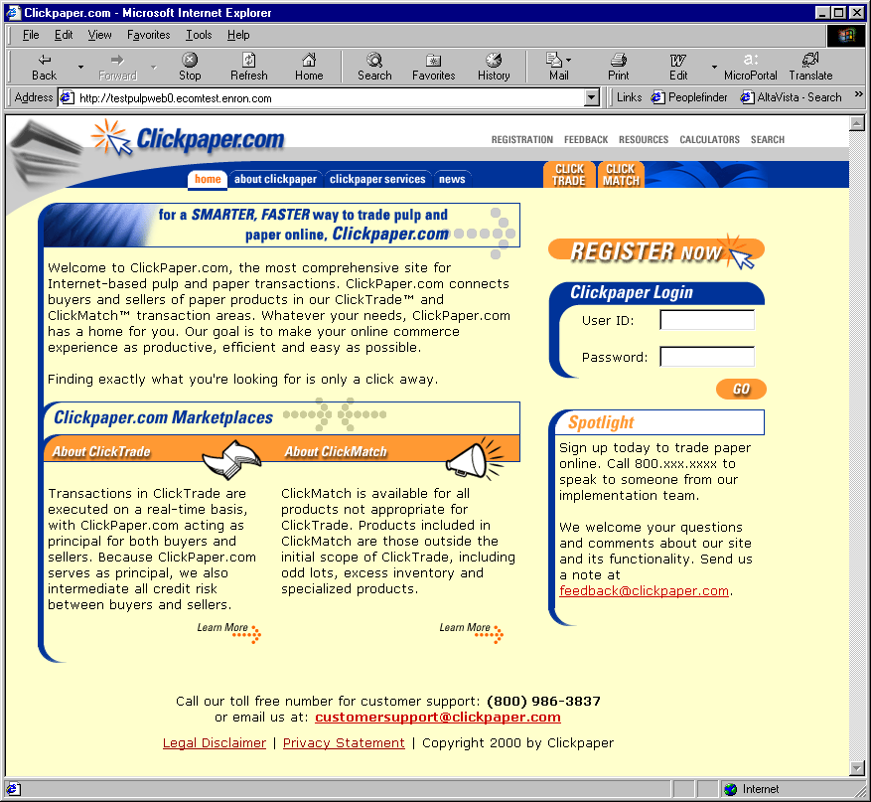
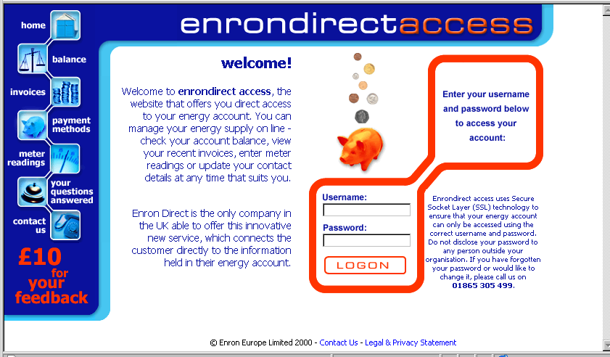
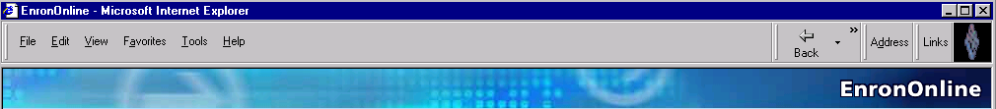
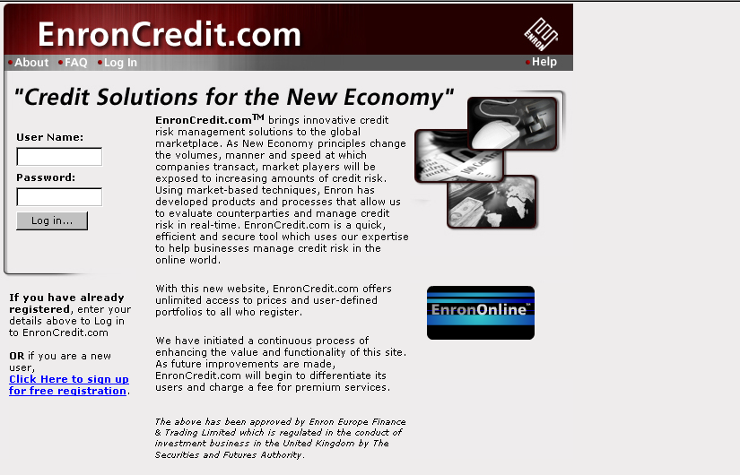
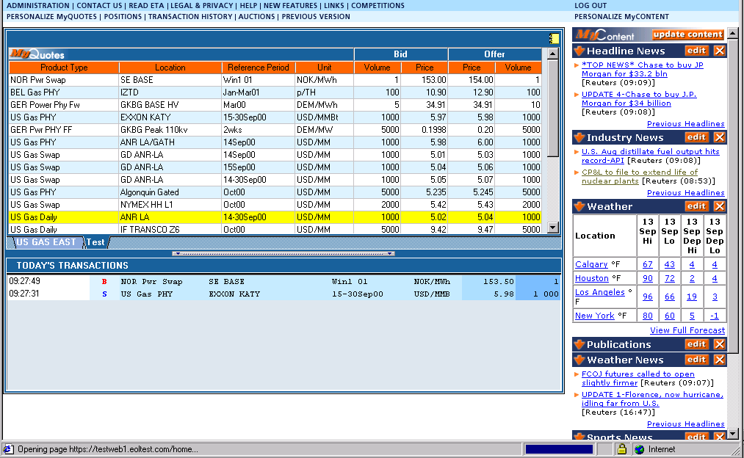
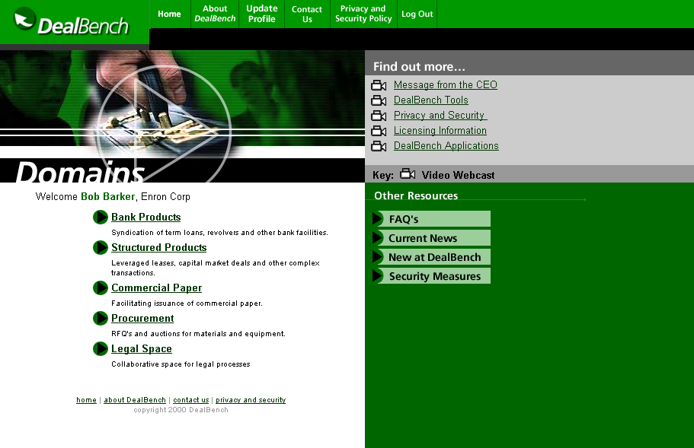
ClickPaper.com
EnronDirect.com
Enron Net Works
EnronOnline.com
EnronCredit.com
DealBench.com

Slide 15
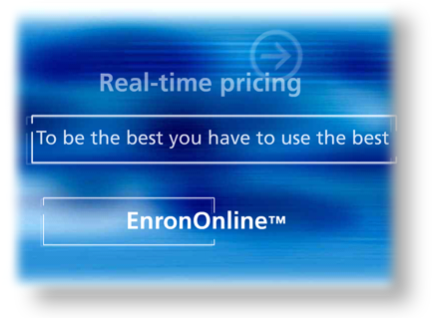
What is EnronOnline?
A free, internet-based, global transaction system which allows Enron’s customers to view real-time prices from Enron’s traders and transact instantly online

Slide 16
EnronOnline’s Approach
Principal based
Expand access to customers
Increase product throughput
Focus on the business in the platform’s underlying commodity products
Time to market is critical, and continued innovation is a must
It’s not about the platform! It’s the electronic transaction!

Slide 17

Changing the Way We Conduct Business
Pre Nov 29 1999 Post Nov 29 1999
Telephone Internet
Enron
Telephone
Enron

Slide 18
Markets Available
Asian Crude & Products
Australian Weather
Australian Power
Austrian Power
Bandwidth
Belgian Natural Gas
Canadian Natural Gas
Credit Derivatives
Dutch Power
Emissions
European Coal
European Weather
German Power
International Coal
Japanese Aluminum
Japanese Weather
LPG
Nordic Power
Oil & Refined Products
Petrochemicals
Plastics
Pulp & Paper
Sea Freight
Spanish Power
Swiss Power
UK Natural Gas
UK Power
US Natural Gas
US Metals
US Power
US Weather

Slide 19
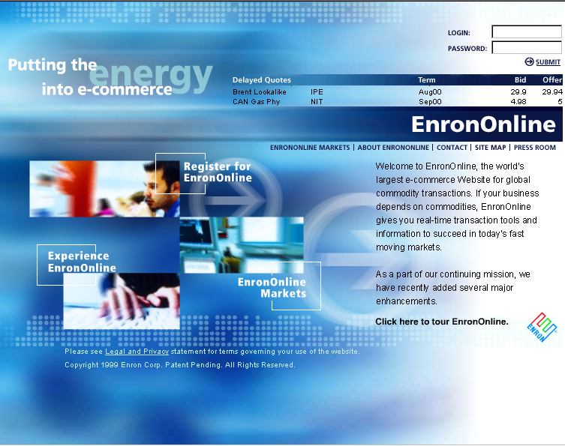
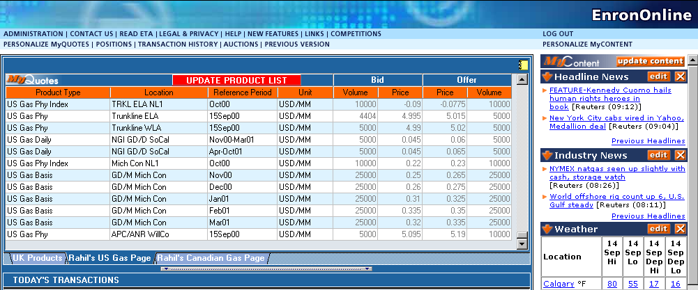
What’s New on EnronOnline?
Taking the Big Deal Out of the
Big Deal…
  New Market Content
  New Trading Functionality
  New Trading Content

Slide 20
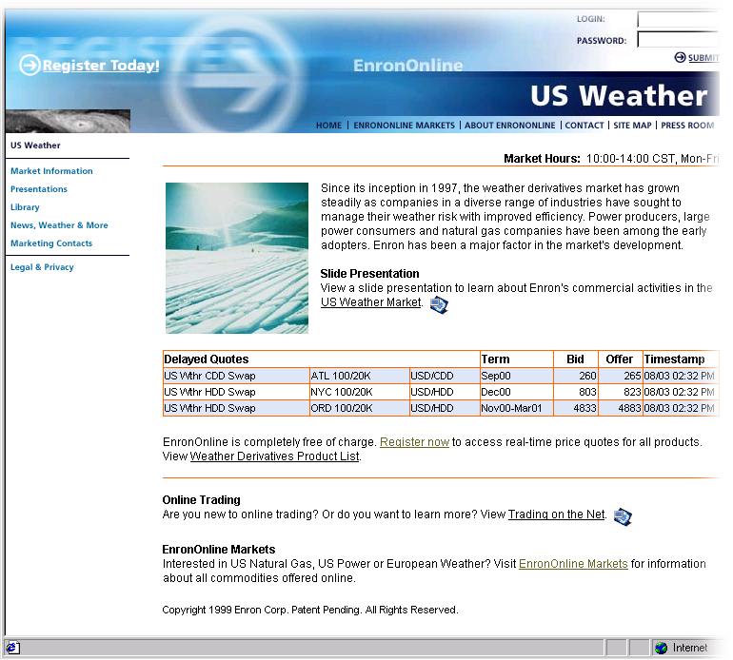
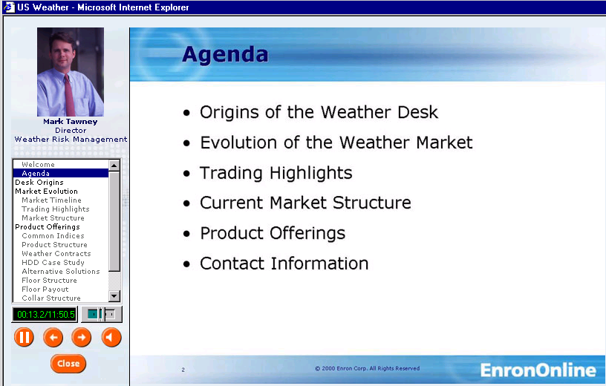
New Market Content
Market-Specific Content customized for what you want to see

Slide 21
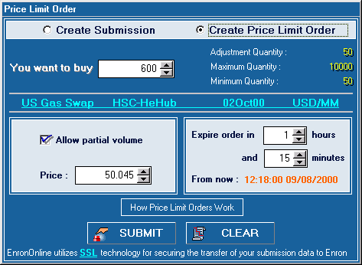
Enhanced Transaction Features
  Price Limit Orders allow greater flexibility in placing orders.

Slide 22

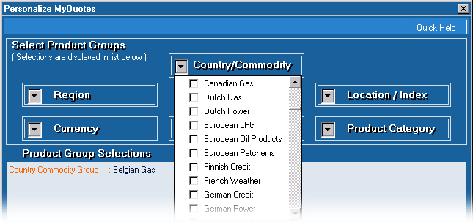
Enhanced Transaction Features
XML - Transactions Information is now downloadable in XML.
Floating Windows give you greater control over optimal use of your screen space.
Enhanced Personalization tools enable you to specify exactly what products and content you want to see and where you want to see them.

Slide 23
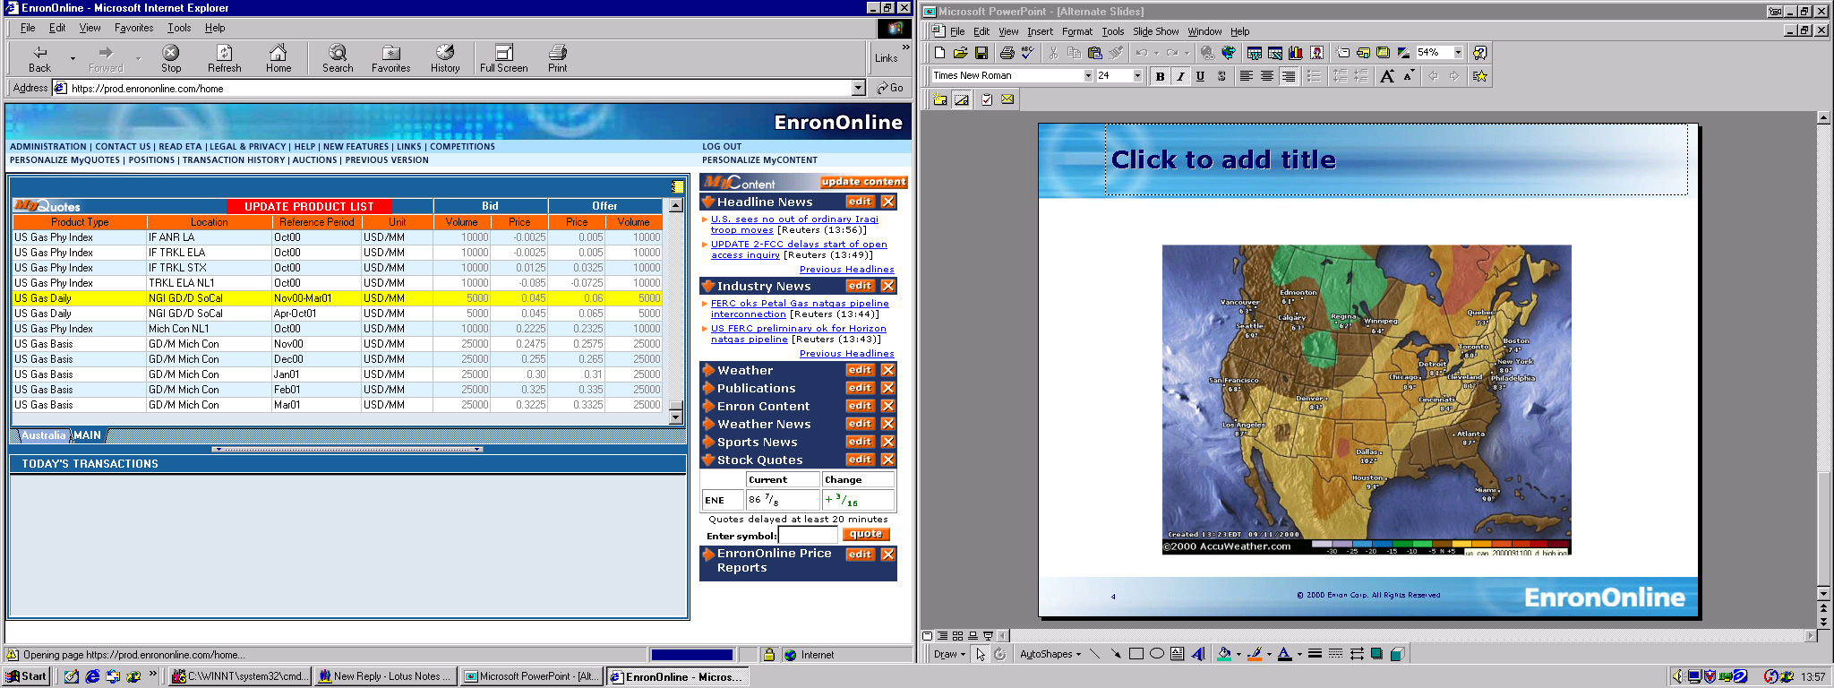

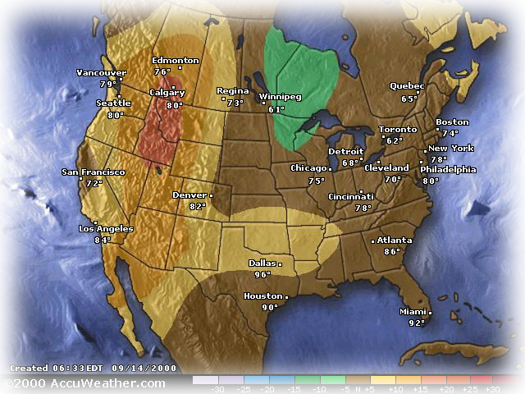


New Trading Content
Real-Time Information
to help you respond faster to changing market conditions worldwide:
  General News
  Global News
  Industry News
  Stock Quotes
  Sports News
  Weather News

Slide 24





Additional Content Available
Industry-Specific Information to help you make better decisions:
  Natural Gas Intelligence
  Petroleum Argus
  Coal Daily
  Air Daily
  Bandwidth Desk
  Market Commentary
  & Analysis
  Others…

Slide 25
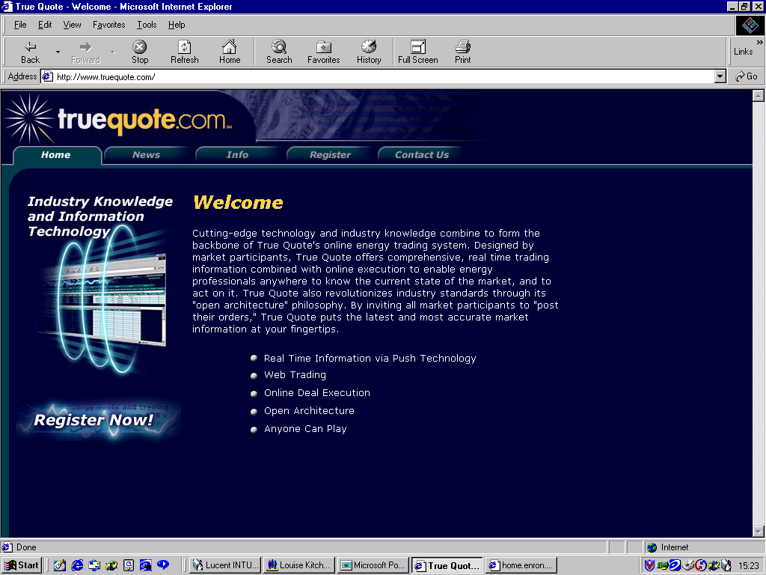
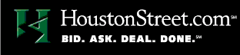
EnronOnline Prices on Other Websites
Increase general customer access to Enron by providing additional transaction channels
Gives Enron access to customers who prefer to transact via multilateral platforms
Leverages the proven technology, liquidity and Enron resources that together provide superior services to all Enron customers
It’s the transaction - not the platform

Slide 26
Lessons Learned
Technology is not difficult with the right people on the team
Time to market is critical with product roll-out
Must continue to innovate to maintain first mover advantage
Business model could have broad applications in other industries
Principal-based and Exchange-based are both viable models
It’s not about the platform, it’s about the electronic transaction

Slide 27
“ Technology makes possible what
good management knew but was
formerly unable to achieve.”
W Wriston
The Listener, 1986

