Slide 3
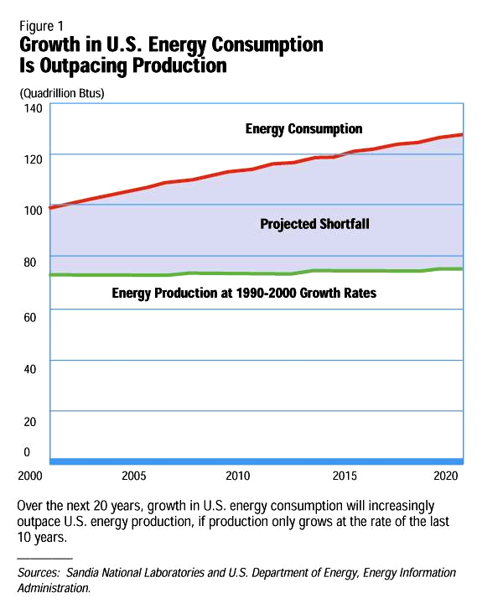
Notes:
Figure 1 Growth in US Energy Consumption Is Outpacing Production
Today in the US, we consume almost 100 quadrillion British Thermal Units of energy every year and produce only about 72 quadrillion BTUs of energy in the US.
This means we have a shortfall of 28 quadrillion BTUs.
This is energy we have to import.
The Energy Information Administration predicts that by the year 2020, we will be consuming almost 130 quadrillion BTUs every year.
If our current rate of energy production continues, and we have every reason to believe that it will continue at this rate without a change in policy, then we will have a shortfall of over 50 quadrillion BTUs.
This projected shortfall is about twice the size of our current shortfall.
The energy production curve shown here was based on an annual energy production growth rate of 0.1882 percent which is the historic annual production growth rate.
The energy consumption curve shown here is based on the Energy Information Administration, 2001 Annual Energy Outlook Reference Case which has an annual consumption growth rate of 1.3 percent from 1999 to 2020.
Electricity consumption on this graph is the sum of "retail sales" and "non retail consumption".
"Delivered electricity generation" which is generation less electricity losses is used in the energy supply curve.
Losses are significant. For example, in 1999, the US imported 43 billion kWh of electricity and exported 14 billion kWh, for net imports of 29 billion. But losses were 234 billion kWh, dwarfing net imports.
Finally, with regards to electricity generation, the energy supply curve assumes a “flat” projection at 3558 billion kilowatt-hours per year for power generation. This assumption was used because the impact of electricity restructuring is unsure. The historical rate of 2.3 maybe too high to reflect the turbulence of the industry so rather than choose a rate based on a history that does not reflect the conditions of the future, we have chosen a flat rate for electricity generation.
Additionally, the new economy may grow faster than the 1.7% predicted by EIA, so the compromise for addressing that very uncertain future was to hold electricity generation flat.

Slide 4
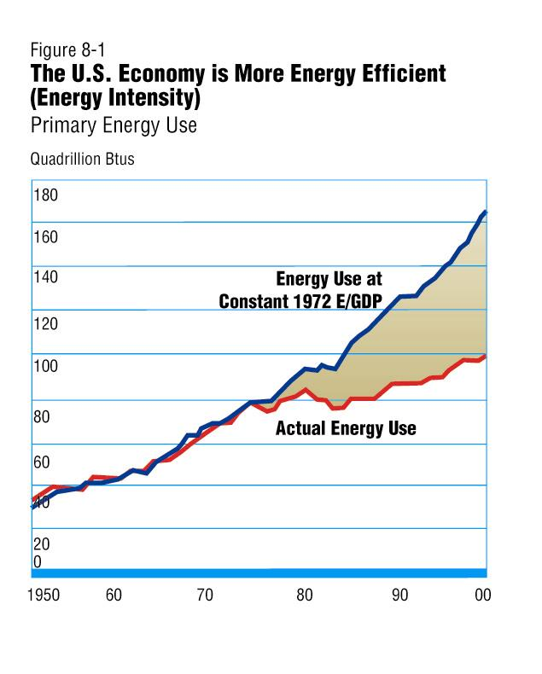
Notes:
Figure 8-1 The US Economy is More Energy Efficient (Energy Intensity)
This chart shows that despite our increase consumption of energy, we are using it more efficiently because of new technology.
Further, when we look at energy consumption as a function of GDP, and had we continued to use old technology, our energy use would have been even greater!
This chart shows that the rate of increase in energy consumption would also have been faster.
In 1950, the US consumed about 30 quadrillion BTUs of energy and consumption was increasing steadily, but in the mid-1970’s, greater conservation of energy through the application of more advanced technologies resulted in greater efficiency in the use of energy.
This efficiency has continued and despite the fact that we are using more energy per capita, we are using it more efficiently.
In 1990, actual energy used was about 90 quadrillion BTUs, but it could have been as high as 120 quadrillion BTUs.
In 2000, actual energy used was about 100 BTUs, but it could have been as high as 160 BTUs.

Slide 5
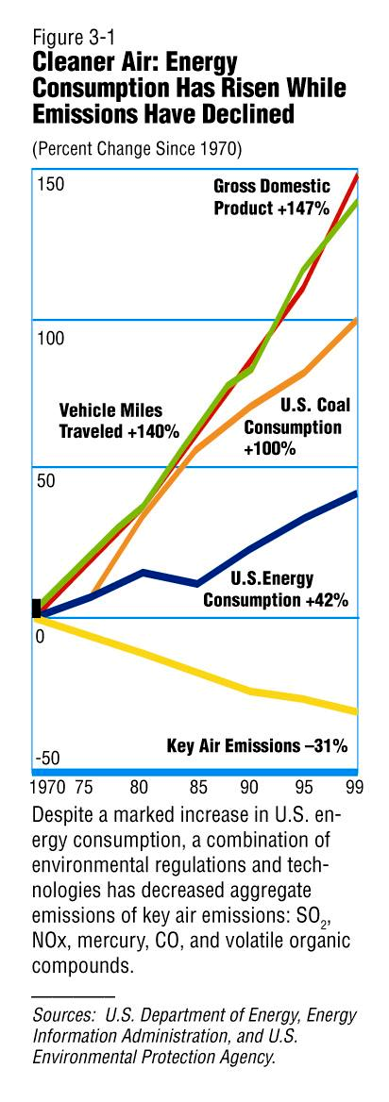

Slide 6
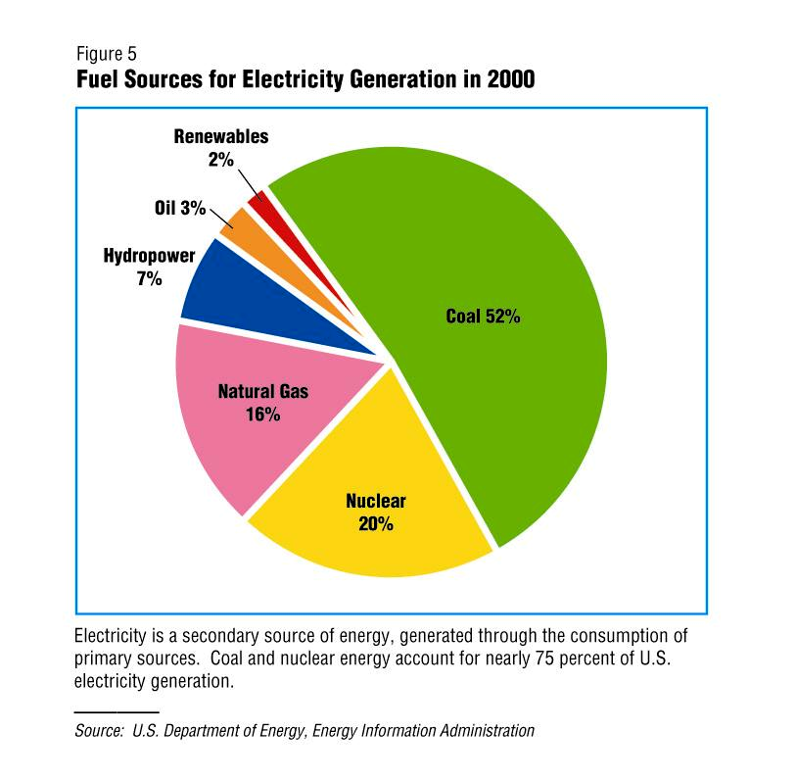
Notes:
Figure 5 Fuel Sources of Electricity Generation in 2000
This chart shows that electricity generation comes primarily from fossil fuels:
52 percent from coal
16 percent from natural gas, and
3 percent from oil
Non-fossil electricity generation accounts for the remaining 29 percent:
20 percent from nuclear
7 percent from hydropower, and
2 percent from renewable sources

Slide 7
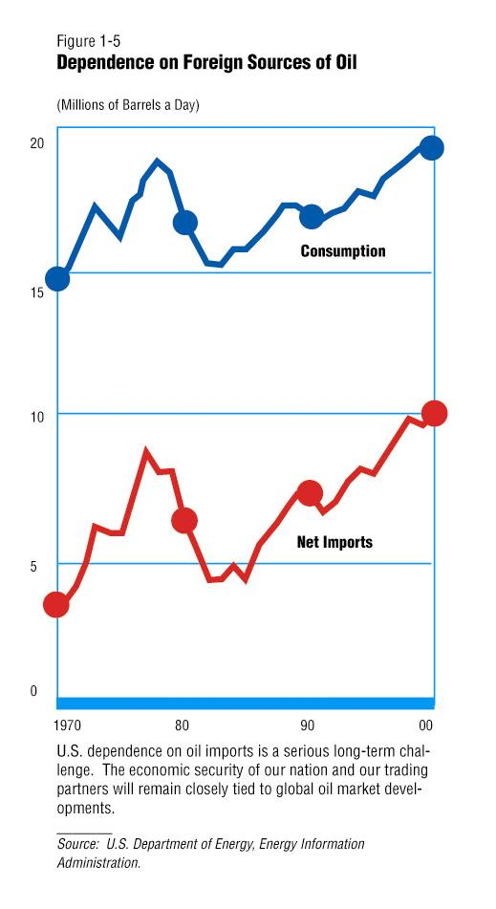
Notes:
Figure 1-5 Dependence on Foreign Sources of Oil
This figure shows actual net imports. We also export oil so the total amount of oil we’re importing is actually more than that. But if we focus just on net imports we can see that imports of oil are going up.
In 1970, oil consumption was about 15 million barrels per day and net imports of oil were less than 5 million barrels of oil per day.
This means that we were importing less than 25% of the oil we consumed every day, in 1970.
In 2000, we consume almost 20 million barrels of oil per day and import over 10 million barrels per day.
One look at this chart shows that the trend for imports is steeper than the trend for consumption
EIA projects that by 2005, we will import about 57% and by 2010, we’ll import over 60%, and import up to 64% by 2020.

Slide 8
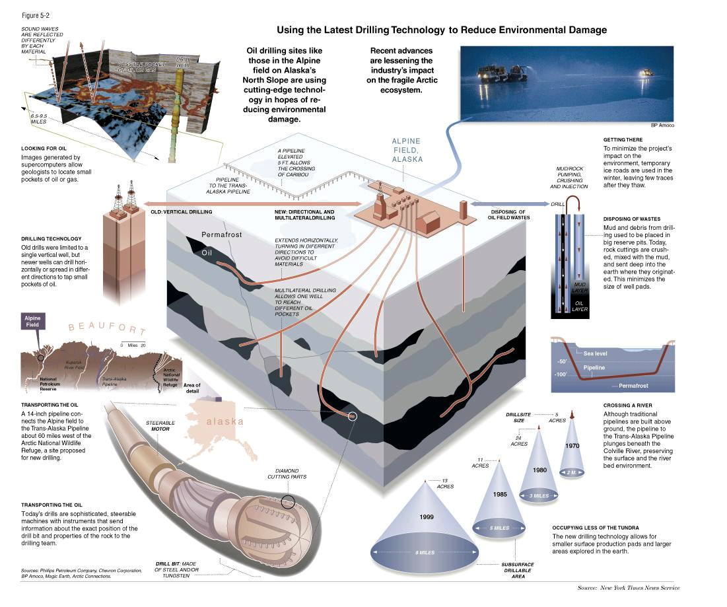
Notes:
Figure 5-2 Using the Latest Drilling Technology to Reduce Environmental Damage
This graphical representation illustrates the dramatic advances in oil and gas drilling technology over the past 30 years.
Although this graphic focuses on the unique environmental challenges of the Alaskan North Slope, most of these technologies also have application in the Lower-48.
For example, the steerable motor, diamond cutters, and tungsten drill bit give the energy producer many options for reaching the desired geologic target—be it horizontal drilling, or drilling through deeper harder rock.
This flexibility in drilling program design is what enables the energy producer to avoid and/or protect environmentally sensitive areas while drilling a well.
It also enables the energy producer to have a great deal of control in deciding where to place a well.
This high degree of control also makes it possible to limit the size of the surface footprint.
Other examples include the use of “closed loop” drilling which enables, among other things, the reinjection of mud and cuttings back into the ground thereby minimizing the amount of waste disposal at the surface.

Slide 9
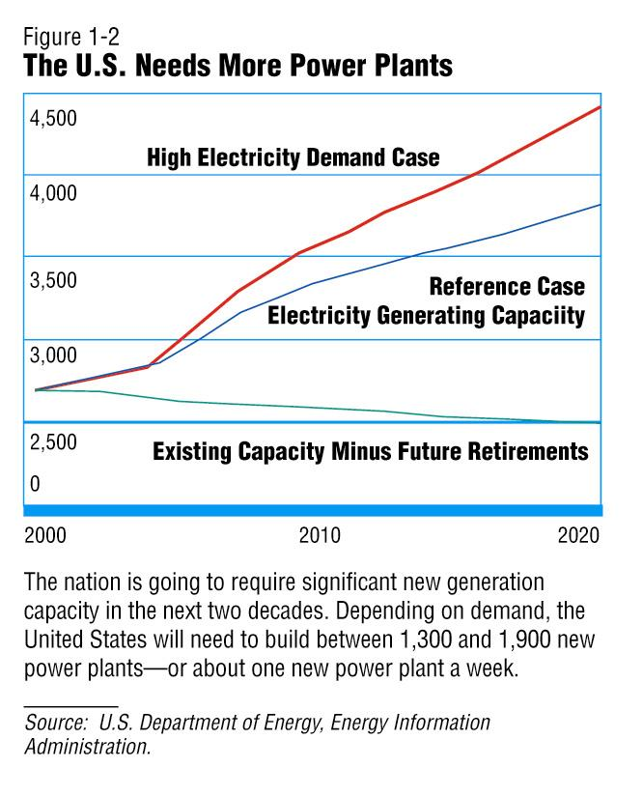

Slide 10
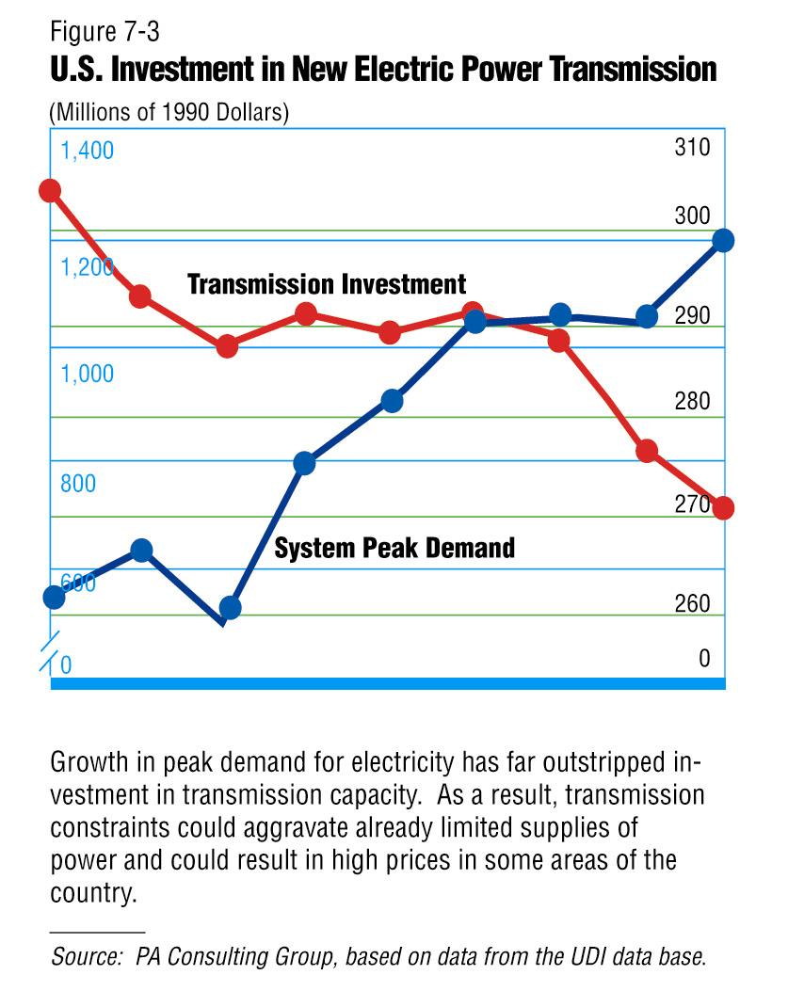
Notes:
Figure 7-3 U S Investment in New Electric Power Transmission
The axis on the left is Millons of 1990 Dollars, and
the axis on the right is Thousands of Megawatts
This chart shows that since 1993, peak demand for electricity has increased from a low of about 260 thousand megawatts to a high of about 300 thousand megawatts in 1998.
At the same time, investment in transmission capacity has decreased from a high of about
$1.3 billion dollars in 1990,
through a flat period at about $1 billion during the mid-1990’s,
to a low of about $700 million in 1998.

Slide 11
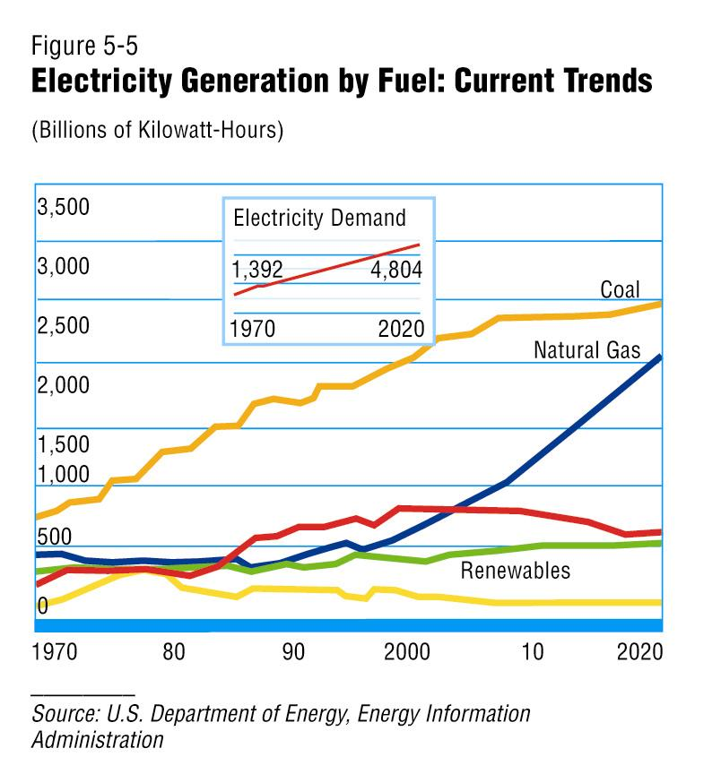
Notes:
Figure 5-5 Electricity Generation by Fuel: Current Trends
This chart shows that electricity generation has increasingly depended on fossil fuels and that this trend is expected to continue in the future.
It is projected that natural gas is the fastest growing fuel for electricity generation through the year 2000.
The inset box shows the steep rate of increase in electricity demand over the next 20 years.
In 1999, coal provided over 1,800 billion kilowatthours of electricity
Nuclear power provided about 730 billion kwh
Natural gas provided 371 billion kwh
Renewable sources provided over 350 billion kwh, and
Petroleum provided about 100 billion kwh
By 2010, coal 2196 billion kilowatthours of electricity
Nuclear power 720 billion kwh
Natural gas will overtake nuclear at 900 billion kwh
Renewable sources 390 billion kwh, and
Petroleum billion 17 billion kwh
In 2020, coal 2298 billion kilowatthours of electricity
Natural gas 1587 billion kwh
Nuclear power 574 billion kwh
Renewable sources 396 billion kwh, and
Petroleum billion 19 billion kwh

Slide 12
