Slide 1

®
The California Energy Crisis
Briefing Materials
3 April, 2001

Slide 2
The “Perfect Storm”
High load growth in California and the Western United States.
No significant new generation has been built in California in the last decade.
  New generation development in the rest of the West has also lagged.
California utilities were strongly encouraged to sell their generation--without traditional “contracts back.”
  Until recently, utilities were prohibited from entering into long-term contracts and were required to meet their power needs from a spot market--the California Power Exchange.
The price of natural gas has increased dramatically, while poor hydro has increased reliance on gas-fired generation has increased.
Little or no incentives were given for demand reductions.
  Until recently rates were frozen at 1996 levels.
®

Slide 3
The “Perfect Storm”-2
No real customer choice available.
  SCE and PG&E Customers Receive No Price Signals Due to CTC Balancing Accounts.
  SDG&E Customer forced onto volatile spot market through the energy component of their retail rate.
®

Slide 4
High Load Growth
California experienced demand in 2000 that has exceeded projections.
  In 1998, the California Energy Commission forecasted annual demand growth of 2.3% between 1994 and 2004.
  Actual monthly peaks in the spring of 2000 ranged from 5.3% to 21 percent more than 1999.
From 1996 -1999, peak demand increased by 2,690 MW.
California accounts for less than half of the demand of the Western Systems Coordinating Council. The WSCC is also experiencing substantial growth.
®

Slide 5
-5-

Slide 6
-4-

Slide 7
WSCC Loads (GW)
5

Slide 8
The New Economy is Energy Intensive
The average microchip processing plant uses enough power to run 50,000 U.S. homes
When you look at the servers and computers that back up a wireless Palm Pilot, you find it has the electrical load equivalent of a refrigerator
Oracle has built its own inside the fence power plant and Sun Microsystems and Microsoft are proposing to do so likewise
Power quality is key--power disturbances can cause over 17,000 different computer problems, from frozen cursors to a full crash
Source: Power Research Institute, 7/11/00 Issue 1873

Slide 9
The New Economy is Energy Intensive
Silicon Valley companies consume as much power as mini-steel mills--and their use is growing over 7% per building per year
A PC and its peripherals boost a home’s electricity consumption 5%
The Web’s infrastructure consumes at least twice as much power as desktop hardware
The amount of power it takes to create, process or transmit a single bit is cut in half about every 18 months--but the number of bits in play is doubling much faster
Source: In Wall St Journal, 9/7/00 Peter Huber (Manhattan Institute); Mills Mark (Competitive Enterprise Institute)

Slide 10
U.S. Electricity Generation
in the Digital Age
Internet Era Begins
Percentage Demand Growth
Through May
Incidence of 3-4% growth per year is increasing
Source: U.S. DOE (EIA); Enron

Slide 11
1999 U.S. Electricity Use by Personal Computers
in BKWH
67.5
68.0
23.0
23.5
21.0
Residential
Commercial
Industrial
Total
PC Use
Total
State of
New Jersey Use
Electricity use by personal computers is nearly equal to all the electricity used in the state of New Jersey in 1999
Source: U.S. DOE EIA, 2/4/00

Slide 12
Generation development has lagged.
From 1996 to 1999, only 529 MW of net capacity has been added to the California system.
  As of January 2000, more than 18,000 MW of new capacity has been announced.
  Approximately 6,300 MW is now under construction.
Resource construction has also lagged in the rest of the West.
®

Slide 13
Base data from WSCC. Adjustments made by Enron based on verifiable data inaccuracies.
-11-

Slide 14
WSCC Capacity Additions
-10-

Slide 15
California Electricity Imbalance
1996-99
11,000 MW
12% Increase
5,500 MW
1% Increase
672 MW
Peak Demand
Increase
Powerplant Capacity
Additions
Proposed Capacity
Backlog
Source: CPUC; Electricity Oversight Board

Slide 16
The Utilities Sold Their Plants; While Being Forced to buy in the Spot Market.
The California Public Utilities Commission provided the utilities with strong incentives to sell 50% of their fossil-fuel generation.
  Provisions were made in AB 1890, for the sale or valuation of the remaining assets--nuclear, hydroelectric, power purchase agreements and QFs.
San Diego Gas & Electric Company, Southern California Edison Company and Pacific Gas & Electric Company sold all of their fossil-fuel generation.
While provision was made for the operation of must-run facilities, no “contracts-back” were executed with the new resource owners.
Utilities were required power produced by all remaining generation into the spot market (the “CaPX”); and buy all of their day-ahead forecasted power needs from the CaPX.
®

Slide 17
Stranded Cost Recovery Incents IOUs to Underschedule in the Forward Market and Buy in the Spot Market
CTC payments can theoretically be increased by underscheduling demand in the PX Day ahead markets
But, underscheduling demand increases ISO prices and reduces reliability
  ~ 30% of ISO load in real time market on 06/14/00
  Only 100 MW of blackouts--a remarkable achievement
13

Slide 18
Gross Underscheduling of Load Is a Real Problem
In actual fact, there is an incentive to underschedule, but consequence is pressure on real time reliability as Ex Post load grows.
15

Slide 19
Gross Underscheduling of Load Is a Real Problem
But when there is massive underscheduling in a tight supply market, the ISO may have to take drastic action.
Increasing load
to Ex Post
16

Slide 20
Gross Underscheduling of Load Is a Real Problem
And, when load is growing faster than forecasts, the consequences are amplified.
Increasing load
to Ex Post
17

Slide 21
Underscheduling’s Effects on Reliability Are Observable
Stage 1 Emergency
  In Anticipation of Low Reserves
  Users Asked to Voluntarily Reduce Consumption
  15 Times From May 22 to August 5
Stage 2 Emergency
  Reserves Fall Below 5%
  2700 MW of Interruptible Load Curtailed
  9 Times From May 22 to August 5
Stage 3 Emergency
  Reserves Fall Below 1.5%
  Firm Load Cut - Rolling Blackouts
  0 Times From May 22 to August 5
-12-

Slide 22
Natural Gas Prices and Emissions
The price of natural gas has increased dramatically.
  Gas prices in January 2001 reached $7.00 MMBtu.
Poor hydro have increased reliance on gas-fired generation.
  Hydro conditions in the Pacific Northwest are currently predicted to be 55% of normal.
Emissions credits have risen from $2.50/pound to $4/pound in 1999, to $40-$50/pound in 2001.
  Fewer credits are available at any price.
®

Slide 23
California’s Proportion of 1999 WSCC Demand
Hydro’s Proportion of 1999 WSCC Capacity
Everything Else
Everything Else
Hydro
California

Slide 24
Have We Been Fooled by Unusually Strong Hydro in Recent Years?
Volume Runoff Percent of Normal
-7-

Slide 25
U.S. Average Gas Prices by Sector
1985 vs. 1999
(In constant 1999$)
-30%
-37%
-48%
$/MMBtu
-48%
The average real price to all end users has fallen 42% under open access. In the prior decade, real prices increased 71%.

Slide 26
U.S. Natural Gas Spot Price Outlook
(in $/MMBtu Henry Hub, LA.)
2001
5.14
$5.24
2000
5.01
4.30
4.25
2001
4.20
4.05
3.47
2.99
2.66
2.75
2000
$2.37
1999
1999
projected
historical
Source: NYMEX (9-11-00 close)

Slide 27
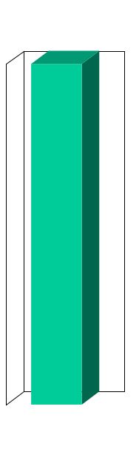
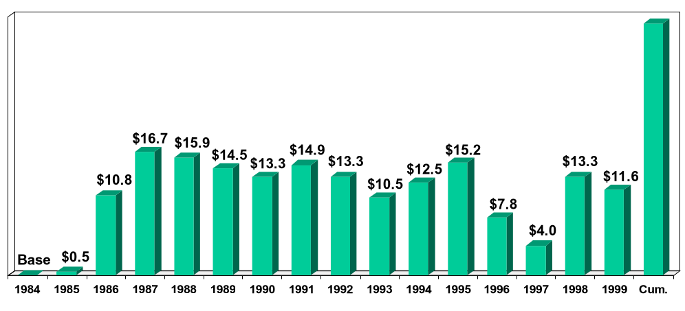
U.S. Natural Gas City Gate Cost Decline
(Billions 1999$)
$174.2
Total savings
since 1984
[Price savings volume]
x
Source: U.S. DOE Natural Gas Annual, Table 21, and Natural Gas Monthly, May 2000

Slide 28
Residential Natural Gas Prices Since 1984
(1999$/MMBtu)
2000/2001
Winter Estimate
1984
1986
1988
1990
1992
1994
1996
1998
2000
1985
1987
1989
1991
1993
1995
1997
1999
Residentials will purchase gas this winter
at real prices last paid in 1986/87
Source: U.S. DOE (EIA)

Slide 29
Increased Price Volatility has Become Common in the Gas Industry
January 1980 - January 2000
1999 Dollars
Nominal Dollars

Slide 30
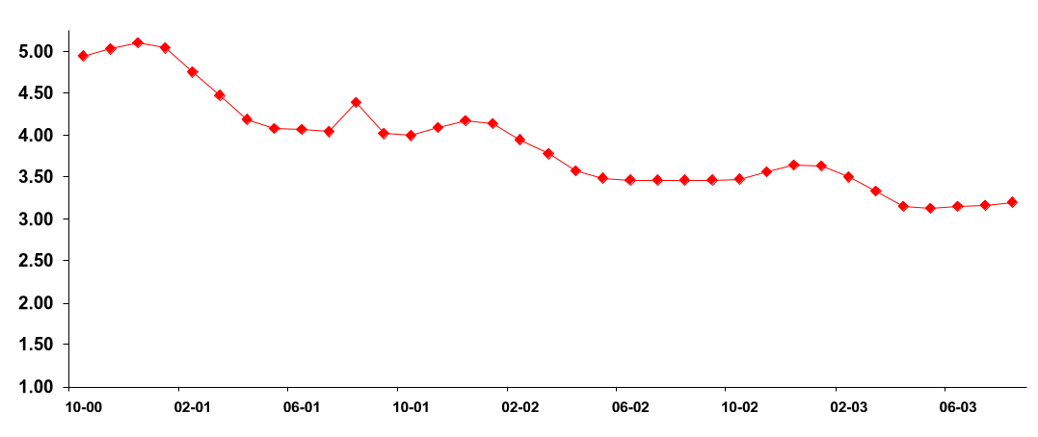
Backwardation Price Curve for Wellhead Gas
($/MMBtu)
$5.15
This Winter
$4.25
Next Winter
$3.75
Winter 02/03
Source: NYMEX (September 11, 2000)

Slide 31
Factors Influencing Natural Gas Prices
Strong Economy - Demand for Power Generation and Manufacturing
Declining Natural Gas Production
Warmer Than Normal Winters the Past 3 Years
U.S. Gas Storage Levels Lowest in Past 6 Years
Other Heating Fuels Showing Significantly Higher Prices & Lower Stock Levels
Notes:
<number>
<footer>
<header>
<date/time>

Slide 32
Short-term Price Volatility?
Affects Supply Affects Demand
Weather
Economic/business conditions
Stock levels
Pipeline capacity
Operational difficulties
Lack of timely,
reliable information

Slide 33
Load Reductions and Rates
Little or no incentives were given for demand reductions.
  Existing programs failed to produce real reductions.
AB 1890 froze rates at 1996 levels and provided a reduction of 10% for small customers.
Utilities were not given any rate relief until January, 2001.
  Rate relief provided was minimal (less than ??)
  Cost of power purchased from CaPX and ISO were substantially higher than cost of power embedded in rates.
Result was loss of credit-worthiness for utilities
  eventual loss of investment-grade ratings, near insolvency.
State responded with emergency authorization for Department of Water Resources to purchase power for utility customers.
  Long-term authorization granted in special session.
  March, 2001 rate increase granted (46% ), neither covers exposure of CDWR nor utility underrecovery.
®

Slide 34
Load Responsiveness
2700 MW of Load theoretically available under the Interruptible Tariffs
New Load Management Programs Have Been Expensive and Small
  100 MW to 300 MW of Shared Savings with IOU’s When Prices Exceed $250/MWh
  230 MW in CAISO Participating Load Agreement with Capacity Costs of $750/MWh and Energy Costs Up to $750/MWh
  Seldom Used - Most Participants Already Under Interruptible Tariff
Source: ISO DMA August 10 Report
-20-

Slide 35
Rate Comparison ($/MWh)
January-August, 2000.
Insert Rate Table
®

Slide 36
CPUC Authorized Rate Increases
March, 2001 rate increase granted (46% ), neither covers exposure of CDWR nor utility underrecovery.
Summary of CAO-equivalent on impact of power purchases.
®

Slide 37
No Real Customer Choice
®

Slide 38
The Result: A Crisis of Epic Proportions
SDG&E Customers experience price spikes in summer/2000
Northern California first to experience blackouts in fall/2000
All of California experience blackouts in winter/2000
Prediction is that California will be 5,000 MW short this summer.
  Blackouts
Utilities near-insolvency.
QFs are not being paid.
Generators forced to generate without knowing whether they will be paid.
CDWR has taken position in market and has used substantial portion of California’s budget surplus.

Slide 39
California Sneezes and the Rest of the West has the Flu
Demand is also up in the rest of the West.
  However, rates have increased substantially in the West.
  Shut-downs are occuring in energy-intensive industries.
Significant concerns remain with reliability this summer.
California’s woes have slowed efforts to restructure other state electric markets
A political crisis
A financial crisis
A looming economic crisis
The Result

Slide 40
Why is Balkanization a Bad Result
The West has had seasonal exchanges and an active wholesale market for years. The next slide shows imports into California.
Numerous Western power plants export their power to other states
  Output from the Intermountain, Mohave, Four Corners, Reid Gardner #4, Palo Verde, Centralia, and Colstrip plants is exported.
The West’s load diversity has been used to reduce ratepayer costs by:
  decreasing the capital committed to resource construction by any one utility
  providing off-system sale revenues to ratepayers
  allowing utilities to incur lower fuel costs as plants can be built closer to fuel sources.
Provides everyone with insurance against unexpected increases in load or decreases in supply.
Increases overall system integrity and reliability.
®

Slide 42
The California Crisis may Balkanize the Western Grid
CaISO claims it currently has the ability to cut exports during a system emergency.
  The concern is that the CaISO will call emergencies not for true reliability reasons but because it does not like the price of power in the market.
  Of equal importance, CAISO has reduced the S-N capacity on the Pacific Intertie as a way to thwart exports.
  Both actions are inconsistent with standard WSCC and RTO policies.
CaISO staff have made a proposal that would, among other things:
  Require cost-based bids from in-state generators
  Not allow importers to submit bids above ISO-computed clearing price based upon such bids
  When resources are insufficient to meet load, cut exports
  Plan has not been formally filed although such a filing is expected soon.
®

Slide 43
The California Crisis may Balkanize the Western Grid
CaISO plan promotes balkanization by increasing when exports are cut:
  This increases prices outside of California relative to California and
  Prevents out of state generators from fully participating in the market. (Essentially, imports will be taken on an out-of-market basis only after exports have been cut.)
  The plan invites retaliation. Utilities in other states can cut exports of in-state resources that serve California, such as the Mohave, Four Corners or Intermountain Projects.
AB 60 “California First” legislation.
  Bill requires as a condition of a certification necessary to start construction that a developer, “offer to enter into a contract to sell” to a utility, municipal utility or the California Department of Water Resources, electrical power generated by the facility “at its initial and continuing available capacity.”
  The power must be priced at “terms not less favorable than the terms of the next offer that the applicant makes for the sale of” power.
®

Slide 44
The California Crisis may Balkanize the Western Grid
Transmission system takeover
  While various representations, but no firm commitments, have been made re: whether facilities will be subject to open access, continuing utility responsibilities, etc.
  Agreement has been reached with Southern California Edison Company, but not with Sempra or Pacific Gas & Electric Company on price and terms. Agreement with all three utilities is necessary.
  FERC approval of sale is required (after agreement is reached (and legislation is adopted authorizing acquisition).
  Based on Long Island Power Authority precedent, FERC will require agreement that facilities will be governed by open access rules.
  However, once approval is granted facilities are no longer jurisdictional.
®

Slide 45
Solutions for the Western States
Increase Supply
Decrease Demand
Maintain the Solvency of Your Utilities
Provide Customers with a Choice.
®

Slide 46
Increase Supply
Ensure that siting laws are streamlined and do not create unnecessary hurdles or delay for power plant developers.
  Merchant developers will build plants to meet the market. Plenty of private capital exists and can be brought to bear.
Allow customers to see the price signal.
  Regional caps are a mistake. They will export California’s shortages to other Western states.
  They will provide a disincentive to new generation construction. Price caps—merchants will build power plants if they believe that they can recover their costs through the wholesale power market.
  Price caps create a risk for merchant plants. At some level they expose the developer to fuel cost risk, emissions credit price risk and O&M cost increases.
  A number of peaking plants were canceled after the California ISO moved to impose a load-differentiated cap.
®

Slide 47
Increase Supply
Encourage utilities to develop uniform and reasonable interconnection rules.
  Interconnection costs can be used as a barrier to entry.
Distributed generation is another solution in the short-term. Distributed generation takes a customer off-system and can be sited quickly. However, there are barriers to distributed generation:
  Standby-charges that penalize self-generators for coming back on-line for emergency supply.
  Interconnection studies that delay construction and increase costs.
Emissions credit limitations
  Develop innovative means for expanding and sharing emissions credits, such as an emissions bank.
®

Slide 48
Decrease Demand
Conservation should be encouraged.
  A regional approach to conservation or demand reductions can be developed. Large customers can be paid a price less than wholesale power costs to reduce their demand during the summer months.
    Key factors to this approach:
      Advance notice allows the customer to change production schedules, address employment issues, reduce the costs of a shut-down.
      Don’t set the price, allow the market to set the price. If the government sets the price it will either be too high or too low.
      Extended shut-downs are preferable to day-ahead, hour-ahead, or blackouts.
  Price signals are key to encouraging conservation. Allow customers to see the price signal through rate increases or rate design.
    When San Diego customers were paying market-based costs, they reduced their demand by approximately 10%. Demand increased once rates were capped by legislative action.
®

Slide 49
Maintain the Solvency of Your Utilities
Utilities should be encouraged to engage in forward contracting and other hedging devises.
  Utilities should have a balanced supply portfolio. This doesn’t require utility ownership of power plants—it does require relying on more than the spot market.
Nobody likes rate increases, but avoid putting the utilities in a negative financial position.
  In many cases, a well-timed rate increase can keep a state from being engulfed in credit and financial difficulties.
    PG&E’s Chapter 11 is an example of “too little, too late.” California refused to increase rates, then adopted a surcharge that was too little too late, then increased rates again only to pay the state for its power costs. Instead of agreeing to a 10% rate increase in the summer of 2000, California’s are seeing a 47% increase in 2001.
®

Slide 50
Customer Choice is a Solution.
Don’t confuse California’s failed effort to restructure their utility market with true customer choice.
  Customer choice has been a success in several states and has protected some California customers from price increases.
Provide customers with a choice.
  Choice can protect customers from price volatility. The market can provided fixed price products to individual customers if they are allowed to leave and seek service from alternative providers.
  Choice can reduce the burden on utilities and other ratepayers.
    To the extent a customer leaves a utility’s system, the customer is no longer imposing costs on the utility.
    The Washington Utilities & Transportation Commission recently approved tariffs that require Puget Sound Energy’s largest customers to leave traditional utility service.
®

Slide 51
What Won’t Work?
Search for “Good Old Days” Is Futile
Price controls or caps will worsen the situation.
Bankruptcy Is a Bad Idea
Price Controls Lead to One Thing
  Shortages
California’s efforts to Nationalize and Balkanize the West Will Make Matters Worse
  Every reason to believe the private sector will outperform government
  California’s budget surplus is already at risk.
  California has been a net importer for the last two decades.

Slide 52
Price Controls Will Perpetuate Scarcity
Power plants are needed; Demand is still not very price responsive
Operating costs of plants are increasing
  Gas prices high
  Gas generally is on the Margin in WSCC (I.e., Gas-fired generation sets the electricity generating market price)
Power plant economics will keep generators from investing in generation if they anticipate price cap
In state and out of state generation will be incented to sell out of state
-12-

Slide 53
Price Controls are Detrimental to Investment and Other Markets
Merchant generation subject to volatile commodity prices -- caps will inhibit investment
Creates asymmetry between load response and generation
Suppliers will sell outside California where markets are more predictable and prices are higher.
Because of the interdependent linkages in California’s electric market, cannot change one aspect of structure without impacting all others
Uncertainty in the marketplace will dry up the growing forward markets
-22-

Slide 54
-19-

Slide 55
-16-

Slide 56
The ISO’s Demand Side Program Has Not Been Very Effective
The proponents of price caps claim that as soon as the demand side is "workably competitive" then there is no need for price caps
But if ISO sets the caps too low it will not get demand response
The utilities have up to 2700 MW of available interruptible load, yet only a small fraction responds when called (600 MW)
Uncut loads willingly lose value of up to $1,500 per MWh
Thus, during times of scarcity, the value of energy is at least $1,500 per MWh

Slide 57
Lessons Learned from California
Be Short on Politics, Long on Leadership
The Governor’s Approach
  Exercise extreme caution--avoid political risk at all cost
  View the crisis as a “political campaign”
  Shift the focus: Assign blame to market power and federal inaction
  Rely on Executive Orders and powers rather than work the Legislature
  Appease consumer advocates—Insists on ”no new rate increases!”
The Legislature’s Approach
  Follow Governor’s lead
  Avoid becoming political road kill
  Express increasing frustration with Governor’s tendency toward secrecy

Slide 58
California’s Proposal
Nationalize, Re-regulate and Hope
Resist rate increases
Re-price QFs and IOU plants; demand wholesale caps in West
Take over electricity procurement
  Appoint obscure agency (CDWR) with little expertise to procurement role
  Assume CDWR can purchase power to fit under rate freeze
  Tap State’s general fund as bridge to bond financing
Take over transmission
  Quid pro quo for keeping utilities solvent
Rescind consumer choice
  Fear that choice threatens recovery of DWR costs and bond repayment
Establish “California First” energy policy
  Confine trade to California’s borders; dictate plant operations

Slide 59
California’s Proposal Faces an Uphill Battle
Both the Math and the Politics Present Problems
Any proposal must be better than bankruptcy or the utilities will reject it
The Bush administration opposes price caps
Finding price that QFs and utilities can agree to is difficult
  QFs sue successfully to sell elsewhere (out-of-state; higher prices?)
  PG&E announces it sues not to pay QFs
Utilities demands in return for transmission sale are steep
  Price PG&E demands for TX is unacceptable to consumer groups
  Consumer groups resist end of rate freeze; rate de-regulation

Slide 60
California’s Proposal Faces an Uphill Battle
Both the Math and the Politics Present Problems
Not surprisingly, CDWR ill-equipped to fill role as energy portfolio manager
  Press reports that DWR is buying at above-market prices
  Power purchase costs skyrocketing
  Significant rate increases now appear inevitable
Legislature becomes increasingly concerned over budget and bond rating
  State budget surplus is evaporating and the economy is faltering
  Concerns over bonds prompts rating agencies to put California on “credit watch”
  Governor’s staff reveals that bond issuance may exceed $20 billion

Slide 61
What Won’t Work?
Search for “Good Old Days” Is Futile
Bankruptcy Is a Bad Idea
  It doesn’t solve any problems
Price Controls Lead to One Thing
  Shortages
Nationalization and Re-regulation Will Make Matters Worse
  Every reason to believe the private sector will outperform government
  Investment fueled by capital markets or government coffers? Who bears the risks? Schools or electricity?
  California’s record as portfolio manager Is very weak—Oil dependence in the 1970s; Nukes in the 1980s; PX in the 1990s

Slide 62
The Alternative Is Preferable
Create the Market that California Was Promised But Never Got
Decrease Demand—May Be Too Late
  Give Consumers and Businesses Price Signals
  Give Consumers Financial Incentives Needed to Respond to Those Signals
  Mine Large Amounts of Reductions Now in Anticipation of Summer
Increase Supply
  Maximize existing sources—Re-balance power and environmental goals
  Overhaul Plant Siting Laws to Create a Stream-lined, One-stop Shop
  Remove Road Blocks to On-site Generation
Get the Utilities Back on Their Financial Feet
  Prices must increase; rate shock can be avoided
Create a Real Retail Market
  The Market Is the Best Portfolio Manager
  Direct Access can save the State’s budget and its bond rating
Fix the Gas Market Before It’s Too Late

Slide 63
Price Risk Continuum
Many pricing options exist between fixed and index
Fixed Price
Volatility
Index Price
Less
More
Notes:
<number>
<footer>
<header>
<date/time>
We already know that Square D prefers to be toward the index side of this continuum. We want to stress the options however along the spectrum.

Slide 64
Why Hedge?
Eliminate uncertainty
Not hedging, i.e. buying on spot, is the same as speculating
Buying index still leaves you at the mercy of market conditions
Smooth production costs - be able to budget effectively - costs are known up front
Minimizes exposure to cyclical cash flows

Slide 65
2000/01 Winter Price Hedging
($/MMBtu)
8/31/00 Lock-in Price for Dec. ‘00/Jan ‘01 - $4.80/MMBtu
Historic 2000 prices through August
Jan/Feb 2000 Hedge for Dec. ‘00/Jan ‘01 - $2.79/MMBtu
Jan
Feb
Mar
Apr
May
Jun
Jul
Aug
2000

Slide 66
Basic Tools: Financial Instruments
Risk Management products are all based on the following basic financial instruments
  - Forwards/Futures
  - Options: Calls and (caps) and puts (floors)
  - Swaps
These instruments can be customized to address the specific needs and sensitivities of the hedging firm.

