Slide 1
RANorder Overview
Rolfe & Nolan Systems Inc.
May 02, 2000

Slide 2
RANorder Features
Internet Front-End
Pre-Trade Credit Control
In-House or Client Order Input
Interface to Back-Office (positions, accounts, trades)

Slide 3
RANorder Features
Full Order Validation (price, month, account, inst.)
Intraday Position Keeping
Access to Real-Time Prices
Relational Data Base with API

Slide 4
RANorder Benefits
Firmwide, Intraday Risk Analysis
Pre-Execution Order Risk Control
Integrated Front-to-Back Solution
Private Label Capabilities or Fully Customized Front-End Options

Slide 5
RANorder Architecture
Other
API - Non API
Markets
Orders
Order Entry
Orders
Front-End Device
Fills
TOPS System & Other Future Int.
Orders
Fills
Internet
Orders
HTML or Windows
Fills
End-User Entry
Orders
Fills
Back-Office
X.25
Fills
Fills
Private/
Market
Prices
Input Device
Switched
Network
Fax
E-Mail
Futures Source
The Complete Order Management Solution
Notes:
26

Slide 6
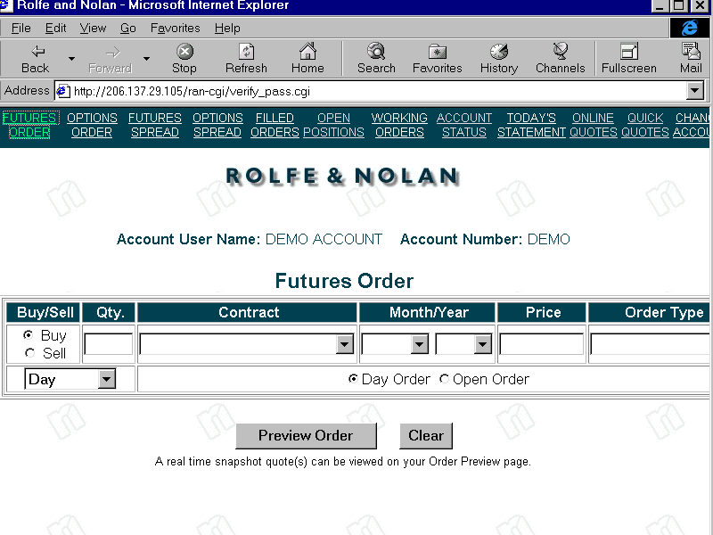
Notes:
9

Slide 7
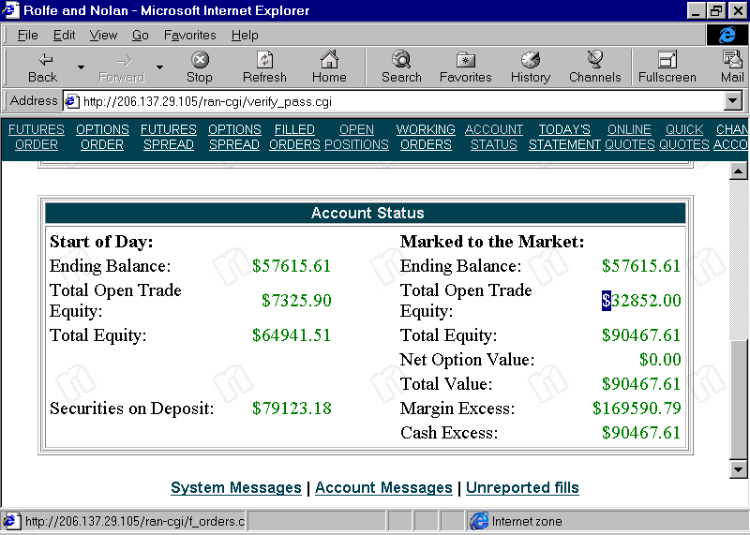
Notes:
10

Slide 8
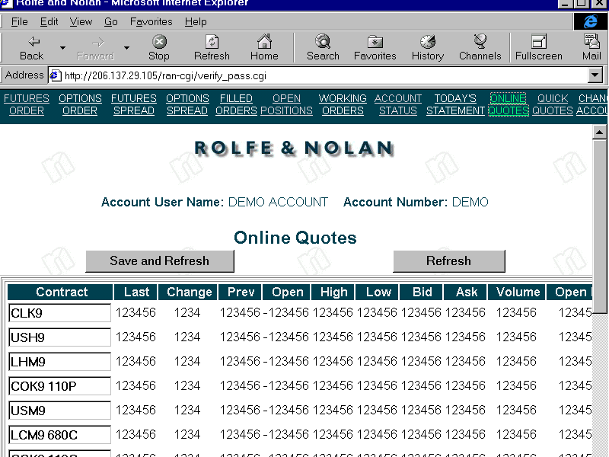
Notes:
11

Slide 9
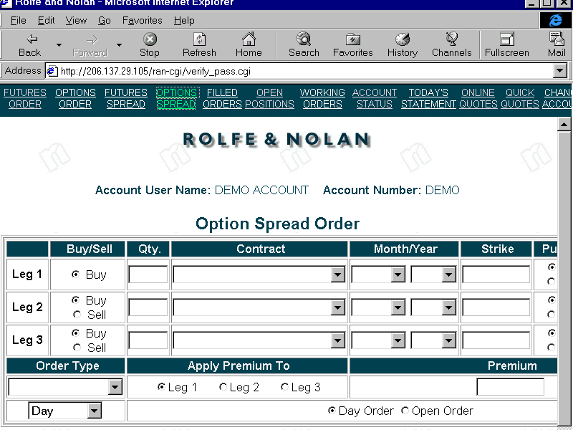
Notes:
12

Slide 10
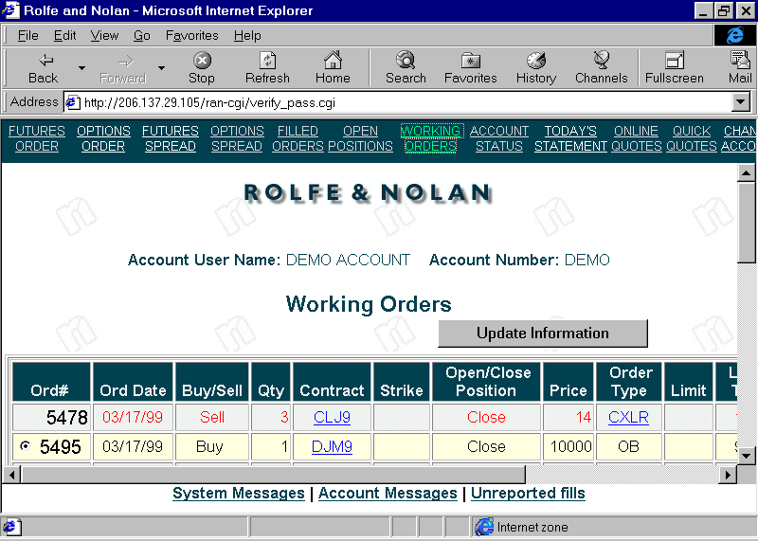
Notes:
13

Slide 11
Rolfe & Nolan
Leading Commitment to Industry
Proven Global Solutions
280 Clients in 22 Countries
Industry Leading Support & Service

Slide 12
Support & Service
‘On-Time’ Installations
24 Hour Help Desks
Project Management
Industry’s Strongest Commitment to Post-Installation Support
Notes:
28

Slide 13
Rolfe & Nolan
Chicago, New York, London, Frankfurt, Singapore, Hong Kong

